Slide 1
Sourcing Analytics support sourcing decisions and negotiation
Yao Zhao
Professor @ Rutgers Business School
Co-director @ Rutgers Supply Chain Analytics Lab
https://yzhao12345.github.io/
Instructors are free to use and modify the content of these slides
Notes:
* Hello everyone, my name is Yao, I like to thank you for your participation and welcome your questions. As we did yesterday, may I ask everyone to raise the questions at the end of the webinar, we will leave enough time for that – thank you. * Hello everyone, welcome to the webinar of teaching SCA: from problem solving to problem discovery. Today we will talk about sourcing analytics - how to use data analytics to support sourcing decisions and negotiations, especially, for identifying and selecting new suppliers.

Slide 2
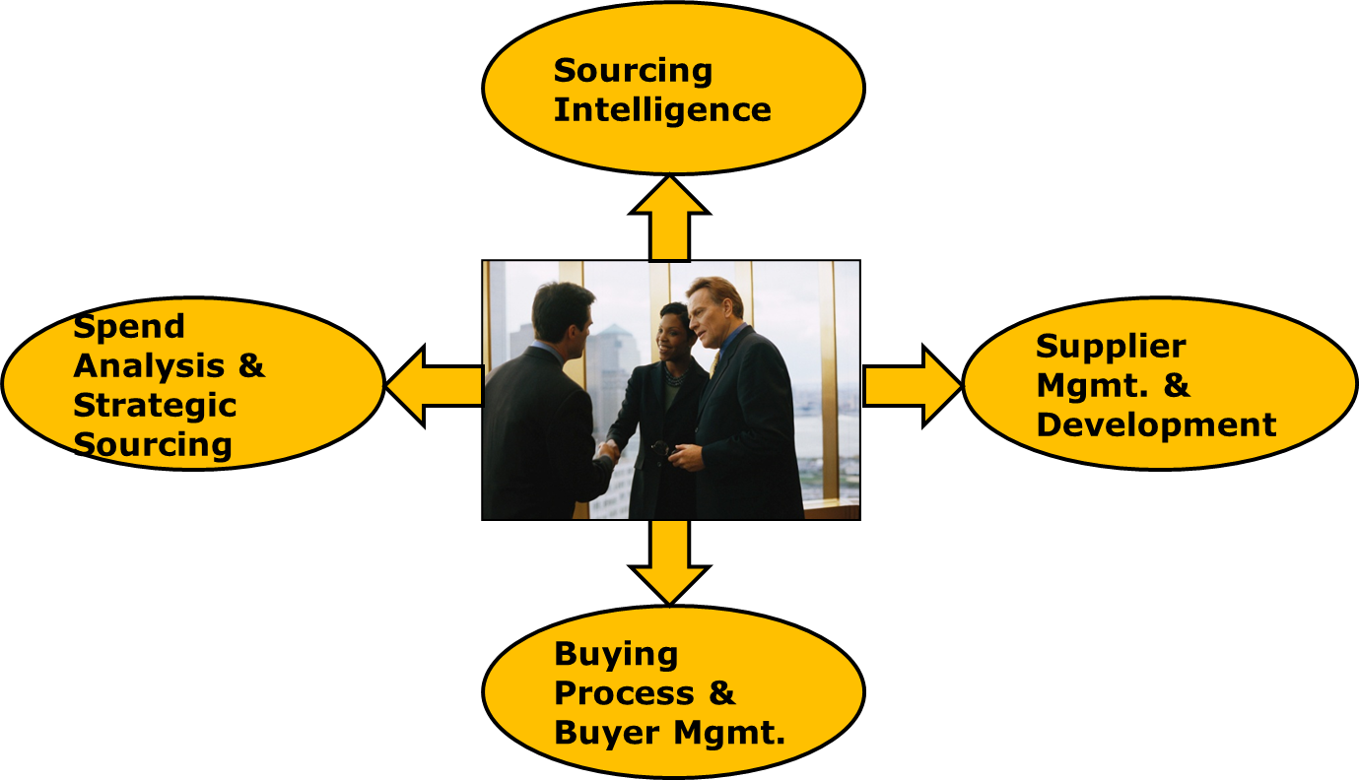
Sourcing Analytics
Rationalize / manage suppliers – supplier management:
  Millions $, hundreds of thousands of SKUs, thousands of suppliers.
Identify / select new suppliers – Sourcing intelligence:
  New suppliers (products & services) emerge, corporate changes (M/A, bankruptcy) constantly – frequent adjustment of supply base.
It is all about analytics!
Notes:
* Sourcing is not just about negotiation, it is heavily data driven! A typical company may spend hundreds of millions $ on … from …, so rationalizing and managing suppliers involves intensive data analysis. * Meanwhile, new suppliers (new products & services) emerge constantly and corporate change (M&A) also happens constantly – this requires frequent adjustments of the supply base. * Data analytics can provide the insights and intelligence needed to support such sourcing decisions. In some sense, sourcing is all about analytics!

Slide 3

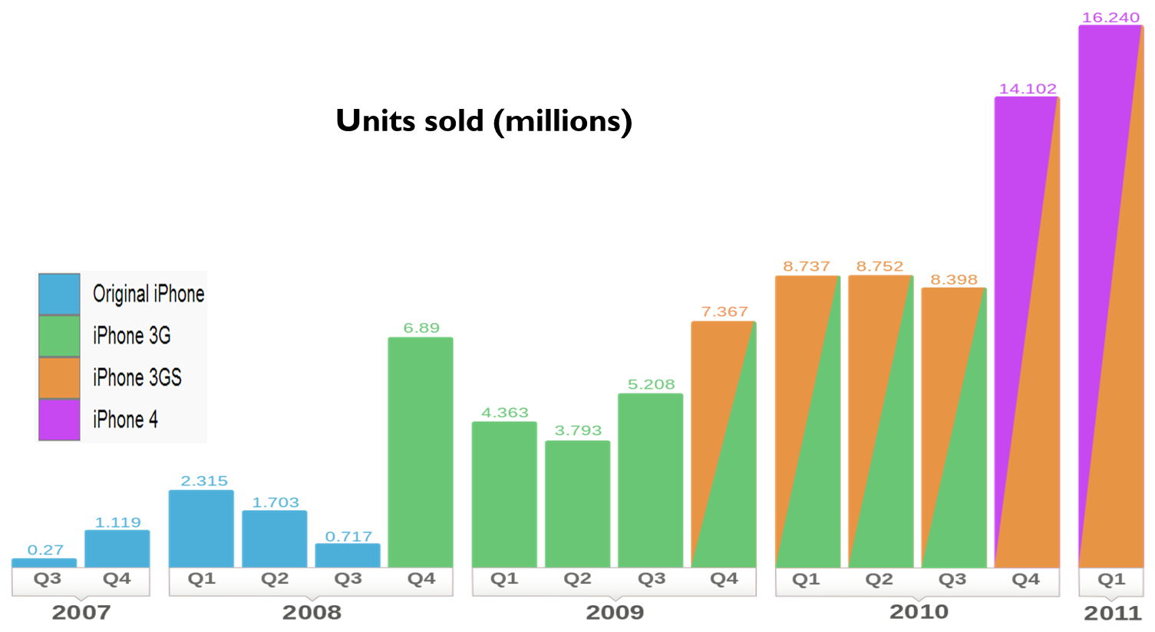
The iPhone Story
1st multi-touch screen phone
From 2007 to 2010, Apple made $27 billion with a profit $15.6 billion*
* Raza Rafique, KwonGi Mun, Yao Zhao (2014). Apple vs. Samsung – Supply Chain Coopetition. Case study of Rutgers Business School.
Notes:
* Let me use the iPhone story to showcase the impact of sourcing analytics. * iPhone was highly profitable, from 2007 to 2010, Apple made $27 billion with a profit of $15.6 billion.

Slide 4
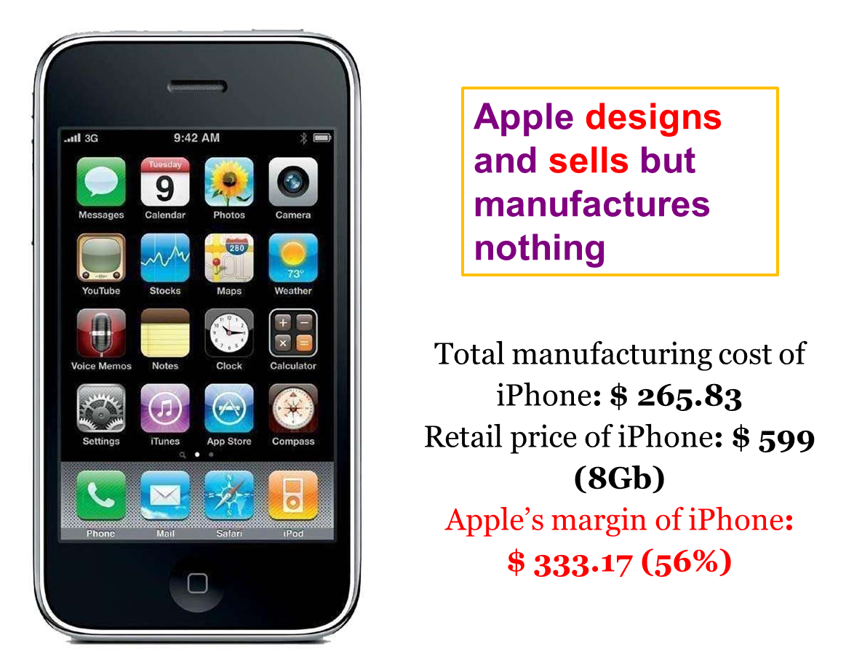
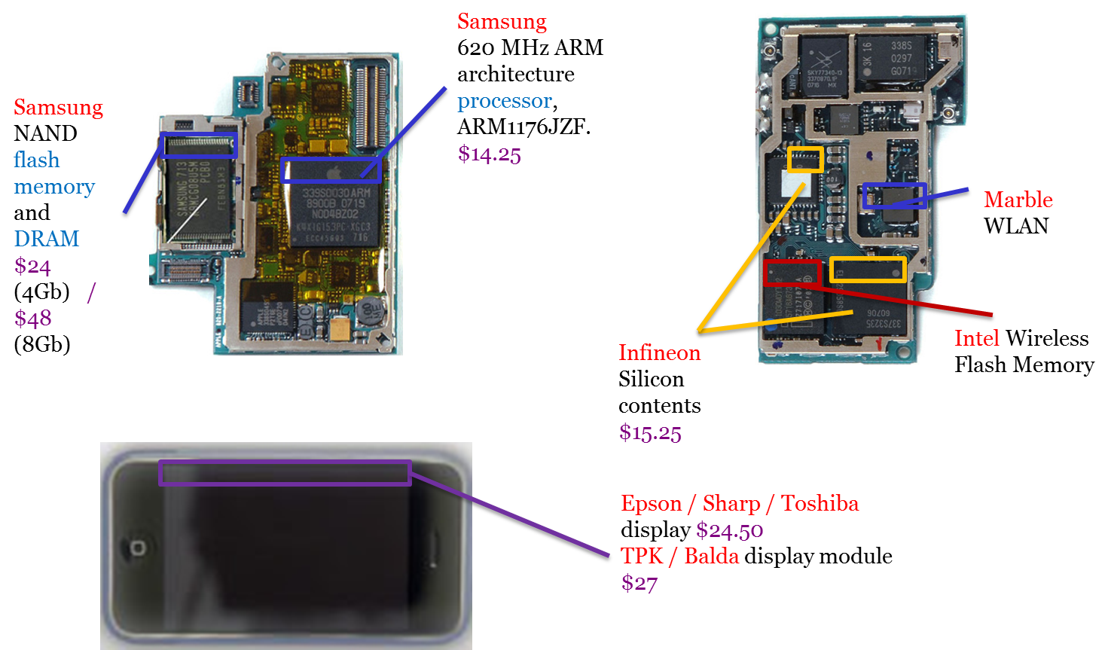
iPhone Global Supply Chain
iPhone’s manufacturing is completely outsourced
Notes:
iPhone’s success partially came from Apple’s global sourcing strategy. Apple designs and sells iPhone but iPhone’s manufacturing was completely outsourced, for instance, to Samsung electronics for processor and flash memory, Intel for wireless flash memory, Infineon for silicon contents, Epson / Sharp / Toshiba for display, … The total manufacturing cost of iPhone was well controlled under $266. With a selling price of $599, Apple’s margin of iPhone was $333 (56%).

Slide 5
Source: 1. iPhone 16GB 2.‘Capturing Value in Global Networks: Apple’s iPad and iPhone ’ July 2011 UC Irvine, Kenneth L. Kraemer
Notes:
Out of the total pie of iPhone, Apple got 56%, how much did suppliers get from it? Korea companies (including Samsung) made a profit of 4.7% of iPhone’s revenue, Chinese labor 1.8%. Because of the meager profit and the huge market potential, Apple’s supplier, Samsung electronics, soon became a competitor to Apple.

Slide 6
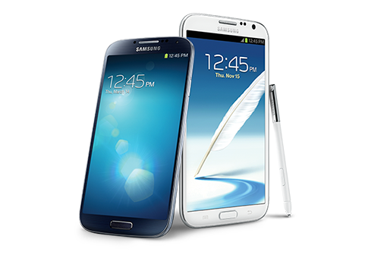
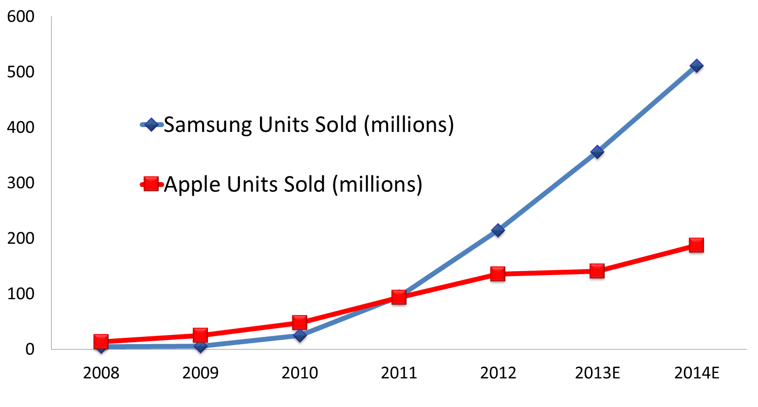
Supplier Became a Competitor
Samsung Took Over Apple in Global Market
Notes:
Samsung electronics, a vertically integrated electronics giant, has products ranged from semi-conductor to technology hardware and to consumer electronics, introduced its smart phones, and used its cost advantage to take over the global market from Apple.

Slide 7

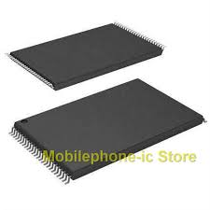
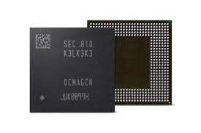
How to Continue the Success?
DRAM: dynamic random access memory
CPU / processor
NAND Flash memory
Identify and select new suppliers for critical components
Notes:
How can Apple continue the success? Note that new suppliers and new products are emerging constantly, which provides Apple new choices for critical components such as CPU / processor and memory! The questions is: How to do it right for this year?
CPU / processor
NAND Flash memory
DRAM: dynamic random access memory
…

Slide 8
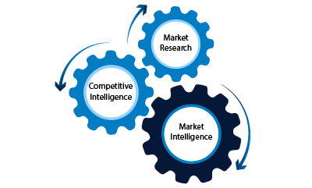
Sourcing Analytics (Intelligence)
Identify company’s need and selection criteria.
Analyze supplying markets to identify and select potential suppliers.
Support better negotiation & bargaining with suppliers.
Supplier
Analysis
Bargain
Power Analysis
Market
Intelligence
Notes:
Sourcing analytics can provide the data-based insights and intelligence to support such sourcing decisions. It consists of 3 steps, first identify the company’s needs and define supplier selection criteria. Then use market intelligence to analyze the supplying markets to identify and select potential suppliers. Finally, using negotiation power analysis and supplier analysis to negotiate and bargain with the selected suppliers.

Slide 9
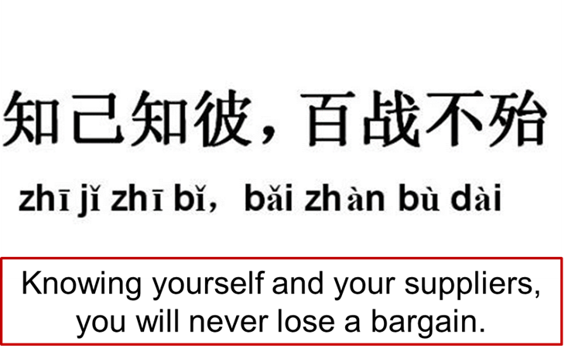
Notes:
In this way, you will know yourself and your suppliers, so you will never lose a bargain.

Slide 10
Identify needs and selection criteria
Align supplier selection criteria with the firm’s strategic objectives.
Notes:
Let’s first talk about how to identify the company’s needs and define supplier selection criteria, which need to be aligned with the company’s strategic objectives.

Slide 11
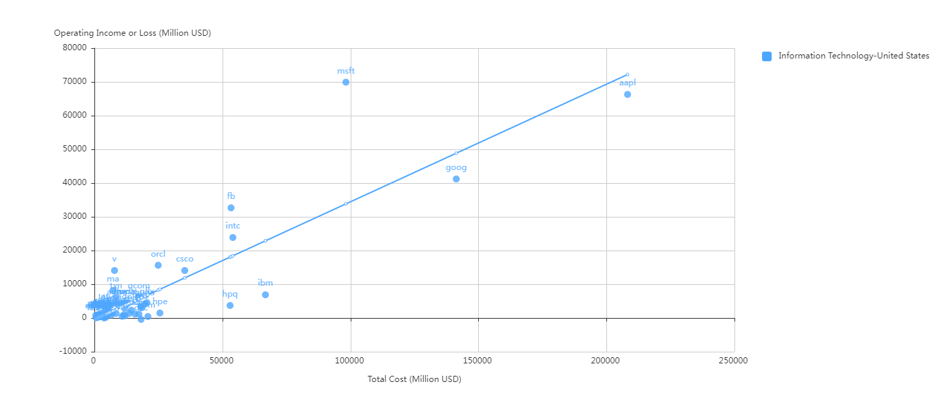
Apple Leads in Revenue But Not Profit
Information Technology, SP500 2020.
Data source: https://gcps.scdata.ai/project/19982
Notes:
There are many analysis you can do to identify the company’s needs, but here let me show you the most important ones. The profit and cost analysis of the US IT industry in 2020 shows that Apple didn’t have the highest profit despite its highest cost and revenue. Indeed, MSFT made more profit with less cost than Apple. Google is large but its profit is below the regression line. FB is smaller but highly profitable – with about 1/3 of Google’s spending, its operating income is close to that of Google. Finally, IBM and HP are smaller and barely profitable in 2020.

Slide 12
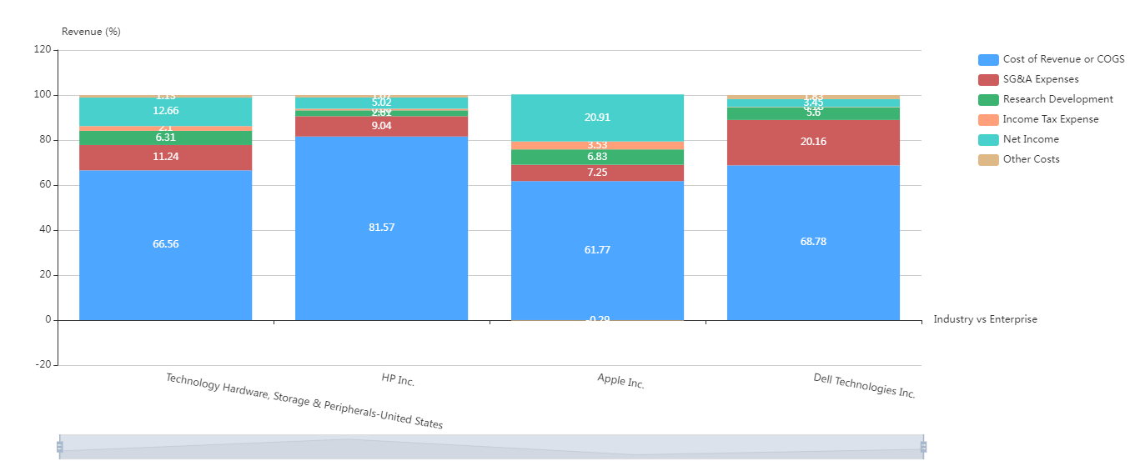
The major cost driver is still COGS
Technology hardware, US 2020.
Data source: https://gcps.scdata.ai/project/19982
Notes:
* A revenue breakdown of the US technology hardware industry provides more details on these companies’ priorities. Comparatively, Apple performed very well on COGS, 62% of revenue vs. industry average 67%. But even for Apple, COGS is still the biggest cost driver! * With a COGS of 81%, HP didn’t look like a technology company because its value added is too small. Dell had an average performance on COGS but its SG&A is too high, almost doubling the industry’s average! So for Apple and HP, the priority is COGS, for Dell, it is both COGS and SGA.
COGS includes: Raw materials, Items purchased for resale, Freight-in costs, Purchase returns and allowances, Trade or cash discounts, Factory labor,
Parts used in production, Storage costs, Factory overhead.
COGS = Beginning Inventory + Additional Inventory - Ending Inventory.

Slide 13
CPU Supplier Selection Criteria
Innovative, technological / engineering capability
Manufacturing capacity / quality
Pricing / profitability
Bargain power
Financially healthy / robust
Leaks & competition
Capability
Cost
Continuity
Notes:
* Long story short, to source critical components like CPU and memory, suppliers should be selected based on three criteria: technical capability, cost, and business continuity. * For capability, the ideal suppliers should be innovative, and have a strong technical and engineering capability (high value added), they should also have sufficient manufacturing capacity & high quality. * For cost, the supplier should offer an attractive pricing to buyers, and even with that pricing, the supplier should be profitable, otherwise, it cannot sustain the good pricing. Ideally, Apple should also have more bargain power than the supplier. * For continuity, the suppliers should have a rock solid financial health, and so it should not bankrupt any time soon. Finally, of course, the suppliers should not leak IP and will not become a competitor.

Slide 14
Market intelligence
Analyze supplying markets to identify potential suppliers.
Notes:
Now let’s use market intelligence to analyze the supplying markets to identify potential suppliers.

Slide 15
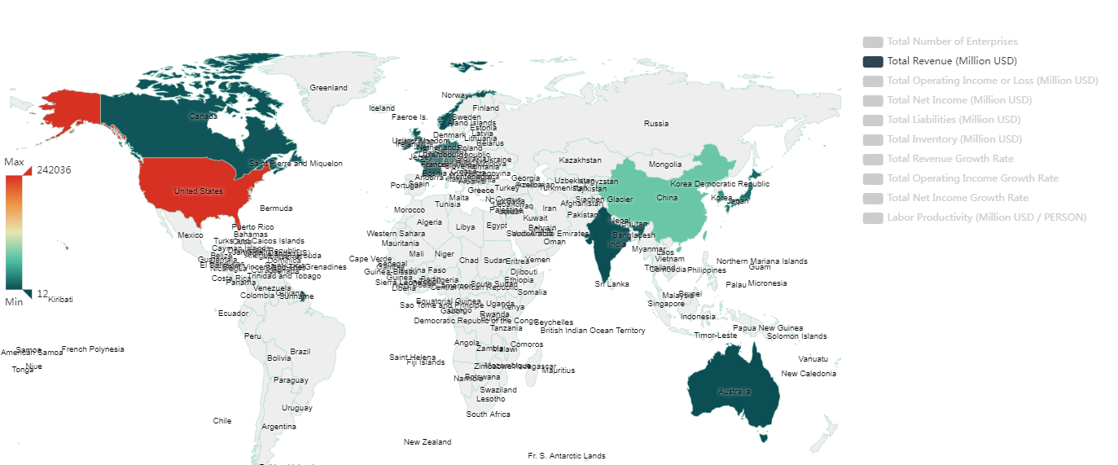
Enterprise distribution – semiconductors 2020
Where to look for CPU suppliers?
Data source: https://gcps.scdata.ai/project/19982
Notes:
Where to look for semi-conductor suppliers? Let us check out the countries with the strongest semiconductors industry. By revenue, we have US, China, Taiwan, Korea, Japan, …

Slide 16
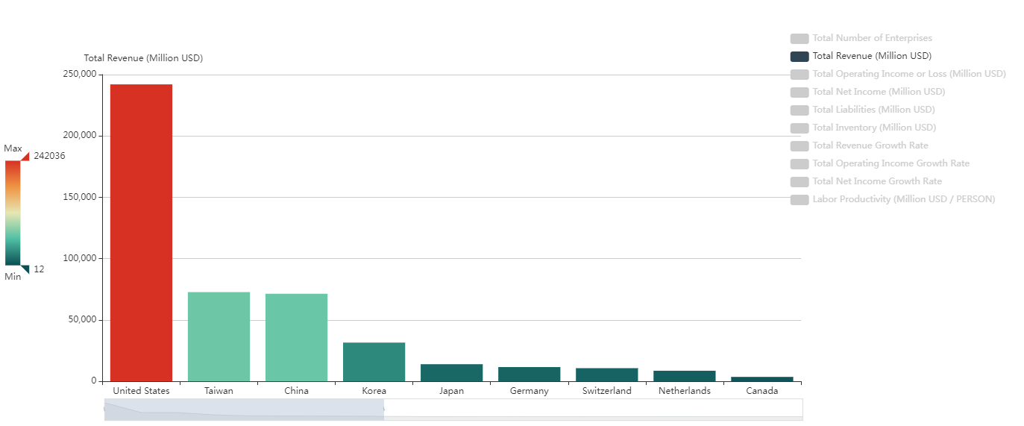
Enterprise distribution – semiconductors 2020
Where to look for CPU suppliers?
Data source: https://gcps.scdata.ai/project/19982
Notes:
The bar chart provides a better picture, US is the no 1 in revenue, far bigger than other countries. Surprisingly Taiwan is no 2 in semiconductor, which is followed by China, Korea, Japan, Germany, Switzerland, Netherlands and Canada.

Slide 17
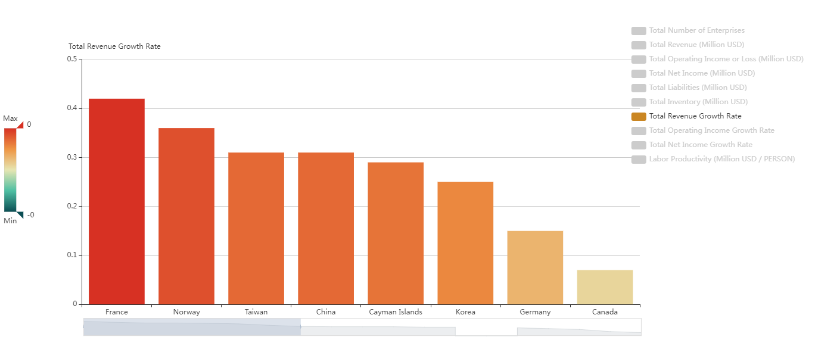
Enterprise distribution – semiconductors growth 2020
Where to look for CPU suppliers?
Data source: https://gcps.scdata.ai/project/19982
Notes:
Now let’s look at the growth of revenue by country for semiconductors, which implies the growth potential. Usually countries with the highest revenue do not have the highest growth, but here we got two exceptions: Taiwan and Korea, they are among the largest and also among the highest growing economies in semiconductors – amazing!

Slide 18
Market competition analysis
Competitive or monopolized? Major players and their stability over time?
Notes:
Having identified the countries for semiconductor suppliers, let’s now look at the competition intensity in each country to identify the major suppliers, and measure the suppliers’ market power and their stability over time.

Slide 19
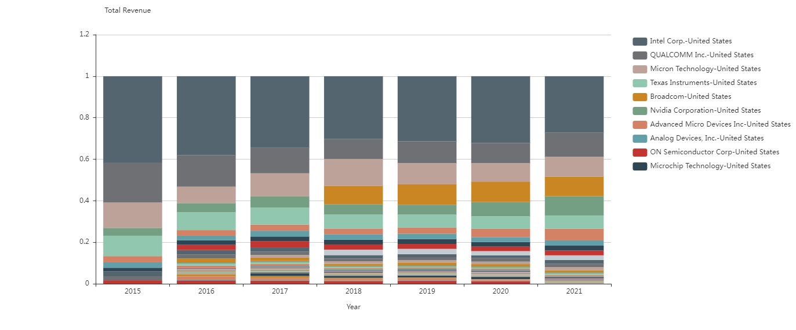
Stable market shares, quite competitive – a few whales with many smaller fish.
The market is becoming less concentrated.
Market shares of semiconductors: US
Data source: https://gcps.scdata.ai/project/19982
Notes:
The market of the US semiconductors manufacturers is becoming less concentrated in recent years as the market share of the largest companies is shrinking! The market is relatively competitive with a few large sharks and many smaller fish. The biggest companies are, Intel, Qualcomm, Micron, TI, and they maintained a relatively stable market share.

Slide 20
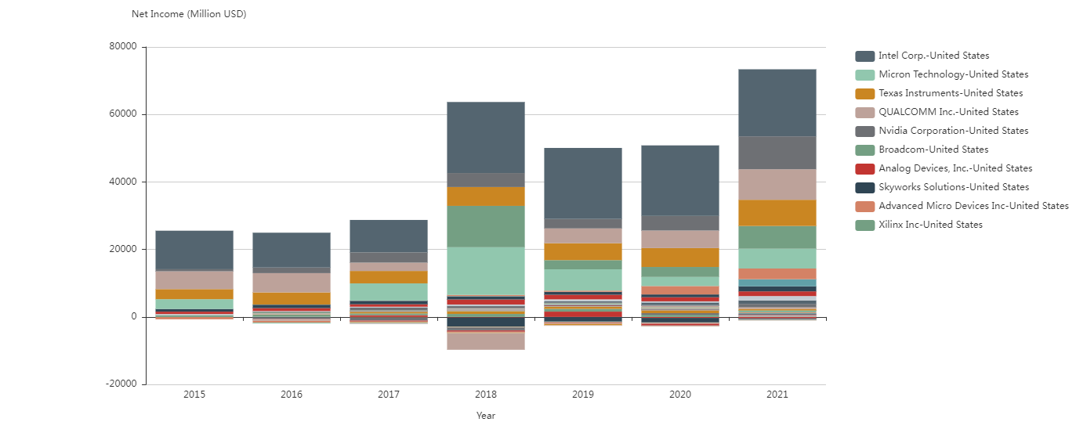
Intel and TI have stable net income
Intel / TI are stable, Qualcomm / Micron fluctuated
Micron have more fluctuations
Qualcomm had negative net incomes
Net Incomes of semiconductors: US
Data source: https://gcps.scdata.ai/project/19982
Notes:
Looking at these suppliers’ net incomes, however, we see more fluctuations. Although Intel and Texas instruments have stable net income throughout, Micron and Qualcomm fluctuated a lot in recent years.

Slide 21
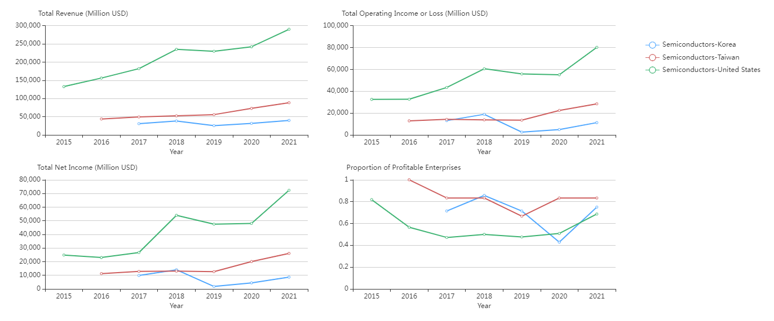
US semiconductors: largest and growing fast during COVID
Taiwan is on the rise. Korea seems more fluctuated
Data source: https://gcps.scdata.ai/project/19982
Notes:
Comparing the semiconductors industry among US, Taiwan and Korea over time, we can see that US semiconductors is the largest in revenue and profits, and also growing fast especially during COVID. In comparison, Taiwan’s semiconductor industry is on the rise, but Korea seems more fluctuated.

Slide 22
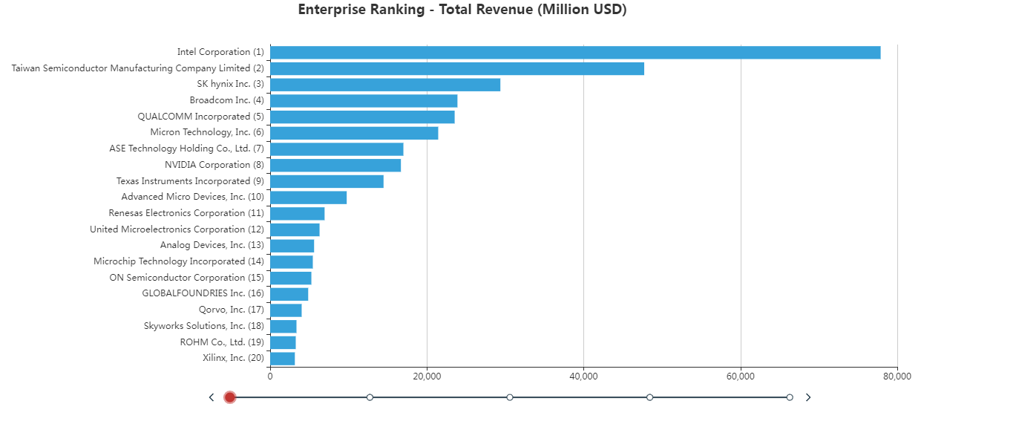
Semiconductors: US, Taiwan, Korea, Japan, 2020.
Data source: https://gcps.scdata.ai/project/19982
Notes:
Suppose we choose US, Taiwan, Japan and Korea. Looking at the enterprise ranking of semi-conductors suppliers in these countries, some potential suppliers for the CPU of iPhone could be Intel, TSMC, Qualcomm, Gobalfoundries, …

Slide 23
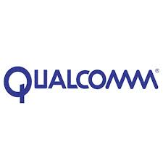
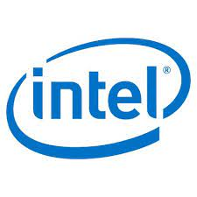


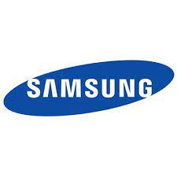
Potential Suppliers (CPU)
Intel
Qualcomm
Global Foundries
TSMC
Samsung electronics*
Notes:
Let us also include Samsung as a benchmark because it was a reliable supplier of CPU for Apple.

Slide 24
Supplier analysis
Individual suppliers’ technical capability & pricing, profitability, financial health.
Notes:
Now let’s analyze these suppliers to understand their technical capability & pricing, profitability, and financial health.

Slide 25
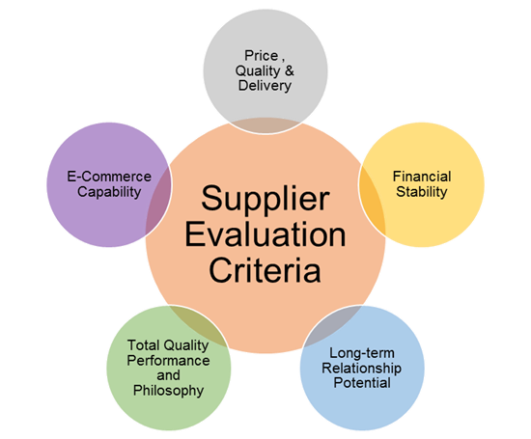
Supplier Analysis
Objectives:
  Identify the best supplier(s) meeting the criteria.
  Support negotiation & bargain
Steps:
  Pricing / profitability analysis: technology, pricing, profitability.
  Financial health analysis: short / long-term liabilities and risks.
Supplier Analysis
Flexibility
Notes:
* The objectives of the supplier analysis is first to identify the best supplier(s) meeting the criteria, and second to support negotiation and bargaining. * We will first perform a pricing and profitability analysis to understand their technology (or value added), their pricing, and their profitability. * Then we will do a financial health analysis to assess their short and long-term liabilities and risks.

Slide 26

Pricing / Profitability Analysis
Technology (value added) → pricing → Gross margin.
Profitability → Net margin.
Ideal suppliers: Attractive pricing but very profitable.
Deceiving suppliers: Attractive pricing but barely profitable.
Notes:
* How to measure a company’s technology and innovation? One way is gross margin. High value-added products typically have high pricing and thus high gross margin. To measure profitability, we will use net margin. * An ideal supplier (for long-term relationship) is the one that can offer an attractive pricing to the buyers, and even with that pricing, it can still be very profitable, so it can sustain the attractive pricing. * A deceiving supplier is the one that offers you an attractive pricing but can barely make $ from it. It is deceiving because it may look good initially but actually is a bad choice because it may bankrupt and eventually you will have to pay.

Slide 27
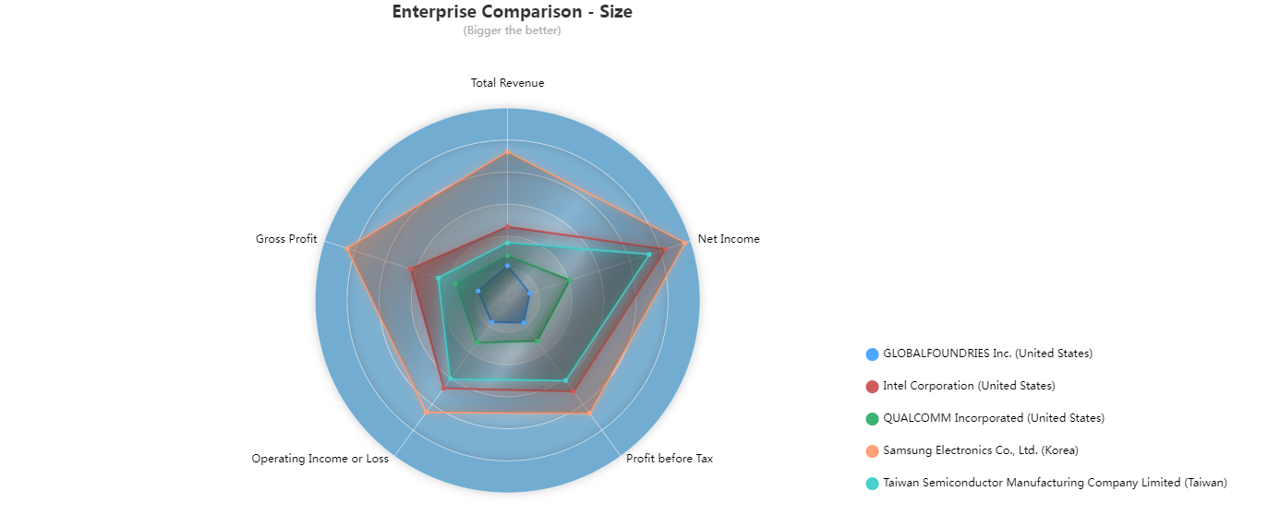
Samsung > Intel > TSMC > Qualcomm > Global Foundries which suffered a loss in 2020.
Data source: https://www.scdata.ai/project/19982
Notes:
Coming back to Apple story, let’s compare the selected suppliers side-by-side first in terms of size. We can see that in 2020, Samsung > Intel > TSMC > Qualcomm > Global Foundries which suffered some loss in this year.

Slide 28
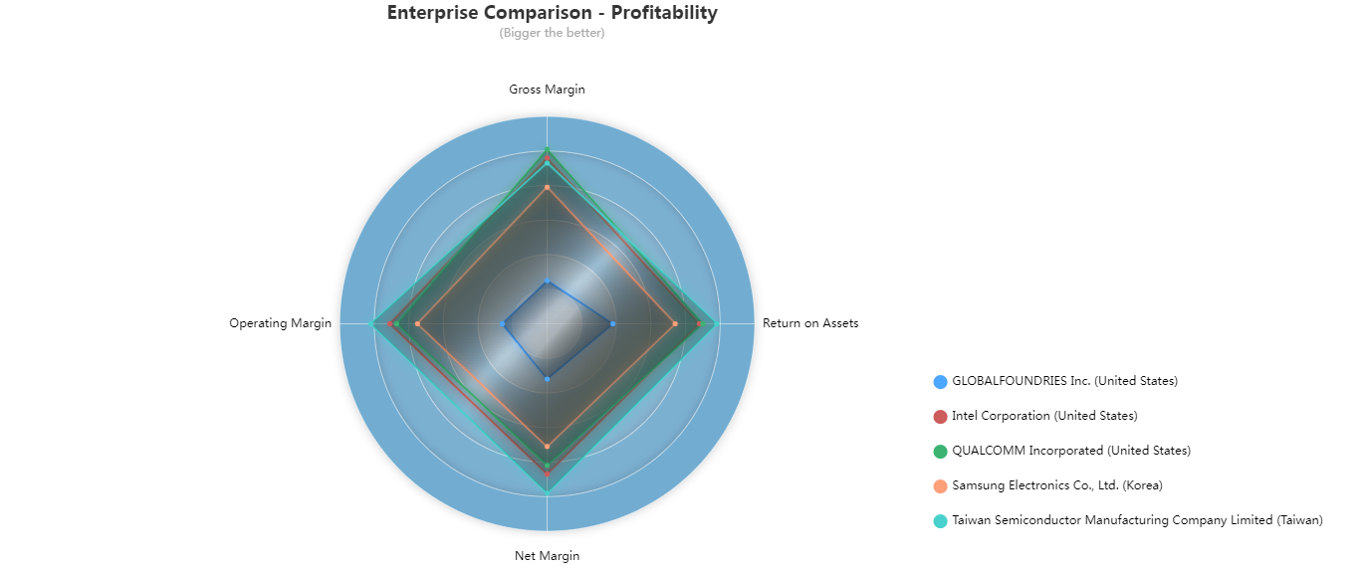
Qualcomm, TSMC, intel: innovative.
TSMC seems to have the lowest pricing with the highest profit
TSMC: lowest
TSMC: highest
Data source: https://www.scdata.ai/project/19982
Notes:
The enterprise comparison on profitability reveals some key insights: First, GF (blue) lost badly in this year, Samsung was profitable but not as much as the other three, Qualcomm, Intel and TSMC – understandable because Samsung produced not only semiconductors but also a variety of household appliances. Looking at Intel, Qualcomm, TSMC, we first find that their gross margins are in the range of 50-60%, implies their technical capability and innovation. Second, Qualcomm has the highest gross margin but the lowest operating and net margins. On the contrary, TSMC has the lowest gross margin but the highest operating and net margins, Intel is in between. The key insight is, out of QC, INTC and TSMC, TSMC had the lowest pricing and made the highest profit.

Slide 29
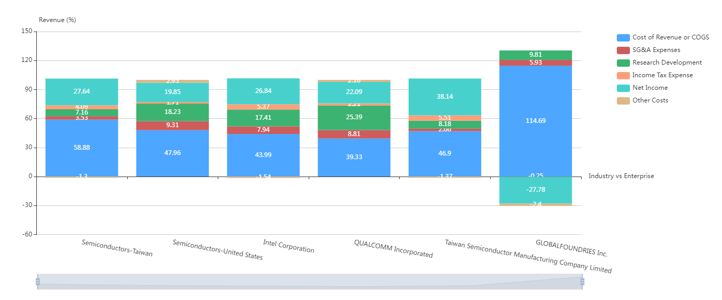
US prices higher than Taiwan
Qualcomm: the opposite of TSMC
TSMC: lowest pricing & SG&A, highest net margin
Intel: in between
Revenue Breakdown, Semiconductors, US and Taiwan 2020.
Data source: https://www.scdata.ai/project/19982
Notes:
The revenue breakdown of 2020 US and Taiwan semiconductors provides more details. US semiconductors, on average, have a higher gross margin (pricing) than Taiwan semiconductors. Comparing individual suppliers, TSMC has the lowest gross margin (pricing), lowest SGA and highest net margin, Qualcomm is the opposite case with the highest gross margin (pricing), highest SGA cost and lowest net margin, Intel is in between. Indeed, TSMC has SGA of 2%! Far below everyone else. However, we also see that Qualcomm spent the highest in RD, TSMC the least – however, Apple is not hiring TSMC to do RD but only manufacturing.

Slide 30
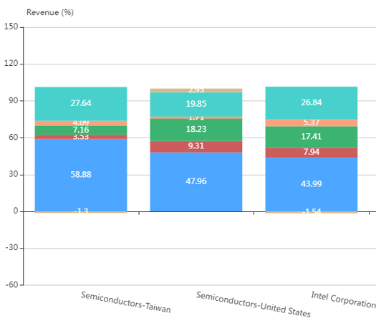
Support Price Negotiation
Net margin: Taiwan > US
Suppliers’ expectation / bottom-line
  Expectation: Suppliers’ gross margins.
  Bottomline: Supplier’s net margins.
Taiwan semiconductor manufacturers may expect a lower pricing than those in US.
Taiwan may concede more than US.
Gross margin: Taiwan < US
Notes:
These analyses can provide important insights to support price negotiation. When negotiating pricing, you need to understand your suppliers’ expected price and their bottom-line at which they cannot concede further. A benchmark for the expected price is the supplier’s gross margin, a benchmark of their bottom-line is its net margin. Data analysis implies that semiconductors manufacturers in Taiwan may expect a lower pricing that those in the US because their lower gross margin. In addition to their lower pricing, Taiwan semiconductors may also concede more in pricing because they have a higher net margin. In plain words, Taiwan semiconductors already priced lower, and they can also concede more on that lower pricing, isn’t it a great deal?

Slide 31
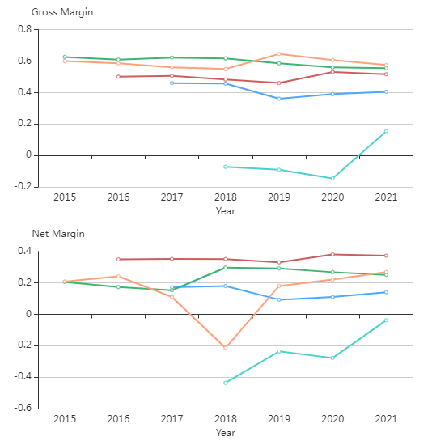
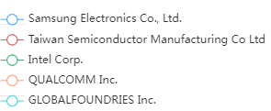
Constant high gross margin (pricing) by Qualcomm & Intel
TSMC’s price was lower but raised recently
TSMC has highest net margin constantly.
Qualcomm’s profits fluctuated more
Data source: https://www.scdata.ai/project/19982
Notes:
What we just saw was a snap-shot in time, now let’s look at the trend of these companies over time. We can see that our observations made before are consistent over time and not accidental. * By gross margin trend, we see constant high gross margin (or prices) by Qualcomm and Intel. TSMC’s pricing was lower but raised recently. * By net margin trend, we find that TSMC has the highest net margin constantly, and Qualcomm’s profits fluctuated the most.

Slide 32
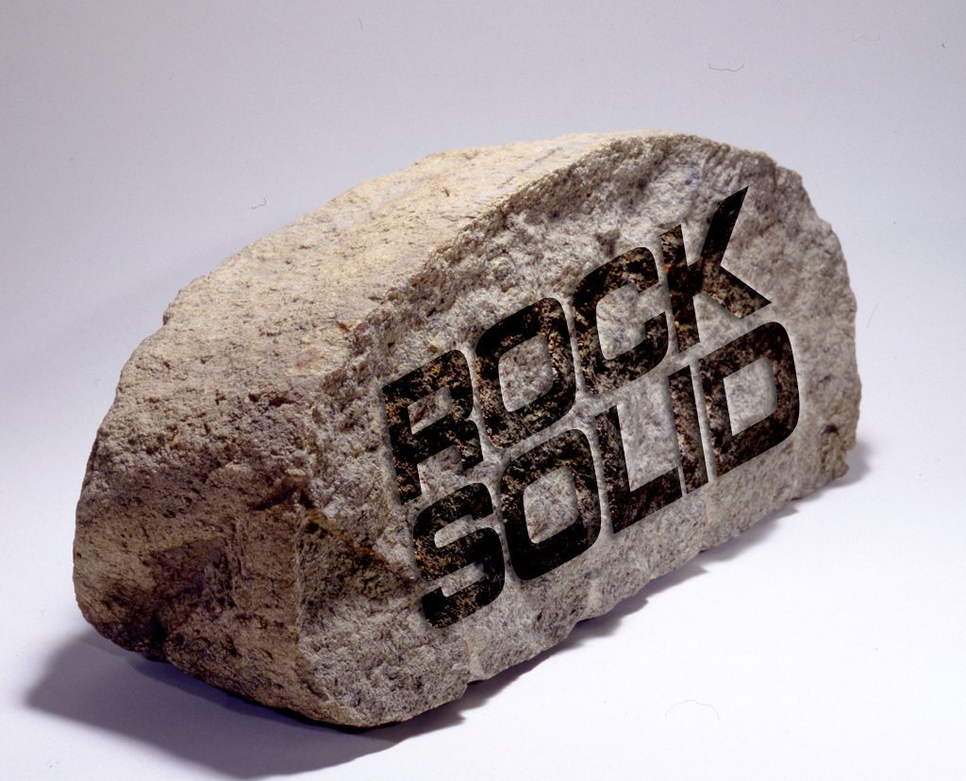
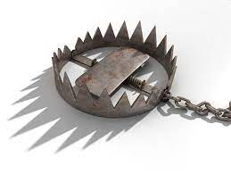
Financial Health
For critical parts, you need the suppliers to have a rock-solid financial health.
A typical trap: good one-time deal and long-run crisis.
Notes:
Now let’s analyze these suppliers’ financial health. For critical parts, you need your suppliers to have a rock-solid financial health, to avoid the trap of good one-time deal but long-run crisis. That is, suppliers may seduce you with heavy discounts to get you indoors, once you are in they may threaten you with bankruptcy and so you will have to pay. That is why data analysis on equity, liability and risk is important for the buyers to understand the suppliers’ financial health before making sourcing decisions.

Slide 33
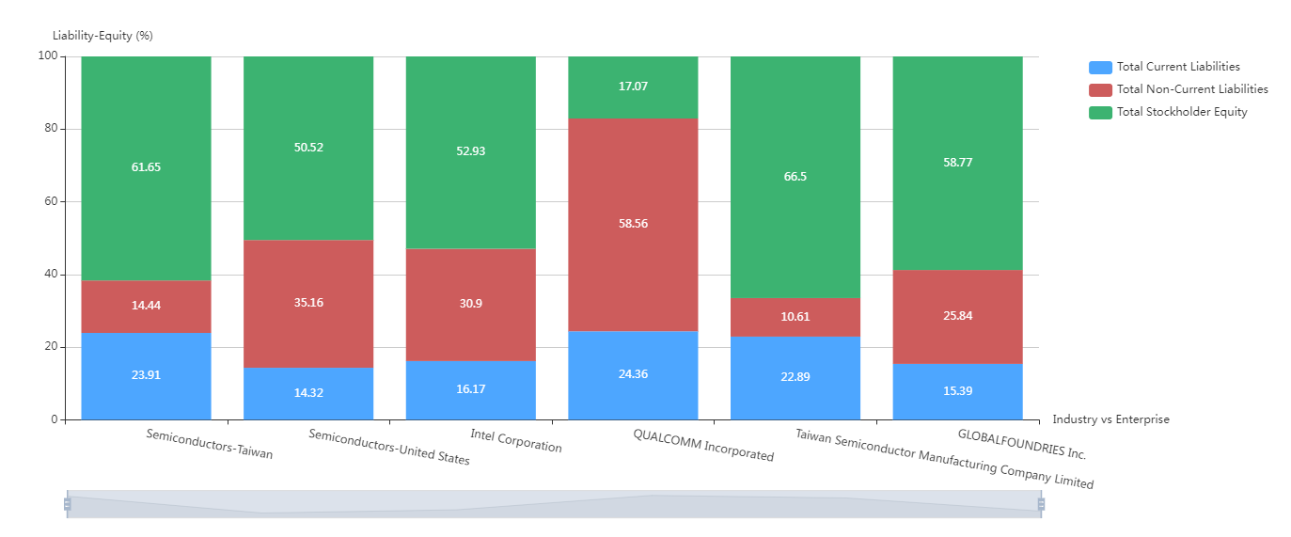
Intel: healthy on liability and equity
QC: highest non-current liabilities
TSMC: highest equity / lowest liabilities
GF: highest equity / lowest liabilities
The assets breakdown, semiconductors, US and Taiwan, 2020
Data source: https://gcps.scdata.ai/project/19982
Notes:
A breakdown of the assets into equity and liabilities can provide insights to suppliers’ financial health. We can see that Qualcomm has significantly more non-current (long term) liabilities than others, TSMC has the highest equity and the lowest liabilities. Intel is in between and has healthy liability and equity. Despite losing money, GF is healthy on equity and liabilities.

Slide 34
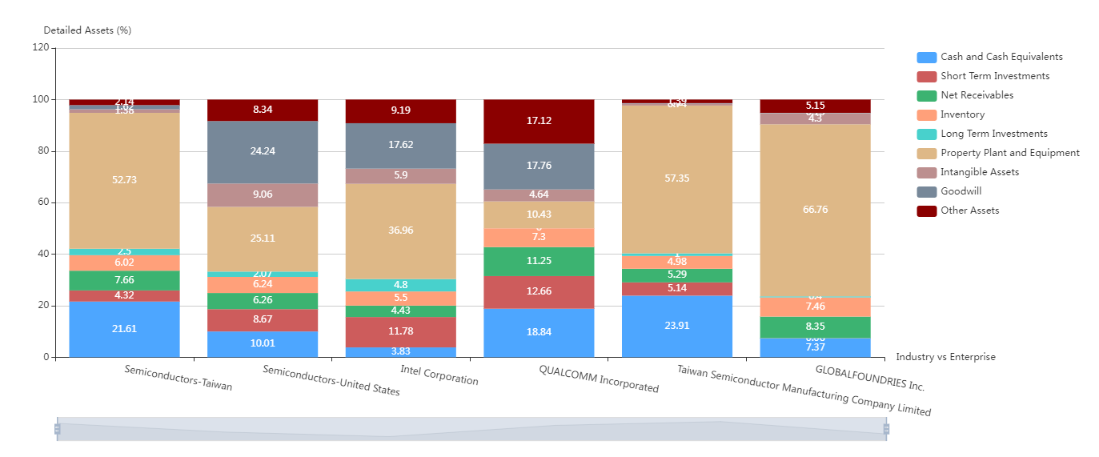
Intel:
$, adequate PPE
QC:
$$, short PPE
TSMC:
$$$,
lots of PPE
GF:
$,
lots of PPE
The assets breakdown, semiconductors, US and Taiwan, 2020
Data source: https://gcps.scdata.ai/project/19982
Notes:
What about these suppliers’ cash and production capacity? A more detailed breakdown of assets shed some insights. TSMC has the highest cash and second highest PPE, property plants and equipment – high production capacity. Qualcomm has good amount of cash but surprisingly less PPE! Putting its production capacity and responsiveness at question. Intel has adequate PPE but running low on cash. GF is fine on cash and has the highest PPE! It has built up a significant production capacity in recent years.

Slide 35
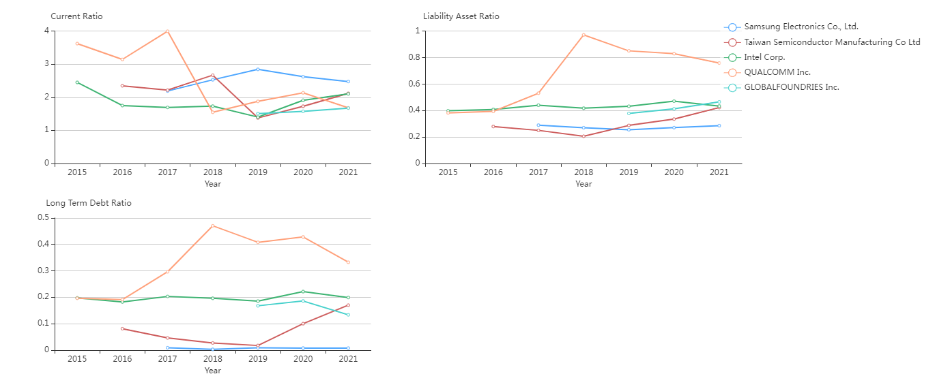
Everyone looks healthy in short-term
Qualcomm: high liability asset ratio
Healthy liability asset ratio for all
Qualcomm: higher long-term debt ratio
Data source: https://www.scdata.ai/project/19982
Notes:
* The trend analysis expands our insights over time: Everyone looks good on short-term liabilities with their current ratio > 1. * Everyone, except Qualcomm, looks healthy on liability asset ratio and long-term debt ratio. Qualcomm's liabilities asset ratio and long-term debt ratio upswings a lot in recent years. Although it is still in the safe zone, it is not as healthy as the others.

Slide 36
Score sheets
Best supplier(s) meeting the selection criteria
Notes:
We can summarize the results of all the analysis above into score sheets to determine the best suppliers meeting the selection criteria.

Slide 37
Intel
 | Excellent | Good | Fair | Poor | Notes
Innovative, technological / engineering capability | x |  |  |  | Superior technology, innovative
Manufacturing capacity / quality | x |  |  |  | Strong production capacity, excellent quality
Pricing |  |  | x |  | High pricing
Profitability | x |  |  |  | Very profitable and stable
Bargain power |  |  |  | x | Intel is used to making its own chips but not a contract manufacturer.
Financially healthy / robust | x |  |  |  | low risks, both short and long term
Leaks & competition | x |  |  |  | Will not compete with Apple.
Notes:
The work is meticulous, and I will just showcase one supplier, that is, Intel. You can do the same for other suppliers.

Slide 38
Summary Score Sheet
 | Intel | Qualcomm | Global Foundries | TSMC | Samsung Electronics
Innovative, technological / engineering capability | Excellent | Excellent | Excellent | Excellent | Excellent
Manufacturing capacity / quality | Excellent | Good | Excellent | Excellent | Excellent
Pricing | Fair | Poor | Excellent | Excellent | Excellent
Profitability | Excellent | Good | Poor | Excellent | Good
Bargain power | Poor | Poor | Excellent | Fair | Fair
Financially healthy / robust | Excellent | Good | Good | Excellent | Excellent
Leaks & competition | Excellent | Fair | Excellent | Good | Poor
Notes:
Combining the score sheets into one, we have a side-by-side comparison among all the potential suppliers. TSMC has the highest # of excellent, even more than Samsung. It is only weak in the area of bargain power because it has grown into a large company and so Apple may lose its leverage.

Slide 39
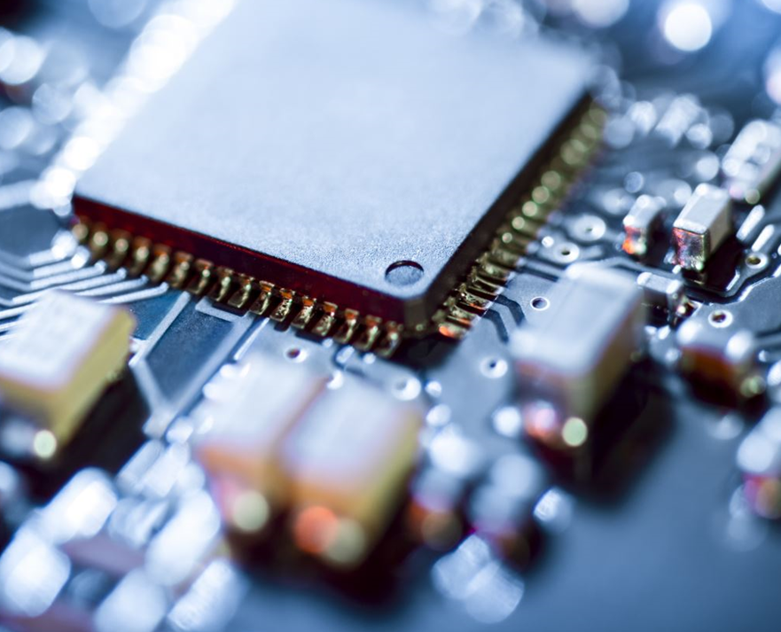
CPU Sourcing Strategy for Apple?
Use TSMC as the main IC supplier.
Cultivating GF as a potential supplier.
Spread some work to Intel, Qualcomm, Samsung for their specialties.
Close to what Apple did in 2020 (except cultivating GF)!
Notes:
So what would be the sourcing strategy for CPU for Apple’s iPhone? We suggest to use TSMC as the main supplier, cultivating GF as a potential supplier; spread some work to Intel, Qualcomm, Samsung for their specialties as minor suppliers. This is very close to what Apple did in 2020!

Slide 40
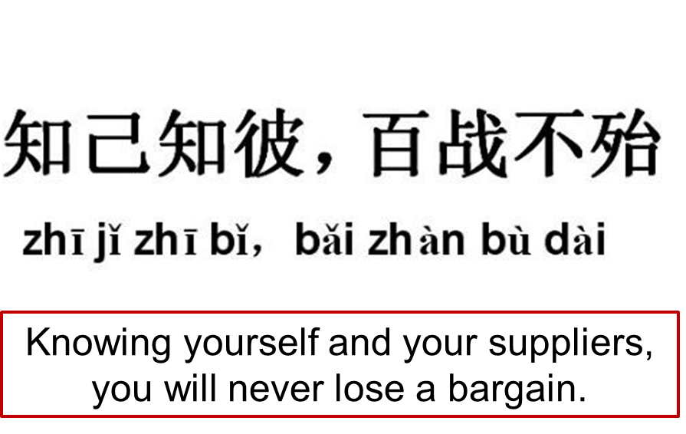
Recap
Sourcing is heavily data driven.
Sourcing analytics (intelligence): discover & select suppliers for critical items.
Identify needs and selection criteria.
Know suppliers:
  Market intelligence.
  Negotiation power analysis.
  Supplier analysis.
Notes:
Let me recap, the key take aways are (1) sourcing is heavily data driven. (2) sourcing analytics can provide the insights and intelligence to support sourcing decisions, such as discovering and selecting new suppliers. You need to first identify your needs and supplier selection criteria, and then select suppliers by market intelligence and supplier analysis. In this way, you will know yourself and your suppliers, so you will never lose a bargain.
Any questions?

Slide 41
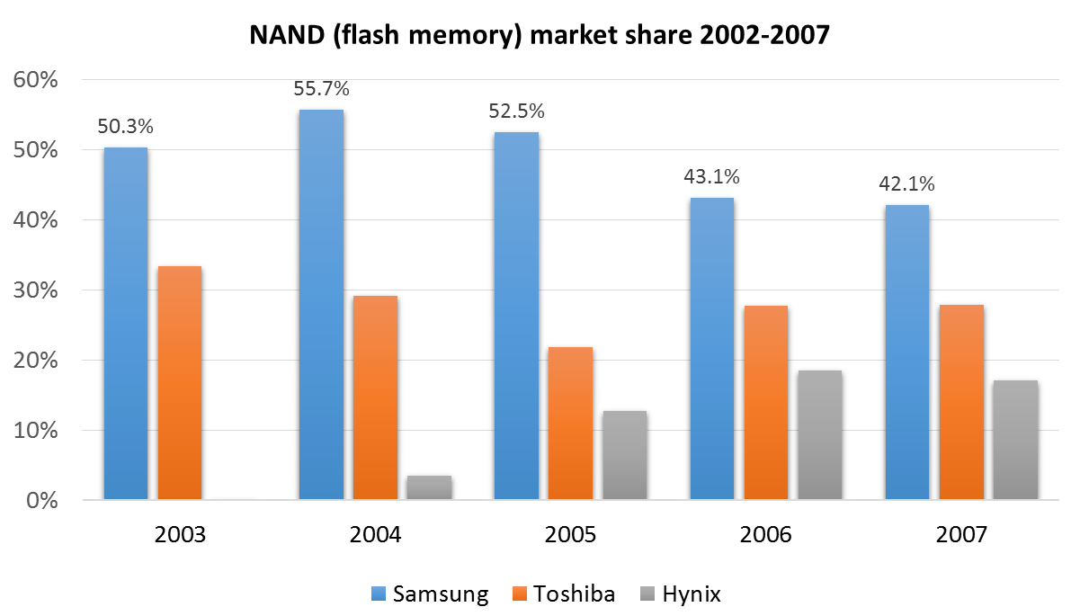
Homework: Help Apple Source NAND Flash Memory
Memory market was unstable; Apple wanted to lock in a supplier that was rock-solid financially.
Samsung held about 50% of the NAND flash memory market.
Jobs: “Whoever controls flash is going to control this space in consumer electronics.”
Notes:
Market analysis. Market share!

Slide 42
Qualcomm
 | Excellent | Good | Fair | Poor | Notes
Innovative, technological / engineering capability | x |  |  |  | Innovative, technologically capable
Manufacturing capacity / quality |  | x |  |  | In business - cell phone chip manufacturing. However, production capacity may be limited
Pricing |  |  |  | x | Highest pricing
Profitability |  | x |  |  | Quite profitable in recent years but less stable than others.
Bargain power |  |  |  | x | Powerful supplier - No leverage.
Financially healthy / robust |  | x |  |  | High long-term risk but low short-term risk
Leaks & competition |  |  | x |  | Some lawsuits on patents, potential leaks and competition.

Slide 43
Global Foundries
Global Foundries | Excellent | Good | Fair | Poor | Notes
Innovative, technological / engineering capability | ? |  |  |  | Technologically capable
Manufacturing capacity / quality | x |  |  |  | Rapidly building up a strong manufacturing capabiliy. But Apple needs to co-invest to ramp-up dedicated fab houses for production.
Pricing | x |  |  |  | Can be low pricing to Apple
Profitability |  |  |  | x | Not profitable for recent years and not sure if it will be.
Bargain power | X |  |  |  | Apple has the bargaining power
Financially healthy / robust |  | x |  |  | Low risk for short and long terms; but lost money for a few years.
Leaks & competition | x |  |  |  | Will not compete with Apple.
Notes:
Apple only accounts for a small fraction of what Intel supplies (at that time).

Slide 44
Samsung Electronics
Samsung Electronics | Excellent | Good | Fair | Poor | Notes
Innovative, technological / engineering capability | x |  |  |  | Trusted Technological capability.
Manufacturing capacity / quality | x |  |  |  | Vertically integrated, strong manufacturing capability
Pricing | x |  |  |  | Low pricing (low expectations)
Profitability |  | X |  |  | Profitable and stable.
Bargain power |  |  | x |  | Apple may not have much bargaining power due to Samsung's size
Financially healthy / robust | x |  |  |  | Low risk, short and long term
Leaks & competition |  |  |  | x | Competing Apple heads-on and patent infringement issues
Notes:
Everyone uses Intel, Apple only accounts for a small fraction of what Intel supplies (at that time).

Slide 45
Taiwan Semiconductor Manufacturing Corp. (TSMC)
 | Excellent | Good | Fair | Poor | Notes
Innovative, technological / engineering capability | x |  |  |  | Technologically capable
Manufacturing capacity / quality | x |  |  |  | Strong manufacturing capability, can raise capital as the company starts processing wafers for Apple.
Pricing | x |  |  |  | Low pricing (low expectations)
Profitability | x |  |  |  | Very profitable and stable
Bargain power |  |  | x |  | Increasingly powerful; compare to Intel and Qualcomm, Apple may have some leverage.
Financially healthy / robust | x |  |  |  | Lowest risk, short and long term
Leaks & competition |  | x |  |  | Some leaks and IP / confidentiality issues

