Slide 1
Teaching Supply Chain Analytics from Problem Solving to Problem Discovery
Yao Zhao
Professor @ Rutgers Business School
Co-director @ Rutgers Supply Chain Analytics Lab
https://yzhao12345.github.io/
Instructors are free to use and modify the content of these slides
Notes:
* Hello everyone, my name is Yao, … I appreciate your participation and welcome any questions, to ensure the smoothness of the webinar, may I ask everyone to raise the questions at the end of the webinar, we will leave some time for questions – thank you.
* Welcome to the webinar of …. The title may sound strange because people usually define and discover the problems first and then solve them. However, it is not strange to us, the OR/MS/DS people, because we are trained problem solvers and sometimes we are so good at solving well-defined problems that we forget about problem discovery altogether. However, problem discovery can be more meaningful and impactful than problem solving to business audience because nothing in real-life is well defined - this is what I want to talk about today in this webinar series.

Slide 2
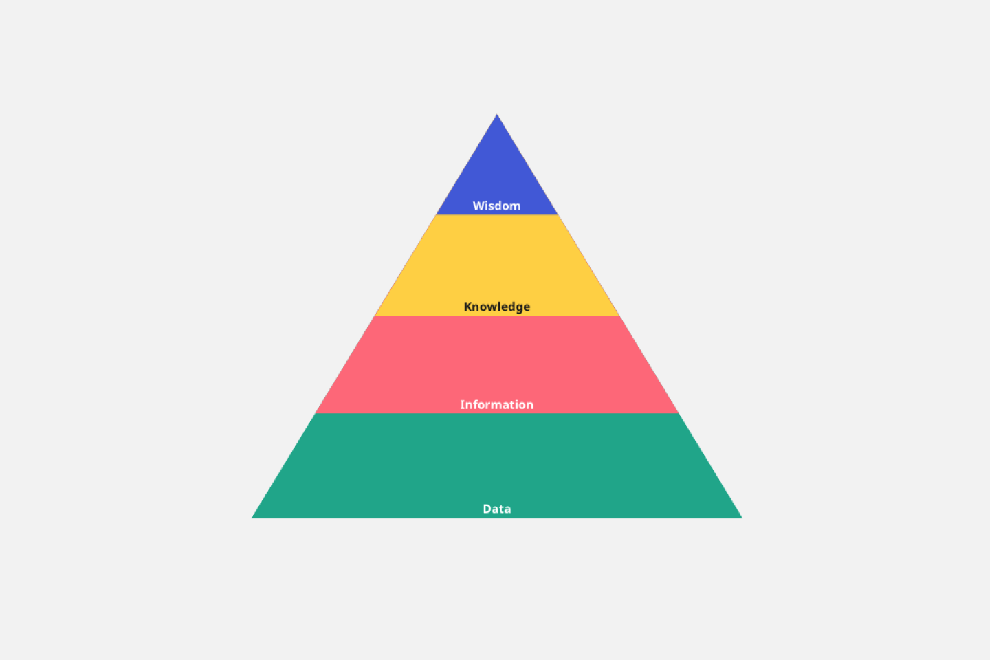
How to make it happen?
Model Driven Problem Solving
Prescriptive Analytics
What will happen?
Predictive Analytics
How did it happen?
Data Driven Problem Discovery
Diagnostic Analytics
What happened?
Descriptive Analytics
Demand or User Base
Notes:
* Everyone knows these 4 types of analytics, but not everyone notices that the descriptive and diagnostic analytics are really data driven problem discovery techniques while the predictive and prescriptive analytics are model driven problem solving skills. * Clearly descriptive and diagnostic analytics have the largest user base and thus demand for education. * However, most current supply chain analytics curriculums focus on model-driven problem solving skills. Data-driven problem discovery skills are rarely taught systematically at all levels. Practitioners and business audience are thirsty for such skills, …

Slide 3

Recap
Knowing the problem
Finding the solution
Notes:
The reason, as Steve Jobs once pointed out, “If you define the problem correctly, you almost have the solution.” * Frankly, it is a bit exaggerated but the point is clear: knowing the right direction to go is far more important than knowing how to get there fast! In another word: a sub-optimal solution to the right problem is better than the optimal solution to the wrong problem! * I think data-driven problem discovery presents a huge un-charted market for higher education and executive programs.

Slide 4
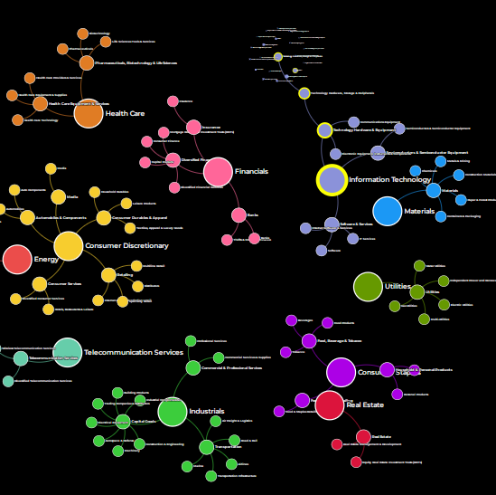
Inventory Analytics
Industry Classification Tree
For which industries is inventory relevant and important?
How may inventory affect firms’ financial performance?
How do I know if I have an inventory problem?
Notes:
In these webinars, I will share experiences and modules to teach data-driven descriptive and diagnostic analytics to define and discover problems in supply chains, including, inventory analytics, that is today, to answer questions such as (1) For which industries is inventory relevant and important? On your right is an industry classification with sectors such as IT, consumer discretionary, and financials, etc. (2) How does inventory affect companies’ financial performance in my industry? (3) How do I know if I have an inventory problem?

Slide 5
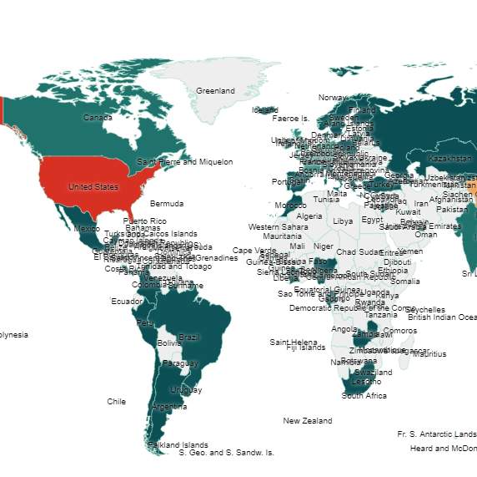
Sourcing Analytics
Enterprise Distribution
Market intelligence to identify and select new suppliers.
Supplier analysis to assess individual suppliers’ technical capability, pricing, financial robustness and efficiency.
Notes:
* Tomorrow, we will talk about sourcing analytics. Sourcing is heavily data driven, just think about the $ value of your spend and # of POs, you will see why data analytics is so important to sourcing. * We will talk about (1) Market Intelligence to identify and select new suppliers (2) Supplier Analysis to assess individual suppliers’ technical capability, pricing, financial robustness and efficiency. * These insights can support sourcing decisions and negotiation. We will use Apple’s global sourcing of CPUs for iPhone as an example.

Slide 6
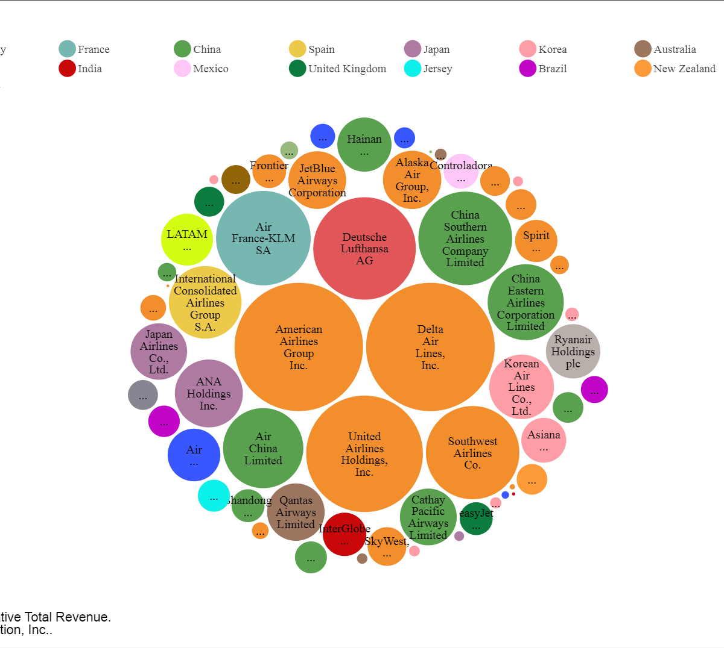
Competitive Intelligence
What are the most valuable segment(s) of my supply chain?
What are my strengths and weaknesses relative to my competitors?
What factor(s) may drive a company’s financial performance in my industry?
Notes:
* In the day after tomorrow, we will discuss competitive intelligence and benchmarking. Using data analysis, we will answer questions such as (1) What are the most valuable segment(s) in my supply chain? For example the airline supply chain. (2) What are my strengths and weaknesses relative to my competitors? (3) What factor(s) may drive a company’s financial performance in my industry? * The objective is to discover problems and diagnose the causes for a company. We will use American Airlines and the US airline industry as an example.

Slide 7


Data Interpretation – Transform Data into Insights
Do we really understand the data?
Notes:
* Our focus is on data interpretation, that is, transforming data into insights. Data interpretation is not as easy we may think, it can be sophisticated and revealing. * Seeing the same data, people may have different interpretations, some saw 6 other saw 9, some saw a random pile of rocks, others may see a human face gazing at you. * The question is, do we really understand the data? Let me give an example before getting into inventory analytics.

Slide 8

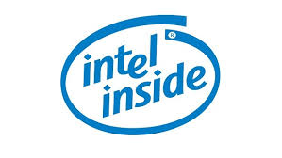
Compaq vs. Dell (2001)
Compaq was the market leader with a larger market share
Healthy cash flow, many patents
But Compaq sold itself, abandon its strong brand, Why?
Computer industry background
  Computer companies have the same key technologies, CPU, operating systems, etc.
  Competing on customer service & cost structure
Notes:
* Around year 2001, Compaq was the market leader with the largest market share. It also has a higher gross margin, a healthy cash flow and owns many patents. But to many people’s surprises, Compaq sold itself to HP in 2002 (for $25 billion) and abandon its strong brand, why? * To see the reason, we need to understand computer industry background: computer companies have the same technology, such as CPU, OS, they are competing on customer service and cost structure.

Slide 9
Interpreting the Data
Data comes from http://yahoo.marketguide.com (2000)
Dell outperformed Compaq by 1% in Operating margin.
Why is this 1% so critical that Compaq, the market leader, gave up the competition and sold itself?
Notes:
* Here is the data – if we truly understand the data, we should know why Compaq sold itself. Compaq has a gross margin of 23%, higher than Dell at 21%. However, Dell is more efficiently with a days of inventory about 5 days while Compaq about 18 days, which translated into a lower operating cost about 10% vs. Compaq about 14%. In the end, Dell outperformed Compaq by about 1% in operating margin. Question … *To see the answer, we must first understand why Compaq’s gross margin is higher than Dell. Recall that they have the same key suppliers, different gross margin actually means different pricing. In fact Dell has a 10% lower selling price than Compaq at that time. Even with a lower price, Dell can make more money, how can Compaq compete? * Not everyone truly understand the data, including folks in HP, but Compaq saw what’s coming and sold itself for $25B – what a wise decision!

Slide 10
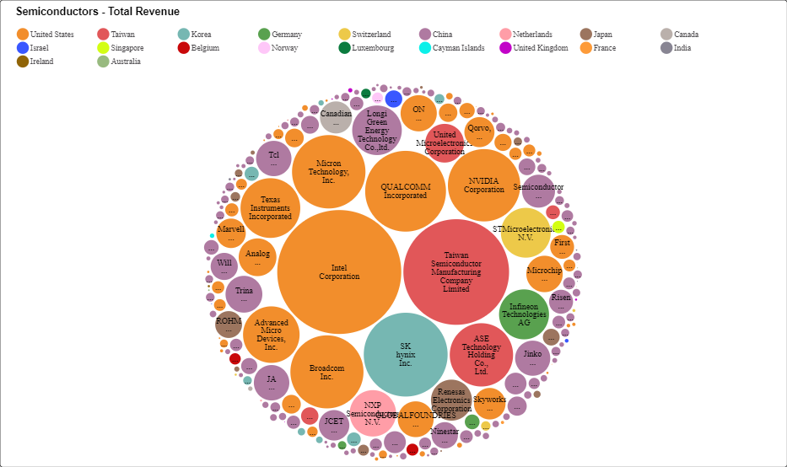
Taiwan Semi. Mfg. Co. (TSMC) To Open 5nm Factory in Arizona
Data source: https://www.scdata.ai/project/17055
Notes:
A similar event happened recently and many people could not see. You probably heard that TSMC was invited to Open 5nm Factory in Arizona 2020. The news immediately raises a question, why invite TSMC? By this picture, doesn’t the US have the best semiconductor manufacturers, such as Intel corporation and so on, in the world. Just looking at revenue, yes, …, but if you dive into data, may be not.

Slide 11
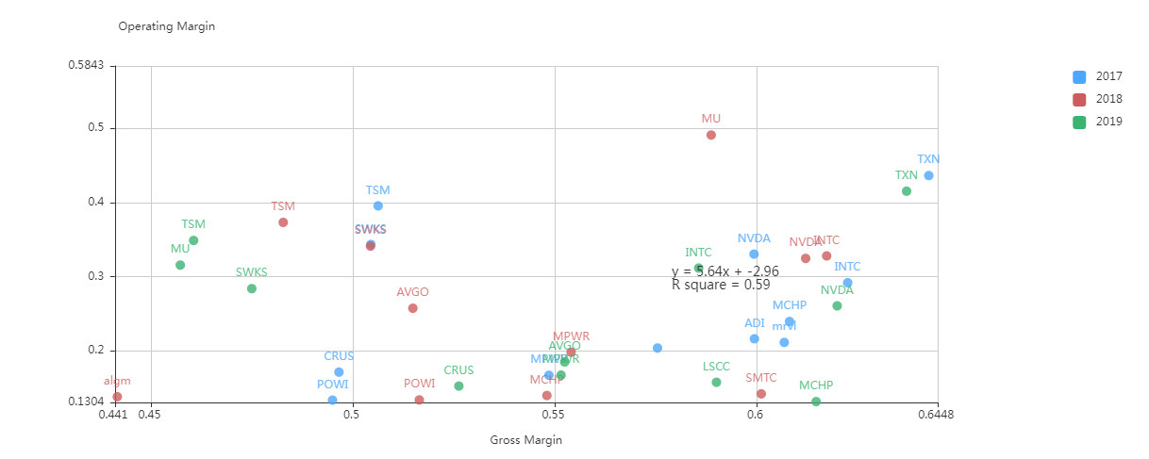
Taiwan Semi. Mfg. Co. (TSMC) vs. Intel Corp. (INTC)
TSMC
INTC
Semiconductors 2017-2019
Data source: https://www.scdata.ai/project/17055
Notes:
The data of Intel and TSMC resembles that of Compaq and Dell. Here is a value driver analysis between operating margin and gross margin for semiconductor manufacturers in the US and Taiwan from 2017-2019. Usually the margins go in the same directions but if you can find a counter-example, then you may discover another Compaq vs. Dell case. Indeed, INTC has a higher gross margin (ie., a higher pricing), but even with a high pricing, it made less operating margin than TSMC. I am not saying INTC is another Compaq, what I am saying is that TSMC is operationally much more efficient than INTC, which is a substantial advantage.

Slide 12
Inventory Analytics from Problem Solving to Problem Discovery
Yao Zhao
Professor @ Rutgers Business School
Co-director @ Rutgers Supply Chain Analytics Lab
https://yzhao12345.github.io/
Instructors are free to use and modify the content of these slides
Notes:
I hope you see the importance and sophistication of data interpretation, now let us move to inventory analytics to discuss how to discover inventory problems.

Slide 13


From Model-Driven to Data-Driven
Solve inventory problems
  EOQ models
  Newsboy models
  (R,Q) models
  …
Discover inventory problems
  For which industries is inventory important?
  How may inventory affect companies’ financial performance?
  How do I know if I have an inventory problem?
Notes:
* I have been teaching inventory for 20 years. I started out just like everyone else, teaching problem solving skills, such as …. * I received many complains; in addition to my spoken English, some said that they do not have inventory, so it is irrelevant! Some others said that they are not sure if inventory will impact their companies’ bottom-line. * The problem, I figured out, is that they are not motivated and so my lectures didn’t make sense. It is my fault because I cannot tell them how to solve a problem w/o telling them how to discover it in the first place! Thanks to data analysis, I changed my teaching style: I still teach models …, but only after I tell them how to discover inventory problems.

Slide 14
For which industries is inventory important?
Inventory distribution by country, industry, over time, along supply chains.
Notes:
We will answer this question not only by industries, but also by countries, over time, along the supply chain.

Slide 15

Inventory Importance
A $4.0B sports retailer may hold $1.0B of inventory. A $45B pharmacy chain may invest $8.5B in inventory.
SP500 retailing companies typically have 25-40% of their total assets in inventory.
Other countries?
Other industries?
Other years?
Other supply chain segments?
Notes:
For many instructors, the importance of inventory boils down to this slide. …, great … but this is only US, what about other countries? Inventory cannot be important only to retailing, what about other industries? Any chances over time? And what about other segments in the supply chain, like the upstream manufacturing and distribution industries?

Slide 16
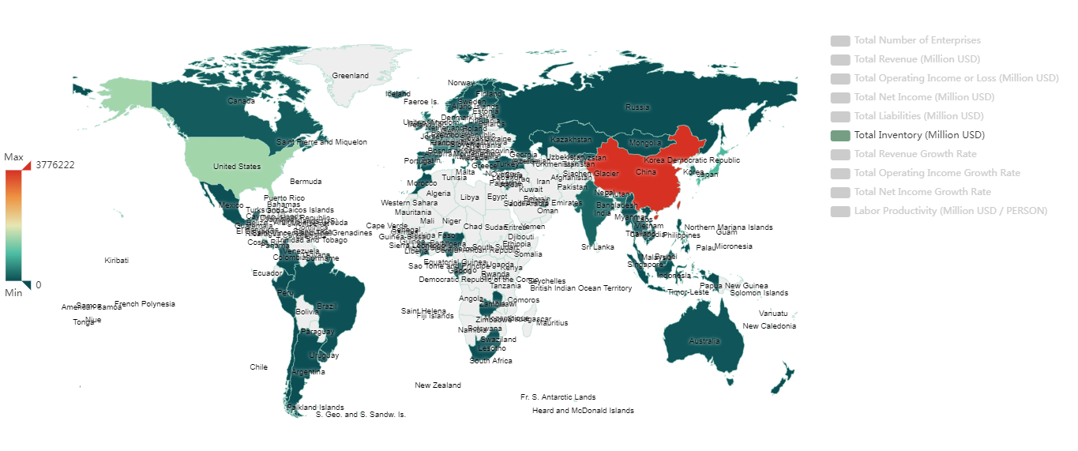
For which countries is inventory important?
2021 reporting year: 7/2021-7/2022
Data source: https://www.scdata.ai/project/30268
Notes:
Let’s first look at which country holds the most inventory. This is the data of publicly traded companies in 2021 reporting year: 7/2021-7/2022. We can see that China is the no. 1, which is followed by US, Japan, and so on.

Slide 17
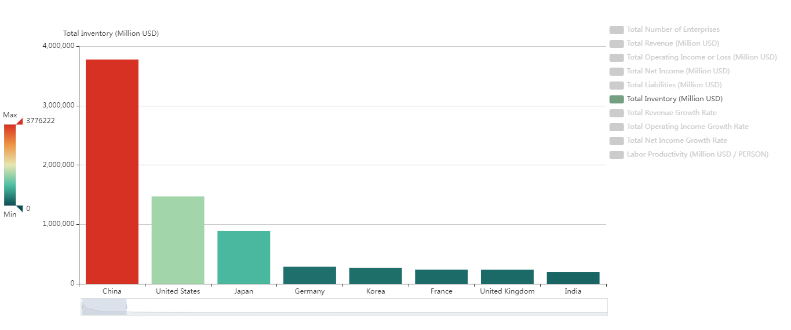
For which countries is inventory important?
Data source: https://www.scdata.ai/project/30268
Notes:
A bar chart provides a better picture, inventory in $ of China is more than twice of that of the US, then Japan, Germany, Korea, France, UK and India.

Slide 18
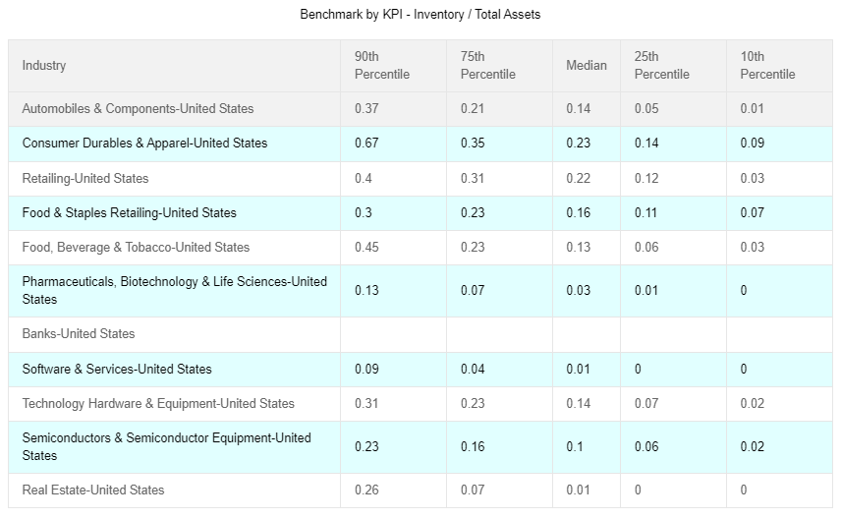

United States 2021
Data source: https://www.scdata.ai/project/30268
Notes:
Now let’s find out which industries hold the most inventory? We first use the measure of Inventory as % of Total Assets. For United States 2021, banks, software and real estate hold minimum inventory. One may expect a lot of inventory for pharma, well, at least by inventory / total assets, inventory does not seem a big issue. However, inventory is a big issue for consumer durables and apparel, retailing, food and staples retailing, technology hardware, and auto & components. In particular, the worst case of consumer durables and apparel has 67% of total assets in inventory!

Slide 19
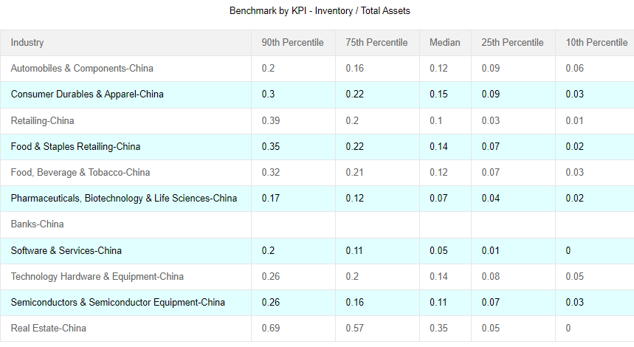

China 2021
Data source: https://www.scdata.ai/project/30268
Notes:
China has many similarities but also important difference from the US. Similarities include minimum inventory for banks and software, and high inventory for consumer durables and apparel, retailing, food and staples retailing, technology hardware and auto & components. An important difference is real estate, real estate in China has a median of 35% assets in inventory, and the worst case has 69%.

Slide 20
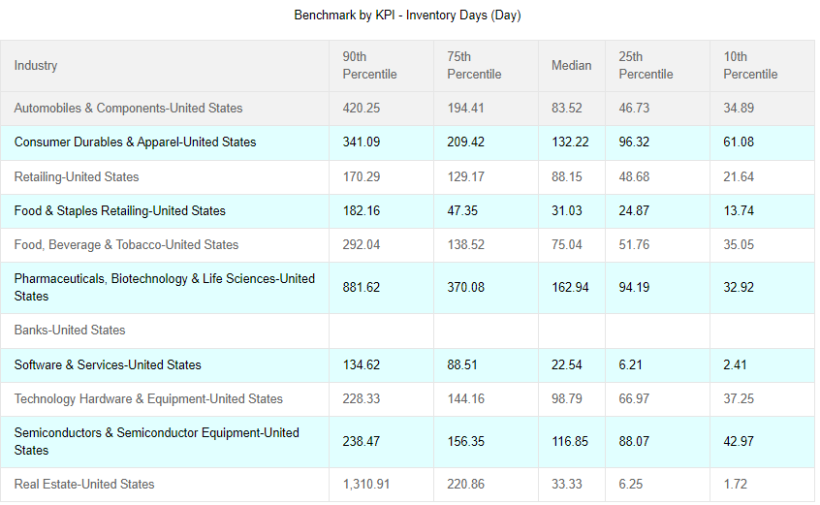
United States 2021
Data source: https://www.scdata.ai/project/30268
Notes:
* To understand the importance of inventory by industry, let us look at inventory days. For US, consumer durables and apparel has a median of 132 days, a worse case of 341 days. * For food and staples retailing, the best case is 2 weeks of inventory while the worst case is half a year! * Pharma has the highest inventory days, with a median of 163 days and worst case about 880 days.

Slide 21
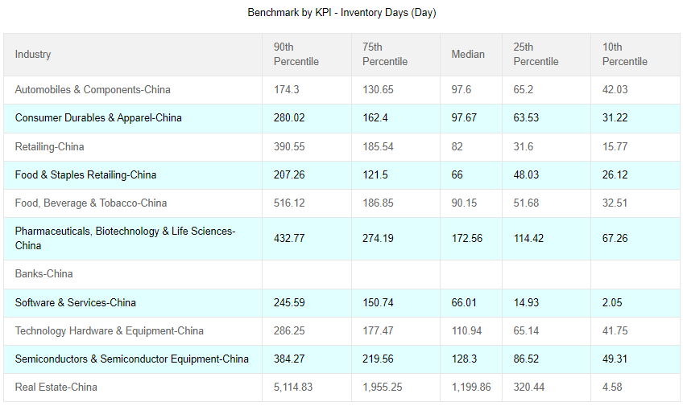
China 2021
Data source: https://www.scdata.ai/project/30268
Notes:
* For China, consumer durable and apparel industry is doing better on inventory days than the US, * but its food and staple retailing was doing a worse job with the best case carrying about 1 month of inventory, and the worst case 200 days. * what is shocking is the inventory days of its real estate industry, the median 1200 days and worst case > 5000 days.

Slide 22

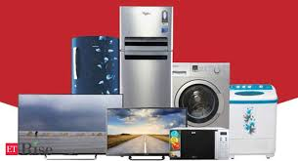


For which industries is inventory important (2021)?
US
China
Food / staples retailing
Consumer durables / apparel
Real estate
Median:23% of assets is inventory, 132 days
Median:35% of assets is inventory, 1200 days.
Retailing
Notes:
In summary, the inventory distribution by industry is country dependent. For US, consumer durables and apparel has the most inventory with a median of 23% of assets in inventory and 132 days. * In China, real estate is the no 1 industry for inventory with a median of 35% of assets in inventory and 1200 days. * Despite this difference, the two countries share some similarities, that is, inventory is important to both of their Food / staples retailing and retailing industries.

Slide 23
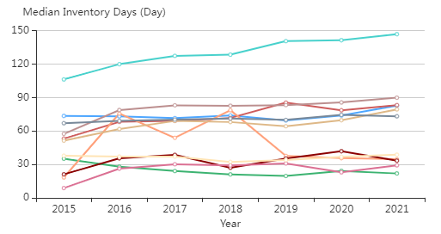
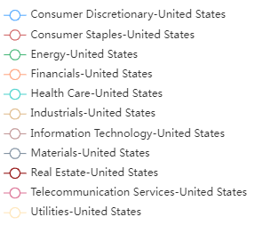
How Does Inventory Change Over Time? USA 2015-2021
Healthcare consistently has the highest inventory days
Followed by IT & consumer staples
Energy has the lowest inventory days
Data source: https://www.scdata.ai/project/30268
Notes:
What we just saw is a snapshot in time, how does inventory change over time? For the US, healthcare consistently has the highest inventory days throughout recent years, which is followed by IT and consumer staples. Energy has the lowest inventory days.

Slide 24
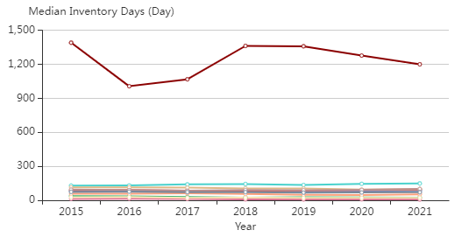
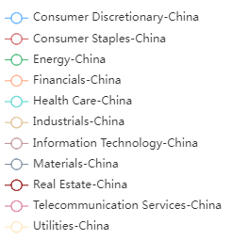
How Does Inventory Change Over Time? China 2015-2021
Real estate consistently has the highest inventory days
Followed by health care
Telecom has the lowest inventory days
Data source: https://www.scdata.ai/project/30268
Notes:
For China, real estate consistently has the highest inventory days throughout recent years, which is followed by healthcare. Telecom has the lowest inventory days.

Slide 25

Which segment(s) of a supply chain carry a large amount of inventory and thus likely to have inventory problems?
Notes:
Inventory may not be evenly distributed in a supply chain. Which segment(s) of a supply chain carry a large amount of inventory and thus likely to have inventory problems? Is it customer facing industries, distribution, manufacturing, or raw materials and components?

Slide 26
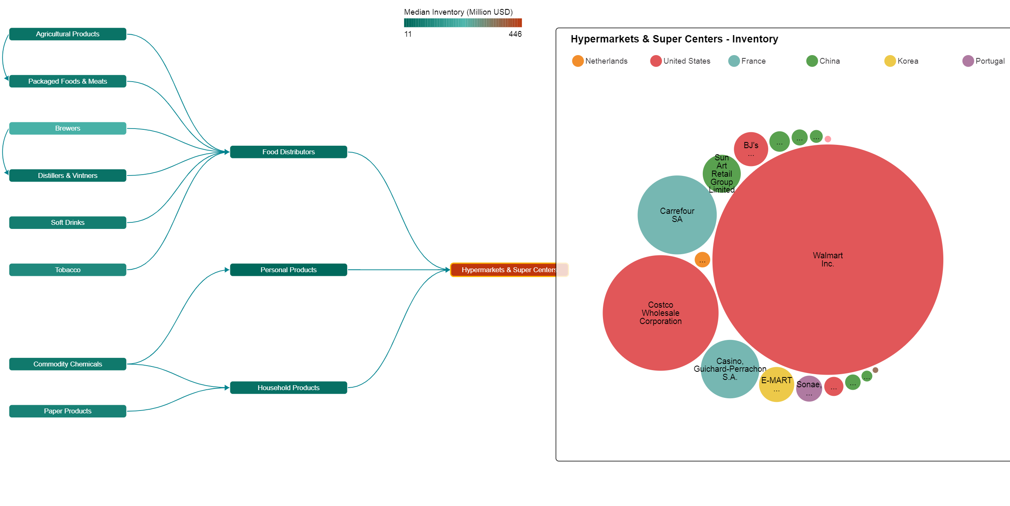
Inventory in the food supply chain? World 2021
Hypermarkets & Super Centers holds the highest inventory $, followed by Brewers.
Data source: https://www.scdata.ai/project/30268
Notes:
The answer is clearly industry dependent. For example, let’s look at the world’s food supply chain. The retailers have a large amount of inventory and likely inventory problems. Which is followed by brewers!

Slide 27
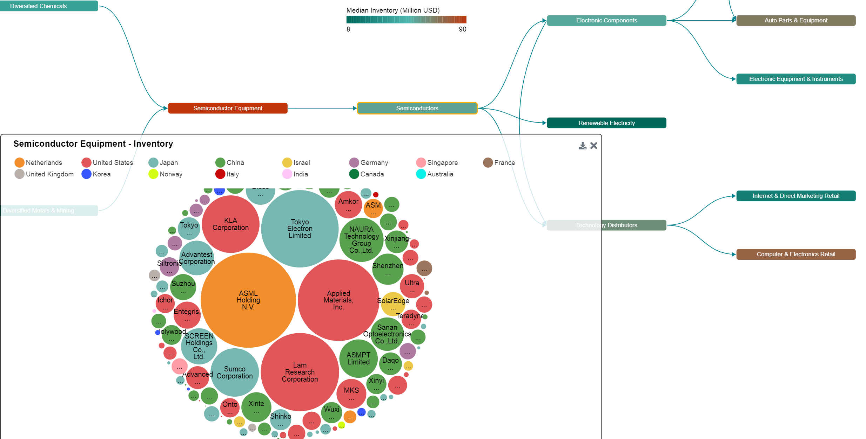
Technology supply chain? World 2021
Semiconductor Equipment hold the highest inventory $, followed by Computer & Electronics Retail, and Auto Parts & Equipment.
Data source: https://www.scdata.ai/project/30268
Notes:
For technology supply chain, the upstream, semiconductor equipment, has the highest median inventory $ (and inventory problems), followed by computer and electronics retail, auto parts and equipment.

Slide 28
How may inventory affect financial performance?
SG&A Cost, Gross Margin, …
Notes:
Next, we answer the question of how may inventory affect firms’ financial performance. This question is valid because we want a payoff for the effort on improving inventory.

Slide 29
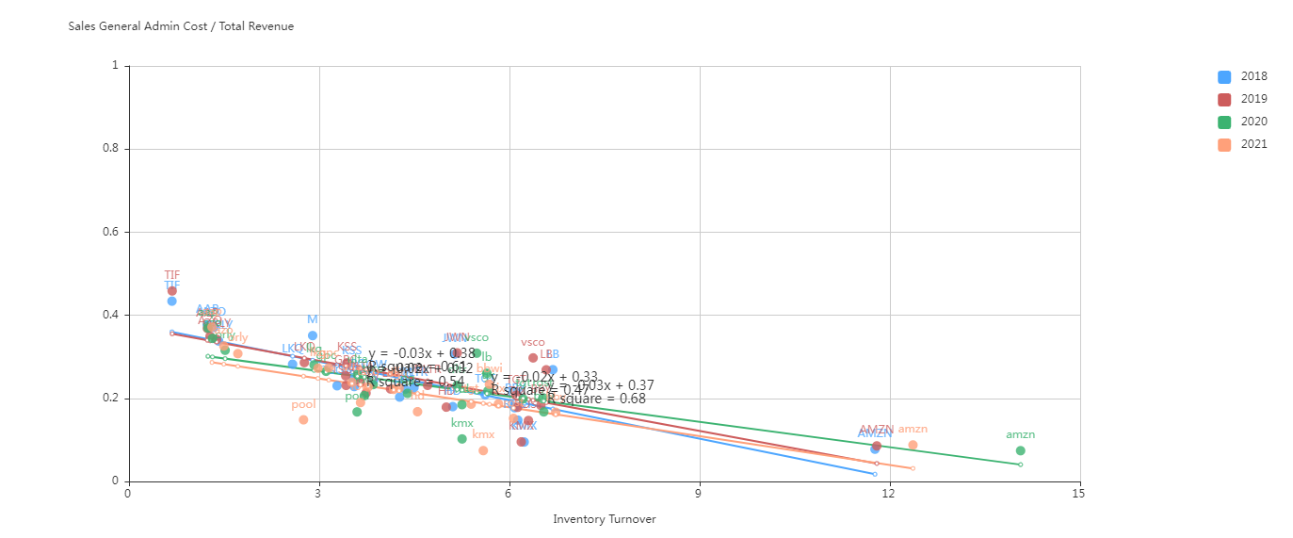
Inventory turnover negatively correlates with SG&A cost / revenue
US retailing (S&P500)
Data source: https://www.scdata.ai/project/30268
Notes:
Such correlations or causal relationships are hard to find, you must have a gut feeling and a careful data analysis, but the results can be rewarding. For example, for the US retailing, as inventory turnover improves, SG&A cost over revenue may decrease. Similar slopes for different years. This may implies that improving inventory management can help reducing SGA cost for retailing!

Slide 30
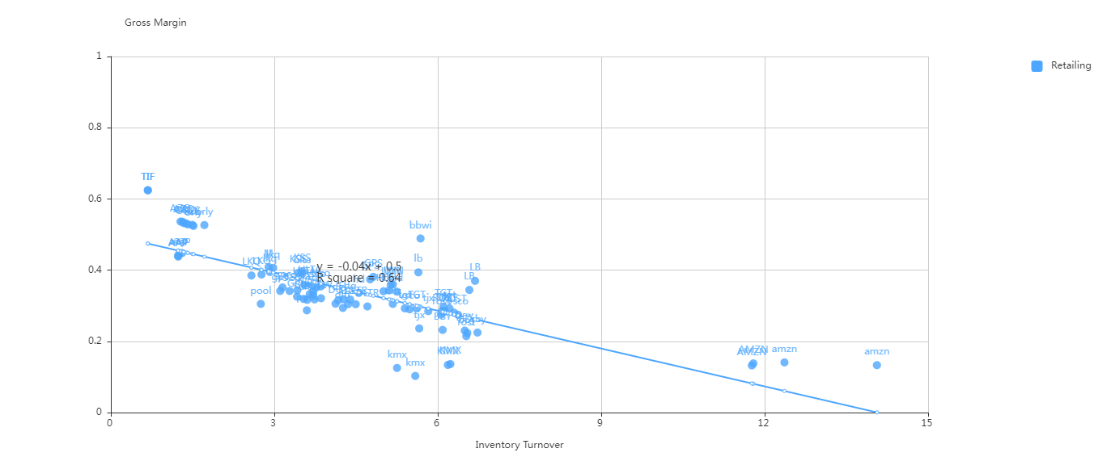
Inventory turnover negatively correlates with gross margin*
US retailing (S&P500)
* V. Gaur, M. L. Fisher, and A. Raman. An econometric analysis of inventory turnover performance in retail services. Management Science, 51(2):181–194, 2005.
Notes:
Another strong correlation was found for US retailing is between gross margin and inventory turnover. Intuitively, high gross margin means expensive items, which moves slowly (slow movers) and stock high, thus inventory turns are small. Low gross margin means cheap items, usually fast movers, and have high inventory turns. The observation is quite time independent.
V. Gaur, M. L. Fisher, and A. Raman. An econometric analysis of inventory turnover performance in retail services. Management Science, 51(2):181–194, 2005. Intuition: Items with higher margins are given lower turns, earns vs. turns.

Slide 31
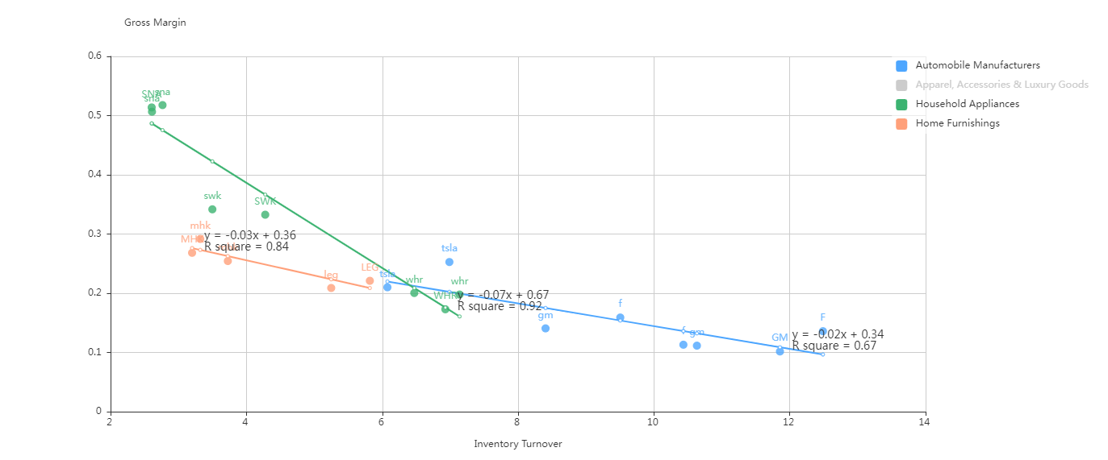
Different slopes for different industries
US (S&P500)
Data source: https://www.scdata.ai/project/30268
Notes:
* The same correlation can be observed for industries other than retailing, such as auto, household appliances and furnishing. * the slopes, however, are different. For instance, auto manufacturers has a flatter slope, which implies a weaker correlation between gross margins and inventory turns. * Finally in semiconductors, technology hardware industries, this correlation is not observed at all.

Slide 32
How do I know if I have an inventory problem?
Define and discover inventory problems.
Notes:
Finally, let us answer the question of how do I know if I have an inventory problem? This question is valid because one company may already be running its inventory at optimum! Thus there is little room for improvement. However, another company may have a huge room for improvement, the question is, how do we know?

Slide 33
Benchmarking
If my revenue is half of yours but I hold the same amount of inventory as you do, then I must have an inventory problem!
Notes:
The answer is simple: benchmarking, specifically, if …

Slide 34

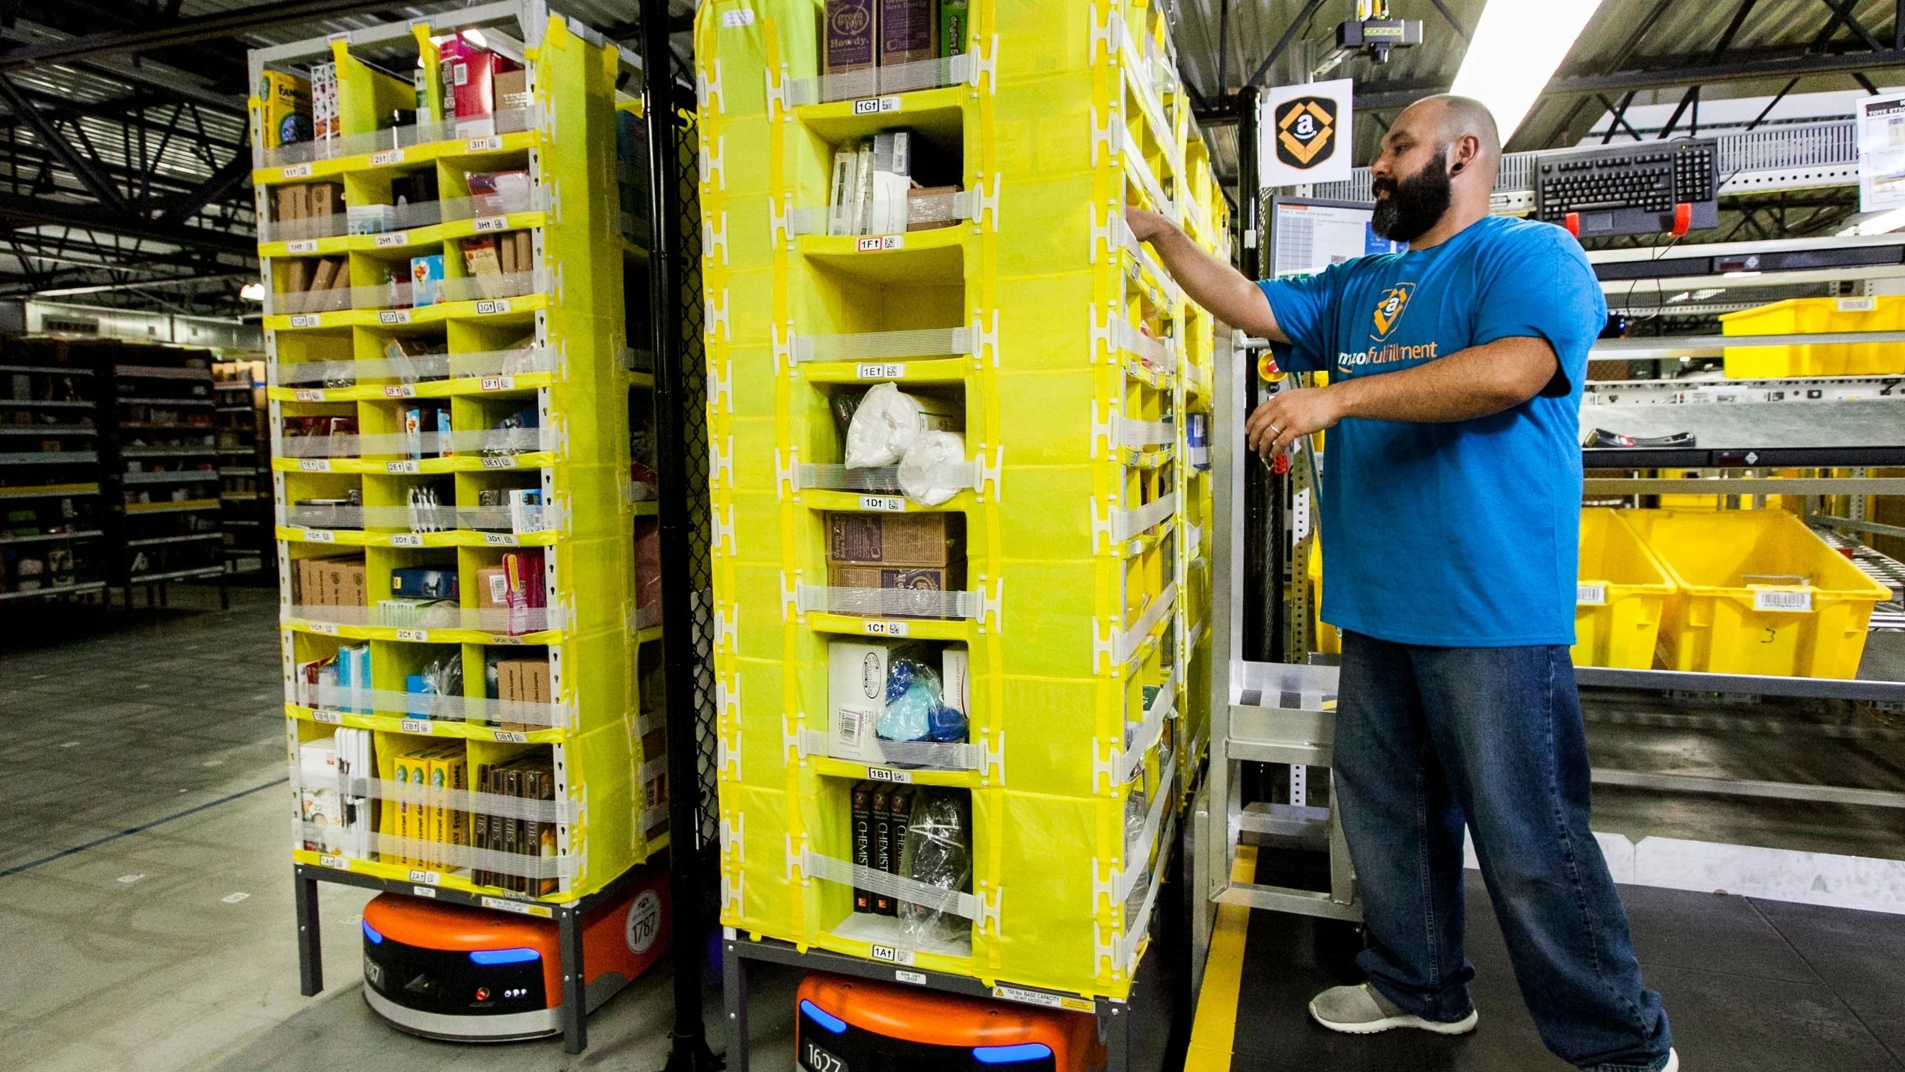
Macy’s vs. Amazon
The America’s Dept. Stores
founded in 1858
The America’s Major Online Store
founded in 1994
Notes:
Let us use Macy’s and AMZN as an example to tell the story.

Slide 35
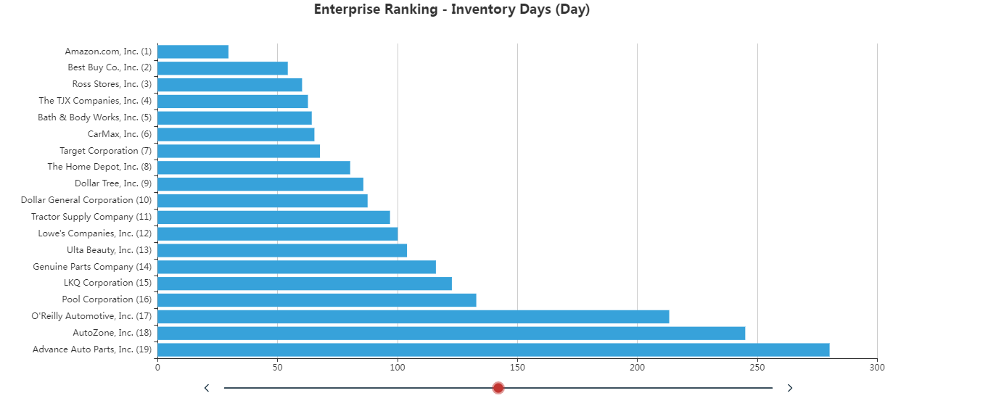
Which retailer may have an inventory problem?
Which may not?
Macy’s
US retailing, 2021, S&P500.
Data source: https://www.scdata.ai/project/30268
Notes:
Ranking all US SP500 retailing firms by inventory days, we see that Amazon has the lowest inventory days in 2021. Macy's should be ranked around 12th with an inventory days of 106 days (it was delisted from SP500 due to its stock market performance).

Slide 36
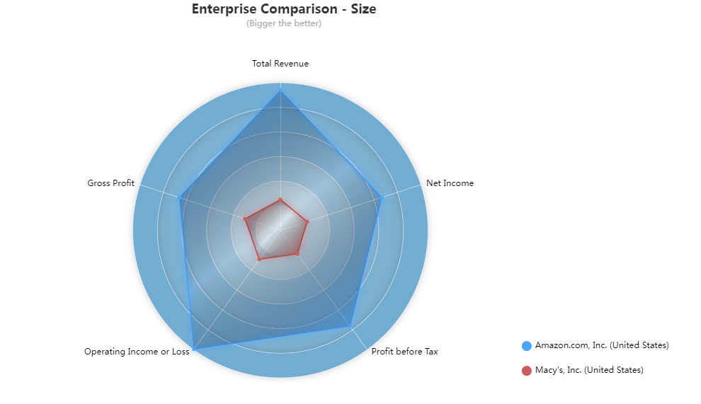
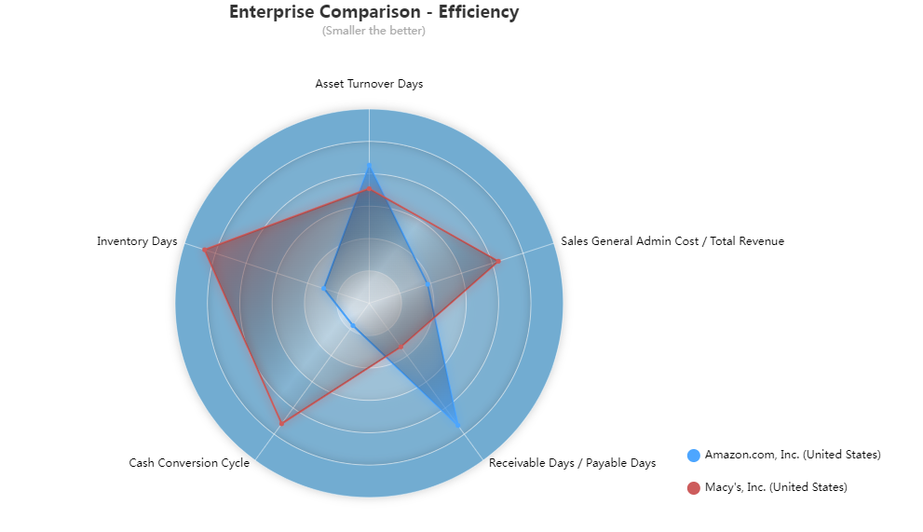
Amazon vs. Macy’s 2021
Amazon outperforms Macy's in all dimensions except receivable days / payable days. Macy's payable days ~ 25x receivable days!
Data source: https://www.scdata.ai/project/30268
Notes:
Comparing AMZN and M side-by-side, we can see that Amazon is much bigger than Macy’s in size. In terms of efficiency, AMZN is better than M in inventory days, cash cycle, and operating cost (SGA/revenue). Macy’s is better than AMZN in receivable days / payable days ratio, indeed, M’s payable days is 25x its receivable days, and AMZN is 5x, in some sense Amazon treats its suppliers better.

Slide 37
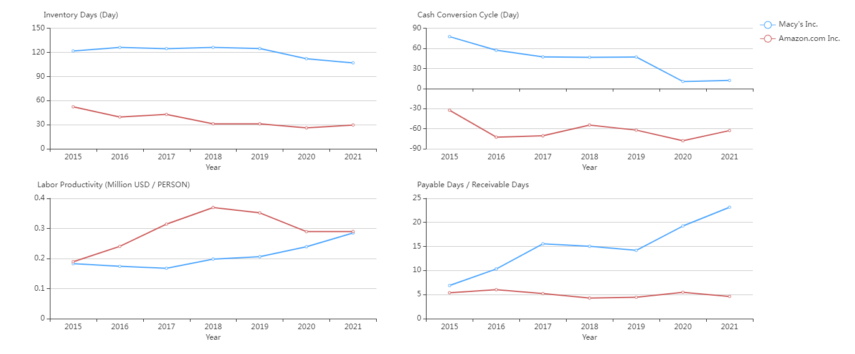
Amazon vs. Macy’s: Operating Efficiency
AMZN labor productivity dropped in COVID.
Macy’s increased payable days – hard time for its suppliers.
Data source: https://www.scdata.ai/project/30268
Notes:
Looking at the trend over time, AMZN consistently outperform M in inventory days and cash cycles. But recently, AMZN’s labor productivity dropped significantly – hired too many people? Macy’s increased its payable days significantly recently – a harder time for Macy’s suppliers.

Slide 38
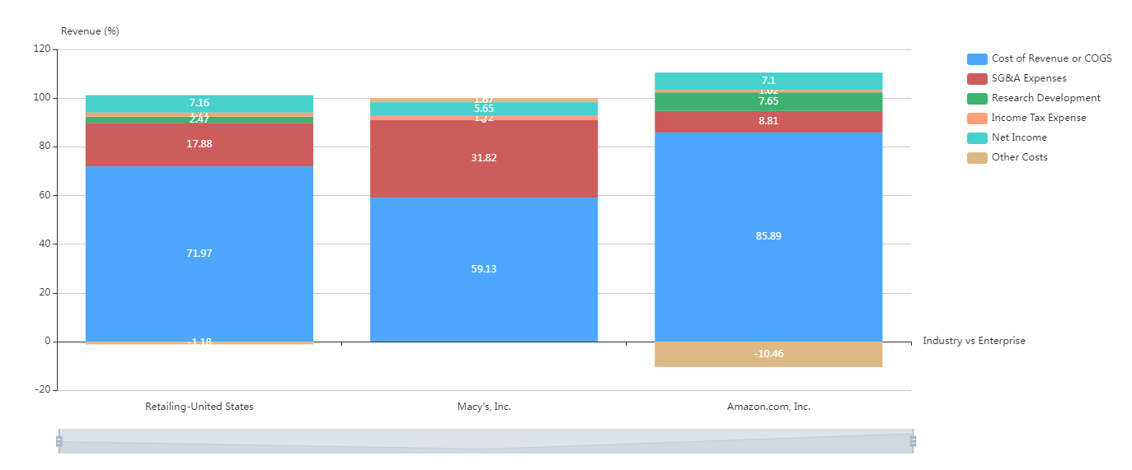
Macy’s high pricing & high SG&A vs. Amazon low pricing & low SG&A.
For an item cost $100, the sale price is $169 (Macy’s), $116 (Amazon).
US Retailing – Revenue Breakdown 2021
Data source: https://www.scdata.ai/project/30268
Notes:
We can use revenue breakdown to understand their pricing and cost structure. For US retailing, average COGS is 72% of revenue, SGA cost 17%. Macy’s is one extreme, much lower COGS (high pricing), and much higher SGA (operating cost). Amazon is the opposite extreme, much higher COGS (lower pricing), and much lower SGA cost. For an item cost $100, an average retail price is $139, the retail price of Macy’s is $169, and the retail price of Amazon is $116.

Slide 39
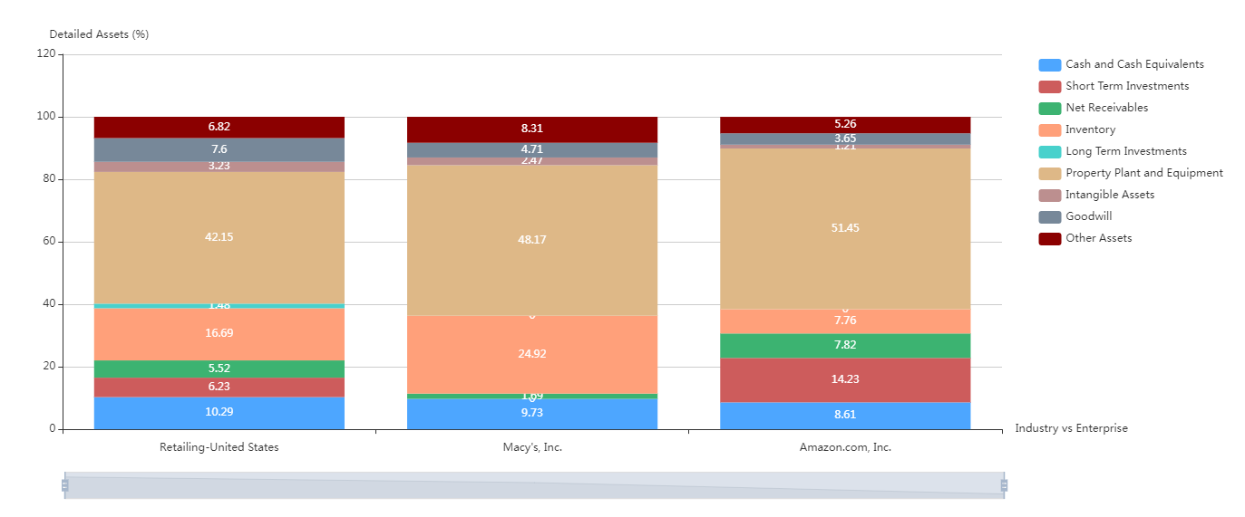
Industry average 16.7%, Macy’s 24.9%, Amazon 7.8%.
Macy’s clearly has an inventory problem!
US Retailing – Asset Breakdown 2021
Data source: https://www.scdata.ai/project/30268
Notes:
The breakdown of total assets shows where the problem lies, US retailing average 17% assets in inventory, Macy’s 25%, AMZN 8%. Macy’s clearly has an inventory problem, amazon, on the other hand, is performing quite well on inventory mgmt.

Slide 40
Summary
Amazon
Low pricing
High profit
Low SG&A cost
Low inventory & cash cycle
Macy’s
High pricing
Low profit
High SG&A cost
High inventory & cash cycle
Macy’s needs to improve inventory and reduce SG&A cost.
Notes:
Inventory is an important driver, it may affect SG&A for US retail.

Slide 41
Recap
Knowing the problem
Finding the solution
Notes:
Let me conclude with Jobs quote again, …, I hope you see the value of data-driven problem discovery in operations and SCM, and the huge un-charted market for such skills. Any questions?

