Slide 1
Competitive Intelligence & Benchmarking discover problems and opportunities for companies
Yao Zhao
Professor @ Rutgers Business School
Co-director @ Rutgers Supply Chain Analytics Lab
https://yzhao12345.github.io/
Instructors are free to use and modify the content of these slides
Notes:
Hello everyone, welcome to the webinar of teaching SCA, from problem solving to problem discovery. Today we will talk about competitive intelligence and benchmarking, to discover problems and opportunities for companies, much like a management consultant.

Slide 2

Notes:
Let me start with an ancient proverb by Sun Tzu, “If you know yourself and your opponents, you can win hundreds of battles without a single loss.” Although he was talking about wars, this statement highlights the value of competitive intelligence which is also the key to success in business.

Slide 3
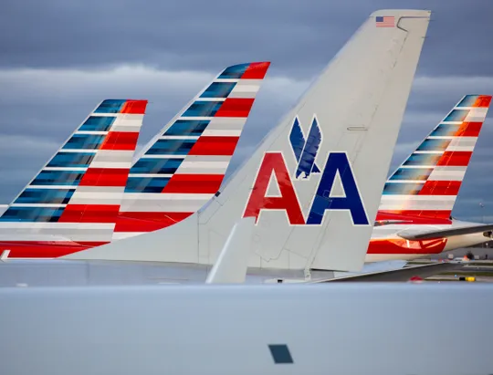
American Airlines
The world's largest airline by fleet size, revenue, passengers carried, passenger-kilometers flown, and number of destinations served.
In 2019, it operates almost 6,800 flights per day to nearly 350 destinations in more than 50 countries.
Best North American Airline 2019 by Business Traveler Asia-Pacific.
Notes:
Competitive intelligence and its impact can be best illustrated by an example, American Airlines and the US airlines industry. American airlines is one of the world’s largest airlines by fleet size, revenue, passengers carried, passenger-kilometers flown, and # of destinations. In 2019 (before COVID), it operates almost 6,800 flights per day to nearly 350 destinations in more than 50 countries. It was also awarded the best north American airline 2019 by business traveler asic-pacific.

Slide 4
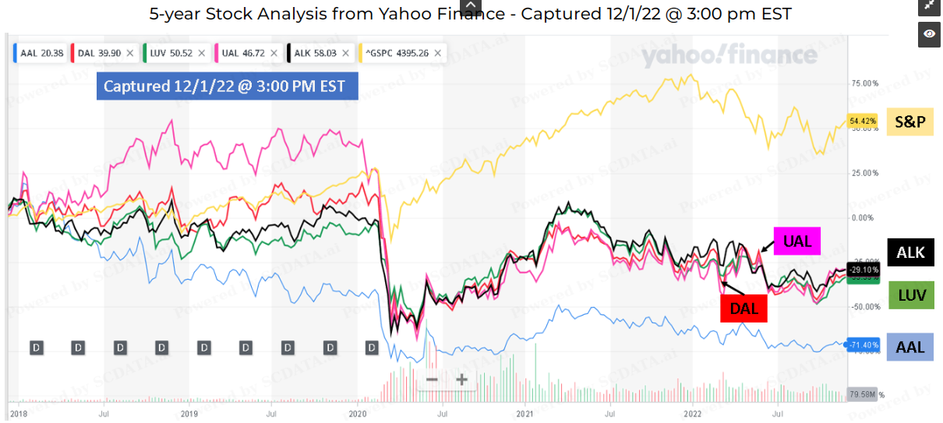
Comparison 2007-2019
Southwest
Delta
United
SP500
American Airlines
AAL is clearly in trouble! Problems? Causes? Opportunities?
Notes:
Despite its size and awards, AAL’s stock price is far below expectation. The 5-year stock price chart shows that all the airlines are not doing well in the stock market due to COVID in comparison to the SP500 index, but AAL is clearly performing the worst as compared to its major competitors, United, Delta and Southwest, actually it is far below everyone else. Clearly, AAL is in trouble just by looking at the stock price. What are AAL’s problems, causes and opportunities? And how to turn the company and its stock price around?

Slide 5
Competitive Intelligence & Benchmarking
Discovering problems & opportunities via data analysis.
  Industry analysis (industry trend, competition intensity, value chain analysis) to assess industry potential and risk.
  Competition positioning (profit frontier, enterprise ranking, KPI examination) to position a company in the competitive landscape.
  Enterprise diagnosis (strengths & weaknesses, value driver analysis, breakdown analysis) to discover problems and diagnose causes.
Notes:
Competitive intelligence & benchmarking can provide the insights necessary to discover the problems and opportunities, which includes three phases. First, Industry analysis (industry trend, competition intensity, value chain analysis) to assess industry potential and risk. * Second, competition positioning (profit frontier, enterprise ranking, KPI examination) to position a company in the competitive landscape. Finally, Enterprise diagnosis (strengths & weaknesses, value driver analysis, breakdown analysis) to discover problems and diagnose causes.

Slide 6
Questions Answered
What are the market potential, risk and trend?
What are the most valuable segment(s) in the supply chain?
Where do I stand in the competitive landscape?
What are my strengths and weaknesses relative to my competitors?
What factor(s) may drive a company’s financial performance in my industry?
What are my key problems and the causes?
…
Notes:
The analysis can help us answer these questions: …

Slide 7
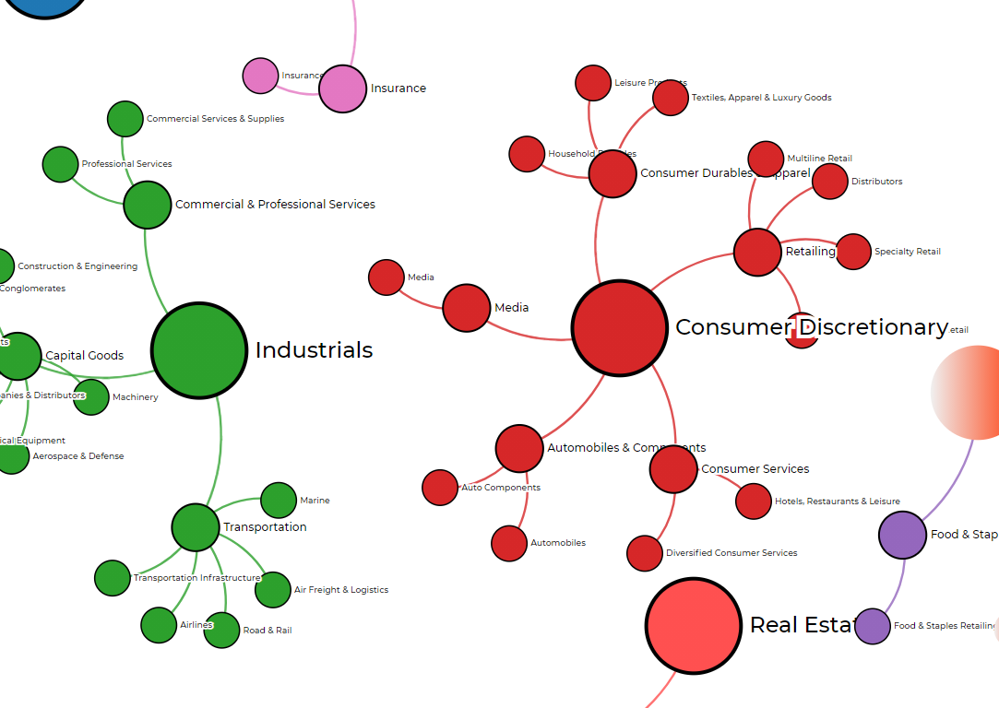
Industry Classification
Company grouping by similar products / services, similar customers / suppliers.
Government agencies: track economic conditions.
Securities analysts: construct portfolios.
Consultants / analysts: discover problems, diagnose causes.
Notes:
Industry classification is the foundation of competitive intelligence. One feedback received in the past two webinars is that companies are so different, that it is hard to compare them apple to apple. To which I completely agree. That is the reason behind industry classification which attempts to group companies to make them as comparable as could be. The industry classifications are far from perfect, but they are better than nothing because they can group companies not only by similar products and services, but also by similar customers and suppliers. That is, similar positions in the supply chain. So they are widely used by government agencies to track economic conditions, by securities analysts to construct portfolios, and by business consultants and analysts to discover problems and diagnose causes.

Slide 8

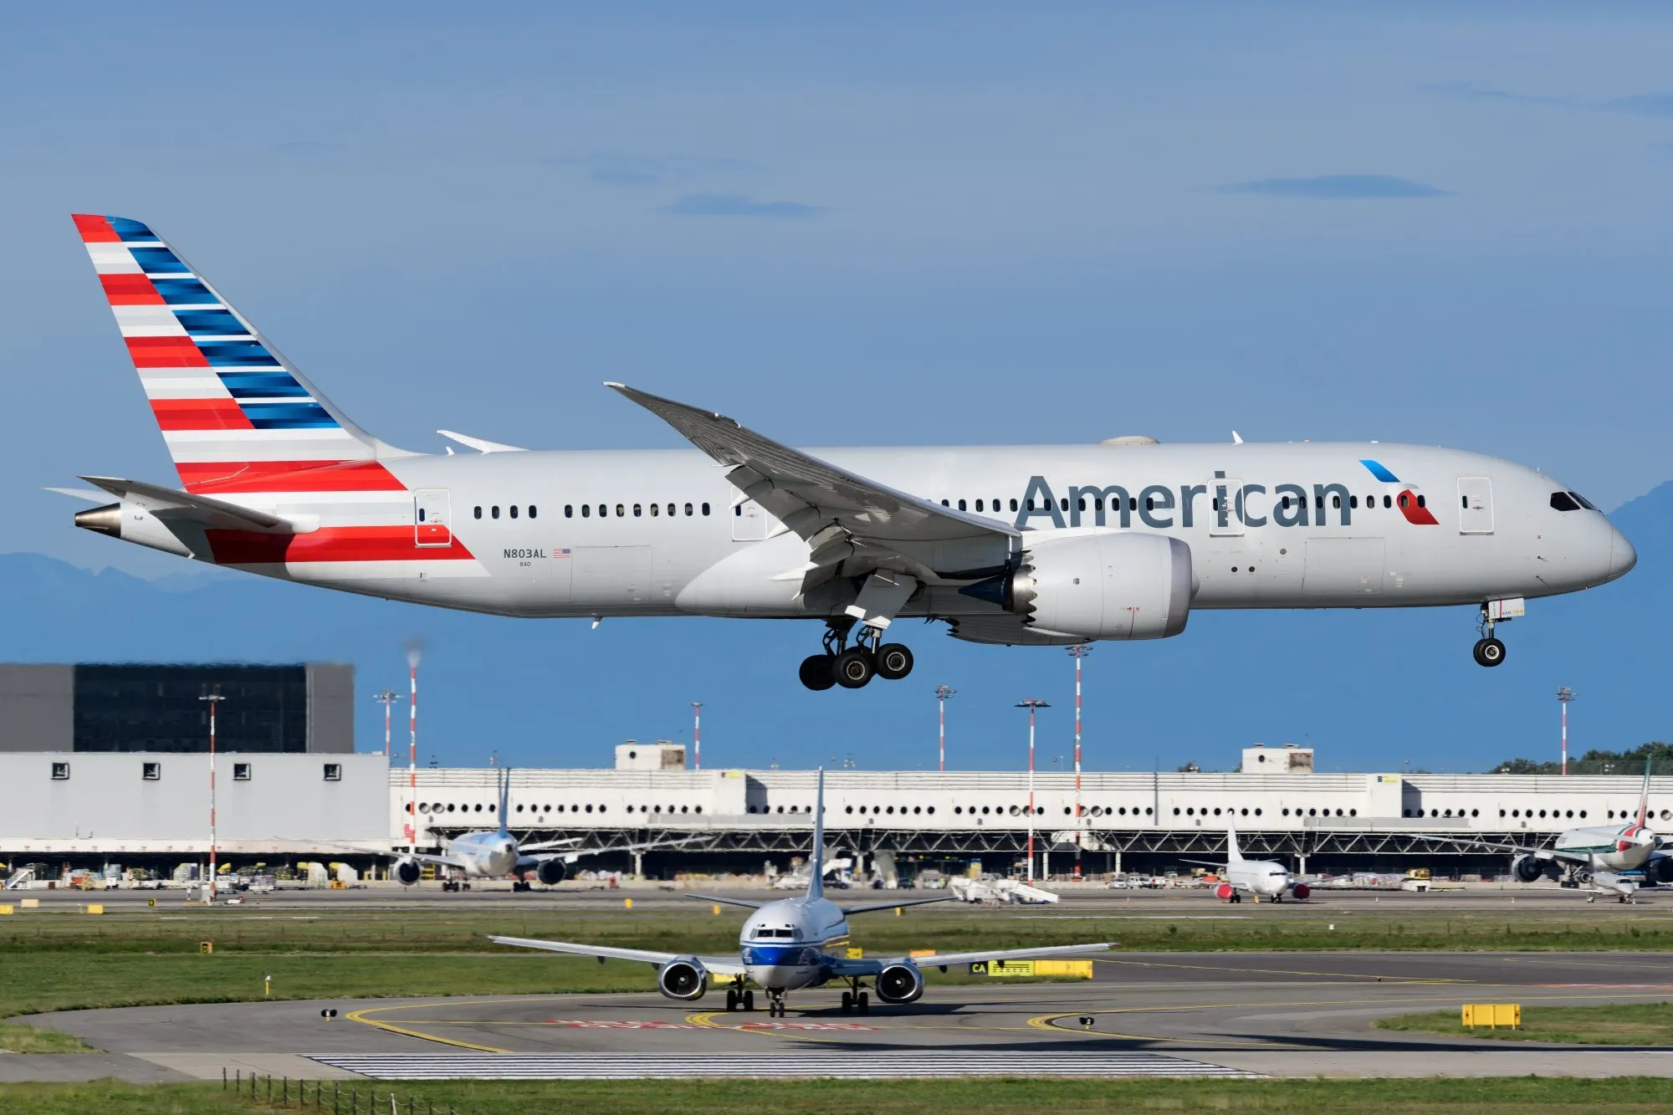
Airlines, Air-Freight & Airport Services
Compare Apple to Apple
Airlines vs. Air Freight vs. Airports
Notes:
As an example, let’s look at the air transportation industry. Although airlines, airfreight and airports are all a part of this industry, their customers / suppliers are quite different. In fact, airlines are often the customers of airports. Thus, comparing an airline to another airline makes sense but to an airport is quite pointless.

Slide 9
I Industry analysis: Trend
The potential and risk of the industry? Sun-rise or sun-set?
Economic or environmental drivers?
Notes:
Let us first talk about industry analysis, the trend, to answer questions such as what are the potentials and risk of the industry? Is it a sun-rise industry or a sun-set industry? You don’t want to stay in a sun-set, right? What economic or environmental factors may impact the industry as a whole?

Slide 10
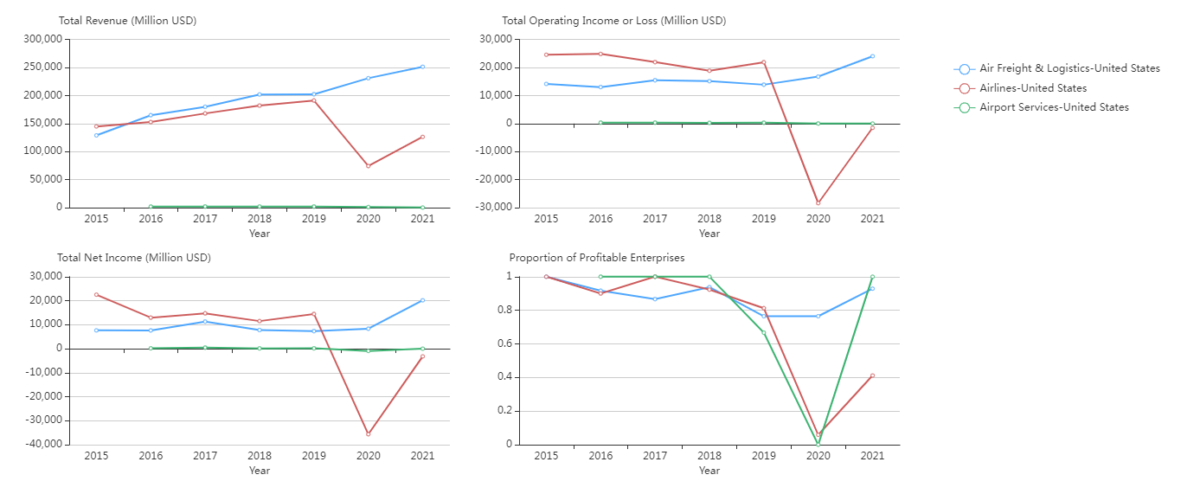
Air-freight > Airlines >> Airport services
Air-freight continued growing, airlines plummeted in COVID
All airlines & Airports lost money during COVID. But they bounced back in 2021
Industrial Trend Analysis – Size. US
Data source: https://www.scdata.ai/project/30322
Notes:
* From the trend analysis on the industry total size for the US, we can see that air freight and airlines are much bigger than airport services and they were constantly growing until 2020 when air freight accelerated its growth, but airlines plummeted in both revenue and profits due to COVID19. * In fact, almost all airlines and airports lost money in that year. However, both airlines and airport services industries bounced back in 2021.

Slide 11
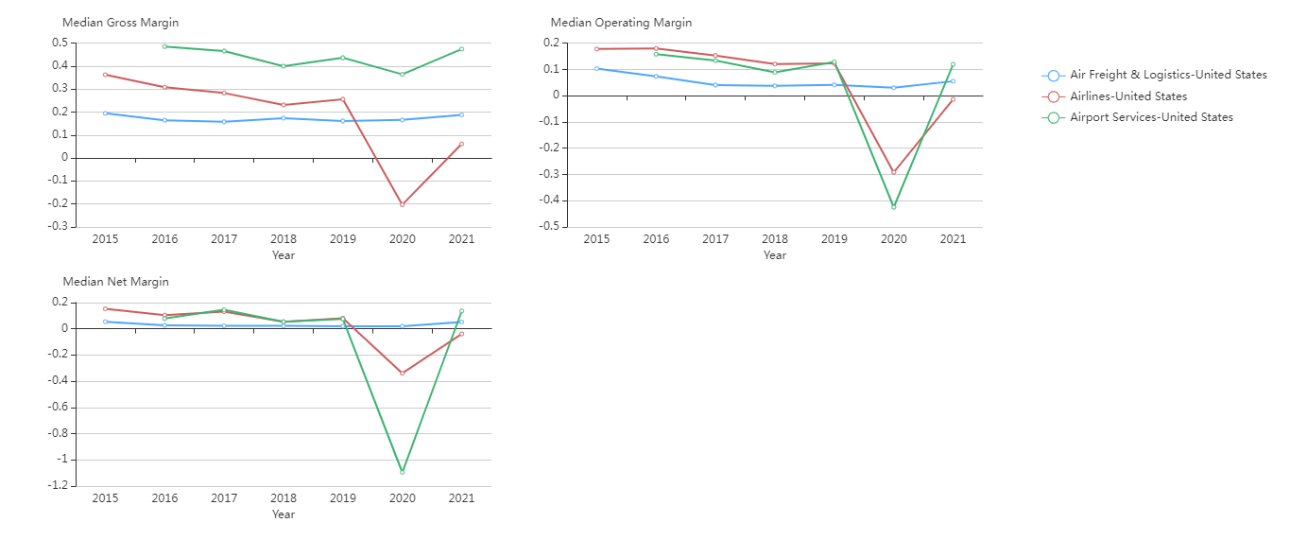
Airport services has the highest gross / net margins except in COVID.
Airlines are more profitable than Air-freight until 2020, COVID.
COVID is detrimental to airlines and airports, but air-freight is not affected.
Industrial Trend Analysis – Profitability. USA
Data source: https://www.scdata.ai/project/30322
Notes:
* The industry trend analysis on profitability confirms our observations and further shows that airport services, although quite small, has the highest gross margin and net margin except during COVID. * Airlines had higher margins than air-freight until 2020 because passengers fly round trips but goods fly only one way. * COVID19 is detrimental to both airlines and airports, but air freight is not affected.

Slide 12
I Industry analysis: competition intensity
Monopolized or competitive market?
Can small companies survive and thrive in this industry?
Notes:
Now let’s look at industry analysis of competition intensity to answer questions such as is this a monopolized or competitive market? Can small companies survive and thrive in this industry?

Slide 13
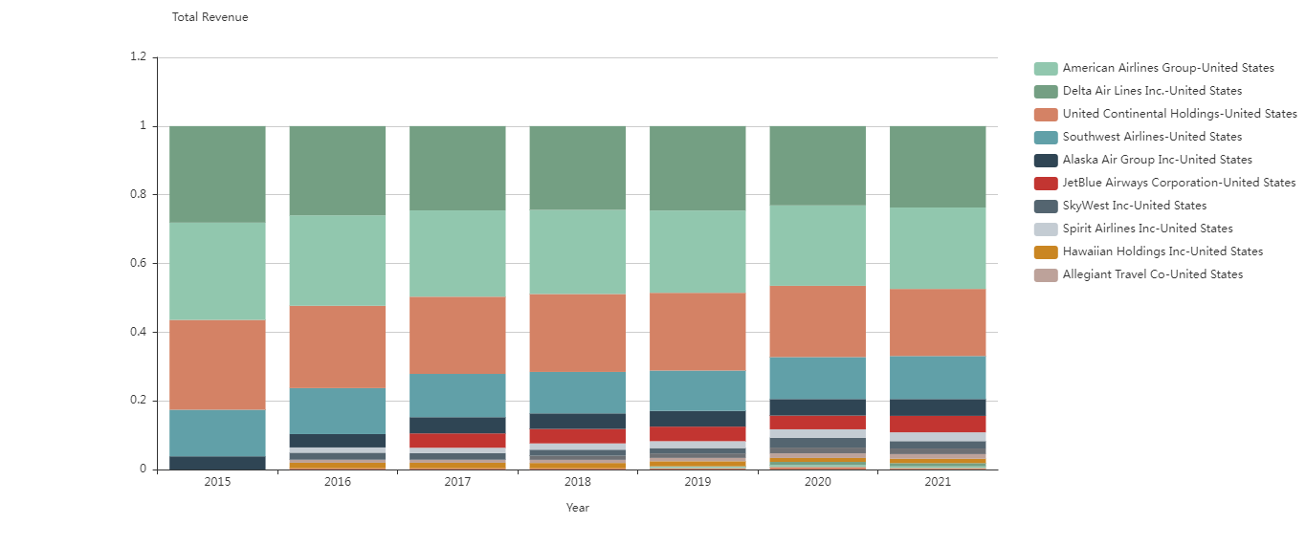
Concentration & competition Intensity, Airlines, USA, 2021
US airlines industry is quite concentrated by a few large companies. COVID seems to make the industry less concentrated.
Data source: https://www.scdata.ai/project/30322
Notes:
The US airlines industry is quite concentrated by a few large companies, such as AAL, Delta, united and southwest, …, with the largest four airlines making up nearly 80% of the industry’s total revenue. However, the industry is becoming less concentrated in the past two years during COVID.

Slide 14
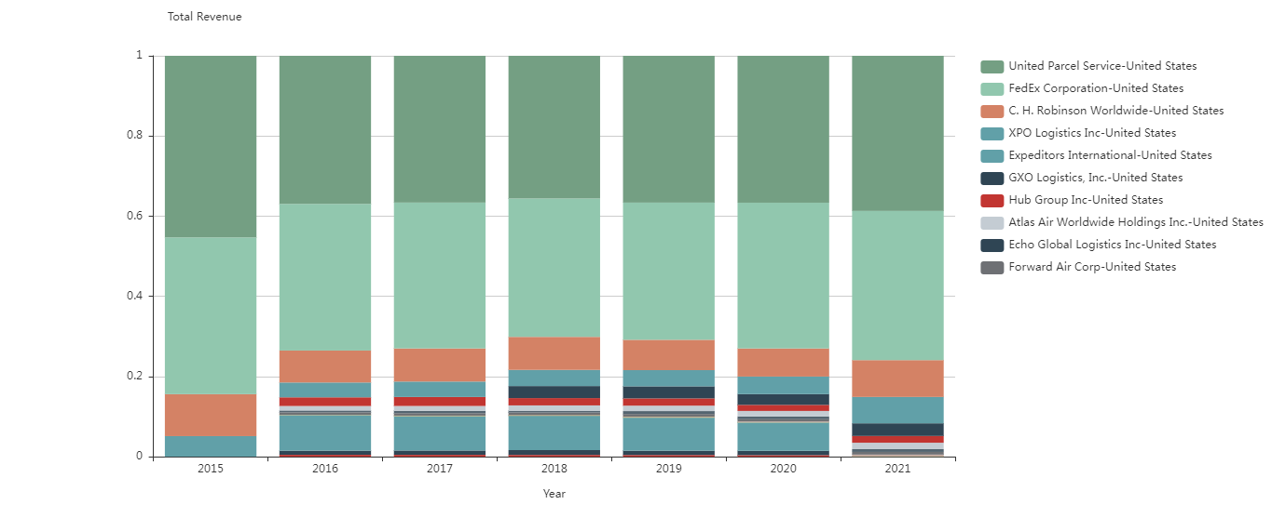
Concentration & competition Intensity, Air-freight, USA, 2021
US air-freight industry is more concentrated than airlines. COVID seems to make the industry more concentrated.
Data source: https://www.scdata.ai/project/30322
Notes:
The US air freight industry was more concentrated than airlines with top four companies taking nearly 90% of the industry revenue. And Indeed, COVID seems to make this industry more concentrated. We can also find that airport services industry is the most concentrated industry of the three (not shown here), which is easy to understand because there is limited # of airports in each city, and each is a local monopoly. In summary, air transportation related industries are quite concentrated, small companies may find it hard to survive and thrive.

Slide 15
I Industry analysis: Value chain
The most valuable segments of my supply chain?
Should we expand our business upstream or downstream?
Notes:
As the last step of the industry analysis, we shall analyze the value chain to answer questions such as what is the most valuable segments of my supply chain? Should we stay on our core business or expand our business upstream or downstream?

Slide 16
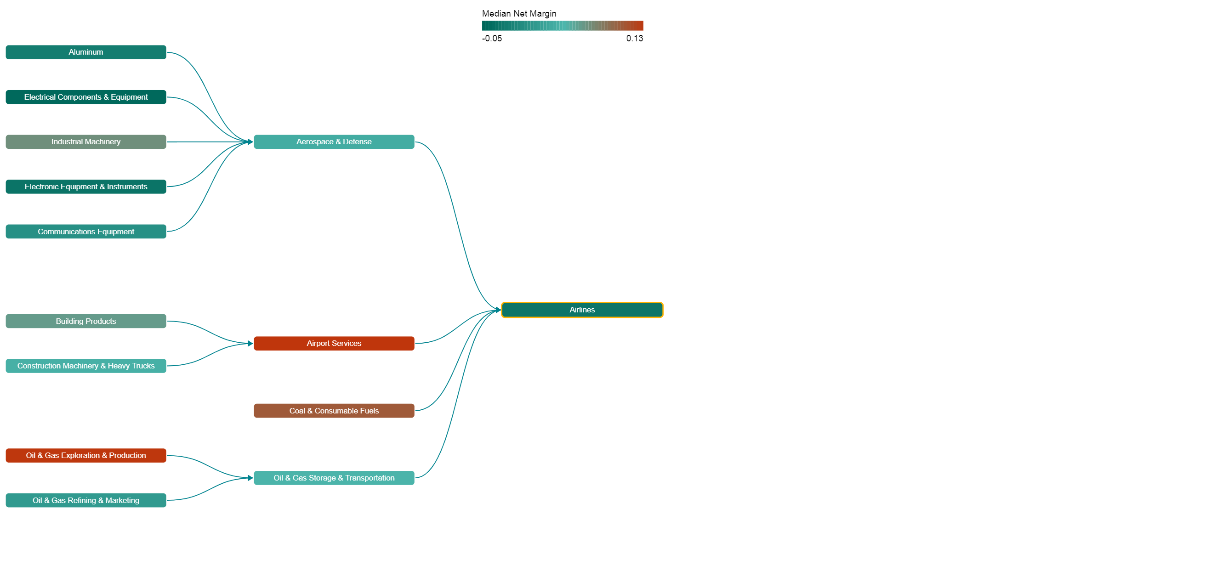
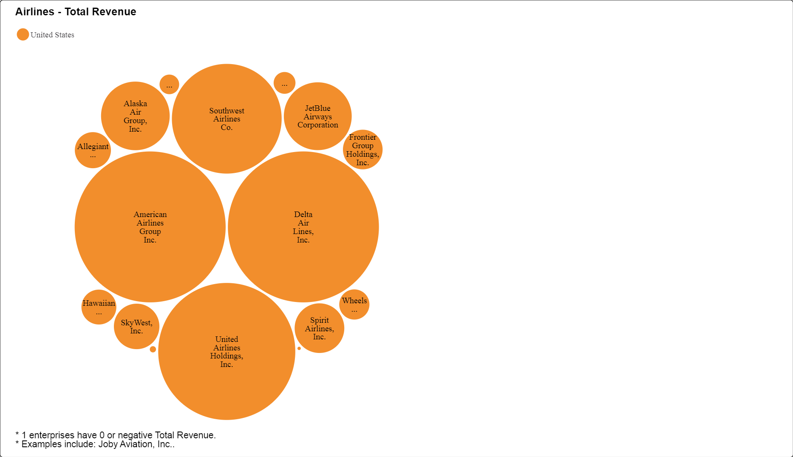
Median Net Margin: 0.13
Median Net Margin: -0.04
Median Net Margin: 0.13
US Airlines Supply Chain 2021
US Airlines 2021
Data source: https://www.scdata.ai/project/30322
Notes:
The airlines supply chain consists of airlines, airport services, aerospace & defense, oil & gas supplies and so on. A supply chain mapping provides a snapshot of the most profitable segments along this supply chain. Airport services, and oil & gas exploration and production are most profitable segments with a median net margin of 13% in 2021, while airlines is the least profitable segment with a median net margin of -4%.

Slide 17
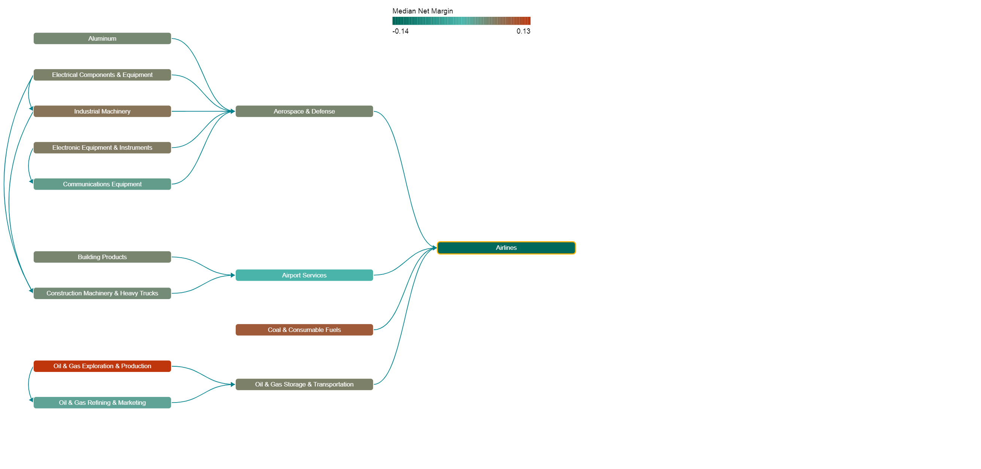
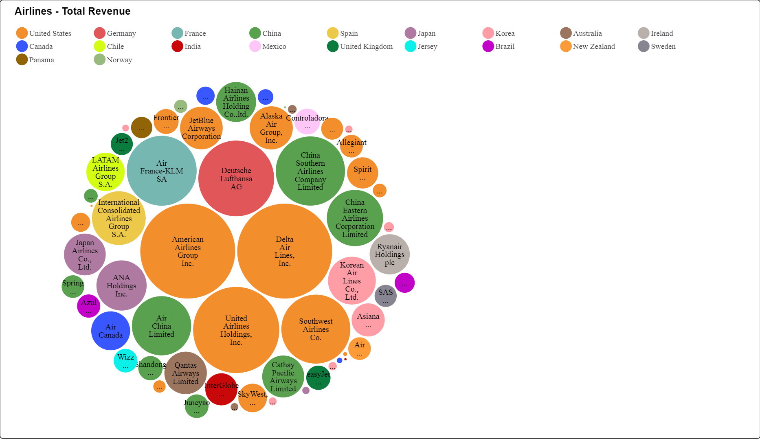
Median Net Margin: -0.01
Median Net Margin: -0.14
Median Net Margin: 0.13
World Airlines Supply Chain 2021
World Major Airlines 2021
Data source: https://www.scdata.ai/project/30322
Notes:
On a global scale, oil & gas exploration and production is also the most profitable segment while airlines are least profitable. In both cases, airport services outperformed airlines in profitability partially due to a more concentrated and less competitive market. So how should an airlines expand its business? An airline may expand its business to airport services. Airlines and airfreight companies may join hands to achieve a better balance over risk and profitability.

Slide 18
II Competition Positioning: Profit frontier
The most profitable and competitive companies in this industry?
Where do I stand in the competitive landscape?
Notes:
Now let’s move on to phase II competition positioning and specifically profit frontier, to answer questions such as what are the most profitable and competitive companies in my industry? And where do I stand in the competitive landscape?

Slide 19
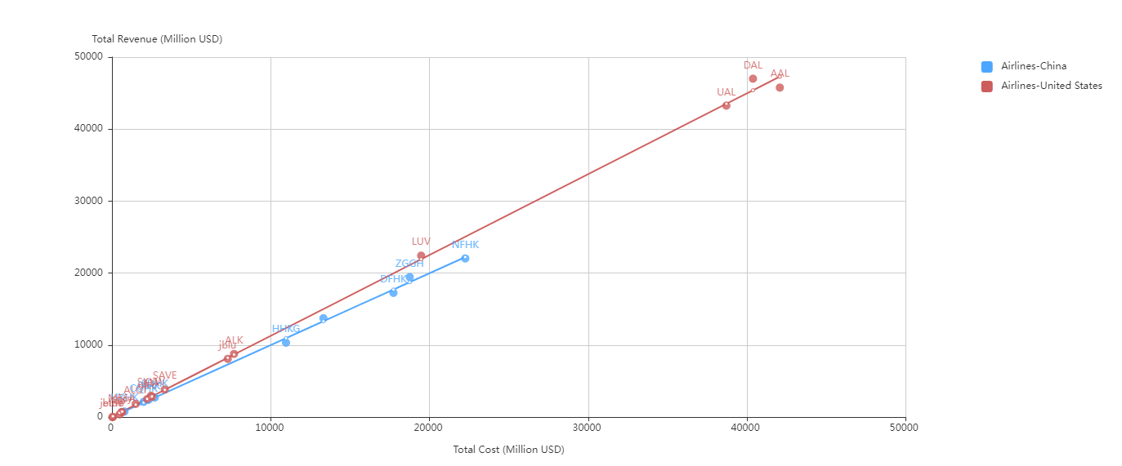
Southwest is much smaller.
DAL made more revenue than AAL with less cost.
Total revenue vs. total cost, Airlines, USA and China, 2019 (pre-COVID)
Data source: https://www.scdata.ai/project/30322
Notes:
Let’s first look at revenue vs cost for US airlines in reporting year 2019 pre-COVID. As we can see, AAL is one of the largest three US airlines, and Delta (DAL) made a higher revenue than AAL with less total cost. Southwest (LUV) is smaller in size. As a comparison, the Chinese airlines are much smaller and they were making less revenue with the same cost.

Slide 20
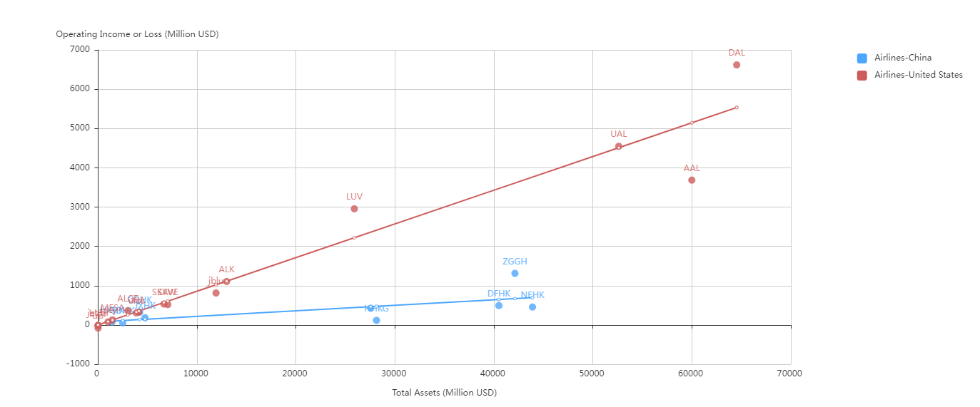
LUV made almost the same operating income with half of AAL’s assets.
DAL and UAL made higher profits than AAL with ~ same assets.
Operating income or loss vs. total assets, Airlines, USA and China, 2019
Data source: https://www.scdata.ai/project/30322
Notes:
The operating income vs total assets analysis shows how efficiently these airlines utilize their assets to make money. AAL has the lowest operating income in comparison to DAL and UAL with about the same assets. UAL achieved a higher operating income with less assets than AAL. LUV has less than half of AAL’s assets but achieved an operating income only slightly lower than AAL. In comparison, the Chinese airlines (in blue) were much less efficient in utilizing their assets.

Slide 21
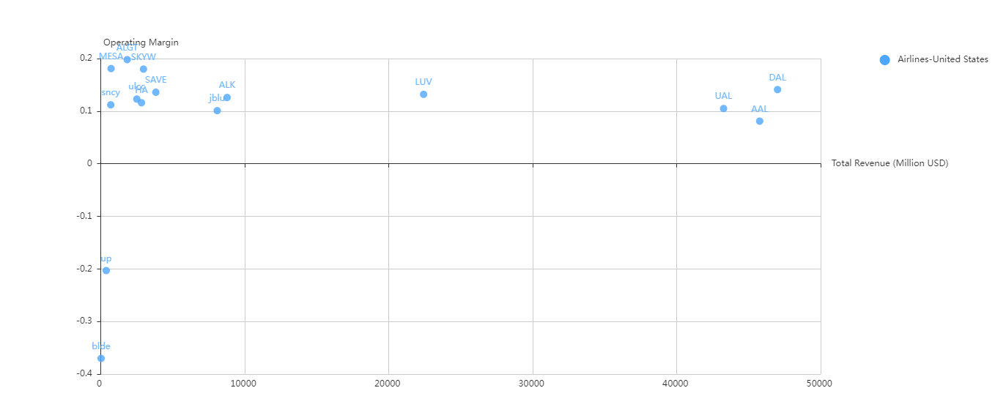
On Profit frontier
On Profit frontier
Profit frontier
Below Profit frontier
Operating margin vs. total revenue, Airlines, USA, 2019
Data source: https://www.scdata.ai/project/30322
Notes:
The operating margin vs. total revenue analysis identifies the profit frontier for the US airlines. Typically, you will observe a declining operating margin as the revenue increases because revenue is the denominator of operating margin. We can see that Southwest (LUV) is on the profit frontier, indicating its competitiveness. Delta (DAL) is also on the profit frontier but American (AAL) is below it. In fact, AAL is the worst performer among its peers: DAL and UA.

Slide 22
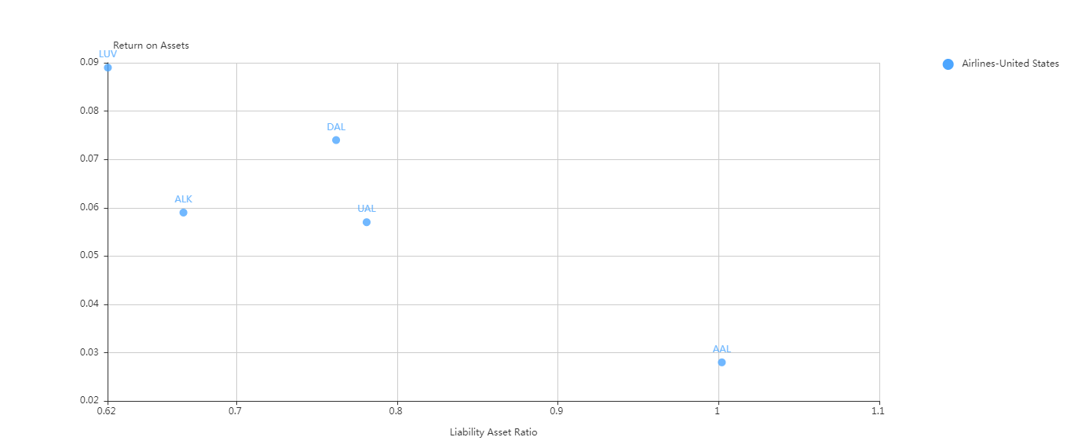
LUV: least liability / Asset ratio,
highest ROA
DAL ~ UAL on liability / Asset ratio,
DAL higher ROA
AAL’s liability > Assets,
Lowest ROA
Return on Assets vs. liability asset ratio, SP500 Airlines, USA, 2019
Data source: https://www.scdata.ai/project/30322
Notes:
The return vs. risk analysis of the US airlines shows: (1) AAL’s liability asset ratio is above 1, which means that the company’s liability is greater than its assets in 2019, AAL has the lowest ROA among these US airlines. (2) Southwest (LUV) has the least liability asset ratio but the highest ROA. (3) DAL and UAL had about the same liability asset ratio, but DAL’s ROA is higher. In plain words, AAL performed the worst on both ROA and risk, and LUV is the best, while DAL and UAL are in between.

Slide 23
II Competition Positioning: ranking & KPI examination
Where is the company ranked relative to its competitors?
Do I have any abnormalities or potential issues undetected?
Notes:
Now let’s look at competition positioning ranking and KPI examination to see where the company is ranked relative to its competitors? and
Whether the company has any abnormalities or potential issues undetected?

Slide 24
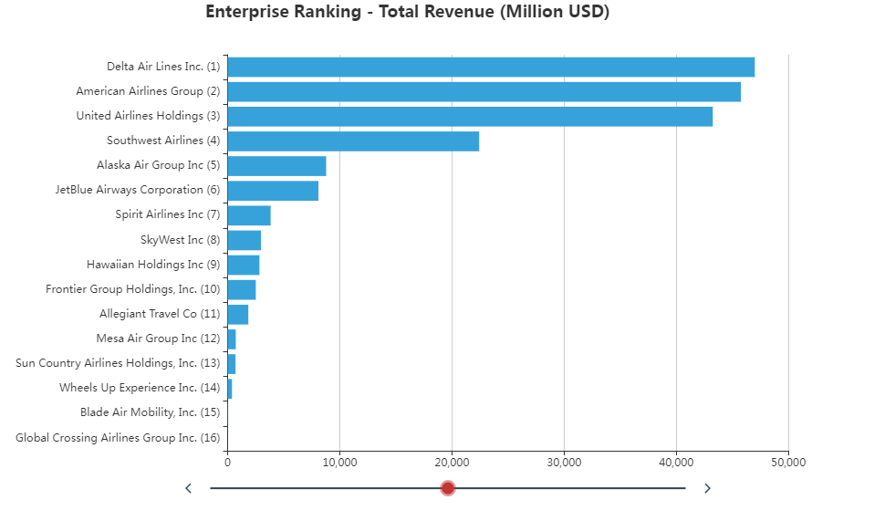
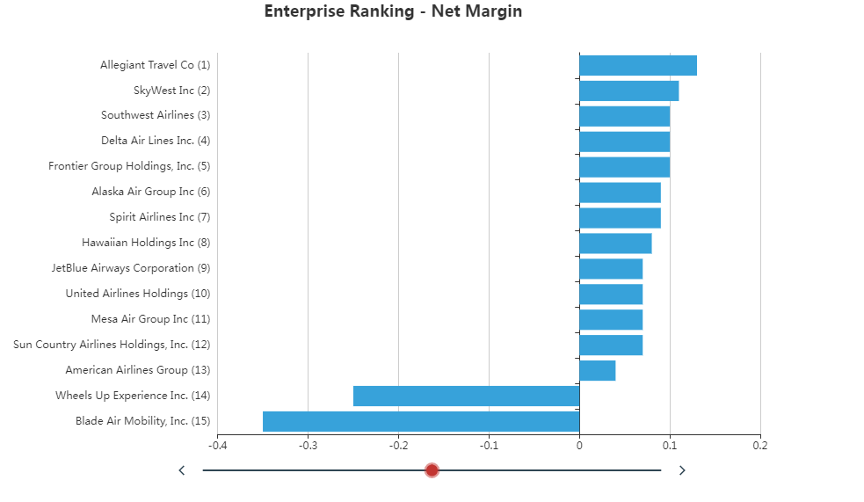
Multiple Rankings, US Airlines, 2019
AAL: One of the largest but least profitable airlines in the US.
Data source: https://www.scdata.ai/project/30322
Notes:
Multiple rankings, when combined together, can provide insightful information on the performance of the company. For instance, the enterprise ranking of US airlines on total revenue shows that AAL is the second largest airline, but the enterprise ranking on net margin shows that AAL is one of the least profitable airlines in the US, barely broke even.

Slide 25
KPI Examination of An Enterprise
KPI examination
  Profitability
  Growth
  Financial Health
  Efficiency
Physical examination of a person
KPI examination of an enterprise
Notes:
Similar to the physical examination of a person, let’s perform an KPI Examination of an Enterprise, which provides a comprehensive assessment of the company’s performance in profitability, growth, financial health and efficiency relative to its peers.

Slide 26


Objective
Detect abnormalities.
Signal alarms for potential issues.
Notes:
Much like the comprehensive health check of a person, the objective of KPI examination of an enterprise is to detect abnormalities and signal alarms for potential issues.

Slide 27
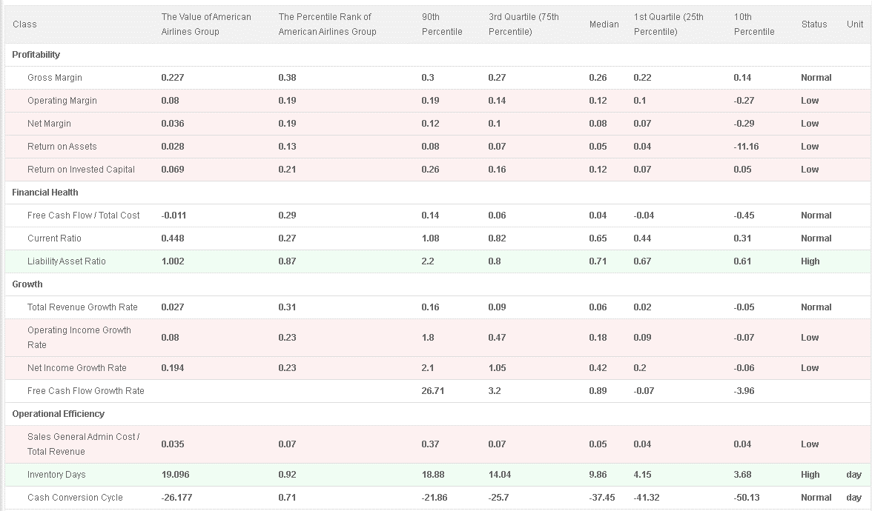
Low
High
Low
Mixed
KPI examination of AAL in the US airlines industry, 2019
Data source: https://www.scdata.ai/project/30322
Notes:
Here the company is AAL, and the population is all US airlines. The KPI examination of AAL relative to the US airlines industry sounds quite many alarms for AAL. The red boxes refer to the KPIs for which the percentile rank of AAL is either below 25% (low) or above 75% (high). For profitability, despite its normal gross margin, AAL’s operating margin, net margin, and ROAs are low in the industry, implying the low profitability. For financial health, AAL has a high liability asset ratio which is above one, indicating its inability to pay long-term debts, and thus poor health. Regarding growth, except for a normal total revenue growth, the growth rates in operating income and net income are low, implying slow growth among its peers. For operational efficiency, AAL has a fine operating cost over revenue ratio, but its inventory days is high, indicating a mixed operating efficiency.

Slide 28
III Enterprise diagnosis: strength & weakness
What are my strengths and weaknesses relative to my competitors?
Notes:
Competition positioning already reveals many problems for AAL. To see such problems more clearly, let’s use phase III enterprise diagnosis to compare these companies side-by-side, to answer the question of what are my strengths and weaknesses relative to my competitors?

Slide 29
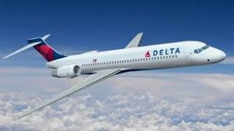
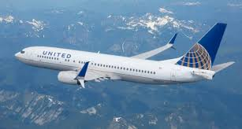

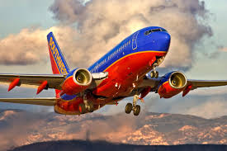
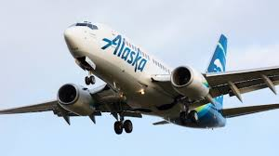
AAL and Competitors
Notes:
We shall compare AAL to DAL, UAL, Southwest and Alaska airlines.

Slide 30
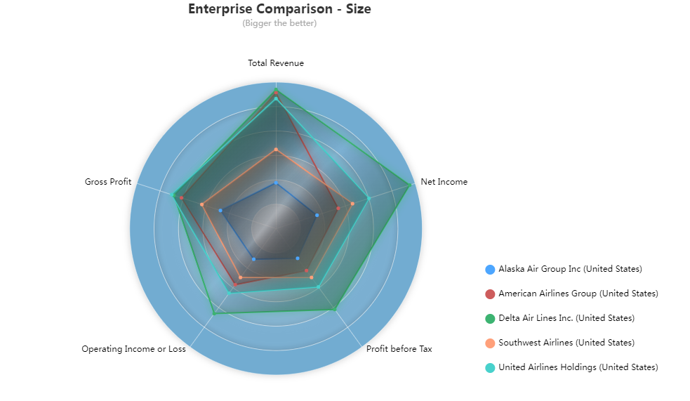
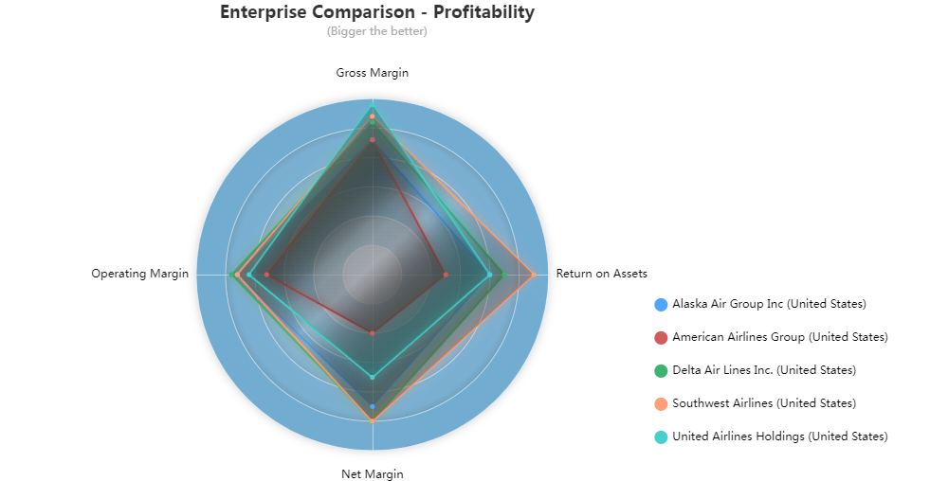
Enterprise Comparison, US Airlines, 2019
AAL has DAL’s revenue but Alaska Air’s profit
AAL has the smallest margins & returns – explained its stock prices
Data source: https://www.scdata.ai/project/30322
Notes:
We first compare these companies by size. We can see that AAL (red) has the revenue and gross profit comparable to DAL and UAL, but profits only slightly larger than the smallest competitor, Alaska airlines. Comparing these airlines by profitability, we can see that AAL has the smallest margins and ROA – explained its stock market performance.

Slide 31
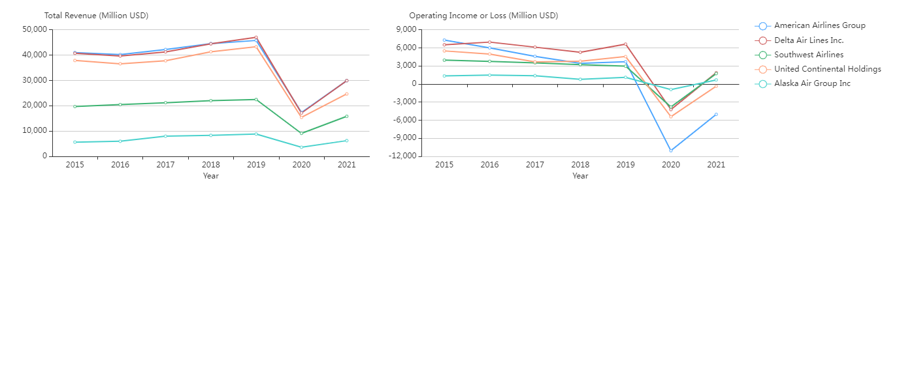
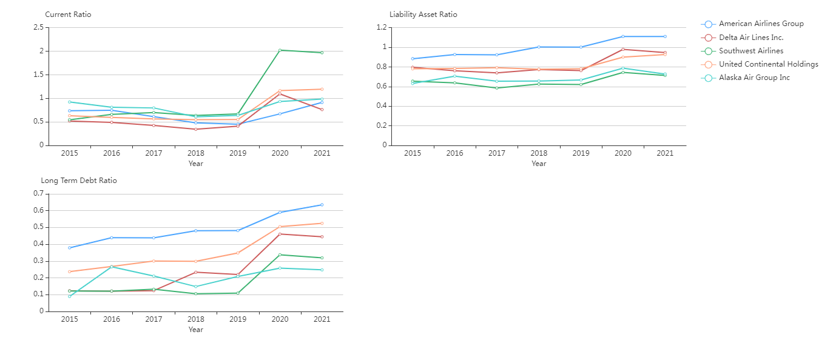
Increasing pre-COVID, plummeted during COVID, rebounded post-COVID.
AAL: decreasing operating income pre-COVID, sharpest decline during COVID, smallest rebound.
AAL has the worst long-term risk.
Southwest has the best short-term financial health.
Data source: https://www.scdata.ai/project/30322
Notes:
The trend analysis expands our insights over time. An enterprise trend analysis on size shows that over time, the total revenues of these airlines kept increasing until the pandemic, then plummeted during the pandemic, finally bounced back post-pandemic. The operating incomes of these airlines were stable before pandemic except AAL which was declining, and AAL (in blue) had the sharpest decline during COVID and the smallest rebound.
The enterprise trend analysis on financial health shows that Southwest has the best short-term financial health, and AAL has the worst long-term risk.

Slide 32
Value driver & Breakdown analysis
What factor(s) may drive companies’ financial performance in my industry?
What are the key problems and their causes?
Notes:
To conclude our analysis, we will use value driver analysis and breakdown analysis to find out the factor(s) that may drive companies’ financial performance in this industry? And of course, the key problems and their causes for AAL.

Slide 33
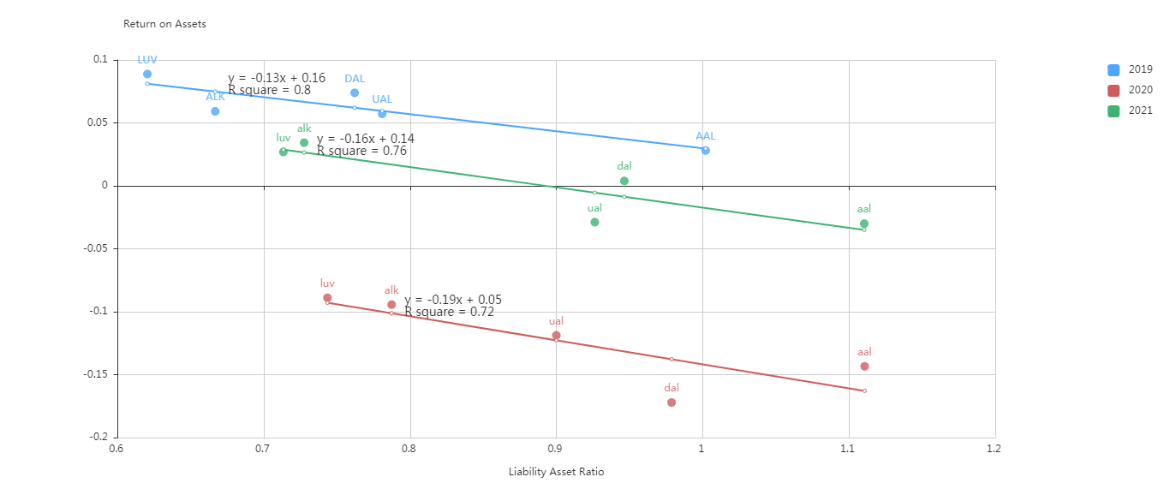
Strong negative correlation between ROA and Liability Asset Ratio
➔ A higher liability asset ratio may lead to a lower ROA.
Return on Assets vs. Liability Asset Ratio, US Airlines SP500.
Data source: https://www.scdata.ai/project/30322
Notes:
Analyzing the US airline industry 2019-2021, we found a strong negative correlation between ROA and Liability Asset Ratio, that is, a higher liability asset ratio may lead to a lower ROA. Thus Liability Asset Ratio can be an important factor that drives an airline’s financial performance, that is, the more liabilities an airline carries, the more likely it will incur lower ROA.

Slide 34
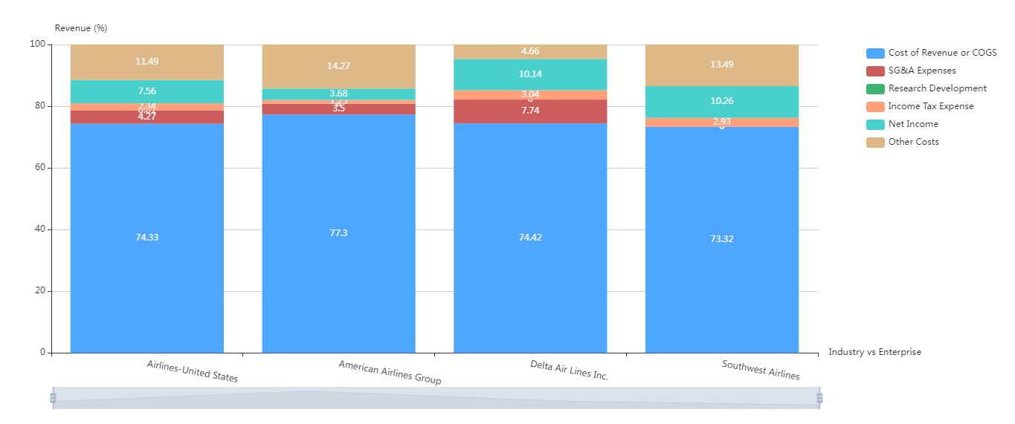
AAL: High COGS, high other costs.
DAL: Avrg COGS, low other costs.
LUV: Low COGS & SGA, high other costs.
Revenue breakdown pre-COVID, US Airlines 2019
Data source: https://www.scdata.ai/project/30322
Notes:
The breakdown analysis can pinpoint to the problems and causes. The revenue breakdown of American Airlines in 2019 together with the US airline industry and Delta (DAL) and Southwest (LUV) shows that American Airlines’ COGS are higher than the industry average; AAL is also higher in Other Costs (interest on loans for equipment, government subsidies, etc.) compared to Delta and Southwest. Delta Airlines’ COGS is the same as the industry average but it is low on Other Costs. Southwest has a lower than the industry average COGS and SG&A cost but a high Other Costs. As a result, Southwest and Delta have a higher net income than the industry average and American Airlines

Slide 35
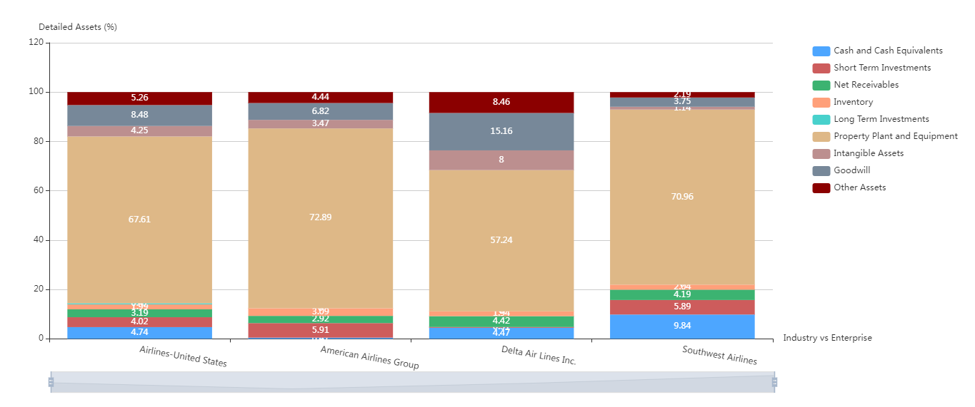
AAL: Heavy PPE (low utilization, high other costs), $
DAL: Light PPE (high utilization, low other costs), $$
LUV: High PPE (high other costs), $$$
Assets breakdown pre-COVID, US Airlines 2019
Data source: https://www.scdata.ai/project/30322
Notes:
The asset breakdown shows the causes for the high other costs. First, Delta Air Lines is much lighter on PPE, property, plants & equipment, than other airlines, explaining its small Other Costs. Recalling DAL generated the highest revenue in 2019, thus Delta stood out by having the best asset utilization. Second, southwest has high PPE which implies its high other costs. However, Southwest stood out by tightly controlling its COGS and SG&A costs. Finally. AAL has the highest PPE, implies its high other cost. Given its lower revenue than DAL, thus AAL’s asset utilization is much less efficient than DAL. Together with AAL’s high COGS (as we saw in previous slide), now we find the causes for AAL’s poor financial performance.

Slide 36

Summary on American Airlines (AAL)
AAL: Large in size but weak in profitability, growth, financial health.
The stock prices told the truth.
AAL needs to improve assets utilization (reduce PPE & liabilities → reduced other costs), reduce COGS, …
Looks like a lion but is a cat
Notes:
In summary, AAL looks like a lion, but actually it is a little cat. In another word, AAL is among the largest airline in size but weakest in profitability, growth and financial health. AAL’s stock prices told the truth. AAL has the potential to turn the company and stock price around. The key to success is to improve assets utilization, by either better utilizing its assets or potentially selling unprofitable resources. Doing so can reduce Other Costs and improve financial health. AAL should also reduce its COGS which is higher than the industry average.

Slide 37
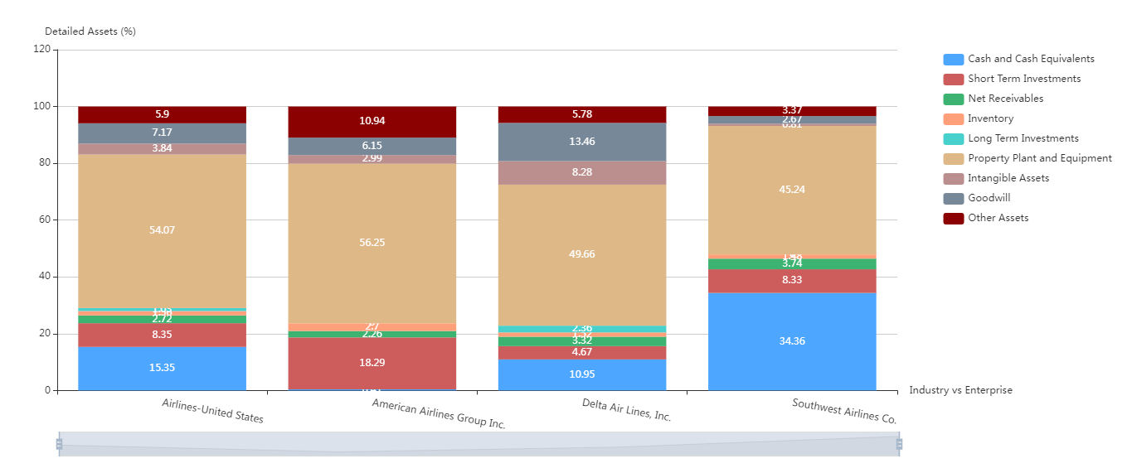
AAL: 73% → 56%
DAL: 57% → 50%
LUV: 71% →45%
Asset breakdown post-COVID, US Airlines 2021
Data source: https://www.scdata.ai/project/30322
Notes:
Post-COVID, we observed that AAL and the US airline industry were moving towards down-sizing PPEs as we suggested, for example, AAL reduced its PPEs from nearly 73% of its assets in 2019 to 56% in 2021. However, AAL still has much work to do to catch up with its competitors.

Slide 38

Recap
Define and discover problems, causes and opportunities.
Competitive intelligence and benchmarking
  Industry analysis
  Competition positioning
  Enterprise diagnosis
Notes:
To recap, competitive analysis and benchmarking is a powerful tool to define and discover problems, causes and opportunities. It consists of three phases each involves extensive data analysis, they are industry analysis, competition positioning and enterprise diagnosis.

Slide 39
Phases | Directions | Questions | Analysis
I: Industry Analysis | 1.1: Industry Trend Analysis | What are the trend, market potential, and risk of the industry? | Industry Trend Analysis
 | 1.2: Concentration and Competition Intensity | Is this a monopolized or competitive market? Can small companies survive and thrive in this industry? | Market Share Analysis, Four-Firm Concentration Ratio
 | 1.3: Value Chain Analysis | What are the most valuable segment(s) along the supply chain? Should we expand up or downstream? | Supply Chain Mapping, Industry Comparison
II: Competition Positioning | 2.1: Profit Frontier | Where does the company stand in the competitive landscape? | Operating Margin vs. Revenue, Return on Assets vs. Liability Asset Ratio, Operating Income vs. Total Cost or Total Assets
 | 2.2: Enterprise Ranking | Where is the company ranked relative to its competitors? | Enterprise Ranking
 | 2.3: KPI Examination | Do I have any abnormalities or potential issues undetected? | KPI Examination
III: Enterprise Diagnosis | 3.1: Strengths and Weaknesses | What are my strengths and weaknesses relative to my competitors? | Enterprise Comparison, Enterprise Trend Analysis
 | 3.2: Value Driver Analysis | What factor(s) may drive a company’s financial performance in my industry? | Value Driver Analysis
 | 3.3: Breakdown Analysis | What are my key problems and their causes? | Breakdown Analysis
Competitive intelligence for problem discovery
Notes:
For everyone’s convenience, I summarize competitive intelligence in this table, that tells management which directions to look, what questions to ask, and what analysis to do in each step, to identify the key challenges and opportunities for a company.

Slide 40
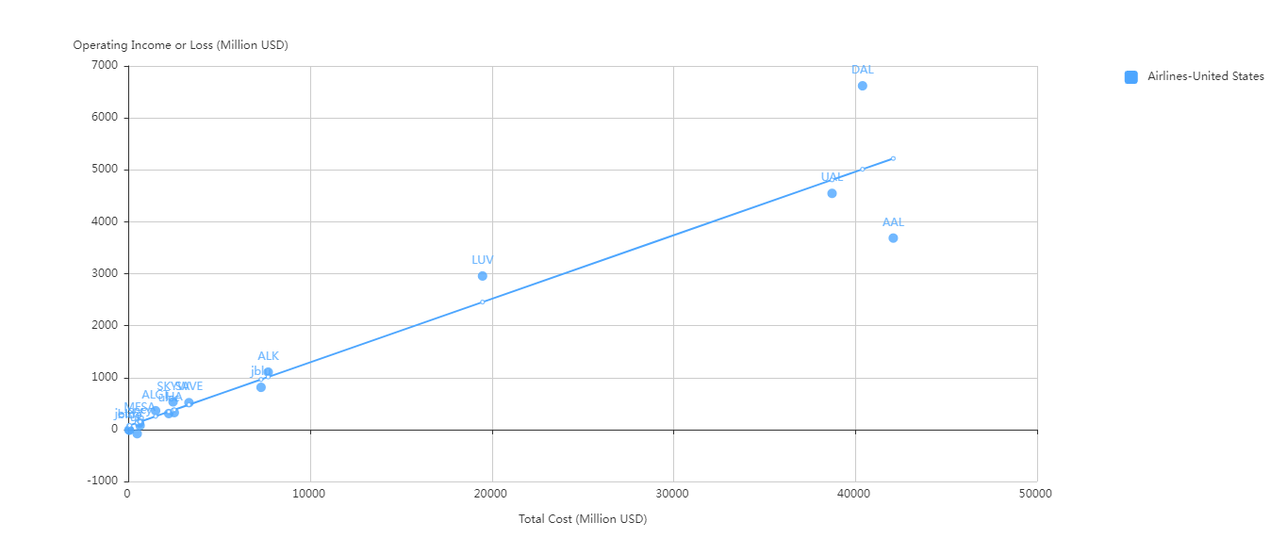
LUV made almost the same operating income with half of AAL’s cost.
DAL and UAL made higher profits than AAL with less cost.
Operating income or loss vs. total cost, Airlines, USA, 2019
Data source: https://www.scdata.ai/project/30322
Notes:
The operating income vs cost analysis for the US airlines shows their difference in profitability. DAL made a much higher operating income than AAL with less cost. Although both UAL and AAL are below the regression line, UAL spent less than AAL but made a higher operating income. LUV made almost the same operating income with half of AAL’s cost.

