Slide 1

Welcome to
The Session Will Begin Shortly

Slide 2
START

Slide 4
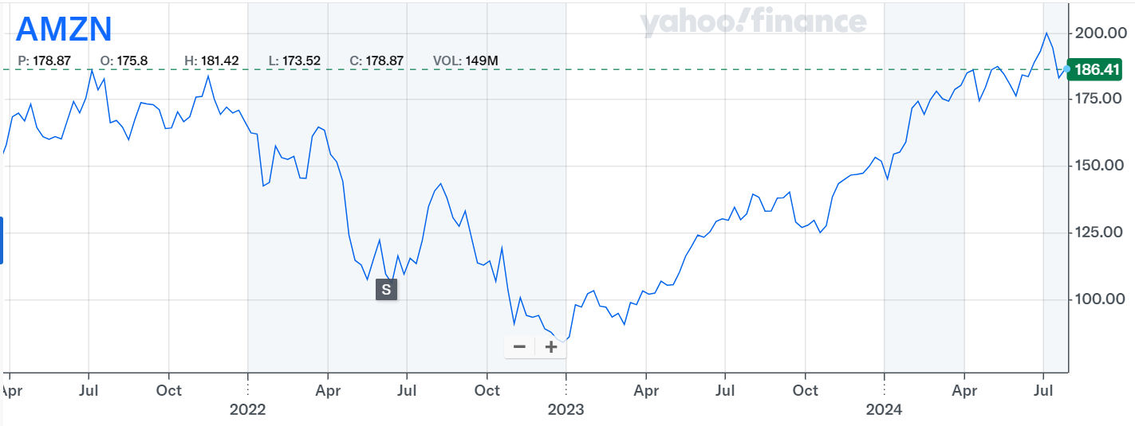
Amazon 2022-23 Roller Coaster!
Dropped by >50%
Completely recovered
What happened? Can we predict? … It‘s closely linked to operations …
Notes:
Welcome to … let’s start with the AMZN roller coaster: Amazon’s stock price dropped by more than 50% in 2022 then completely recovered in about 1 year! What happened? Can we predict? In fact, it’s closely linked to operations which are quite predictable.

Slide 5
Operations, Finance & Stock Market Intelligence
Yao Zhao
Professor @ Rutgers Business School
Co-director @ Rutgers Supply Chain Analytics Lab
VP Certifications & Curriculum Development @ Supply Chain Analytics Institute
https://yzhao12345.github.io/

Slide 6
Disclaimer
The information or service provided is for informational purposes only and is not intended to be personal financial advice. There's an inherent risk involved with financial decisions and the course instructor shall not be held liable for decisions others make.
Notes:
Target audience: researchers, investors, management consultants. Neither investment advice, nor comprehensive theory or empirical study, but some observations, hopefully thought provoking.

Slide 7

Outline
How financials impact stock market performance?
How operations impact financials?
Predict stock market by operations.
Questions, discussions.
Notes:
Non-technical talk focusing on data visualization and interpretation. Objectives: easy to implement, biggest value.

Slide 8
How financials impact stock market?
Stock market performance heavily depends on some financials but not all
Notes:
how many financials drive stock mkt? because …

Slide 9
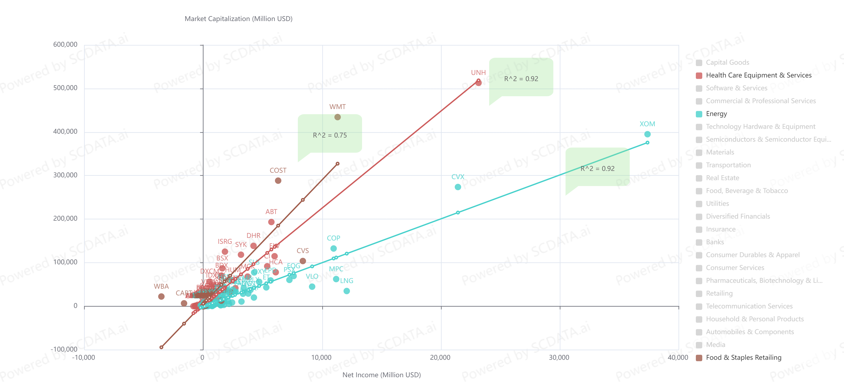
Robust & significant correlations between Market Cap and Net Income
5000+ US Companies, 2023
Source: https://www.scdata.ai/project/47037 page 22
Notes:
Robust and significant correlation for almost all industry groups between market cap and net income! I haven’t seen anything like this before! Different slopes: the market responds differently to the financials. For instance, the market responded more enthusiastically to the net income growth of Food & Staple Retailing than Energy.

Slide 10
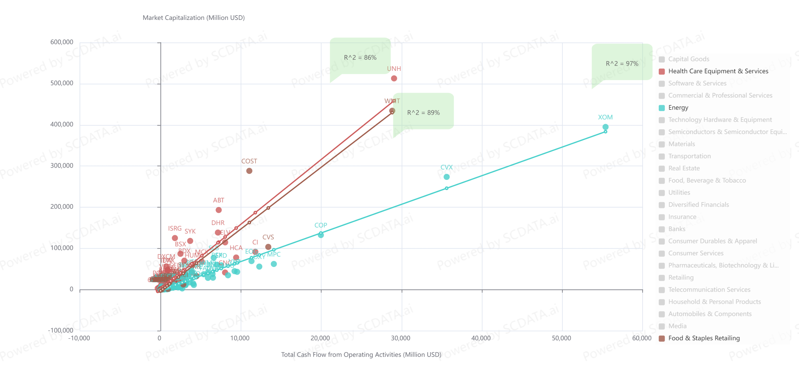
Robust and significant correlations between Market Cap and Operating Cash Flow
5000+ US Companies, 2023
Source: https://www.scdata.ai/project/47037 page 23
Notes:
Robust and significant correlation for almost all industry groups. Not for banks because it is hard to differentiate operating, financing and investing cash flows.

Slide 11
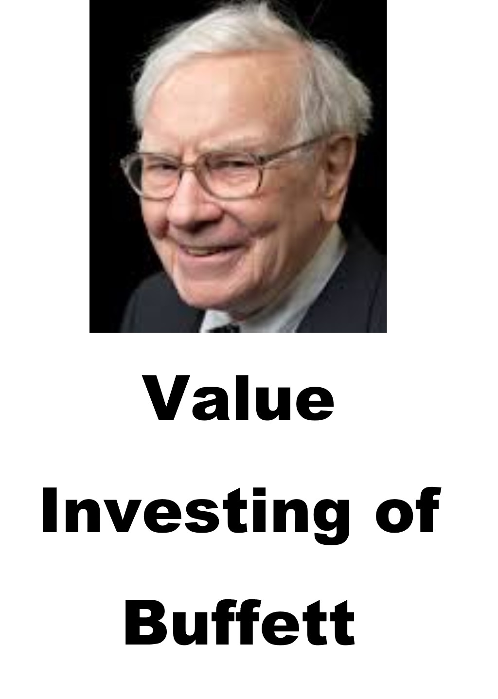

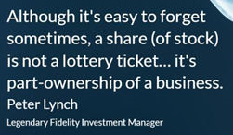
Financials Drive Stock Market
Notes:
Buffett is correct: financials do drive stock market performance. As Peter Lynch put in this way: “although it’s easy to forget, a share is NOT a lottery ticket … it’s part-ownership of a business.”

Slide 12
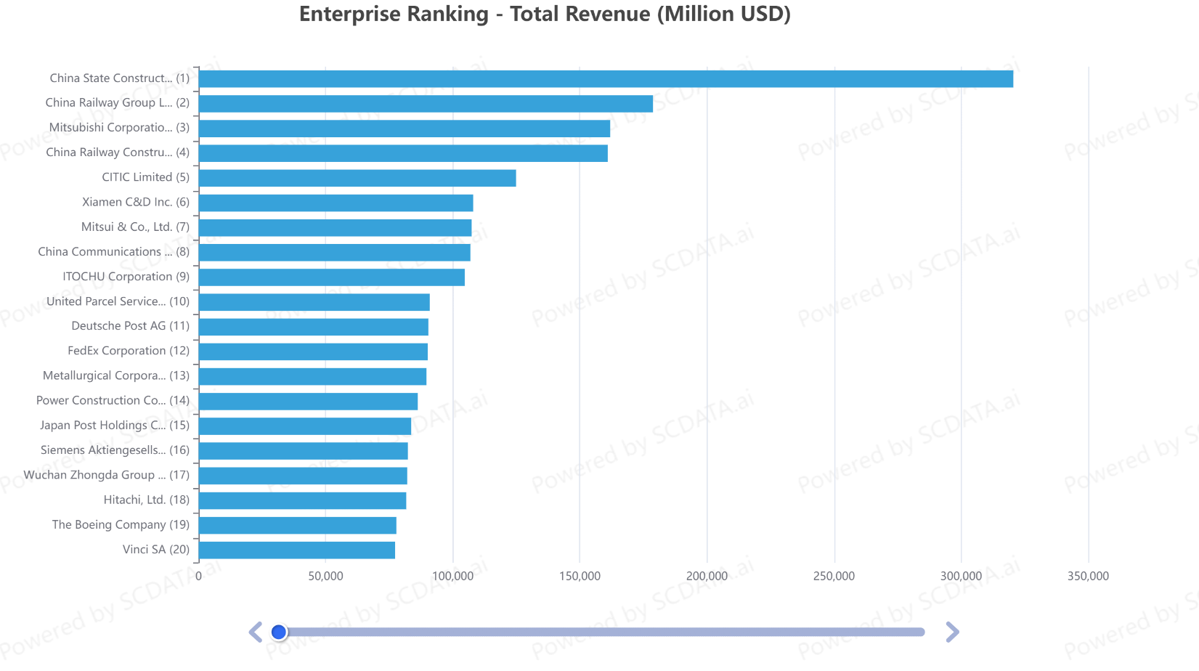
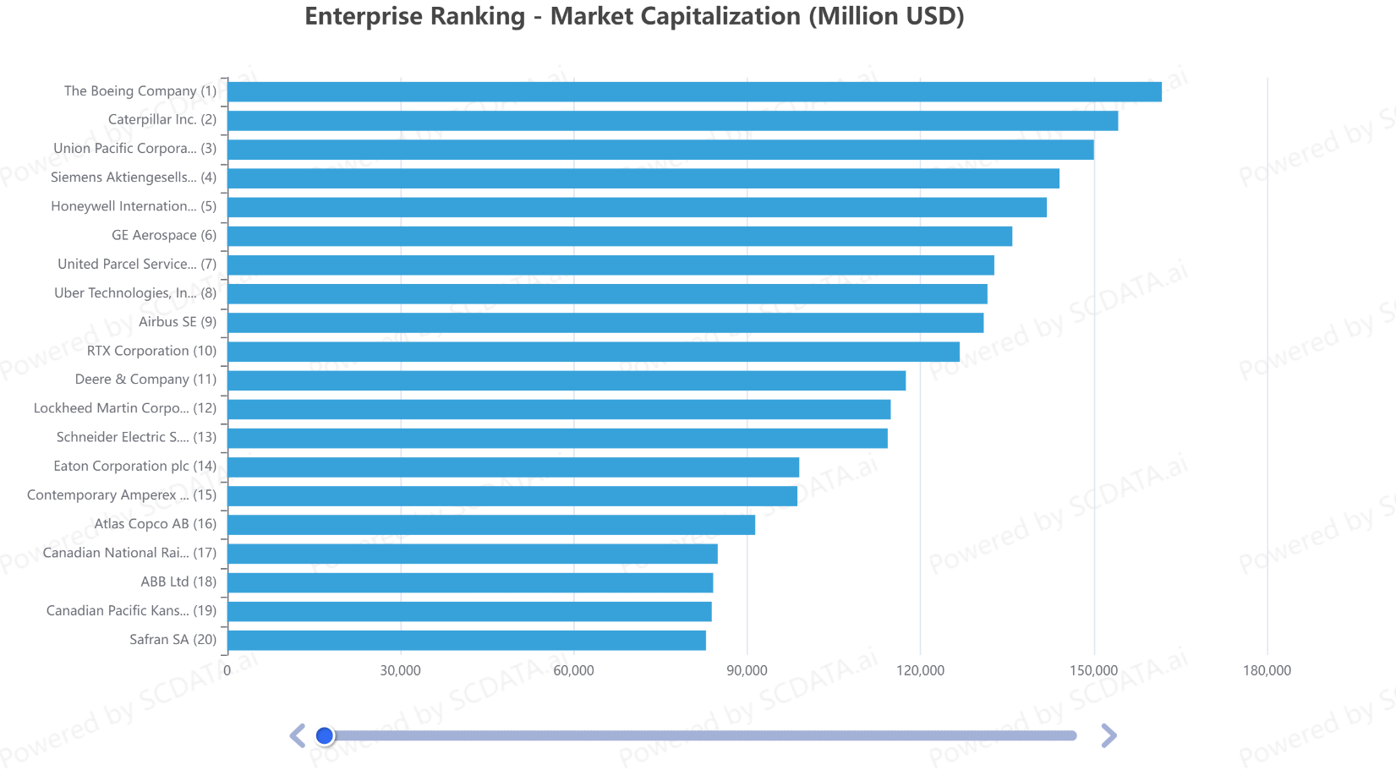
Paradox: Revenue Ranking $≠$ Market Cap Ranking
Industrials 2023
Source: https://www.scdata.ai/project/27187
Notes:
* Top 20 Industrials firms by revenue is quite dominated by Chinese companies, which are followed by companies from Japan and US.
* However, top 20 industrials companies by market cap are completely different! It starts with Boeing, Caterpillar and UPC, followed by Siemens, Honeywell and GE, ..., the largest Chinese firms didn't make them into top 20 list.

Slide 13
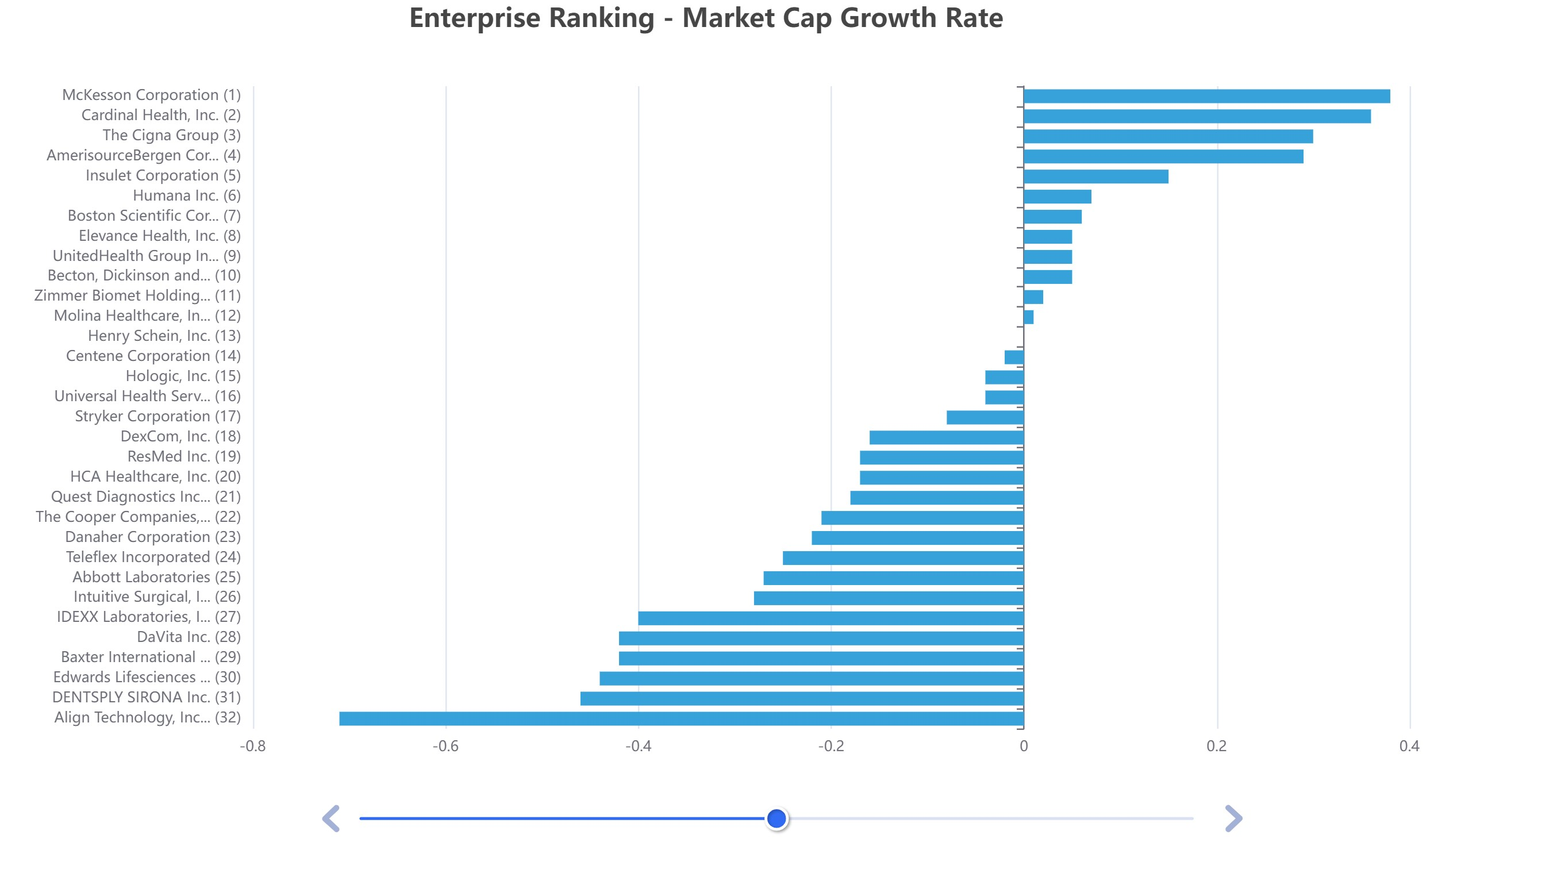
Individual Stocks Disparity
Individual stocks may >> industry average
Healthcare Equipment & Services 2022, SP500, US
Source: https://scdata.ai/project/45871
Notes:
index funds vs. individual stocks. Using SP500 healthcare equipment & services companies as examples, an enterprise ranking by market cap growth shows significant disparity and the top performers had a growth rate far greater than the average industry performance. The disparity comes from different financial performance of the companies.

Slide 14

How operations impact financials?
What’s the strategic importance of operations & SCM?

Slide 15
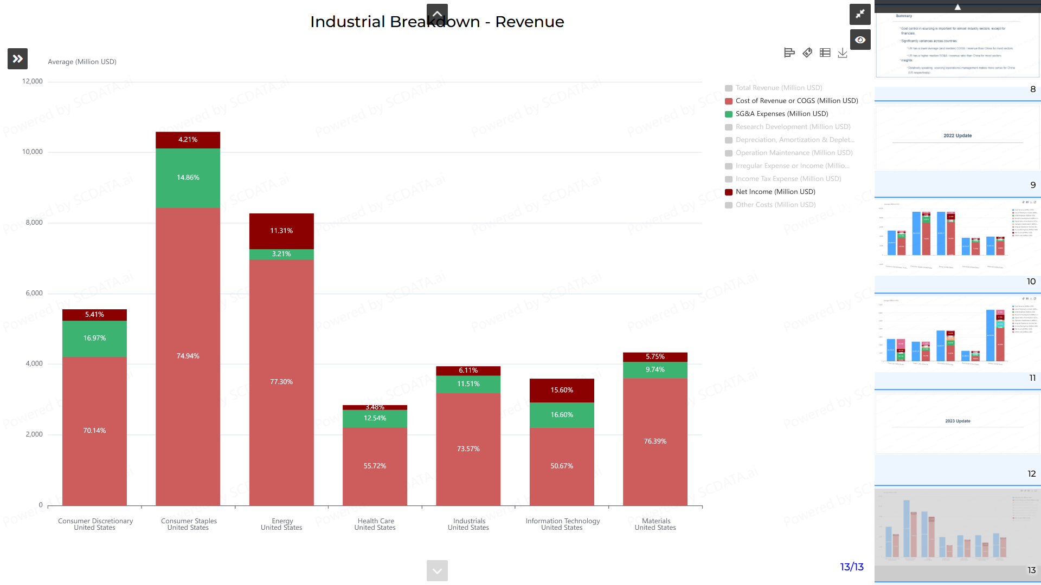
1% saving in COGS ~ 18% increase in profit
1% saving in COGS ~ 16% increase in profit
1% saving in COGS ~ 3% increase in profit
Source: https://www.scdata.ai/project/19934
Notes:
Revenue breakdown to show how net income was made. The biggest impact factor is COGS (SCM), true for all industries. A small change in COGS can result a huge change in net income and thus stock price. Competition-wise, however, it’s often hard to gain advantage on COGS over competitors because they often have the same supply base! Thus SG&A (operations), although smaller, often play a critical role in achieving a competitive advantage. If so, you can reduce price and make more profit, which lead to market dominance.

Slide 16
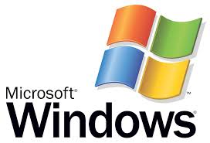
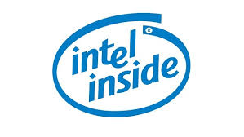
Compaq vs. Dell – The $24 Billion Insight
Compaq was the market leader with the largest market share
Healthy cash flow, many patents
But Compaq sold itself, completely abandoned its strong brand!
Computer industry background
  Computer companies have the same key technologies, CPU, operating systems, etc.
  Competing on customer service & cost structure
Notes:
The first example is Compaq and Dell, and the $24B insight! Around year 2001, Compaq was the market leader with the largest market share. Compaq also has a healthy cash flow and owns many patents. But surprisingly Compaq sold itself in 2002 for $24B and abandoned its strong brand. Why? …
In 2002, Compaq signed a merger agreement with Hewlett-Packard for US$24.2 billion.

Slide 17
Interpreting the Data
Data comes from http://yahoo.marketguide.com (2000)
Dell outperformed Compaq by 1% in Operating margin
Why is this 1% so critical that Compaq, the market leader, gave up the competition and sold itself?
Notes:
Here is the data – if we understand the data, we will know why Compaq sold itself. …
To see the answer, we must first explain why Compaq’s gross margin is higher than Dell. Recall that they have the same key suppliers, different gross margin actually means different pricing. In fact Dell has a 10% lower selling price than Compaq at that time. Even with a lower price, Dell can make more money, how can Compaq compete?!
Compaq really understand the data and made a wise decision worthy $24B. No everyone understood the data though, such as HP who bought Compaq.

Slide 18
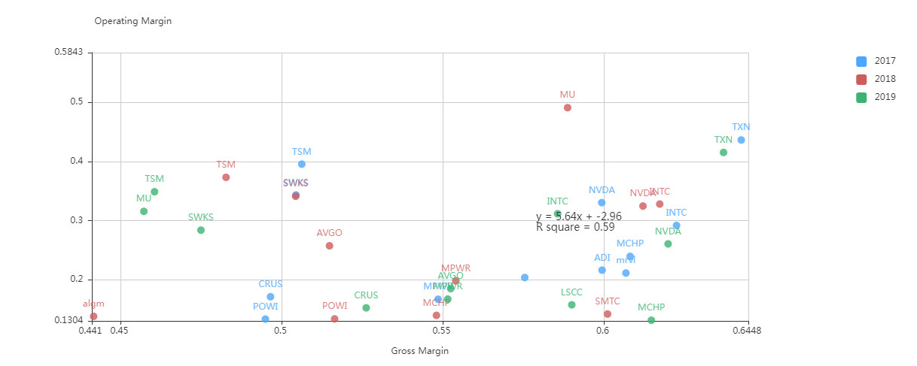
Taiwan Semi. Mfg. Co (TSMC) vs. Intel Corp. (INTC)
TSMC
INTC
Semiconductors 2017-2019
Data source: https://www.scdata.ai/project/17055
Notes:
By the data, this looks like another Compaq vs Dell case. Why do I say this? Let us do a value driver analysis of gross margin vs operating margin on semiconductors from 2017-2019. Usually the … go in the same directions, but if you can find an opposite example, then you may discover another Compaq and Dell case. Indeed, INTC has a higher gross margin (ie., a higher pricing), but even with a high pricing, it made less operating margin than TSMC. That said, INTC may not be another Compaq given tech innovations, however, TSMC clearly enjoyed a substantial operational advantage over INTC.

Slide 19
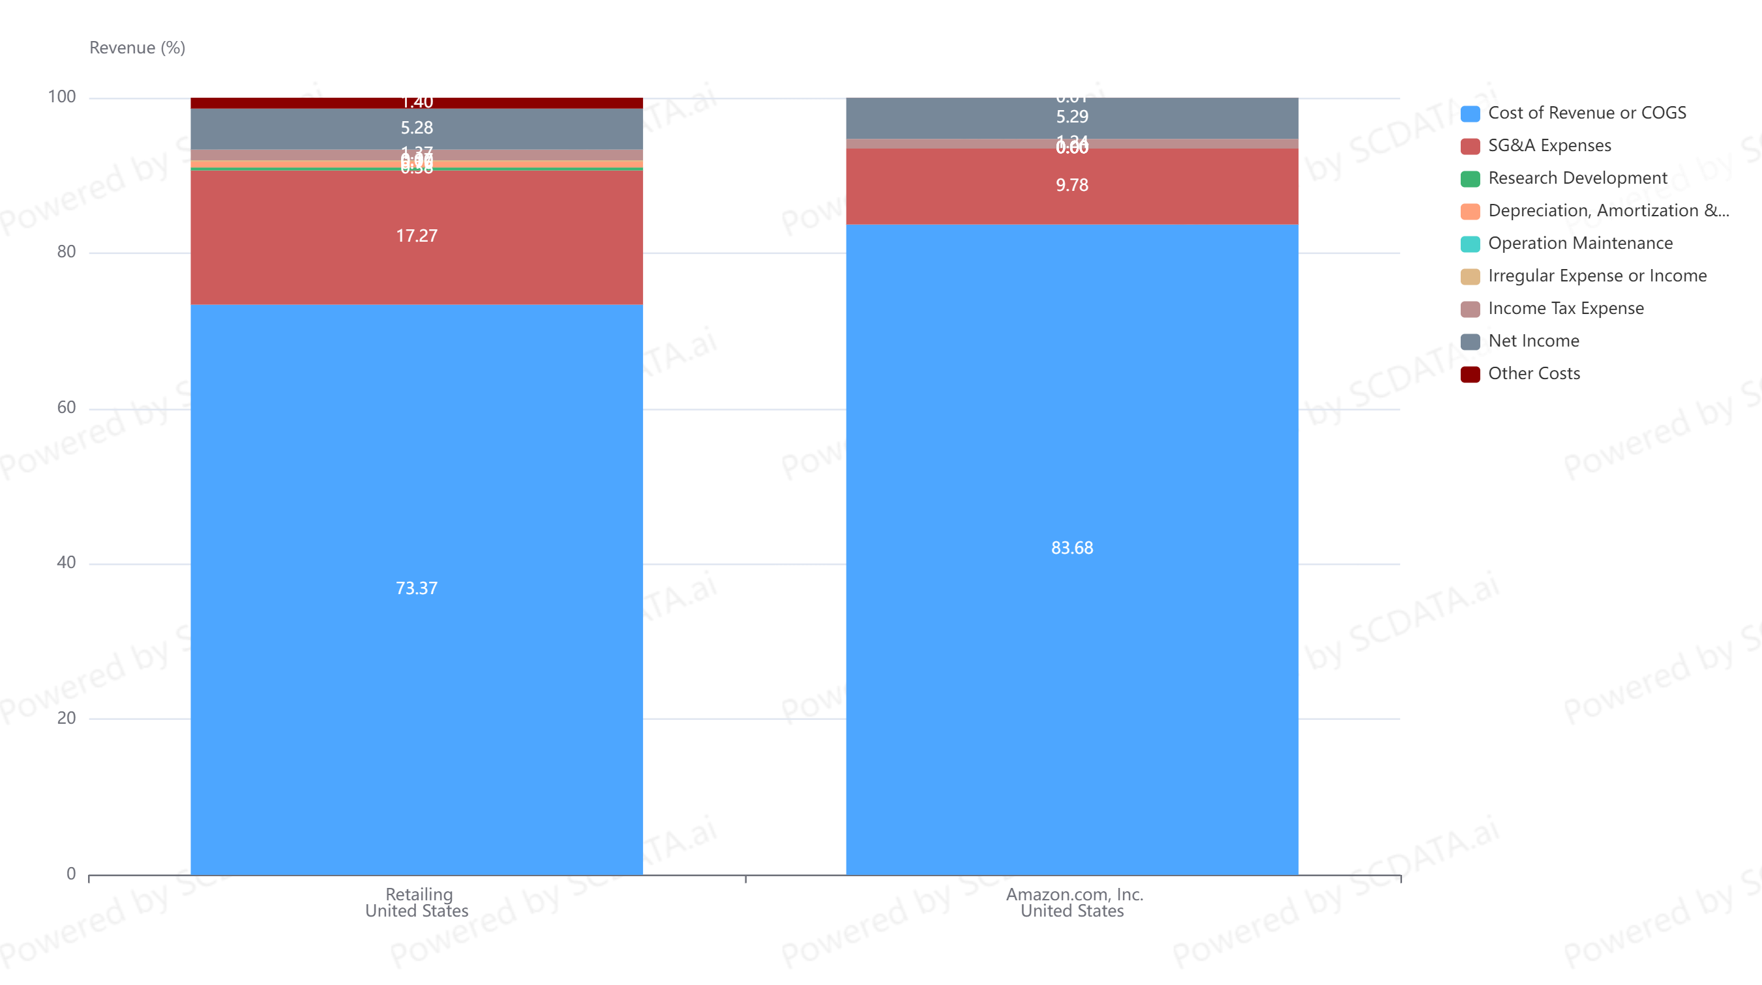
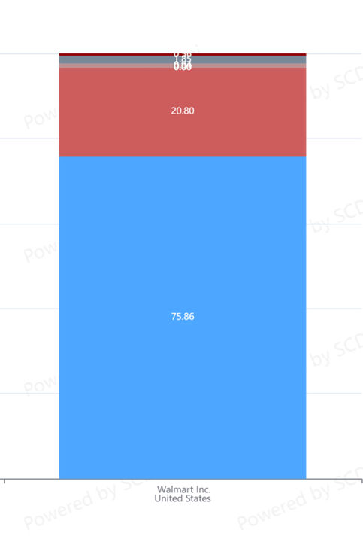
For Item Costing $100, You Pay $132 (WMT), $120 (AMZN)
SG&A made the difference.
Operations / SCM → SG&A!
Walmart
Amazon
Data source: https://www.scdata.ai/project/403
Notes:
To see more clearly AMZN’s advantage over WMT and the driver behind it, let’s compare a revenue breakdown between WMT and AMZN. In 2023, WMT’s COGS is 75% of revenue, gross margin or markup is 25%. AMZN 84% (16%). For Item Costing $100, You Pay $132 (WMT), $120 (AMZN). Despite the lower price, AMZN’s net margin is better than WMT! The reason behind it is SG&A cost: WMT 21% vs. AMZN 10%. What’s behind SG&A? admin, mkting and operations cost …

Slide 20
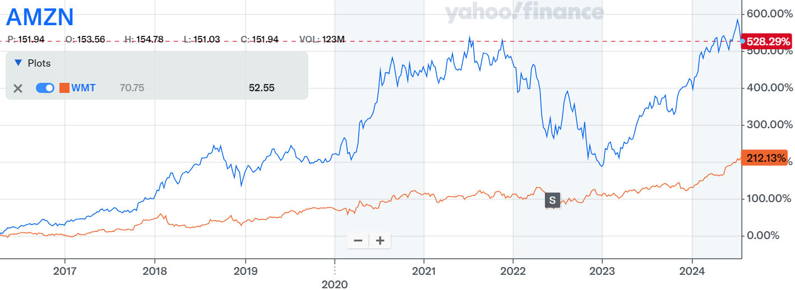
Stock price changes for Amazon and Walmart
Amazon
Walmart
Data source: Yahoo finance, retrieved on 1/14/2023.
Notes:
Revenue: AMZN < WMT

Slide 21

Predict stock market by operations
Back to Amazon 2022-23 Roller Coaster …
Notes:
Finally, let us come back to Amazon 22-23 Roller Coaster and see how we can predict stock market by operations.

Slide 22



Financial Impact of Operations / SCM
Improved revenue and reduced cost
Improved financials, e.g., net income, operating cash flow
Larger market capitalization, higher stock price
Notes:
Operations (including inventory) have an impact on stock market …, through the financials.

Slide 23
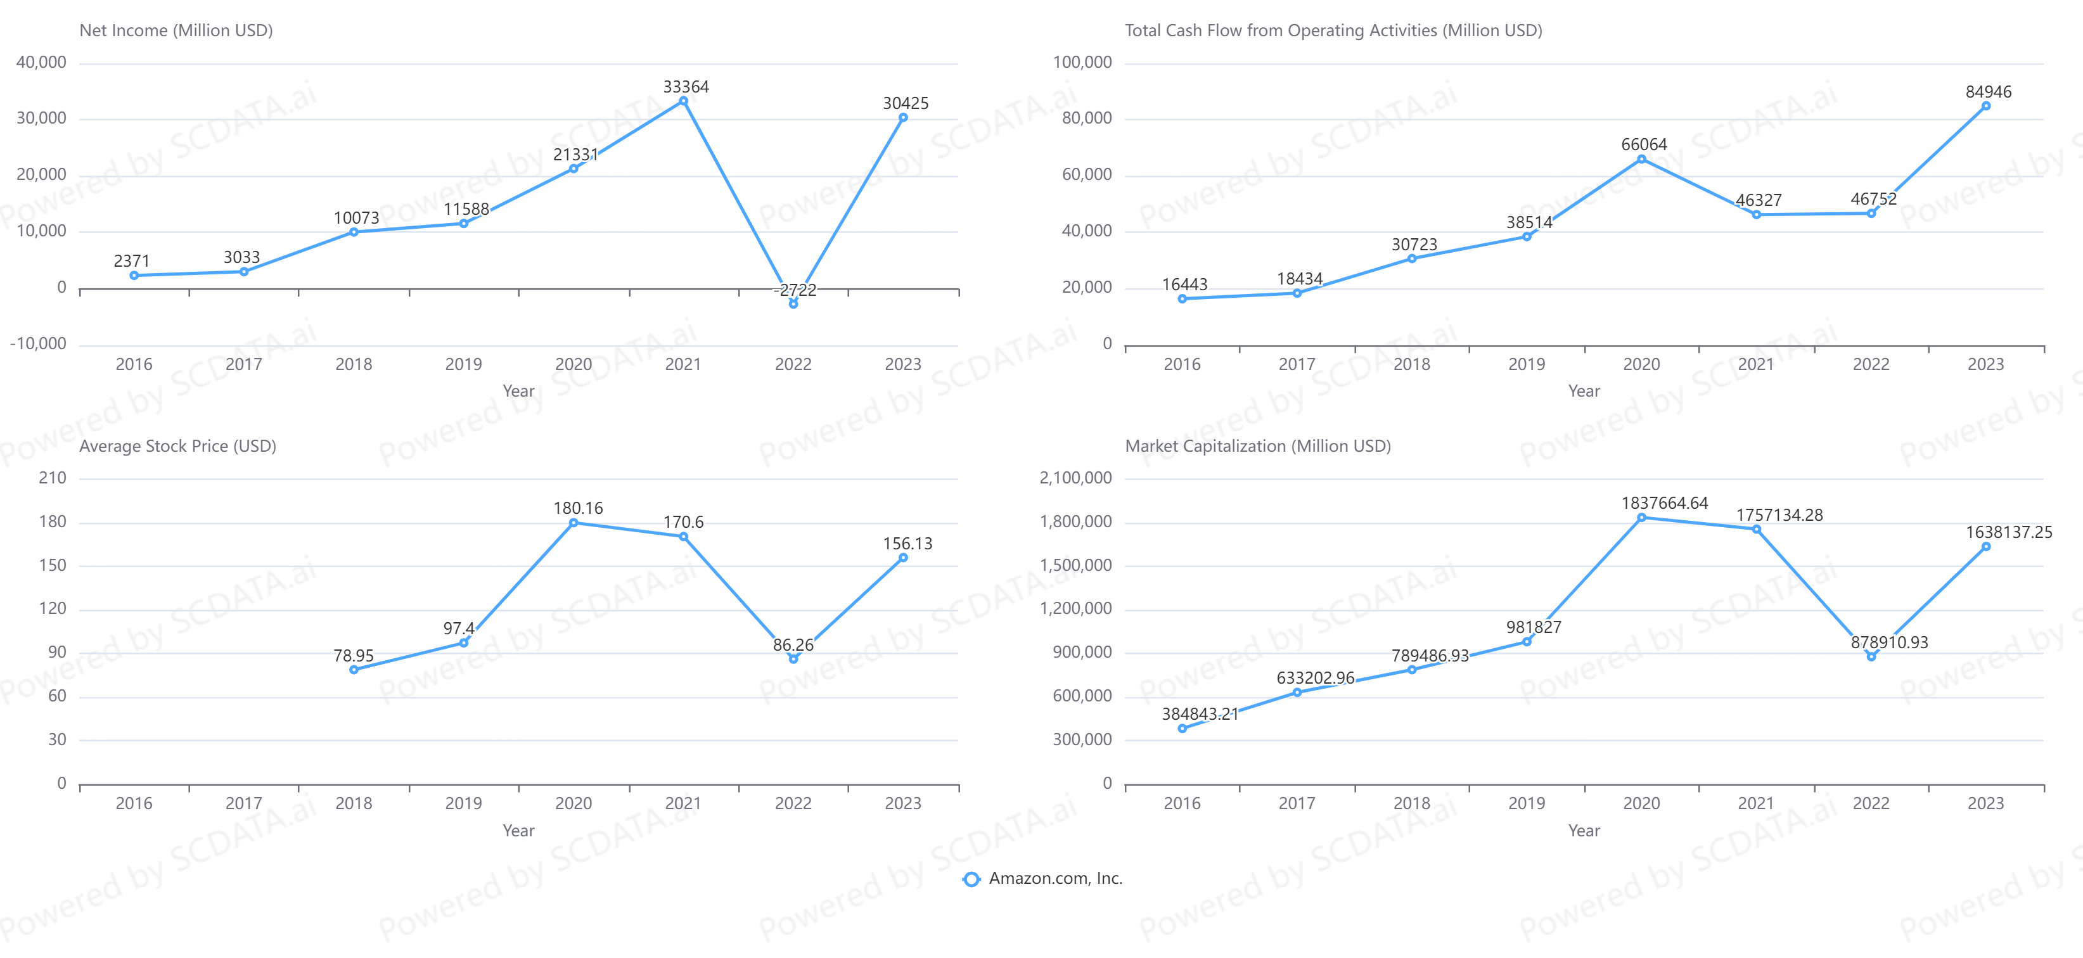
Amazon: Financials vs. Stock Market
Source: https://www.scdata.ai/project/47037
Notes:
high correlation between net income (operating cash flow) and market cap (and stock price). Specifically, the drop and rebound of net income and operating cash flow are the direct cause of the stock market crash and rebound in 2022 and 23.

Slide 24
Predicting Stock Market = Predicting Financials!
Can we predict?
What happened?
Notes:
Close correlation between net income trend and market cap movements: Predicting Stock Market Becomes Predicting Financials which can be much easier! So let’s use financials to find out what happened in 2022 and how we can predict the stock market in 2023.

Slide 25
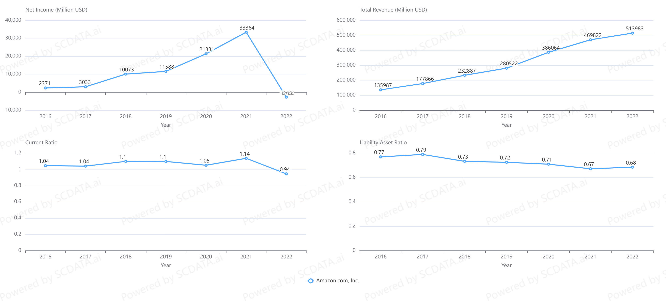
Amazon: Profitability and Health
Growth slowed
Net Income Plummeted
Can handle short-term liabilities
Get better on overall liabilities
Healthy both short and long terms
Source: https://www.scdata.ai/project/47037
Notes:
Let’s go back to 2022, Amazon’s revenue is still growing but at a lower speed, but net income plummeted, which led to the stock market crash. However, AMZN is healthy both short-term (current ratio > 1) and long-term (liability asset ratio has been improving from around 80% to below 70%). In summary, despite the slip, Amazon will not go under in the near future. So no panic.

Slide 26
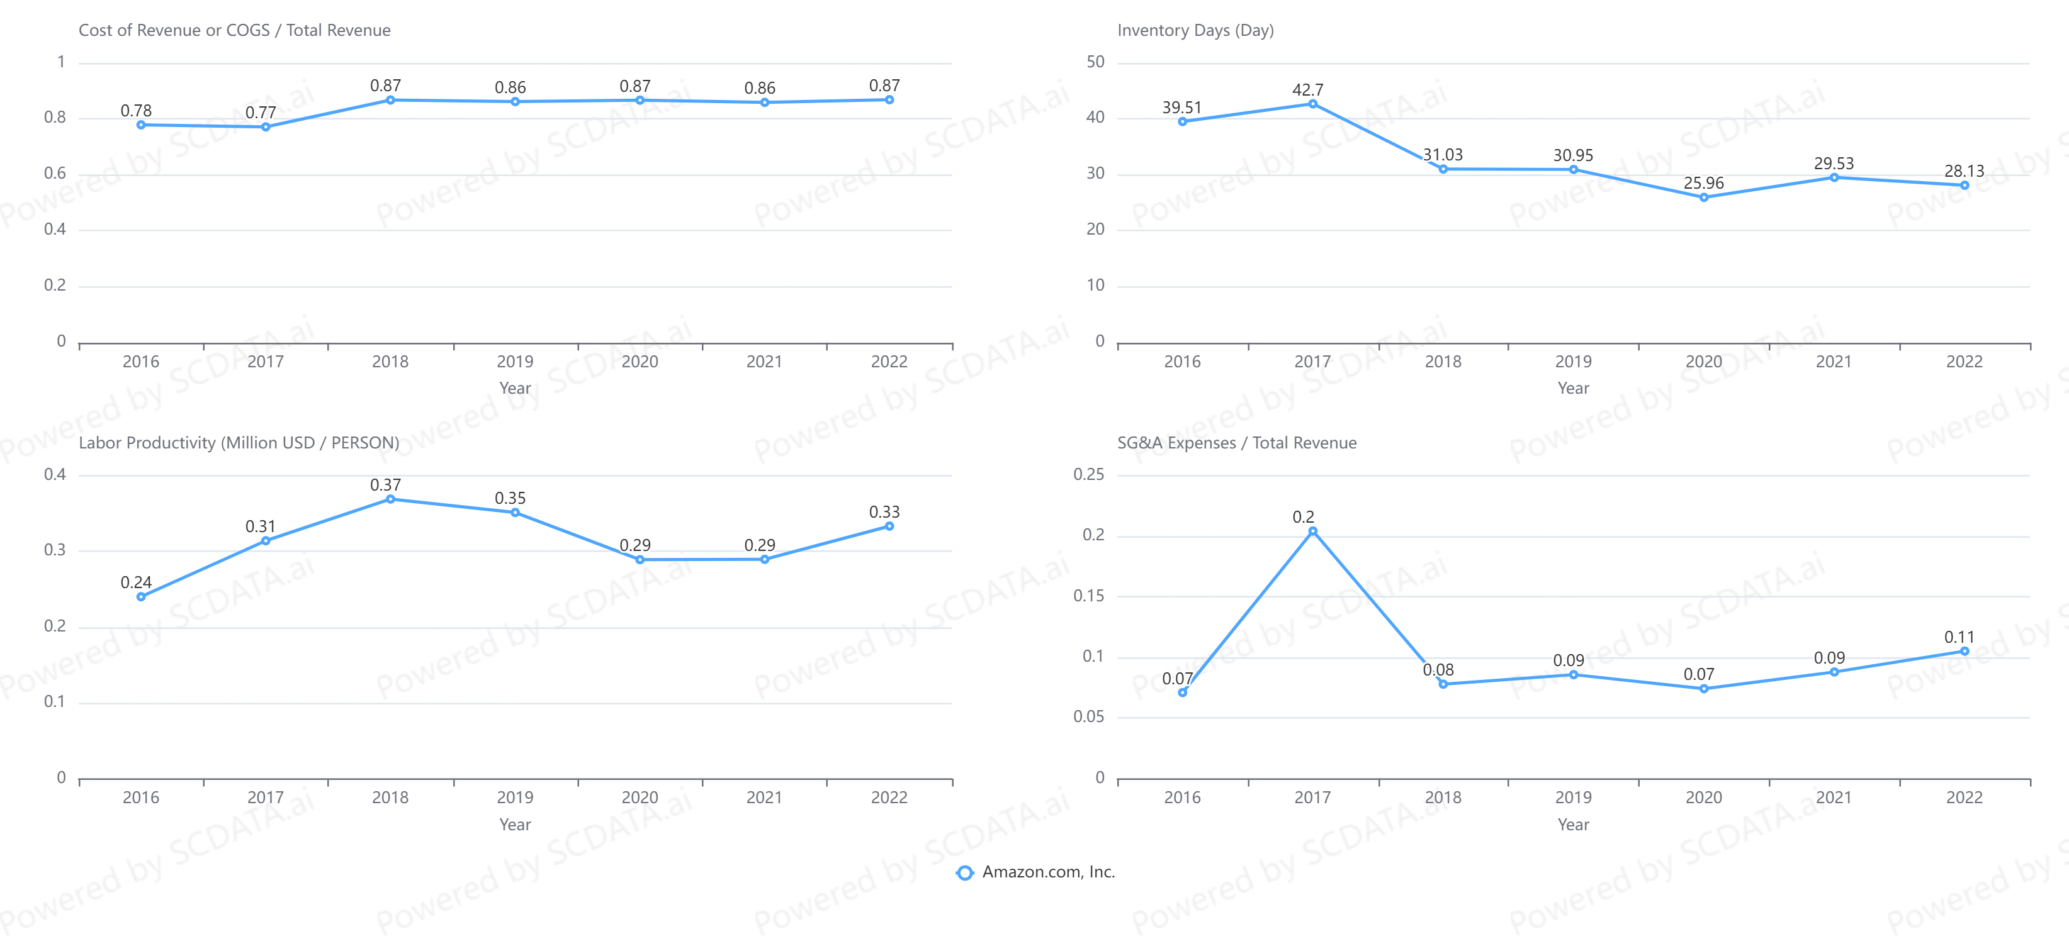
Amazon: Operating Efficiency
Inventory? At most minor
Not a sourcing issue
SG&A went up!
Labor productivity down!
Source: https://www.scdata.ai/project/47037
Notes:
So what caused the slip? operating efficiency analysis: AMZN’s cost of revenue or COGS remained about the same (not a sourcing problem), inventory days slightly increased (inventory problem not major). However, the labor productivity went down during the pandemic … and SG&A expenses rose up by 2%, which is significant because AMZN’s median net margin in recent years is about 4%.

Slide 27
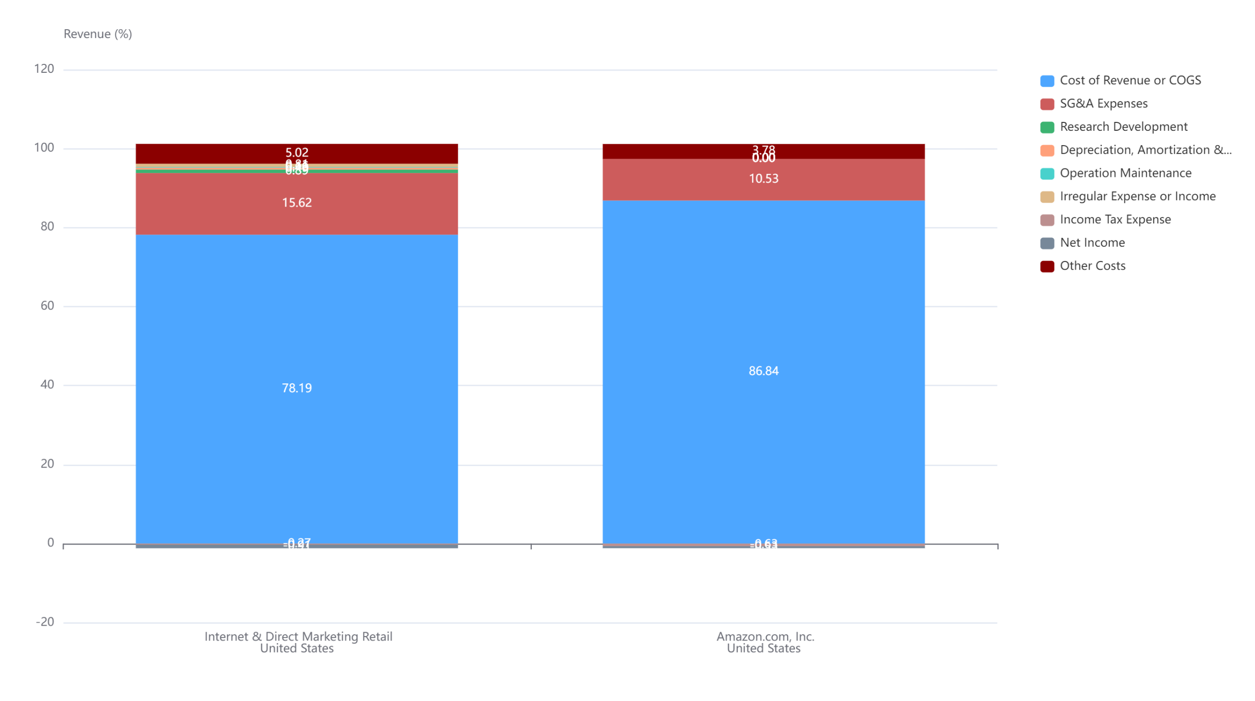
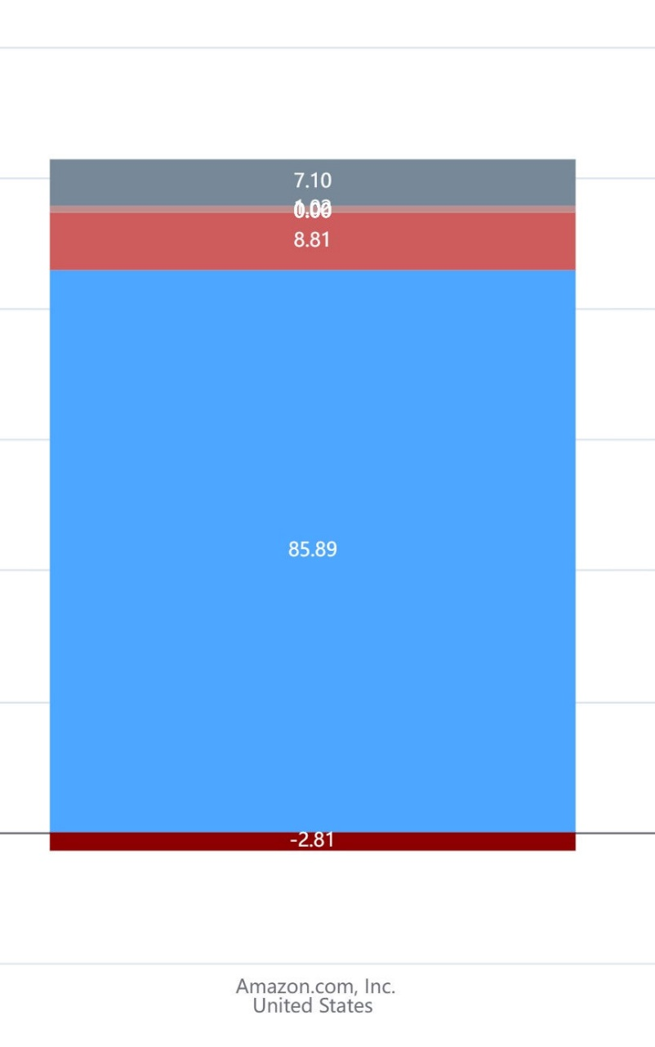
Revenue Breakdown: Causes of Slip
2021
2022
“Sales slowed and costs ballooned”
- Investor’s Business Daily, 8/7/23
Ballooned cost due to over-expansion
Source: https://www.scdata.ai/project/47037
Notes:
A revenue breakdown for AMZN between 2021 and 2022 shows the main differences: first, the other costs increased to +3.8% in 2022 from the -2.8% in 2021, a 6.6% increase. Second, the SG&A expenses rose up to 10.5% in 2022 from the 8.8% in 2021. As Investor’s Business Daily commented “sales slowed and costs ballooned”. In summary, the cause of Amazon’s slip in 2022 is the ballooned cost due to over-expansion during the pandemic.

Slide 28
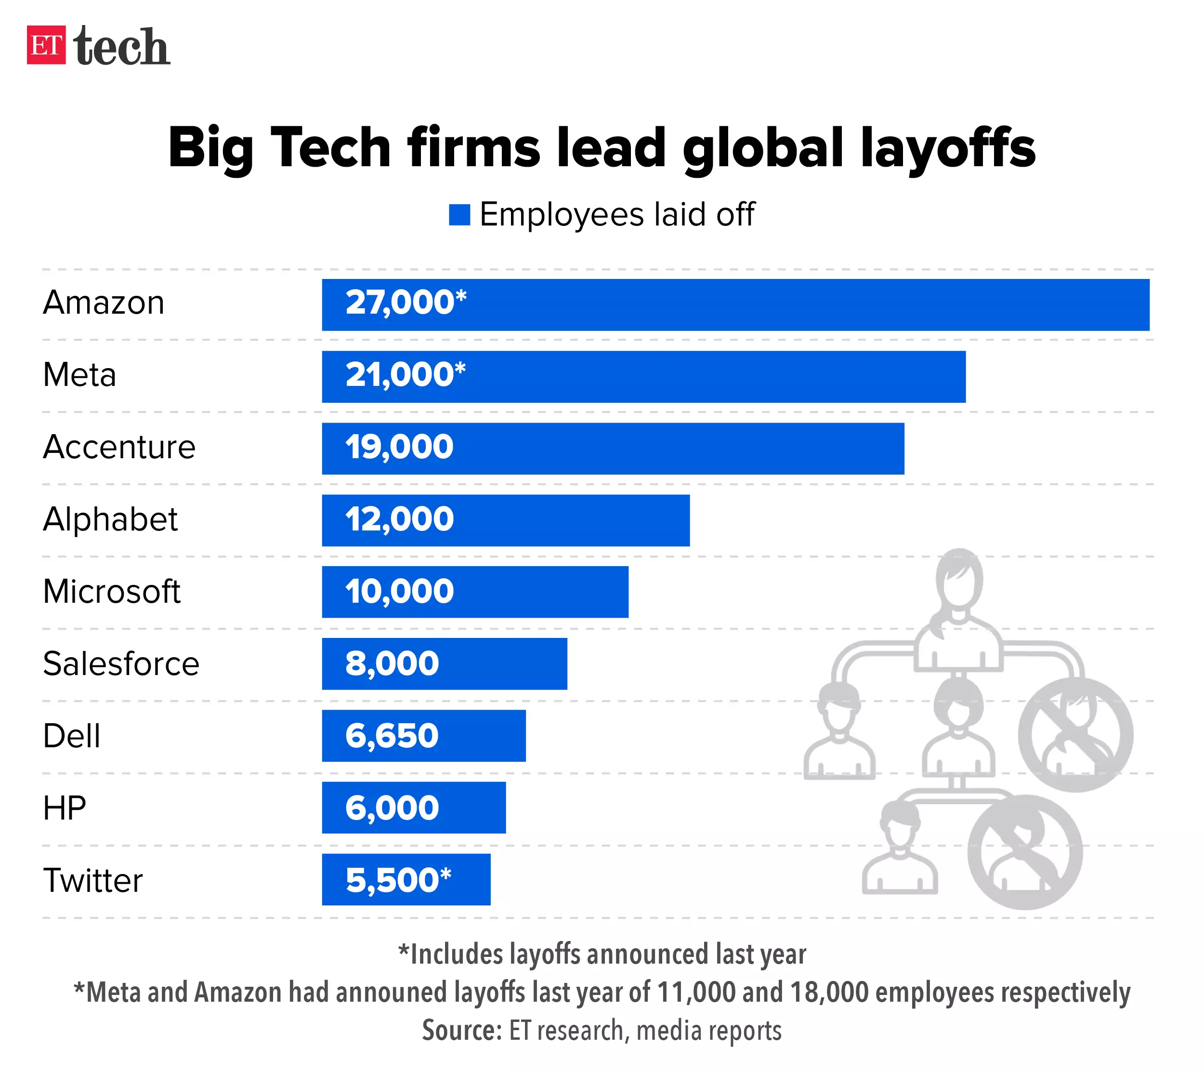
Amazon’s Turnaround Strategy
Jul 11, 2023
Massive lay-off & reorganization starting 2023.
Drastic cost-cutting measures: “from ending experimental projects to pausing grocery store growth to cutting jobs” (The Seattle Times 2/2/23).
… a rebound case: strong buy.
Notes:
AMZN’s turnaround strategy: massive lay-off & reorganization, including … all towards cost reduction. If you know the problem & AMZN’s action, what would you expect about its stock price?
ETtechLast Updated: Jul 11, 2023,
https://economictimes.indiatimes.com/tech/technology/layoffs-2023-tech-companies-which-laid-off-most-number-of-employees/articleshow/98974661.cms?from=mdr

Slide 29
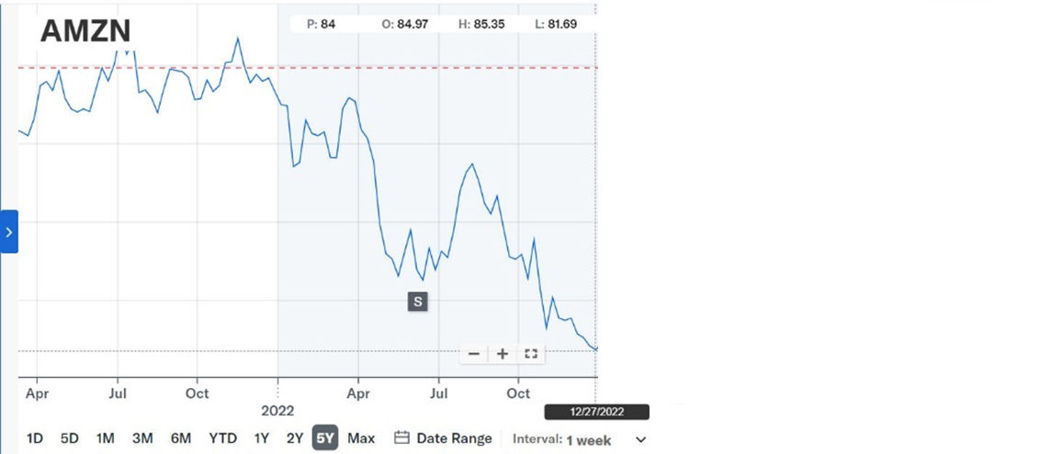
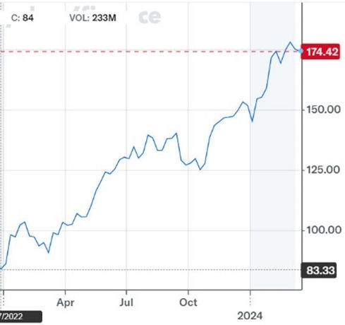
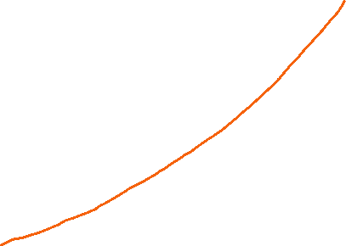
Amazon’s Rebounds in 2023
Notes:
As predicted, AMZN’s net income and stock price rebounded in 2023 and eventually recovered all the losses.

Slide 30
Macy’s: Predicting Stock Market = Predict Financials!
Notes:
AMZN is not an exception … Macy’s.

Slide 31
Nvidia: Predicting Stock Market = Predict Financials!
Notes:
Retailing industry is not an exception … NVDA, …

Slide 32
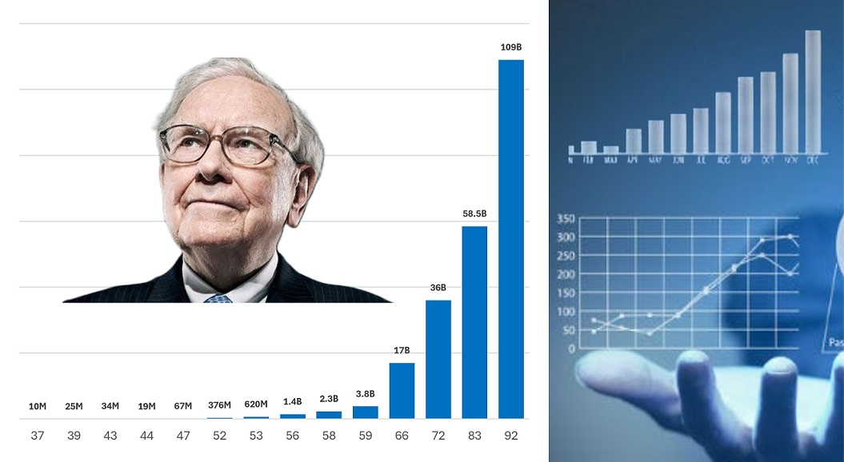
“Data Science 4 Buffett Value Investing”
https://www.udemy.com/course/data-science-4-buffett-value-investing/
Notes:
How to predict stock movement by financials and data science? You can find lots of examples from diverse industries here on how to handle different situations.

Slide 33



Recap
Predicting stock market ~ predicting financials (net income, operating cash flow …).
Operations / SCM is critical in establishing a competitive advantage in financials.
Improving operations / SCM can improve stock market performance in a predictable way.

Slide 34
Questions, Demos & Discussions
yaozhao@rutgers.edu
https://yzhao12345.github.io/

Slide 36
STOP

