Slide 1
Topics Overview
Review by module

Slide 2
Module 1: Job Intelligence
Job opportunity analysis by region, industry and company
  Locate strategically.
  Enter the right industry.
  Work for the right company.
Plenty of opportunities, higher pay & lower effort, career growth, job security → dream job
Notes:
Job opportunity analysis is job intelligence – we need to make intelligent decisions on the right region to locate, the right industries to enter, and pick the right companies to work for. Doing so we will get plenty of opportunities, a higher pay with a lower effort, a promising career path and job security. In another word, a dream job!
Opportunities, high pay & low effort, career growth, job security, …

Slide 3
Module 2: Competitive Intelligence
Discover problems & opportunities as a management consultant.
Teaching objectives
  Industry analysis (industry trend, competition intensity, value chain analysis): Industry potential and risk?
  Competition positioning (profit frontier, enterprise ranking, KPI examination): Where do I stand in the competitive landscape?
  Enterprise diagnosis (strengths & weaknesses, value driver analysis, breakdown analysis): Problems and causes?
Require 3 hours in-class time

Slide 4

Module 3: Pandemic Influenza
Align commerce with public health
Teaching objectives
  Predict rare but disastrous events
  Decision making under uncertainty
  Companies want to make money, governments want to save lives; how to align the mismatched interests?
Case: Pandemic Influenza – Just-in-Time vs Just-in-Case Strategies.
3 hours

Slide 5
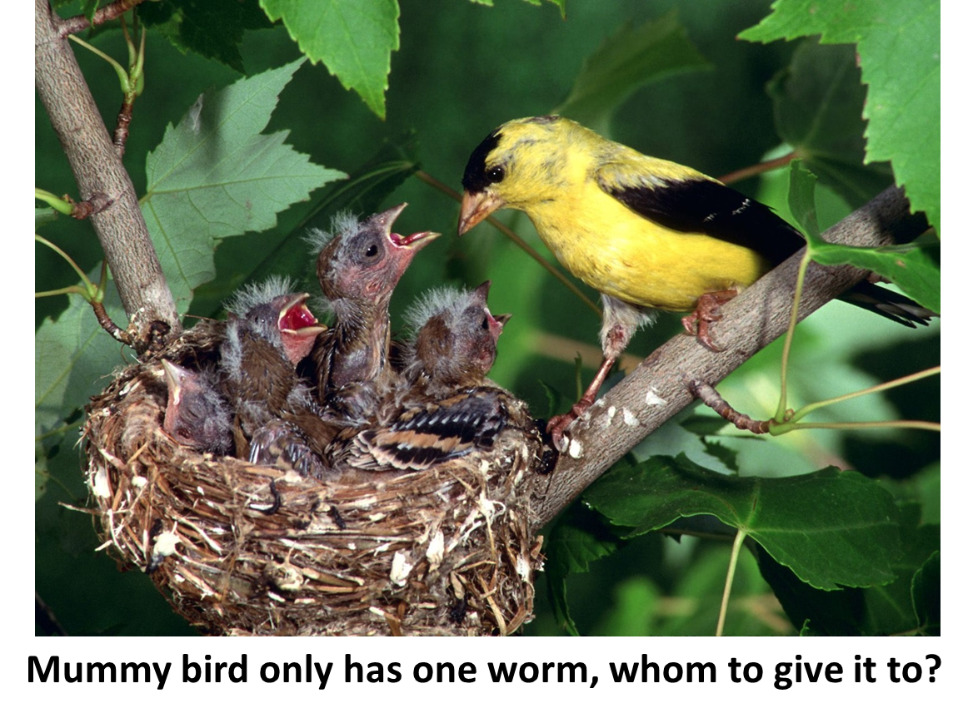
Module 4: Shortage Gaming and Supply Rationing
Play the Hunger Chain simulation to learn:
  Shortage gaming (panic order, hoarding).
  Supply rationing for efficiency and fairness.
  Supply chain competition (the Prisoner’s Dilemma)
  The Newsvendor model.
Game: Hunger Chain simulation (Finalist DSI Instructional Innovation Award 2019, Best DSJIE Teaching Brief Award 2021)
Require 3-4 hours in-class time

Slide 6
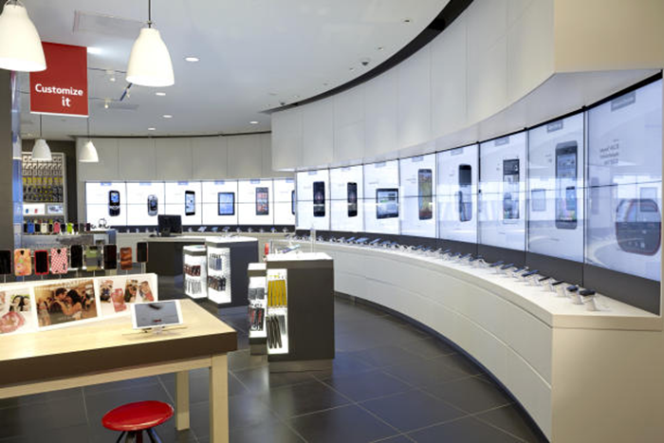
Module 5: Distribution Analytics
A major US wireless carrier changed its supply chain model from store to showroom and save $1 billion in inventory.
Teaching objectives
  Supply chain analytics
  Distribution strategies: store vs showroom models
  Integrating inventory and transportation decisions in distribution and logistics
Case: VASTA Wireless – Push vs. Pull Distribution Strategies (1st prize INFORM case writing competition 2014)
3 hours

Slide 7

Module 6: Sales & Operations Planning
Redesign Coach’s logistics network to reduce cost and improve customer satisfaction.
Teaching objectives
  Prescriptive analytics: Linear and integer programming, solvers.
  Applications: production planning, staff scheduling, transportation planning, resource allocation, logistics network design.
Case: Distribution Network Design – COACH Handbags Inc.
Require 6 hours in-class time

Slide 8
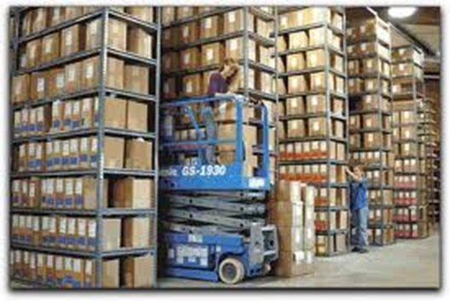
Module 7: Inventory Analytics
Inventory mgmt. is the corner-stone of SCM.
Questions answered:
  For which industry may inventory management be important?
  How may inventory drive a firm’s financial performance?
  How do I know that I have an inventory problem?
  How to categorize SKUs and manage their inventory accordingly?
3 hours

Slide 9
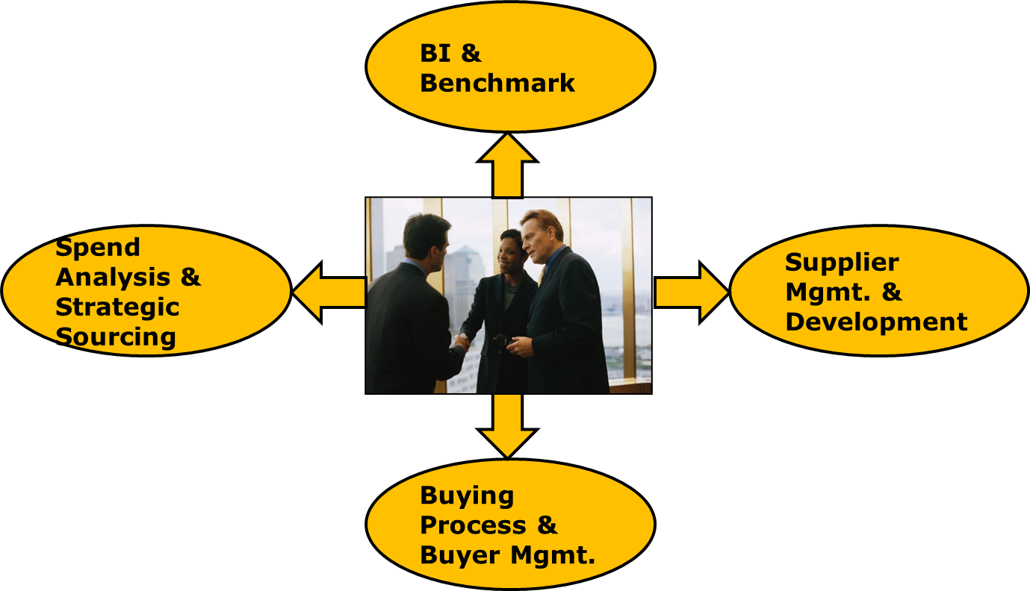
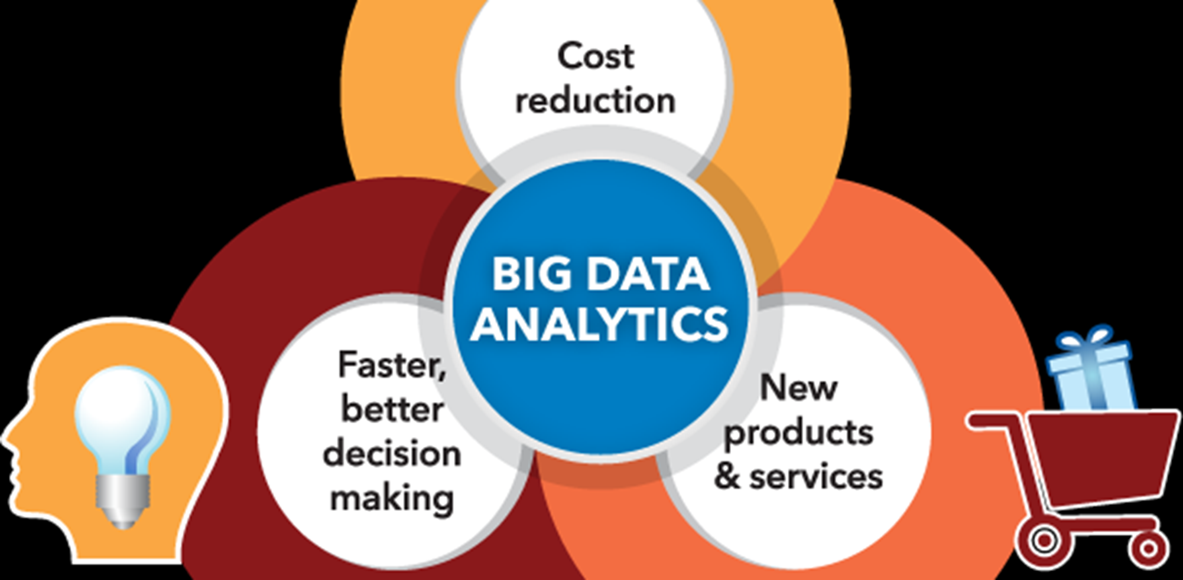
Module 8: Sourcing Analytics
4 pillars of sourcing
It is all about analytics!

Slide 10
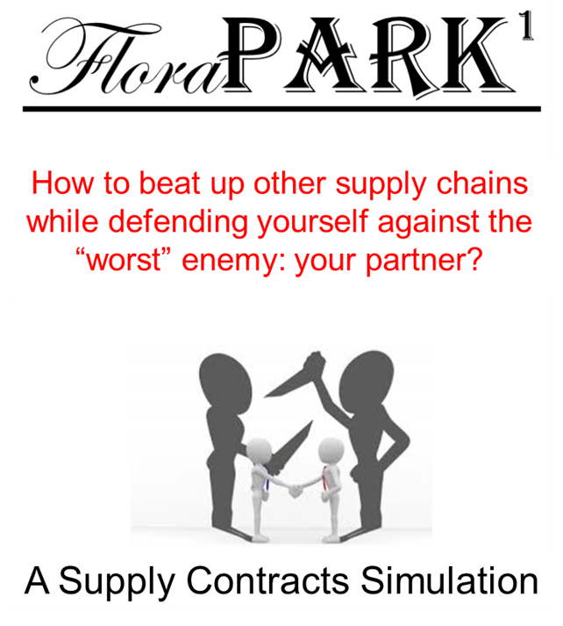
Module 9: Supply Chain Collaboration & Contracts
Play the FloraPark (flower game) to learn:
  Supply chain collaboration & contracts
  Supply chain marketing interfaces
  Strategic thinking
  Negotiation
Game: Flora-Park simulation.
Require 6-9 hours in-class time

