Slide 1
Job outlook
SCM + Analytics

Slide 2
The Talent Crisis
“The demand-to-supply ratio of supply chain jobs to qualified individuals is 6 to 1. Suddenly, supply chain management became more complex than ever. And the number of people who could handle it were few.”
SOLVING THE TALENT CRISIS (Automotive Industry Brief 2015)
“The technology explosion and global expansion are the key drivers. Big Data may put early adopters at an advantage, but without talented analysts, Big Data is just a pile of numbers; meanwhile, misinterpreted data can lead to devastating business interruptions.”
https://www.supplychaindive.com/news/talent-crisis-education-tech-supply-chain-nature/440392/
Notes:
However, a major hurdle for many companies and organizations to achieve the potential of supply chain analytics is the talent crisis – a significant shortage of talents who has both the supply chain domain knowledge and data analytics skills. For example, the automotive industry brief 2015 shows that “…”. The reason being, as another article from supply chain dive pointed out, “…”

Slide 3
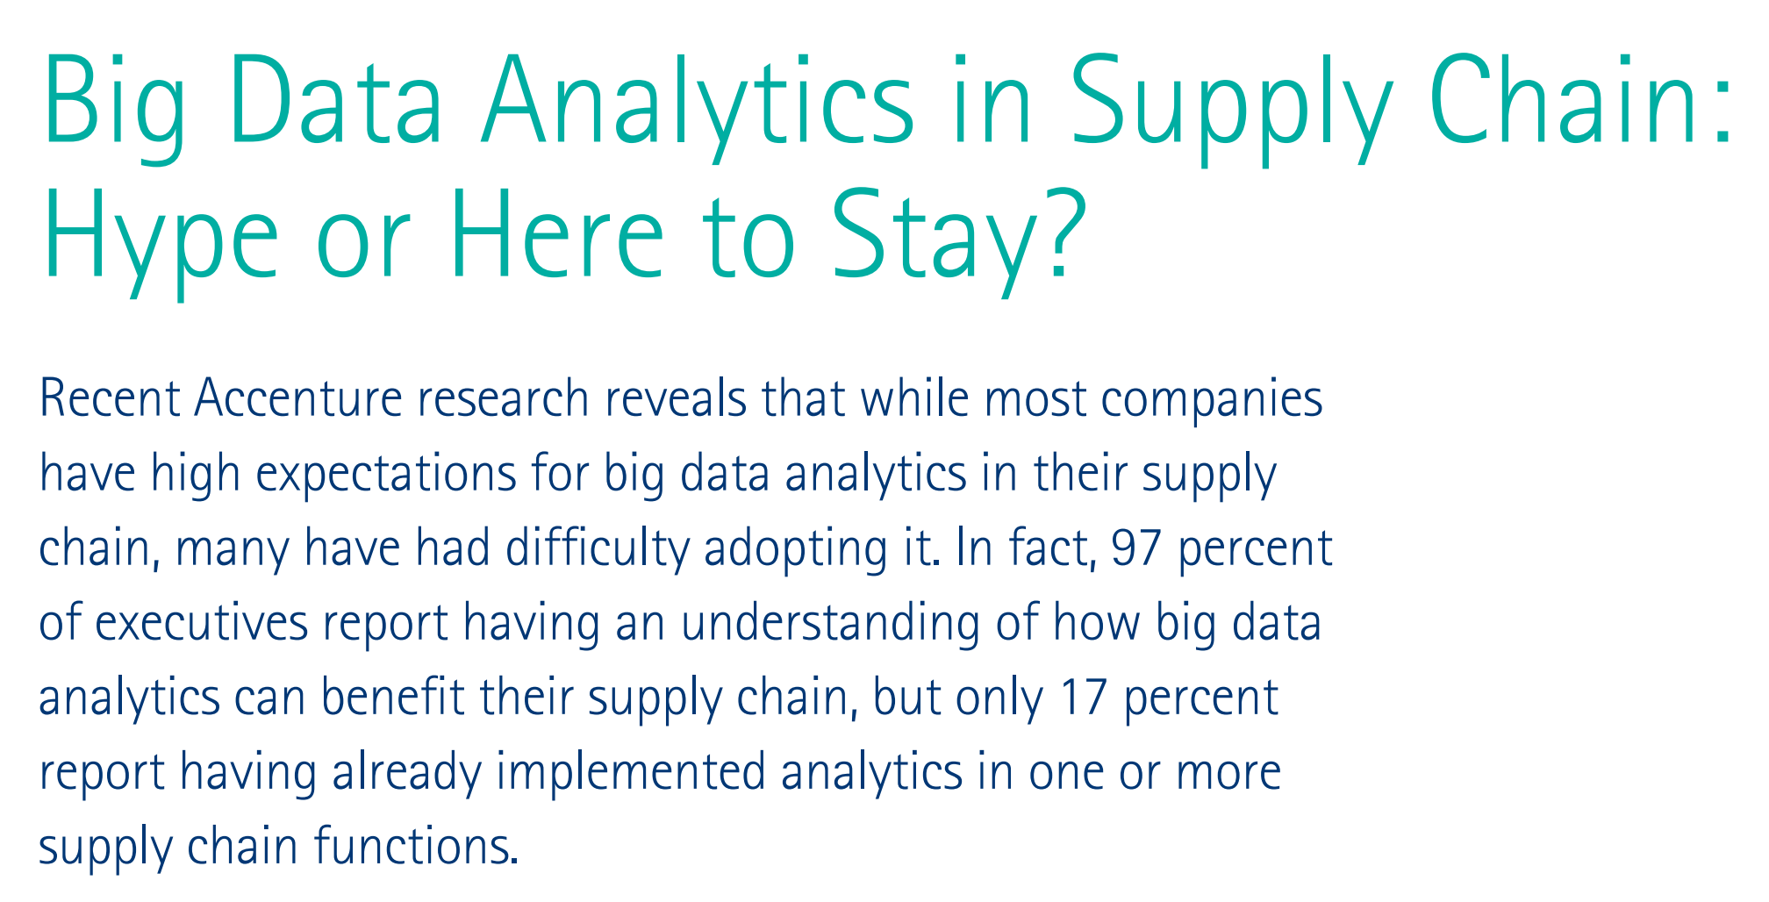
What Does Market Say?
Notes:
What does the market say about data analytics in supply chains? A survey by Accenture in 2016 said that while most companies understand the importance of big data analytics to their companies, only a small fraction reported having already implemented analytics in one or more supply chain functions. The huge gap between expectation and implementation creates a significant demand for talents who know how to apply data analytics to supply chains.

Slide 4
2019 Deloitte Digital and Analytics Supply Chain Survey
Bottom line: The competition for technically and analytically savvy talent is high and will only increase in the future …
Notes:
In 2019, Deloitte publishes a survey on digital and analytics supply chain, with 156 respondents from large corporations in manufacturing, logistics, retailing, energy, technology and healthcare sectors. 76% of respondents agreed that developing digital and analytics capabilities was most important or very important to the overall SC strategy. 47% of respondents expect an 11-20% ROI for digital and analytics investments. The bottom line is, …
*156 in manufacturing, logistics, retail, energy, technology, health care, hospitality and services
*large corporations with ~70% of revenue > $1B
*sourcing, SC strategy, mfg, logistics, product development, SC planning, ...

Slide 5
“We don’t need more data weenies and we don’t need more strategic marketing planners. What we really need are more people with a foot in each camp who can make some sense of all of this new technology.”
–Don E. Schlutz
Source: Big Data: Prospects and Challenges.
Available from: https://www.researchgate.net/publication/275035912_Big_Data_Prospects_and_Challenges
Notes:
Let’s first cite Don Schlutz from his paper on big data: prospects and challenges, …, he was talking about marketing, the same situation also applies to supply chains.

Slide 6
Hottest Jobs
“In five years of fielding quantitative studies on supply chain talent, we consistently find that the greatest shortages of professionals are at the intersection of process and analytical mastery. In this study, jobs like demand and supply planning, and data scientist, top the list of positions in greatest demand, …”
http://supplychaininsights.com/portfolio/supply-chain-talent-evolving-across-generations/
Notes:
A more focused study from supply chain insights finds that the greatest shortages of professionals (in supply chain management) are at the intersection of process and analytical mastery. It shows that demand and supply planning, data science and S&OP planning top the list of positions in greatest demand.
40 % means: 40% of the survey correspondences (n=386) select this item in response to the question of “which 3 of the following supply chain related positions do you think are most in demand today”

Slide 7
Most Important Skills
http://supplychaininsights.com/portfolio/supply-chain-talent-evolving-across-generations/
Notes:
It also found that more than 50% of the survey respondents selected problem solving and analytical skills as the most important skills.
Problem solving (64% of respondents)
Strong analytical skills (58%)
The ability to see the big picture (50%)

Slide 8
A Sample Job
Business Analyst - Supply Chain Data and Analytics
Benefits: Highly competitive salaries, bonus programs, world-class benefits
Job Overview: Dell is driven by data. Our business is built on the understanding that data creates value and drives progress. So we take the stewardship of our data very seriously. That’s the vital role played by Business Intelligence teams within Business Support. Internal clients across Dell rely on us to analyze, test, validate and maintain the integrity of data. We make use of leading-edge software and tools to collect, mine and interpret data and the statistical analyses and reports we produce informed decisions with a global impact
Went to https://www.indeed.com/ and searched “supply chain analytics” in June 2018
Notes:
Let’s look at an example job on www.indeed.com from Dell; The job title is business analyst – supply chain data and analytics, it offers highly competitive salaries and world-class benefits. Dell has a firm belief on the value of data and analytics. The position is with Dell’s business intelligence team to provide data analytics support across the organization, so Dell can make informed decisions with a high impact.
Totally 16323 jobs, with a median salary of $90,000. Top $125,000 and bottom at $60,000

