Slide 1
Impact of Supply chain Analytics

Slide 2
K-Mart vs. Wal-Mart
Wal-Mart
No. of stores (1979): 229
Revenue per-store: $3.5 M.
No. of stores (2003): 4688
Revenue: $245 B.
Operating margin: 5.5%
Number 1 on Fortune 500 list
Number 1 on Fortune’s most admired companies list
K-Mart
No. of stores (1979): 1891
Revenue per-store: $7.2 M.
Operating income (2003): ‒ 6.6%. Bankrupt
Notes:
Wal-Mart in 1979 was a small discounted chain-store with 229 stores and a revenue per store around $3.5 million, it is in no comparison with K-Mart which has 1891 stores with a revenue per store $7.2 million. Discount store is a tough business with an average operating margin of about 1%, meaning for every dollar of sales, you only make a profit of 1 cent.
After 24 years, in 2003, their competitive positions completely switched; Wal-Mart grew into the No. 1 company on Fortune 500 list with 4688 stores and a total revenue of $245 billion. Its operating margin is much higher than the average, 5.5%. In the same year, K-Mart declared bankruptcy with an operating margin of negative 6.6%.
Guess the profit margin of a discounted store in the US?
知道到处都是的红旗连锁的运营利润是多少吗？中国最赚钱的连锁零售是什么？运营利润多少？

Slide 3
K-Mart vs. Wal-Mart
Starting in the 1990s, the two firms embarked on different strategies
Kmart invested in flashy marketing and advertising…
Wal-Mart invested in SCM technology…
How did Wal-Mart do it?
Provide customers with access to goods where and when they want them
Develop a competitive cost structure
Lesson: in the long-run cost efficiency and customer satisfaction beat pure marketing plays!
High service levels
Cost reduction
Notes:
What has happened? Starting in the 1990s, the two companies embarked on different strategies, K-Mart focused on flashy marketing and advertising, while Wal-mart, invested in SCM technology. SCM tech enabled Wal-mart to provide customers with access to goods when and where they want them – what is this? High service levels! So customers visiting Wal-Mart can always get what they want. In the same time, Wal-Mart developed a competitive cost structure – which is cost reduction.

Slide 4
Example: Compaq vs. Dell (2001)
Compaq was the market leader with a larger market share
Gross margin: 23.18% (Compaq) vs. 20.62% (Dell)
Healthy cash flow
Compaq also owns many patents
But Compaq sold itself, abandon its strong brand, Why? What did Compaq see？
Notes:
Around year 2001, Compaq was the market leader with a larger market share than Dell. It also has a higher gross margin. Compaq also has a healthy cash flow and owns many patents. But surprisingly Compaq sold itself and abandoned its strong brand. Why? What did Compaq see? What danger is approaching?

Slide 5
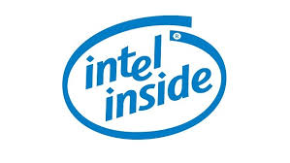
Computer Industry Background
Computer companies have the same key technologies
CPU, operating systems, etc.
Competing on customer service and cost structure
The dilemma
Technology advances fast, product life-cycle is short, inventory cost is high
Demand is highly unpredictable, customer expectations are high on service level
Notes:
Our second example comes from the computer industry. Computer companies have the same key technologies, CPU from Intel and operating systems from Microsoft. So they are not competing on technologies, but on customer services and cost structure.
They faced a challenging dilemma: on one hand, technology advances fast, which means that product life-cycle is short and inventory cost is high due to obsolescence – so you cannot hold inventory. On the other hand, demand is highly unpredictable and customers expect high availability of products and fast delivery, so you must provide high service levels.

Slide 6
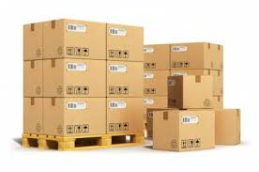
Compaq vs. Dell：Supply Chain Strategies
Compaq’s strategy
Batch production
Sell by retailers
High inventory
But low production / shipping costs
Dell’s strategy
Configure to order
Direct sales
Lowest inventory
But high production / shipping costs
Notes:
The root cause comes from their supply chain strategies. Compaq’s strategy focuses on the economies of scale by producing its products in batches and selling them by retailers. This results in high inventory cost but lower production / shipping costs.
Dell’s strategy is the complete opposite. It focuses on inventory cost and speed to market by making to order and direct sales to end customers, which results in lowest inventory cost but high production and shipping costs.

Slide 7
The Power of Benchmarking: Dell vs. Compaq
Data comes from http://yahoo.marketguide.com (2000)
Dell outperformed Compaq by 1% in Operating margin
Why is this 1% so critical that Compaq, the market leader, gave up the competition and sold itself?
Notes:
To see the answer, we must first explain why Compaq’s gross margin is higher than Dell. Recall that they have the same key suppliers, different gross margin actually means different pricing. In fact Dell has a 10% lower selling price than Compaq at that time. Even with a lower price, Dell can make more money, how can Compaq compete?!

Slide 8
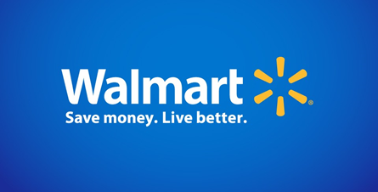
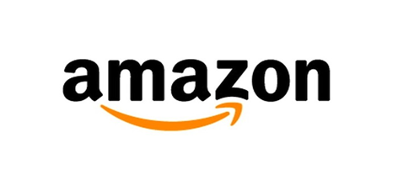
Wal-Mart vs. Amazon
World’s largest retailer (offline)
Sell anything
World’s main online seller
Sell anything including those of 3rd party sellers
The combat between the best offline vs. online retailers!
The outcome determines the future of retailing
Notes:
Our last example is Wal-Mart vs. Amazon! Walmart is the world’s largest retailer – mainly offline, it sells anything. Amazon is the world’s leading online retailer, it also sells anything including those of 3rd party sellers. They are fighting against each other in the last 10 years. This is the combat between the best offline retailer and the best online seller. The outcome will determine the future of retailing in this country and around the world.
Amazon was founded in 1994 by Jeff Bezos. In 1962, Sam Walton purchased bulk merchandise and transported it directly to stores.
Amazon and Walmart have been locked in price wars in last couple of years

Slide 9
2014 Financial Data
Market Cap | $314 B | $191 B
Revenue 2014 | $89 B | $482 B
Gross Profit | 29% | 24.3%
P/E | 974 | 13
Dividend | N/A | 1.96
Growth Rate | 6.47 % | -6.52 %
Why?!
Notes:
Let’s look at the financial data first. In year 2014, Amazon’s revenue is about only 1/5 of that of Walmart, but its market cap is 50% higher. The difference in gross profit is not high; the growth rate of Amazon is much higher than Walmart. But does that alone justify a nearly 1000 P/E ratio for Amazon vs. 13 for Walmart? Why did investors take such a different view on these companies? To answer this question, we shall look deeper at their sales and operations data.
Profit margin similar, Amazon is 1/5 of Walmart in revenue, Amazon is growing much faster. But Amazon has no dividend.
看数据

Slide 10
Price
https://www.profitero.com/2017/10/new-profitero-study-reveals-amazon-is-winning-the-online-price-war-but-walmart-is-on-the-offensive/
Notes:
We first look at the price. Using Amazon as a benchmark, we find that Walmart is on average 2.9% higher on prices than Amazon, and Target is 16.9% higher on prices.
Walmart appears to be making the largest strides to compete with Amazon in the beauty category, with products found to be 1% lower than Amazon on average; in the Profitero 2014 study, beauty products were priced 10% higher than Amazon;
Electronics is one of Walmart’s least competitive categories to Amazon, with products priced 7% higher on average than Amazon;
Target was found to be the most expensive of the major retailers, and 17% more expensive than Amazon; this marks a shift in price competitiveness from the 2014 Profitero study which found Target pricing to be 10% more expensive on average;
Specialist retailers such as Staples, Best Buy and Home Depot struggle to compete with Amazon on price: Staples was found to be the most expensive specialist retailer to Amazon (products were 49% higher than Amazon on average), while Chewy.com had the closest pricing (its average prices were just 7% higher than Amazon).

Slide 11
Delivery
https://www.gobankingrates.com/saving-money/walmart-amazon-shipping-cost-comparison/
Notes:
Regarding shipping and delivery, we look at 5 dimensions of performance, from standard shipping, free shipping minimum to expedited shipping. Walmart and Amazon are comparable on delivery with Amazon being slightly better.

Slide 12
Product-Variety
March 2017
Walmart (22 million products) vs. Amazon (375 million products)
Walmart has only 5.8% of what Amazon has to offer.
https://www.scrapehero.com/amazon-vs-walmart-products-sold-in-march-2017/
Notes:
We also look at product variety. Walmart has 22 million products while Amazon has 375 million, Walmart has only 5.8% of what Amazon has to offer. So Amazon has a much bigger product variety and thus can better match customer needs with its products. So far, the data shows that Amazon outperforms Walmart on price, delivery and product variety, and thus can provide a better service level (satisfaction) to customers.

Slide 13
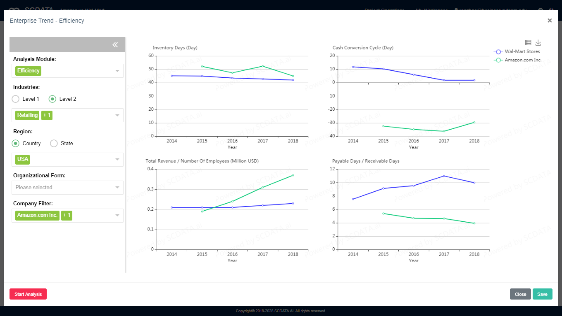
Efficiency: Cash Conversion Cycle
Notes:
Now the question is, what about their operational efficiency? Can Amazon do more with less? Without further getting into the details, we just look at one important measure, the cash conversion cycle, which measures the time it takes a company to convert its investment in inventory and other inputs into cash. Walmart is very efficient, the cash conversion cycle is constantly about 10 days. Amazon is about negative 30-40 days, which means its suppliers and customers are financing Amazon’s operations and it can deposit the cash received from customers in the bank for 30-40 days (to get interest) before paying the suppliers.
So our data analysis shows that Amazon outperforms Wal-Mart on both customer satisfaction and operational efficiency, which explains the investors’ enthusiastic preference to Amazon than Wal-mart.
Return to customer satisfaction and efficiency / cost. Why CCC is directly related to efficiency? Because it measures inventory (internal ops), supplier (supply mgmt.) and customers (demand management).
Amazon is the money machine，空手套白狼！靠供应链管理。A few hundred PhD work on their operations. One of our students is there!

Slide 14
PWC 2013 Global Survey – Economic Impact
“Companies that acknowledge supply chain as a strategic asset achieve 70% higher performance.”
“Nearly 50% higher sales growth and 20% more profitable.”
“Supply chain leaders achieve an average of earnings before interest and taxes (EBIT) margins of 15.6%, versus the laggards at 7.3%.”
Source：“Next-generation supply chains, Efficient, fast and tailored”，PWC Global Survey，2013 。
Notes:
These three examples do not stand alone. A PWC survey shows that …

Slide 15
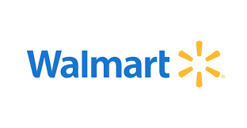
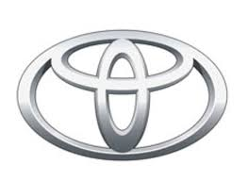
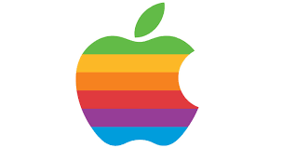
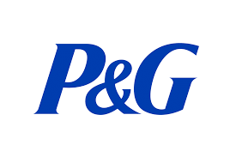
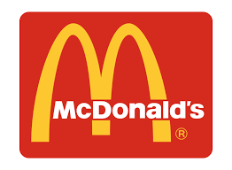
Top Companies in SCM
SCM is so important that the success of Wal-Mart, Amazon, McDonald, Toyota, Apple, P&G, largely depends on it.
The CEOs of Apple, GM and P&G have a SCM background.

