Slide 1

Dream Job Analysis
Job Opportunity Analysis by Region, Industry & Enterprise
Your
Dream Job
Dr. Yao Zhao
Professor in Supply Chain Management
Rutgers Business School
Instructors are free to use and modify the content of these slides
Notes:
To demonstrate the power of data analytics is, let’s us do a job opportunity analysis to define and discover YOUR dream jobs. We will analyze jobs opportunities by region, industry and enterprise.

Slide 2

Navigation
Define dream job
SP500 Companies
Regional Analysis – Business Geographic Information System (BGIS)
Industry Analysis
Company Analysis
Notes:
We will start by defining dream jobs, then discuss the data on “S&P 500 companies”. Then we do a regional analysis on job opportunities through a business geographic information system (BGIS). We will also do an industry analysis and finally a company analysis on jobs opportunities.

Slide 3
Defining Dream Jobs
A dream job: Something you like to do and makes you tons of $!
Lower effort but higher pay, growth opportunities, job security
Region
(where to locate)
Industry
(which industry to enter)
Company
(which company to work for)
Economically prosperous regions have many job opportunities
If your industry does not have a future, neither will you.
Profitability,
growth, risk / financial health
Notes:
What is your dream job? For most people, a dream job is something that you like to do AND also makes you tons of money. More specifically, most people may prefer a job with a higher pay but a lower effort, more growth opportunities and job security. Hum, sounds like too good to be true – but if you use data analytics, you may actually achieve it! Basically, you have 3 decisions to make: * First, Region (where to locate), second, industry (which industry to enter), and third Company (which company to work for). * Regarding region, the preference should be given to economically prosperous regions because they have many job opportunities. * Regarding industry, you don’t want to enter a sun-set industry because if your industry does not have a future, neither will you. * Regarding company, you may prefer those companies that are more profitable (higher salary), growing faster (career path), and lower financial risk (job security).

Slide 4
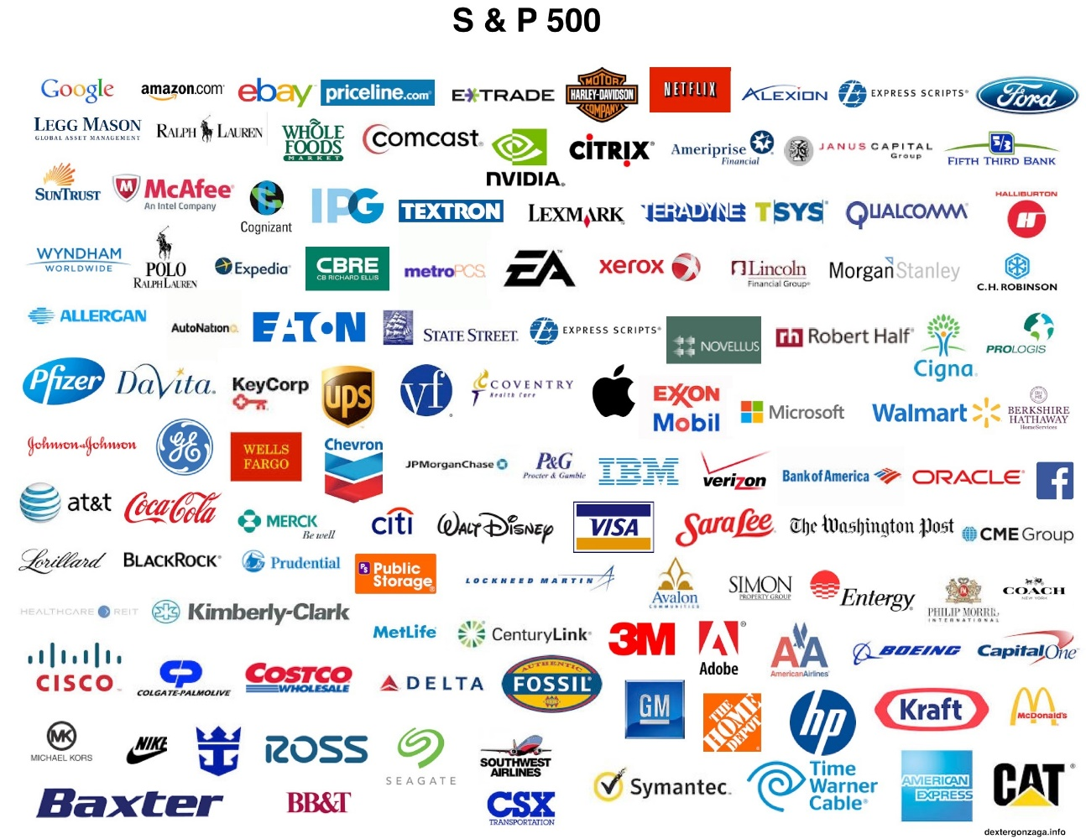
S&P500 Companies
Representative in their industry sectors
Well known companies that many people like to work for
Manageable amount of data not overwhelming
Notes:
To perform the analysis, we use the data of S&P500 companies because they are representative in their respective industry sectors and many of them are well known that people like to work for. We limit the study to these companies so the amount of data is manageable but not overwhelming.

Slide 5
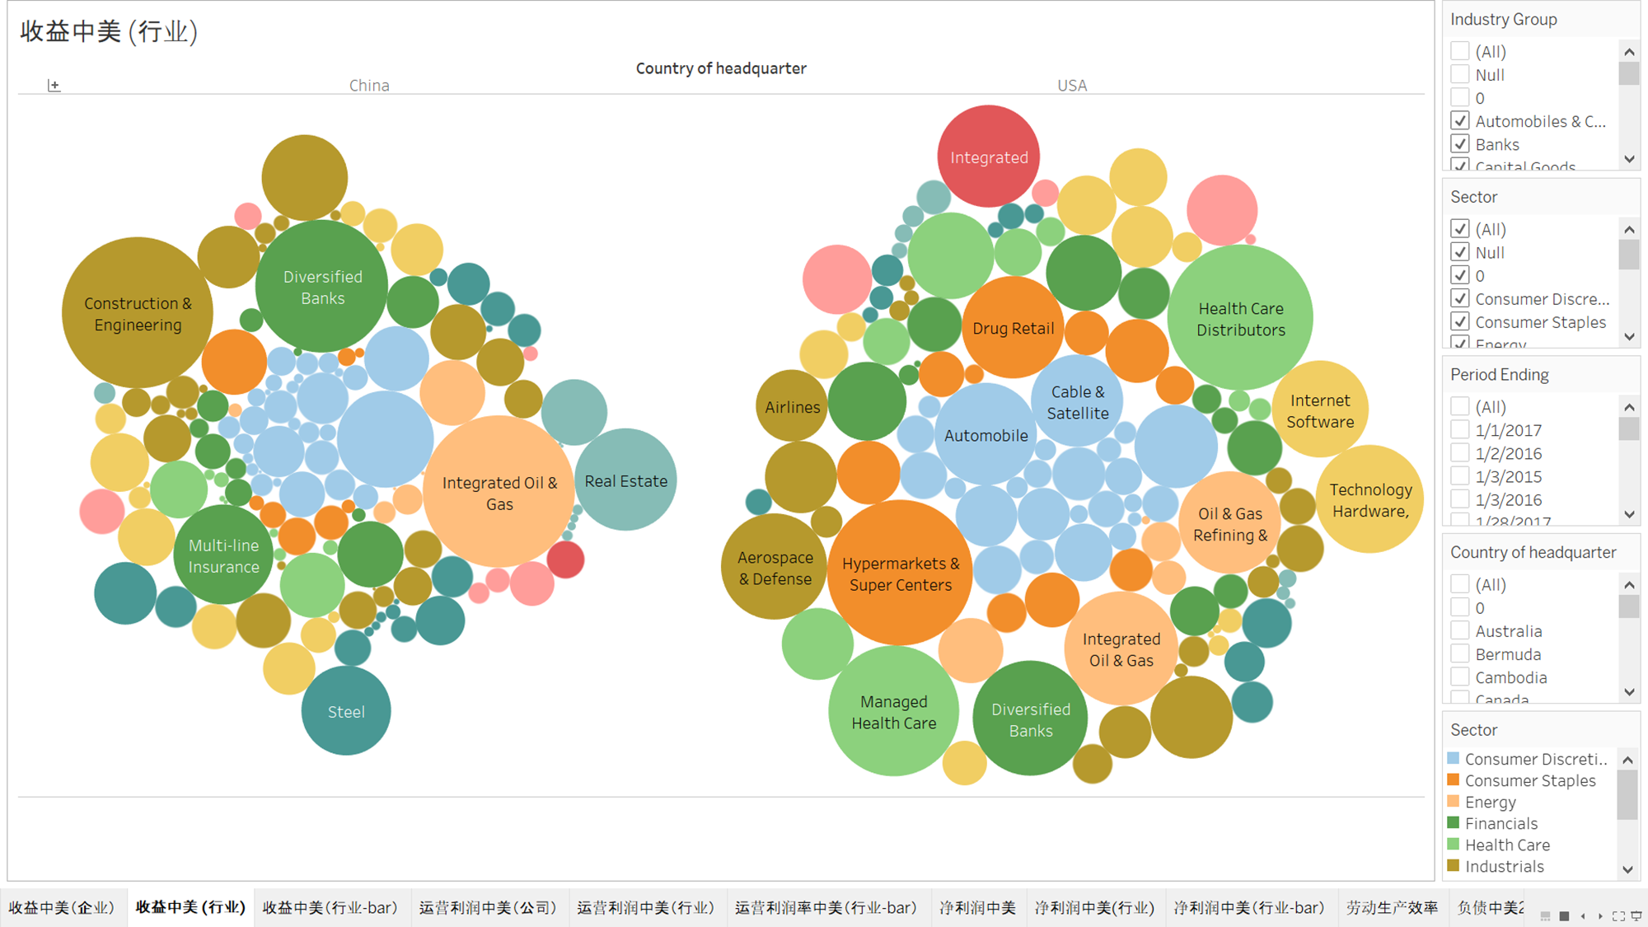
Revenue by Industries
SP500 companies > all Chinese public firms in revenue!
China all publicly traded companies US SP500 Companies
中美主要企业
Notes:
To put the SP500 companies into perspective, let’s compare their revenue and operating profit with those of the publically traded companies in China which is the second largest economy in the world in 2017. From this picture, we can see that in year 2017, the S&P500 companies have a total revenue larger than all the publically traded companies in China! FYI, 95% of S&P500 companies are headquartered in the US.

Slide 6
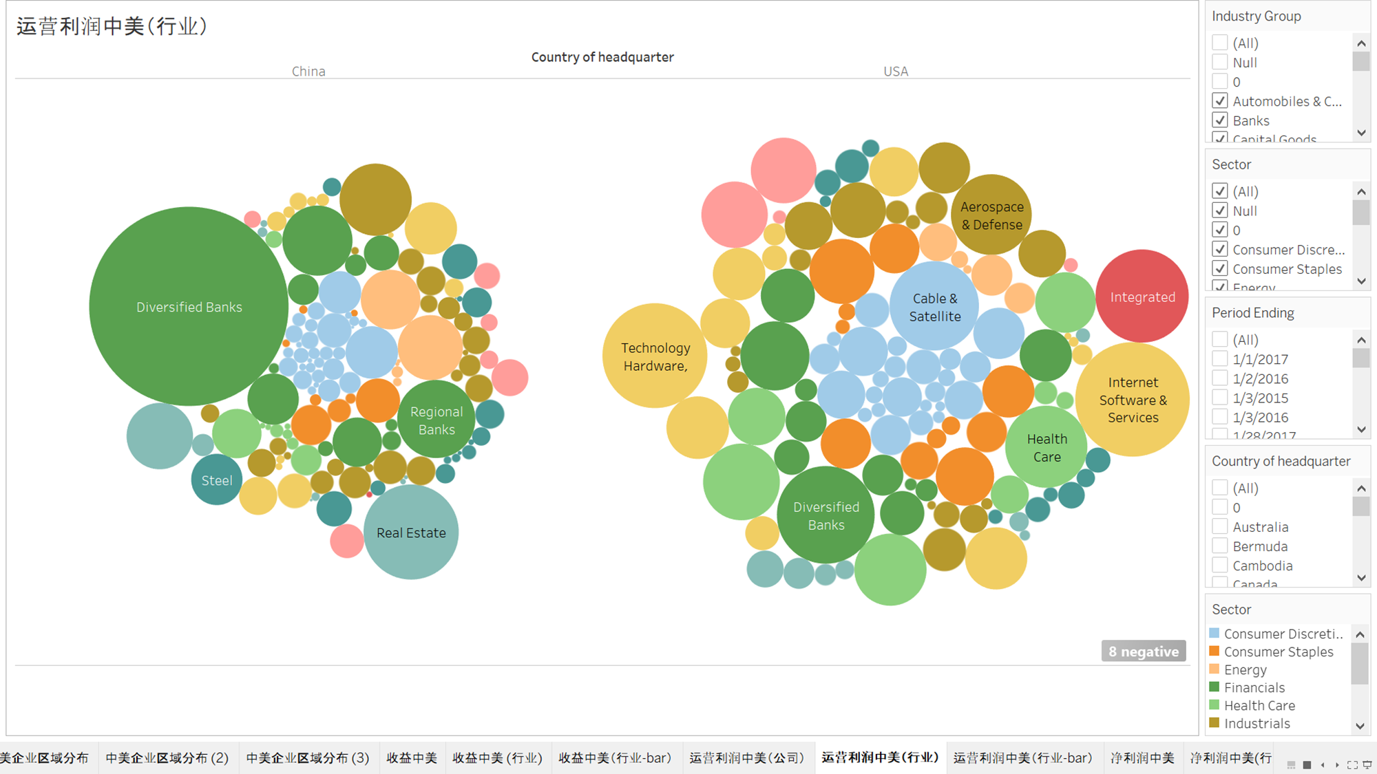
Operating Income by
Industries
SP500 companies > all Chinese public firms in profit!
China all publicly traded companies US SP500 Companies
Notes:
The S&P500 companies also have a larger total operating profit than all the publically traded companies headquartered in China in 2017, and the profit distribution is more even out than the latter because for China, the operating profit is highly concentrated on the banking industry.

Slide 7
Economically most prosperous regions
BGIS: Where are the economically most prosperous regions?
Notes:
Using the business-GIS tools, we want to answer the following questions: where are the economically most prosperous regions in the US for all industries?

Slide 8
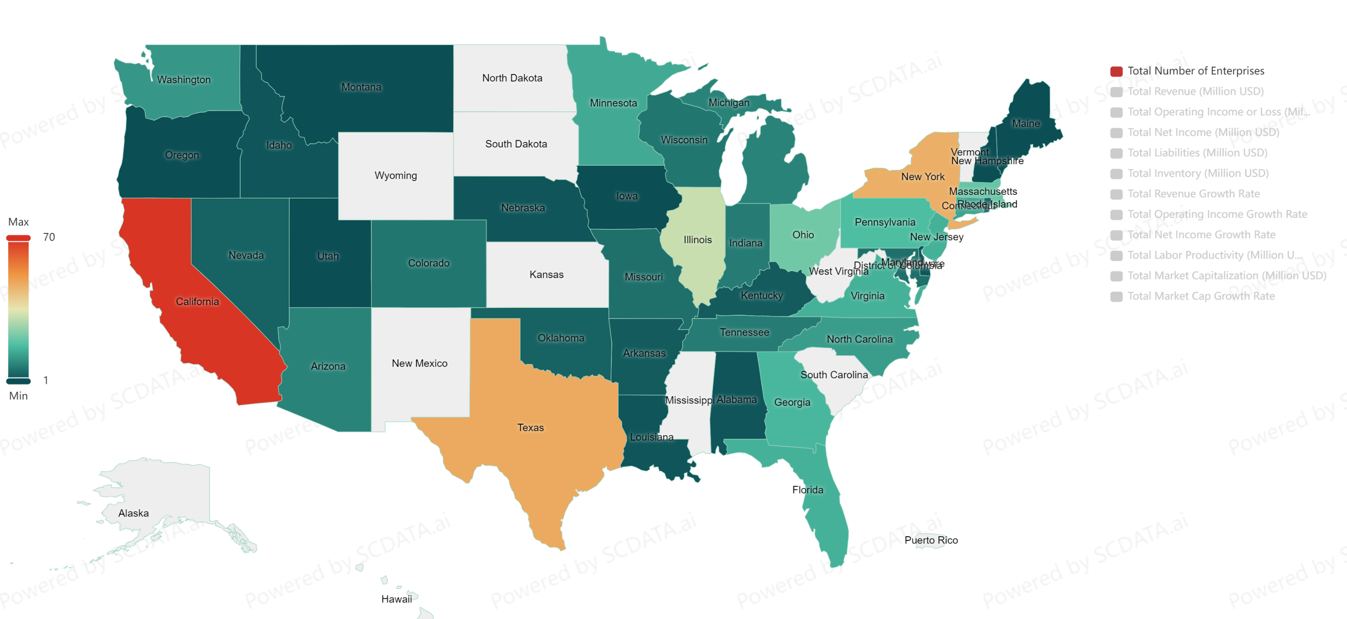
2023, S&P500 Companies by State.
California, Texas, New York and Illinois have the most SP500 firms! Most prosperous regions in the US
Data source: https://www.scdata.ai/project/30332

Slide 9
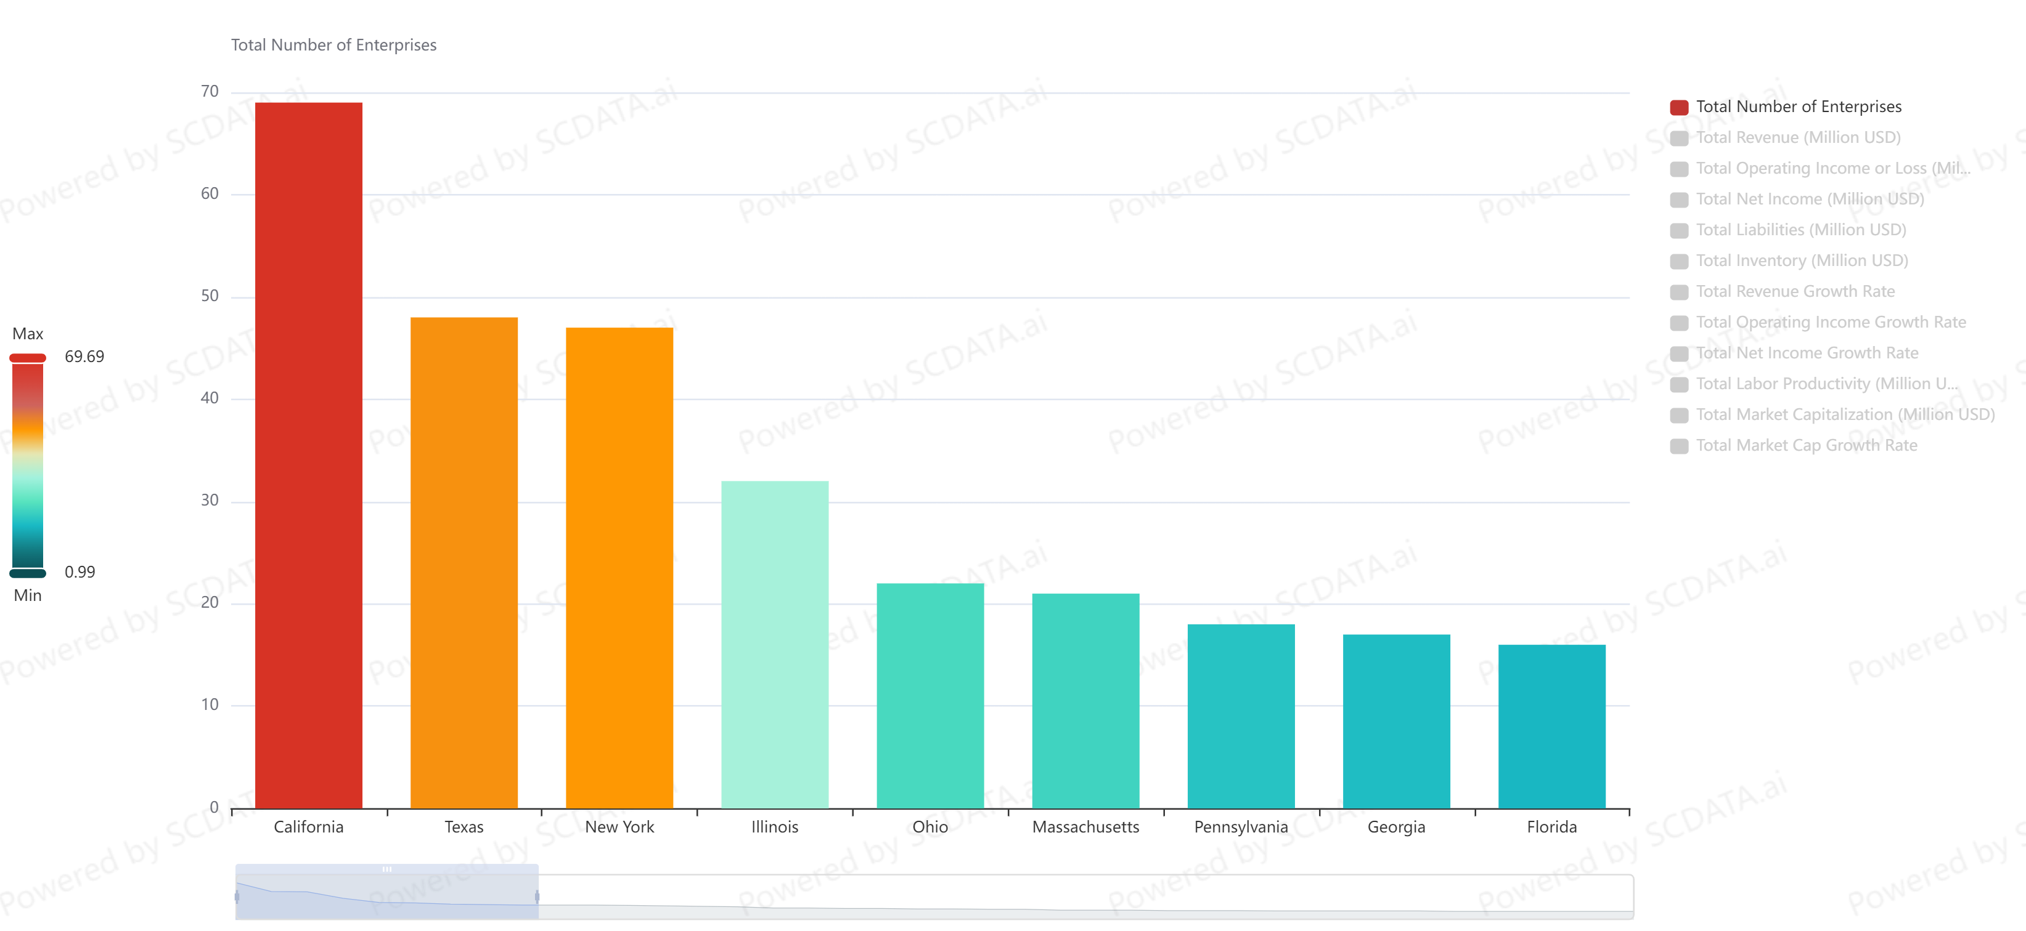
2023, S&P500 Companies by State.
Data source: https://www.scdata.ai/project/30332
Notes:
The bar chart shows more clearly the distribution of SP500 companies by state in 2021.

Slide 10
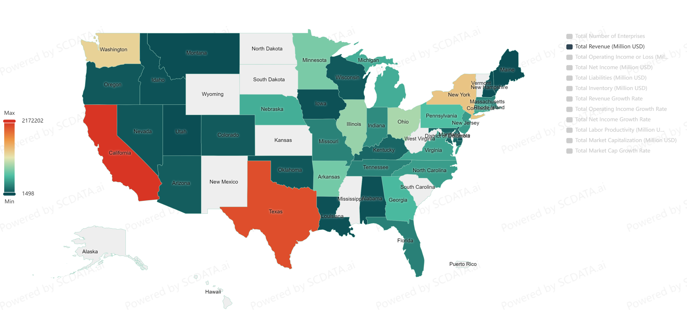
2023, S&P500 Revenue by State.
California, Texas, New York, Washington, and Illinois have the highest revenue!
Data source: https://www.scdata.ai/project/30332
Notes:
Regarding total revenue, …

Slide 11
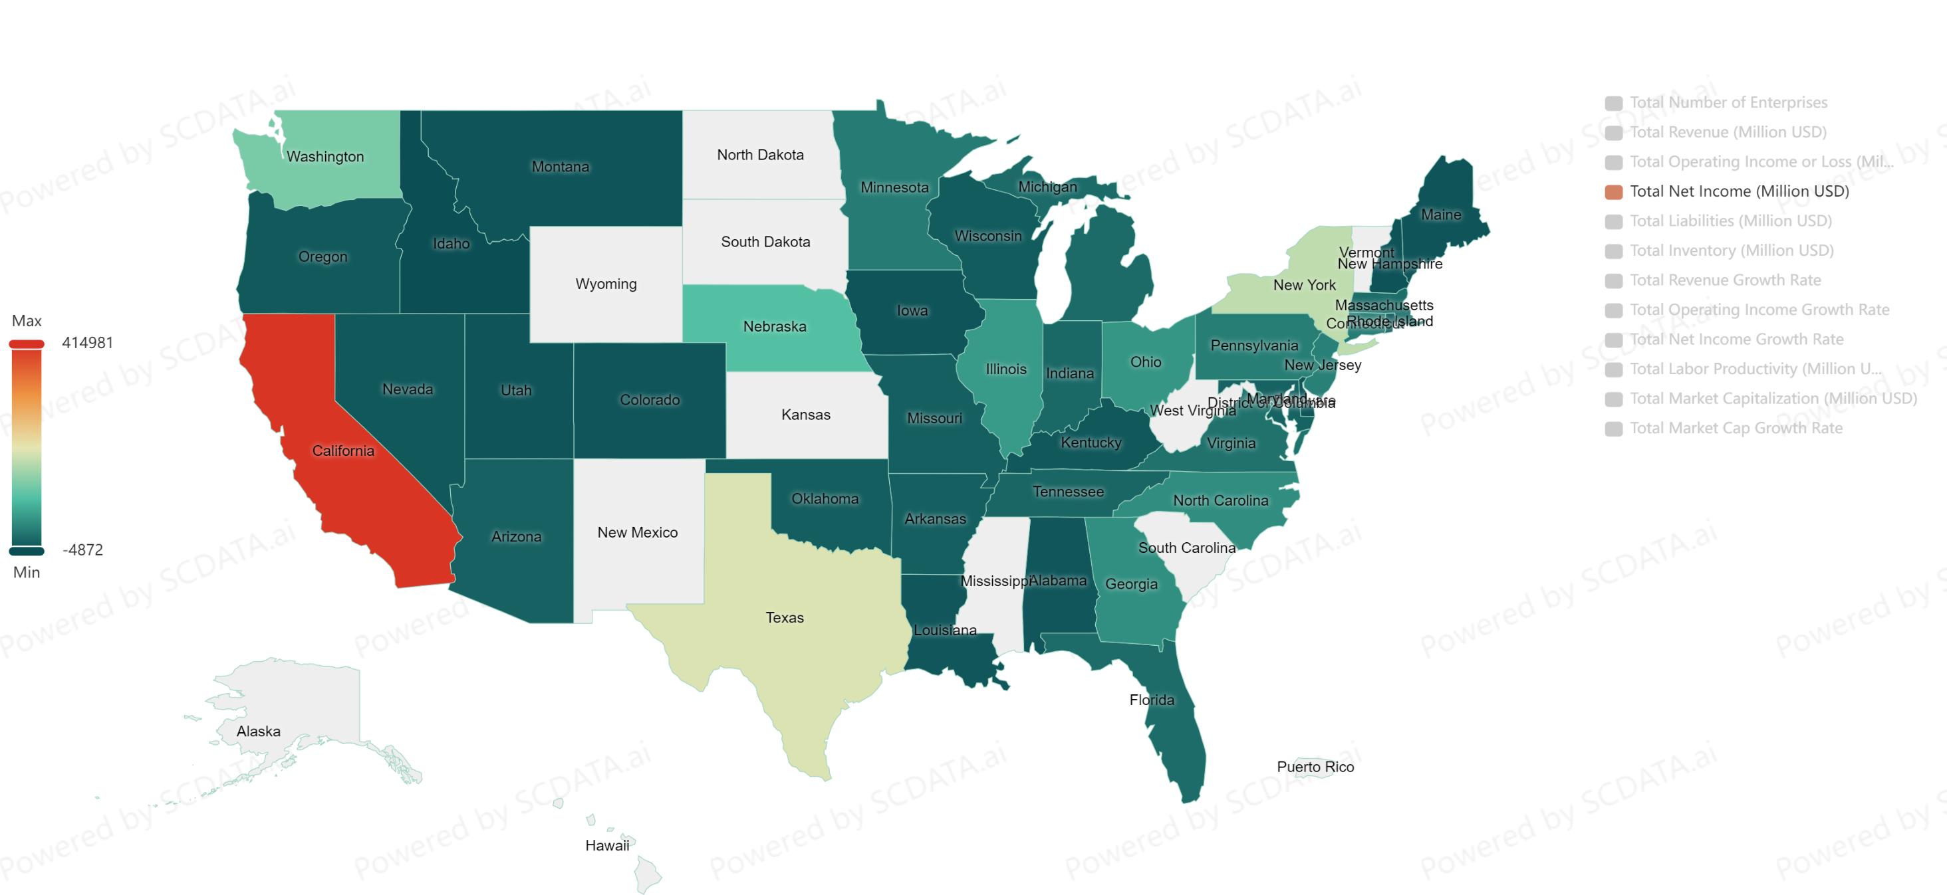
2023, S&P500 Net Income by State.
California, Texas, New York, and Washington are way above other states in net income.
Data source: https://www.scdata.ai/project/30332
Notes:
Regarding net income, … Texas companies seem less profitable than CA companies.

Slide 12
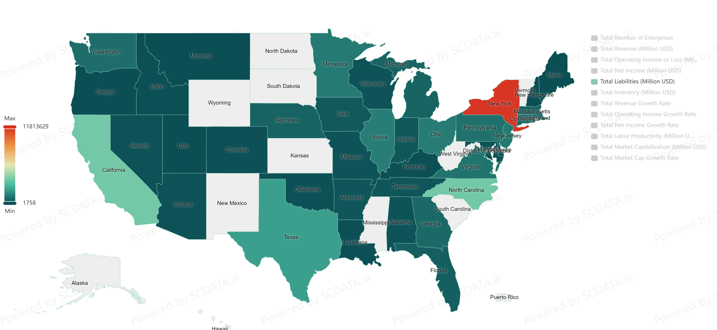
2023, S&P500 Liabilities by State.
New York has the highest liabilities / risk although it hasn’t the highest revenue / net income. CA’s risk is much lower than NY – higher paid & better job security?
Data source: https://www.scdata.ai/project/30332
Notes:
However, NY has the highest liabilities and risk (probably due to financials) although it didn’t have the highest revenue and operating profit. CA has liabilities much lower than NY but a higher revenue and operating profit – implying that the jobs there can be higher paid with a better job security.
Liabilities: NY (however, financials also bring liabilities and risk!), CA (high tech does not) is much lower! TX (oil is also fine on risk) too! NC is also quite high on liabilities although not high on revenue / profit

Slide 13
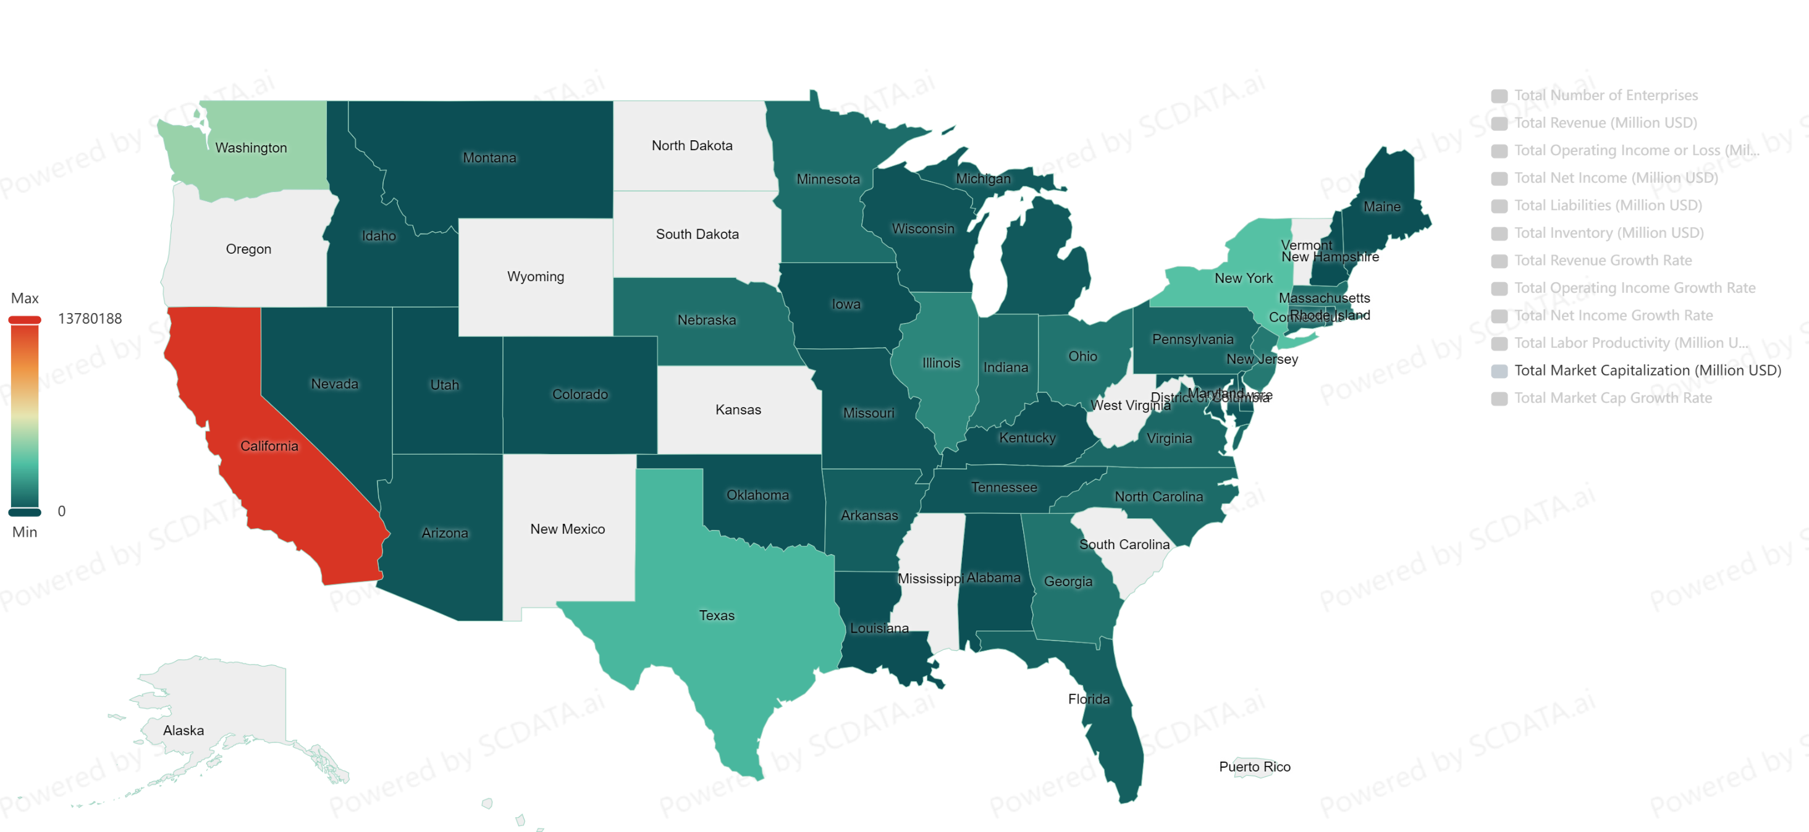
2023, S&P500 Market Cap by State.
CA, WA, TX and NY have the highest market cap or valuation, likely jobs with more valuable stocks and bonus.
Data source: https://www.scdata.ai/project/30332

Slide 14
Industry specific prosperous regions
BGIS: Where are the best locations for IT, financials, energy & healthcare, industrials jobs?
Notes:
Using the business-GIS tools, we also want to know where are the most economically prosperous regions in the US for specific industries such as IT, financials, energy, and healthcare?

Slide 15
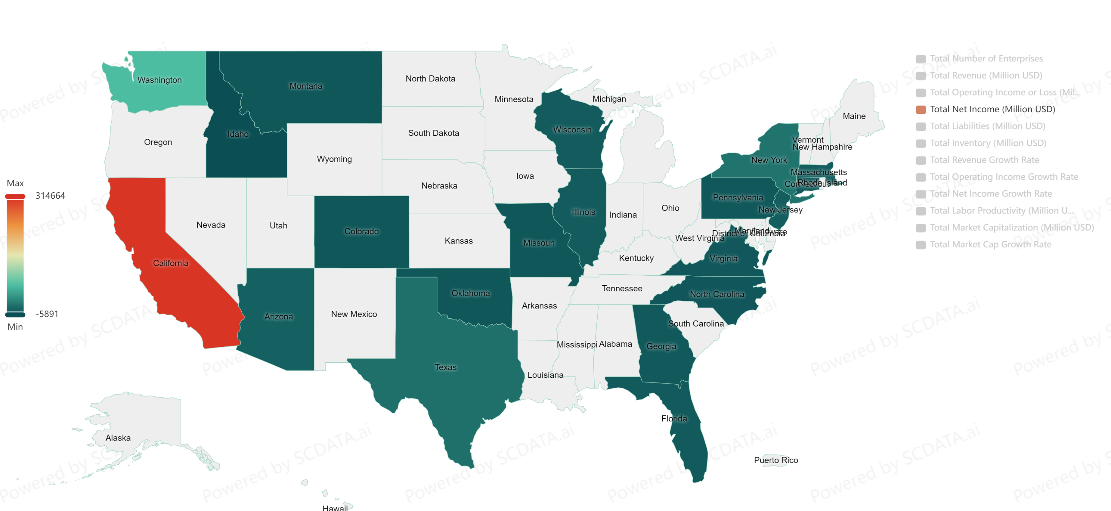
2023, S&P500 IT Net Income by State.
Want to work in IT? Clearly CA! Many more firms / profit in CA than WA which ranks 2nd
Data source: https://www.scdata.ai/project/30332
Notes:
Want to work in IT, clearly CA! Much more than the 2nd WA.

Slide 16
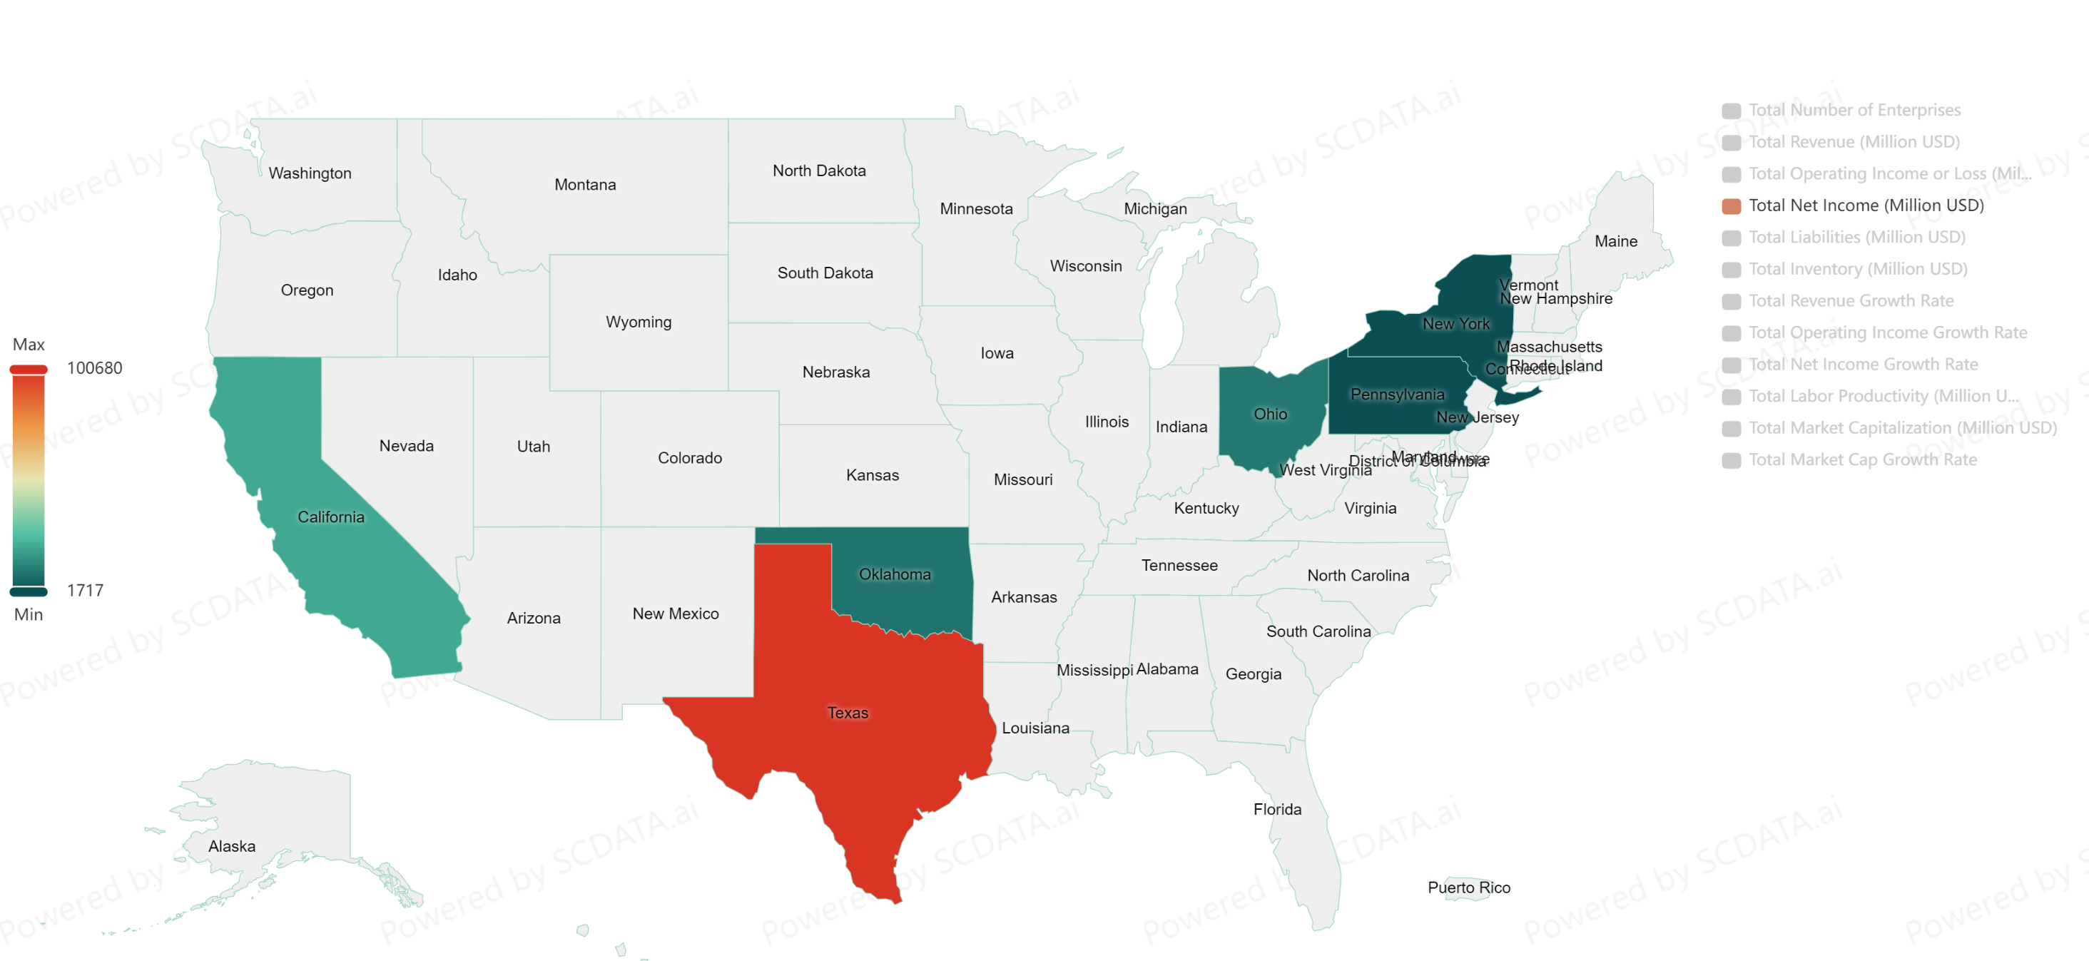
2023, S&P500 Energy Net Income by State.
Want to work in Energy? Clearly TX! Many more firms / profit in TX than CA which ranks 2nd
Data source: https://www.scdata.ai/project/30332
Notes:
Oil: TX! Much better than the 2nd CA.

Slide 17
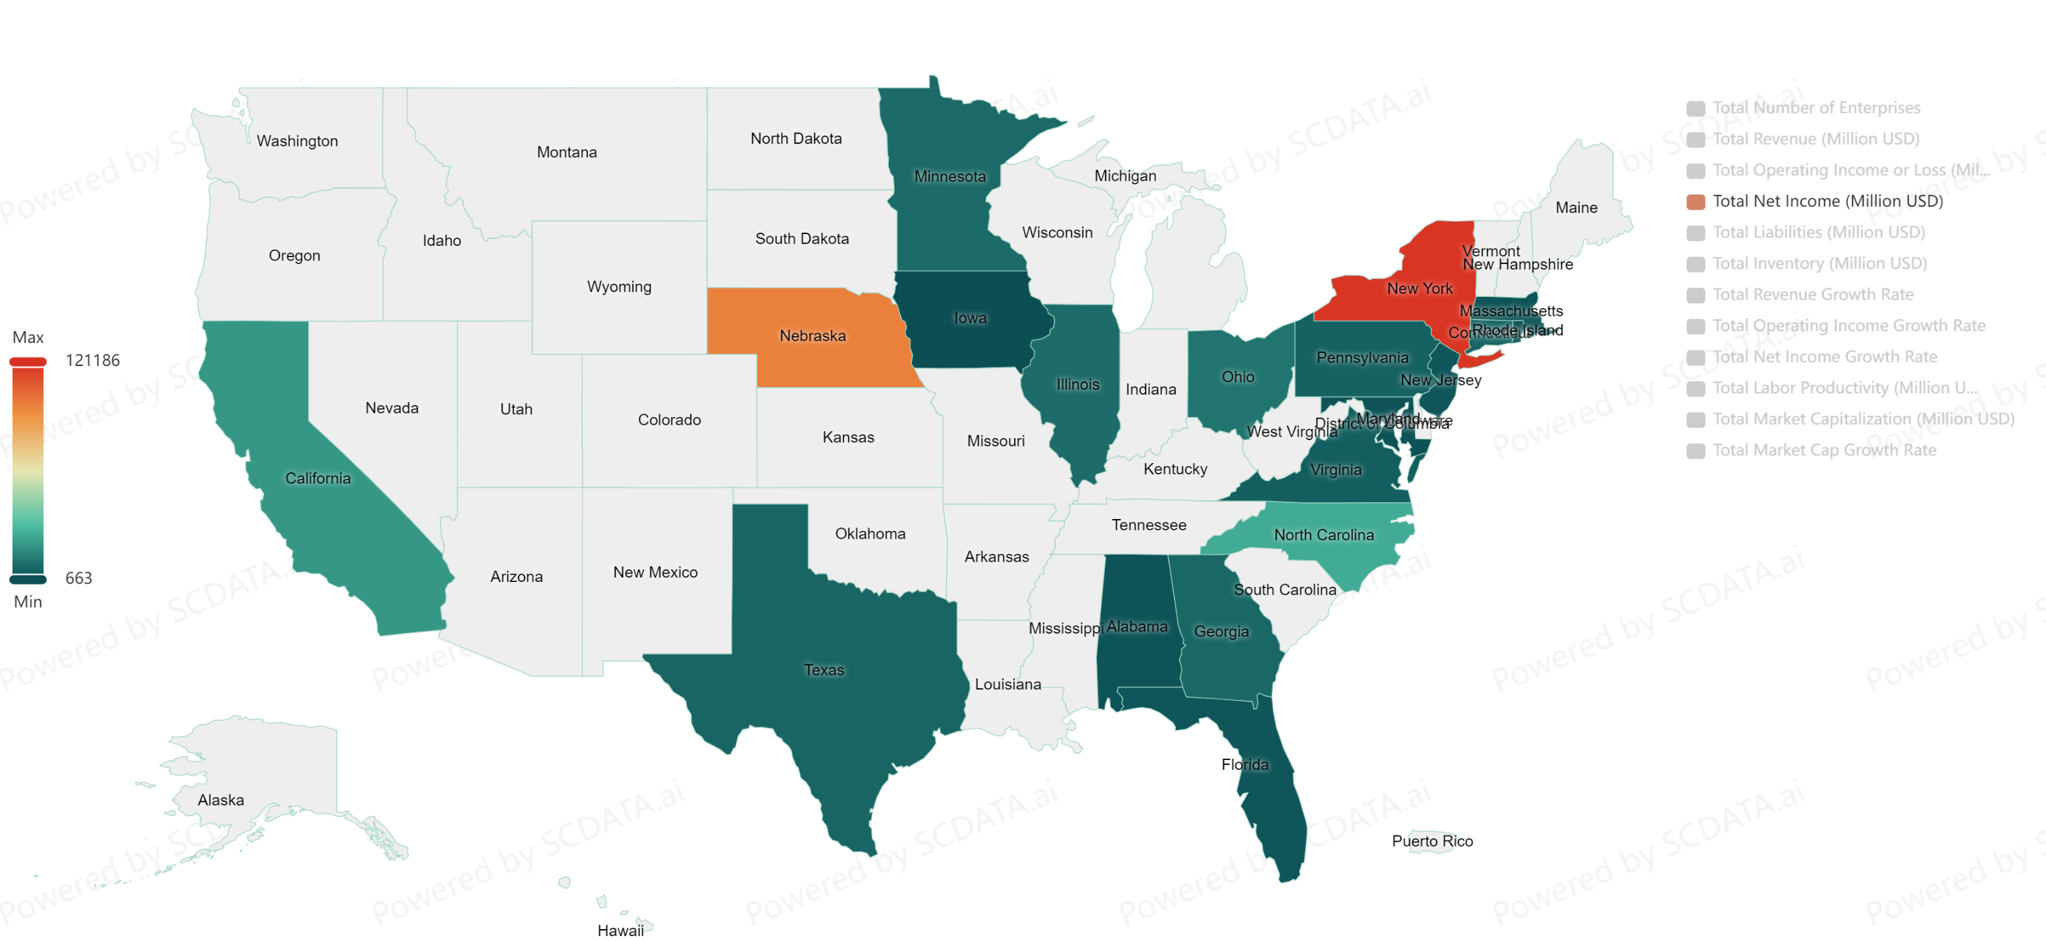
2023, S&P500 Financials Net Income by State.
Want to work in Financials? Clearly NY! Much higher profit in NY than Nebraska which ranks 2nd
Data source: https://www.scdata.ai/project/30332
Notes:
Financials: clearly NY! Much better than the 2nd NE (BRK)

Slide 18
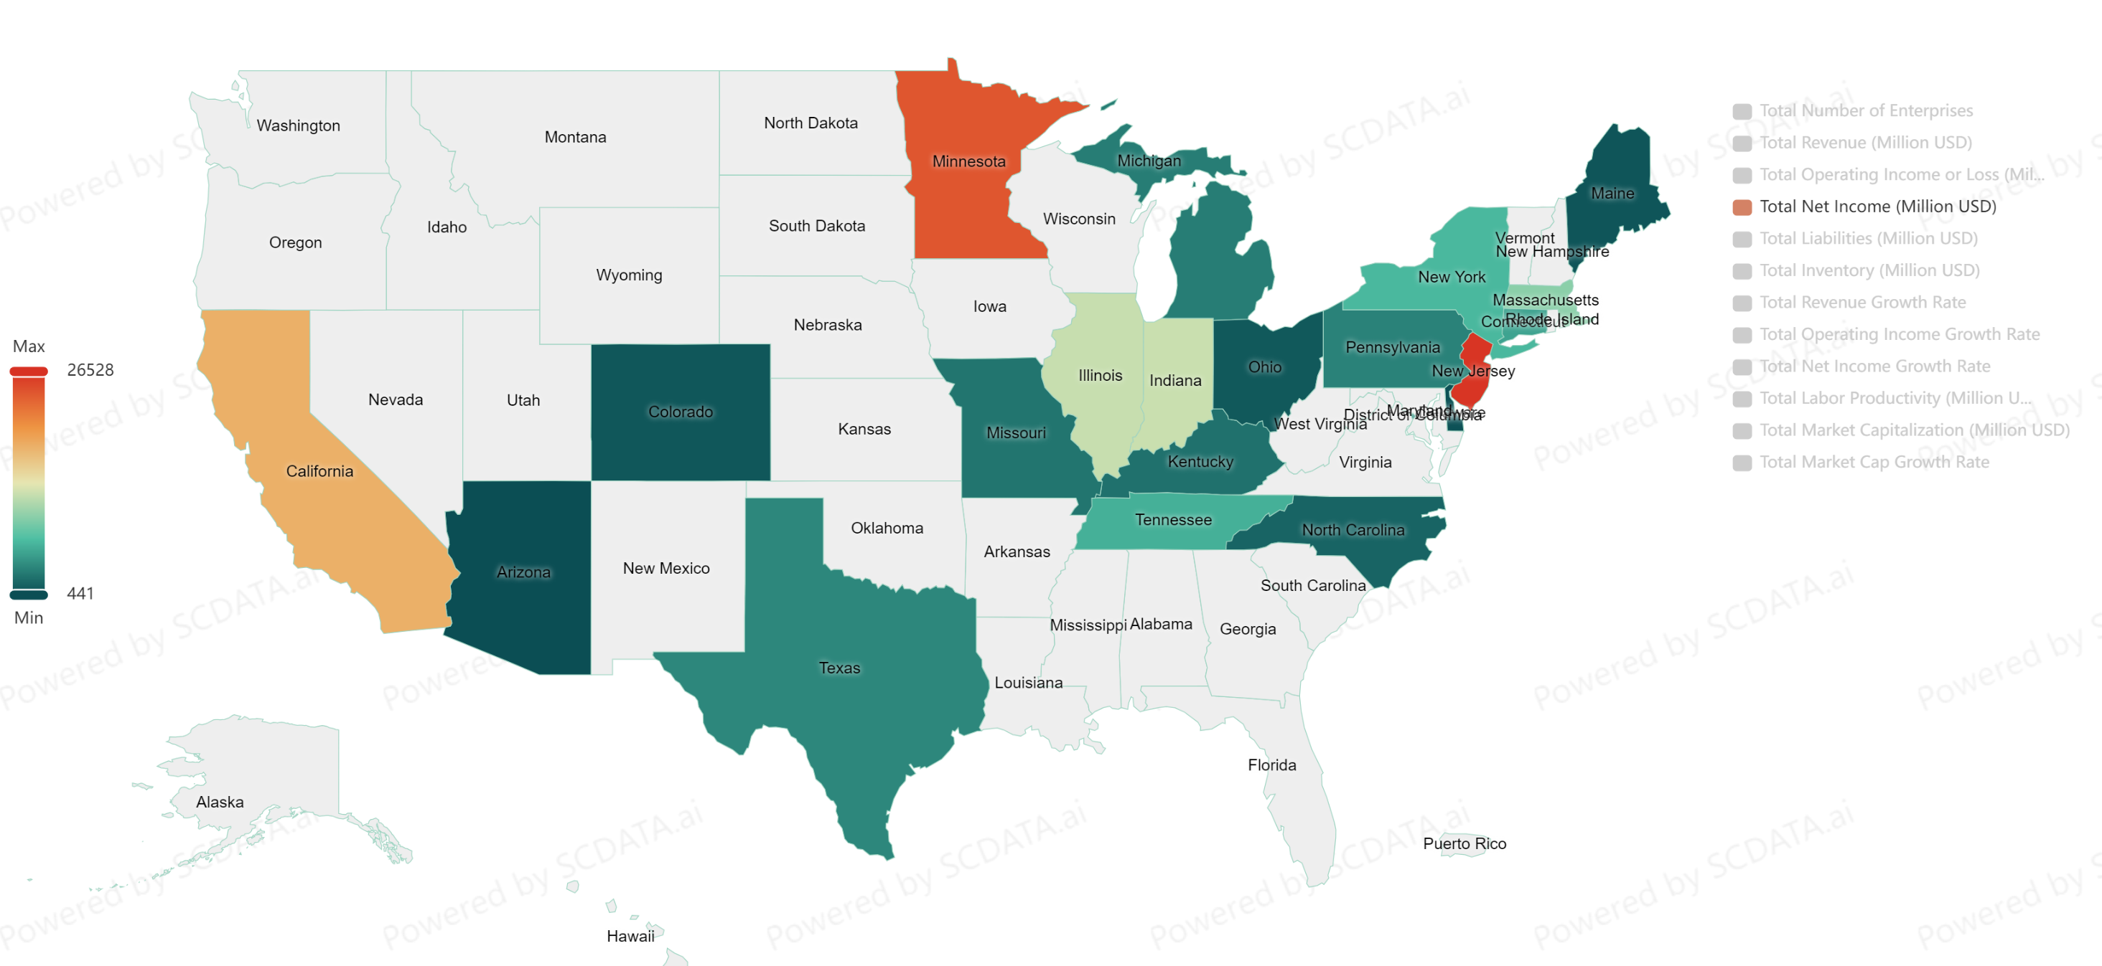
2023, S&P500 Healthcare Net Income by State.
Want to work in Healthcare? Clearly NJ, better than MN and CA.
Data source: https://www.scdata.ai/project/30332
Notes:
Healthcare: NJ, MN, CA!

Slide 19
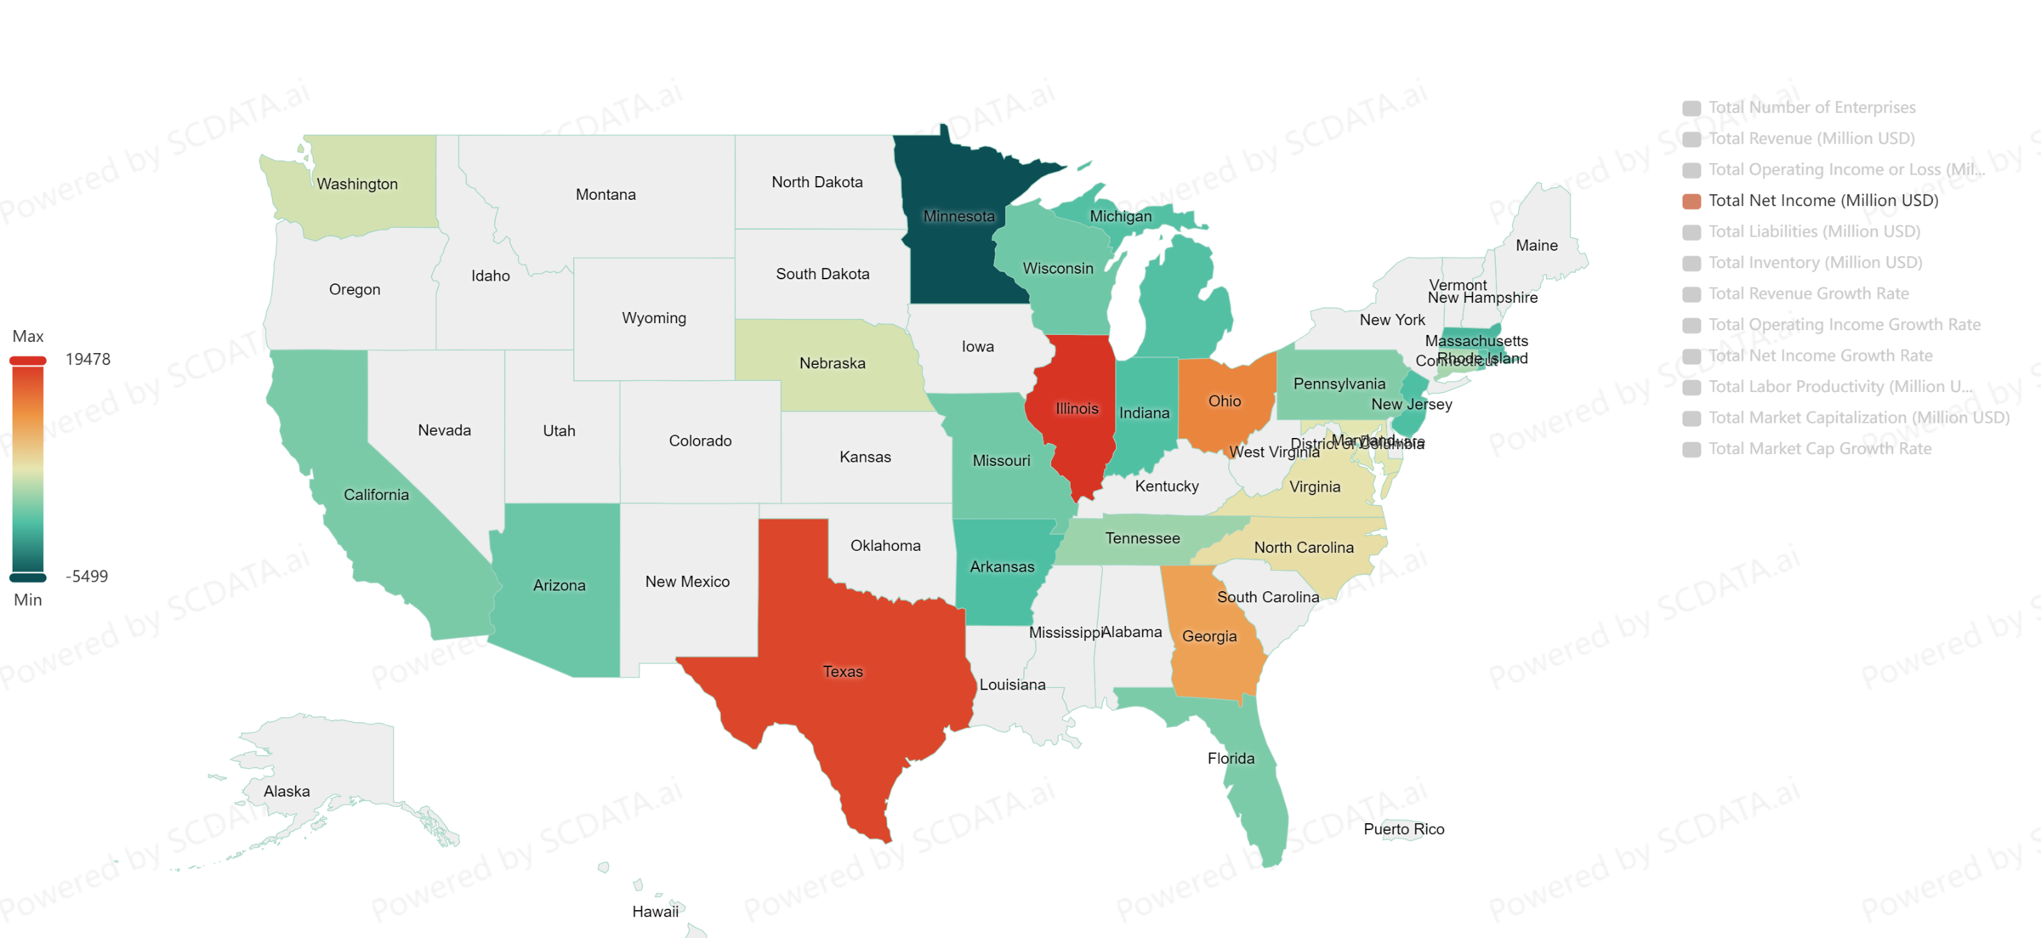
2023, S&P500 Industrials Net Income by State.
Want to work in Industrials? Clearly IL or TX, better than Ohio and Georgia.
Data source: https://www.scdata.ai/project/30332
Notes:
Industrials: IL, TX, Ohio and Georgia!

Slide 20
Industry Analysis
Which industry to enter?
(1) The highest profitability (high salary), highest growth (career path), and lowest financial risk (best job security)?
(2) The largest and steadily increasing workforce?
Notes:
Now, let’s move on to industry analysis, to answer questions such as Which industries to enter? More specifically, which industries have the highest profitability (which can imply a higher salary), the highest growth (implying a promising career path) and the lowest financial risk (meaning a better job security)?

Slide 21
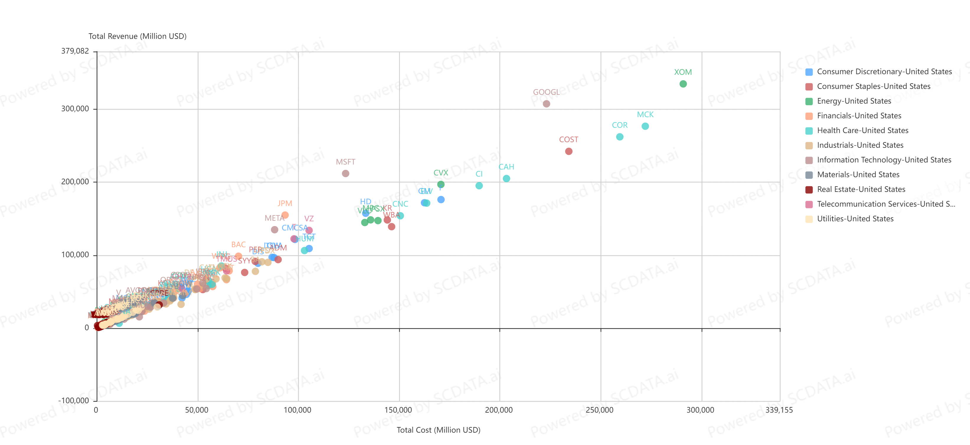
Different Companies Have Different Profitability
Microsoft spent $123B and made $212B
Target spent $105B and made $109B
Total revenue vs. Total cost. 2023, S&P500 companies.
Data source: https://www.scdata.ai/project/30332
Notes:
The revenue vs cost analysis of SP500 companies shows that different companies may have very different profitability, likely because they are in different industries. For instance, MSFT spent $123B and made $212B in 2023, Target spent $105B and made $109B.

Slide 22





Scalable (Easy) vs. Unscalable (Hard) Money
1 person
1 person
1 million persons
1 brick
1 million bricks
Notes:
One of the reasons behind different profitability is the scalability, that is, scalable (easy) and unscalable (hard) money. For example, you need one person to move one brick. What about 1 million bricks? If you still need just one person, then the business is scalable and easy money. But if you need proportionally more persons, say 1 million persons for the 1 million bricks, then the business is unscalable and hard money.

Slide 23


Scalable (Easy $)
Unscalable (Hard $)
Notes:
Easy money Example: AI or automation, robots, …
Hard money Example: restaurants, grocery stores, …

Slide 24
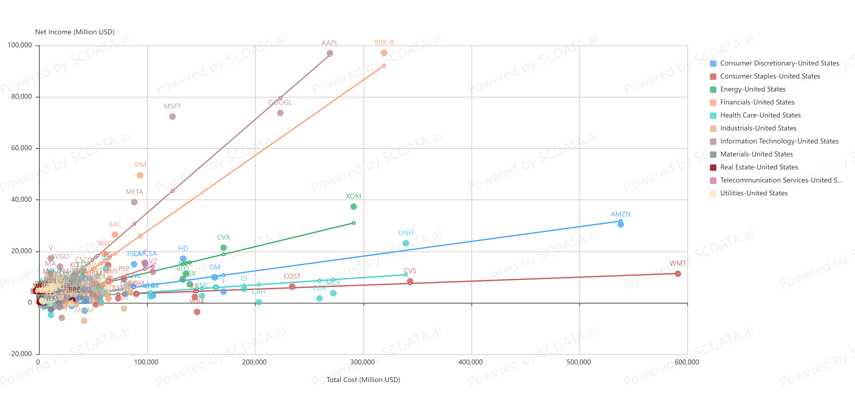
Different Scalability (Profit / Cost) for Different Industries!
Easy $: IT and financials
Hard $: Consumer Staples
Net Income vs. Total Cost. 2023, S&P500 companies.
Data source: https://www.scdata.ai/project/30332
Notes:
MSFT and Target come from different industries. These examples imply that if you enter different industries, you may have very different money making potential! To see the impact of industry on profitability, that is, with the same amount of effort, how much money companies can make in various industries, we can perform a profit vs cost analysis. The slopes indicate the scalability of the industries. We can see that the best industries (smallest cost, biggest profit) in the US are IT and Financials. Consumer staples made the least net income. Consumer discretionary is somewhere in between.

Slide 25
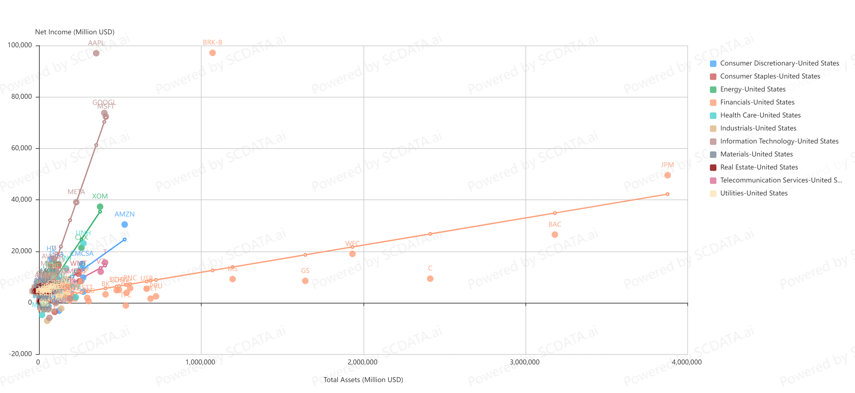
Different Scalability (Profit / Assets) for Different Industries
Easy $: IT
Hard $: Financials
Net income vs. Total Assets. 2023, S&P500 companies.
Notes:
IT still has the highest return for the same amount of asset, followed by consumer discretionary, energy, consumer staple and telecom followed, financials and industrials are among the worst! Different from operating profit vs total cost. Financials and industrials are the worst performers on these metrics because of their high liabilities and high investment in factories, equipment etc.

Slide 26
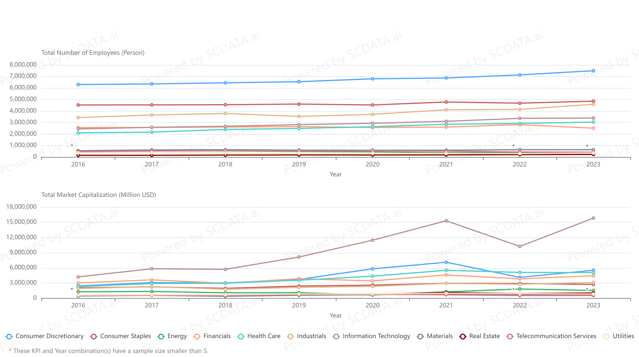
Workforce $≠$ Valuation
Notes:
Valuation is not driven by employees: Industries hiring more employees is not necessarily more valuable, can often be the opposite.
* Consumer discretionary hired the most employees, followed by consumer staples, industrials and IT. Industries with the least employees are Real Estate and utilities. Decent growth or remain stable for recent years.
* However, IT has the highest market cap / valuation despite hiring a lot fewer employees than consumer discretionary. Health Care has about the same valuation as consumer discretionary but hired much less workforce.

Slide 27
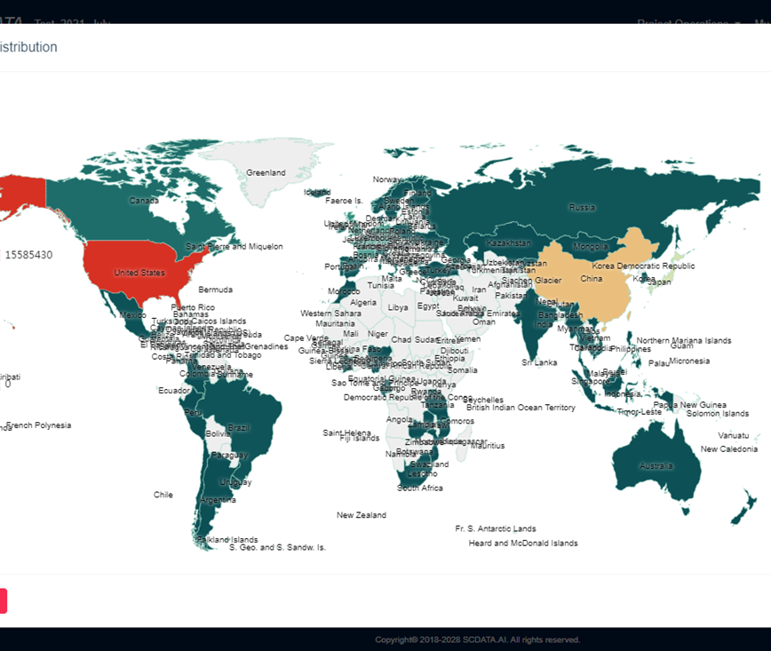
See … for
“What Drive Stock Market Performance”.
Competitive Intelligence
Notes:
So what drive stock market performance? See ... For …

Slide 28
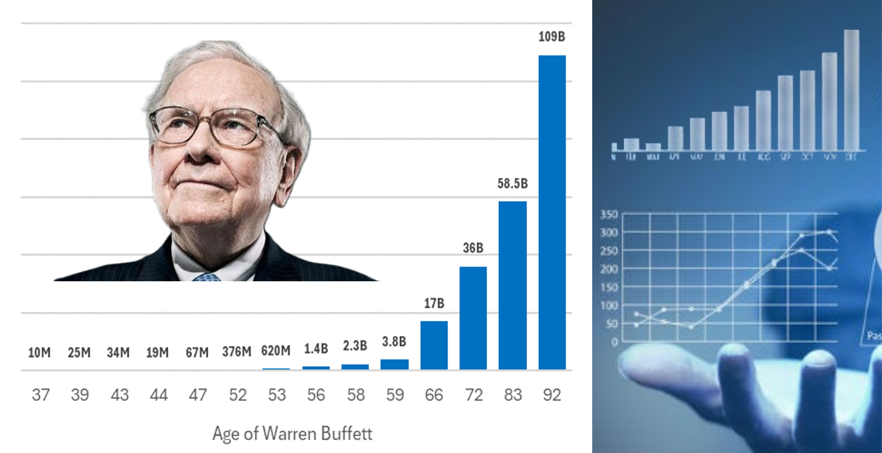
“Data science 4 Buffett Value Investing”
https://www.udemy.com/course/data-science-4-buffett-value-investing
Notes:
How to predict stock market using data science? See https://youtu.be/5tEMn1hODIA for more resources.

Slide 29
IT vs industrials
(1) Profitability (Salary), Growth (Career Growth) and Risk (Job Security)
(2) # of Jobs and stock valuation
Notes:
As an example, we can provide a detailed comparison between IT and industrials by a trend analysis on the profitability, growth and risk. Again, profitability is linked to salary, growth links to career path, and risk or financial health links to your job security.

Slide 30
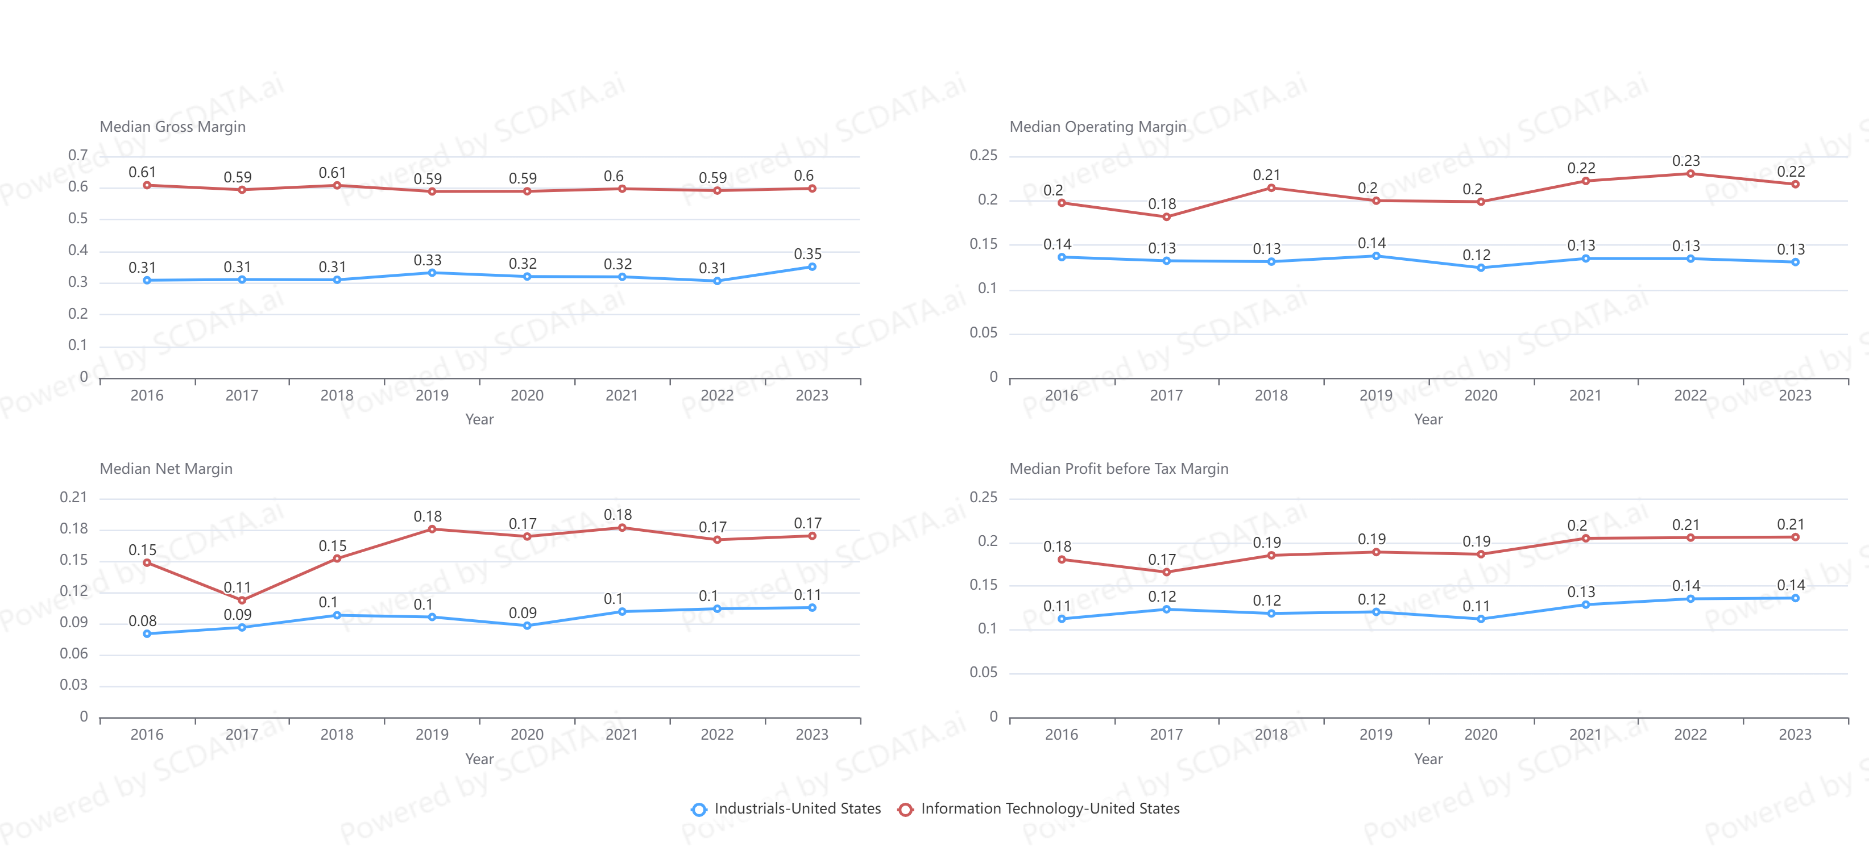
IT firms are more profitable than industrials firms
Trend of Profitability, US Industrial and IT S&P500 companies.
Data source: https://www.scdata.ai/project/30332
Notes:
Comparing IT vs. Industrials on profitability, e.g., median gross margin, operating margin, and net margin, we can see that IT outperforms industrials in every dimension by far for all recent years!

Slide 31
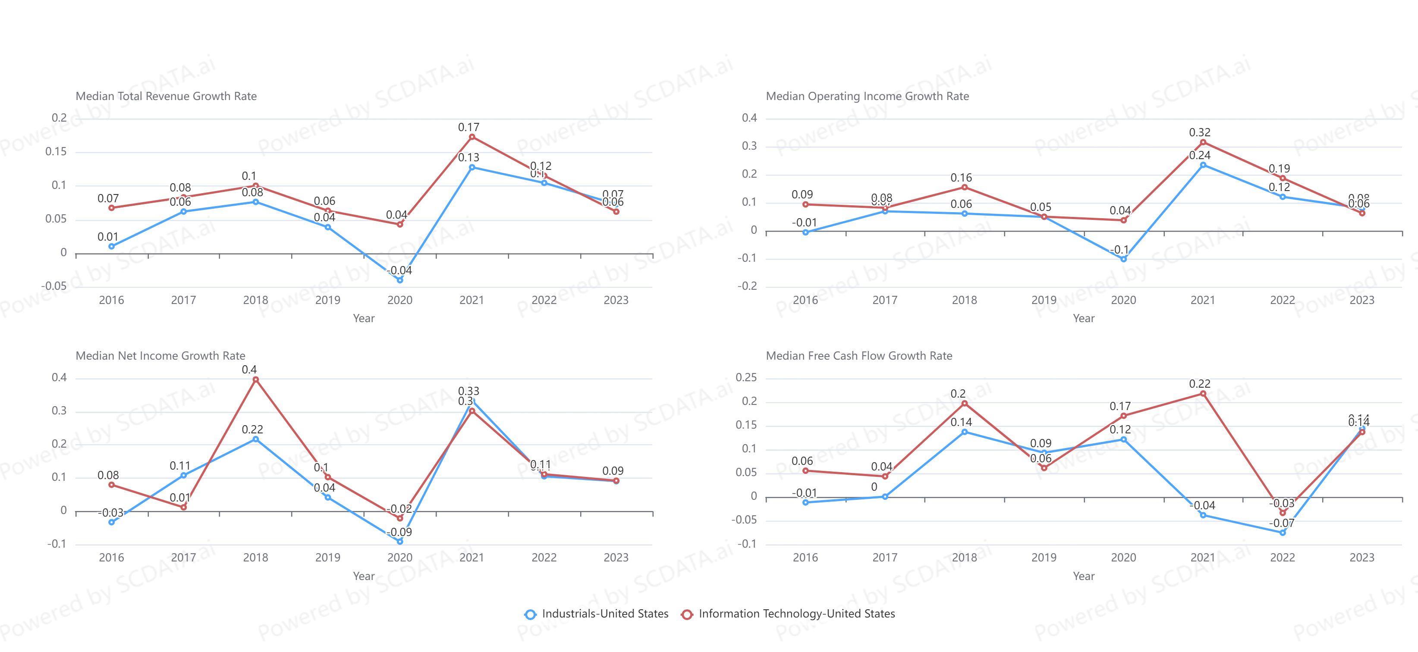
IT firms grew faster in revenue and profits than industrials firms
Trend of Growth, US Industrial and IT S&P500 companies.
Data source: https://www.scdata.ai/project/30332
Notes:
Comparing IT vs. Industrials on growth, that is, the growth rate of total revenue, operating profit and net income. IT firms also grow faster than industrials firms for most years and most measures!

Slide 32
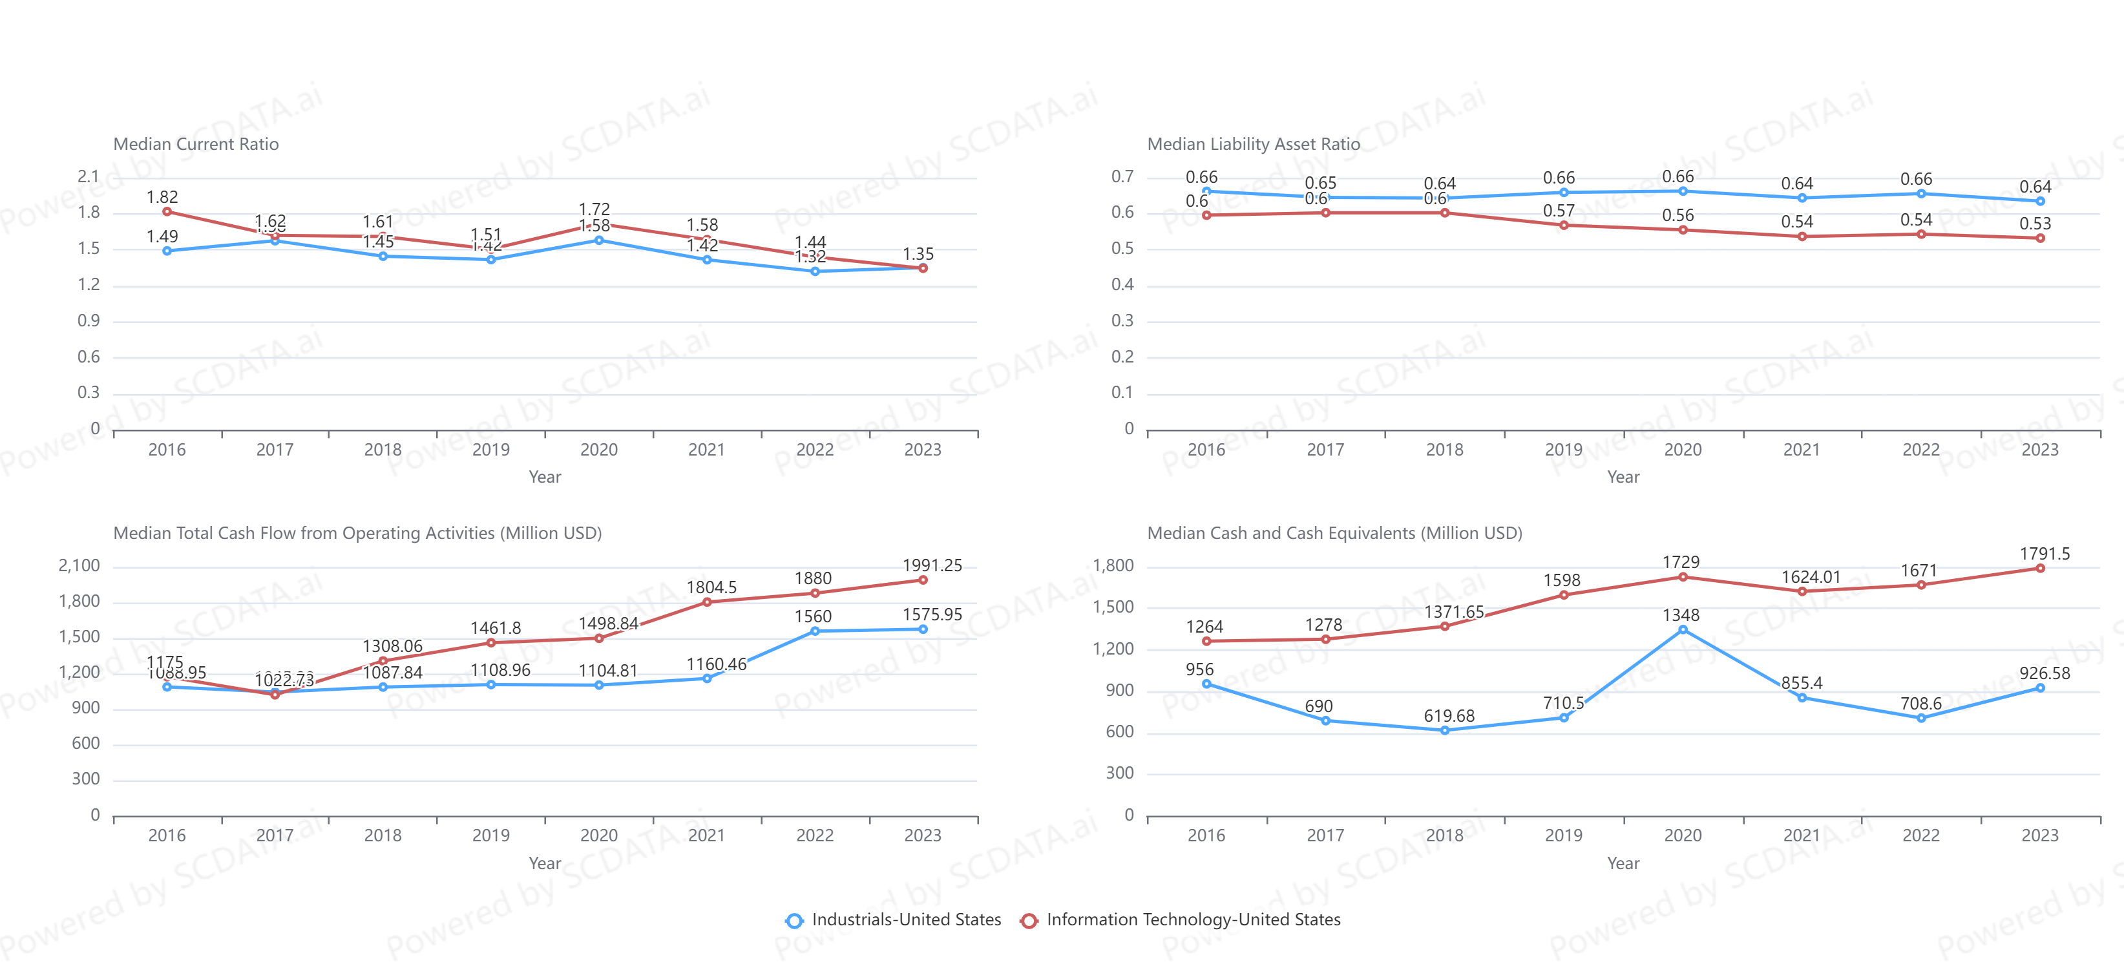
IT firms have a lower short-term risk.
IT firms have a lower liability asset ratio.
IT firms generated more cash each year and in total.
Trend of Financial Health, US Industrial and IT S&P500 companies.
Data source: https://www.scdata.ai/project/30332
Notes:
Lastly, we compare IT and industrials on financial health, and we can see that IT firms have a better current ratio (or liquidity ratio), a better liability asset ratio, more cash generated from operating activities in recent years.

Slide 33
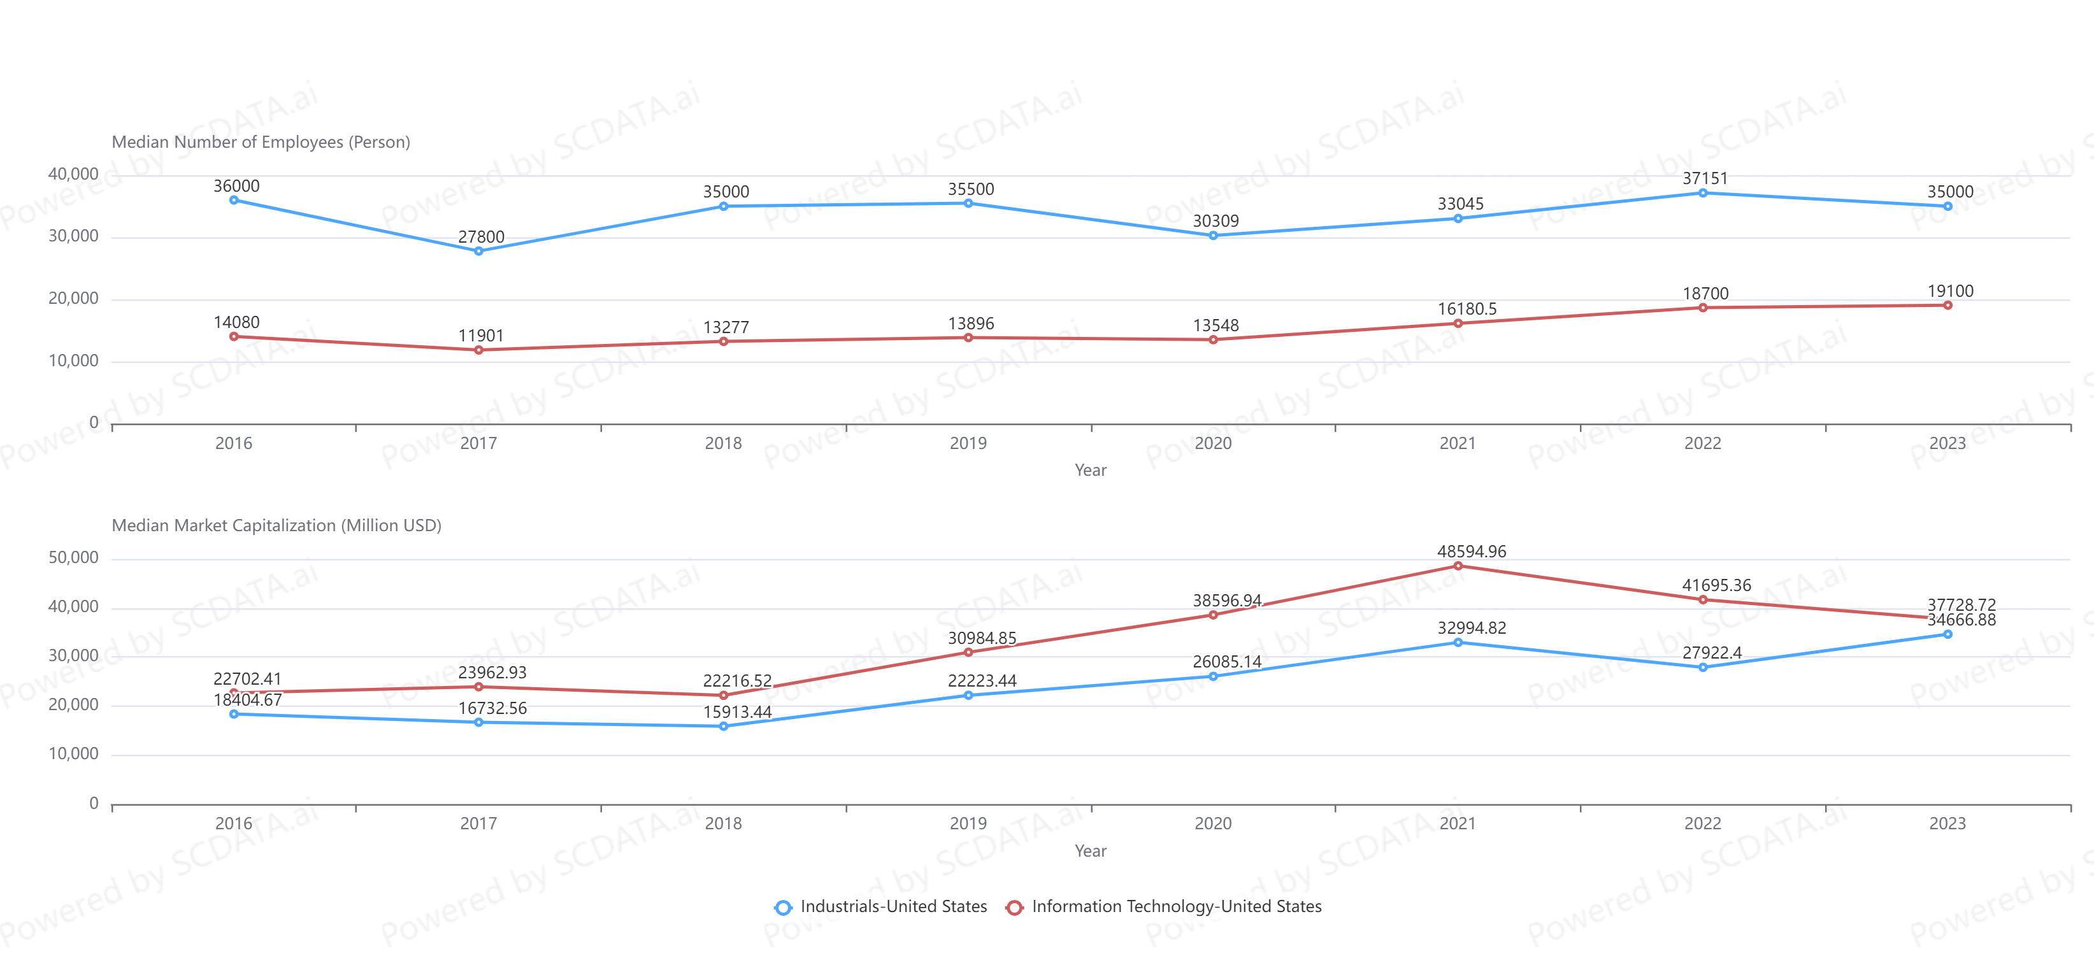
Industrial firms hire more people than IT
IT firms have higher valuation
Trend of Employees & Valuation, US Industrial and IT S&P500 companies.
Data source: https://www.scdata.ai/project/30332
Notes:
Industrial companies offer more jobs than IT, but IT firms offer stock options and bonus of a higher value.

Slide 34
IT vs. Industrials, US, S&P500 Companies
IT outperforms industrials in profitability, growth and risk.
A higher pay, better growth and more secure industry to enter.
Although IT offers fewer jobs, it has a higher valuation.
Notes:
In summary, IT is better than industrials in profitability, growth and risk! Which implies that IT can be a higher paid, better career growth and more security industry to enter. Although IT offers fewer jobs, it has a higher valuation, implying a higher value for its stock options and bonus.

Slide 35
Company Analysis
Suppose you choose IT, which company to work for?
Which company has the highest profitability, highest growth and lowest financial risk?
Notes:
Suppose you choose IT, then which company to work for? To answer this question, we can use company analysis to identify companies that have the highest profitability, highest growth and lowest financial risk.

Slide 36
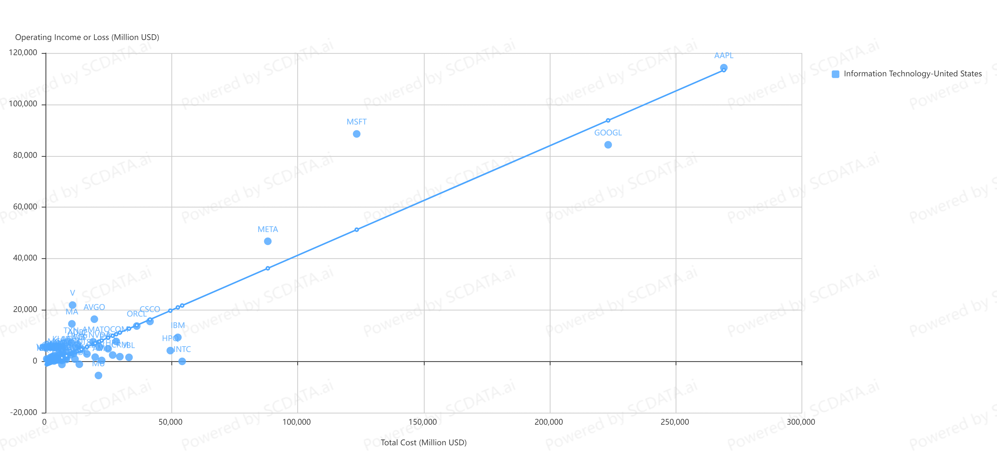
Profit vs. cost for IT industry: Apple is most profitable. Microsoft, Meta, Visa outperformed the average. Google, INTC, IBM, HP are below average.
Operating Income vs. Total Cost, US IT S&P500 companies, 2023
Data source: https://www.scdata.ai/project/30332
Notes:
Profit vs. cost for IT industry: Apple is most profitable. Microsoft, Meta, Visa outperformed the average. Google, INTC, IBM, HP are below average.

Slide 37
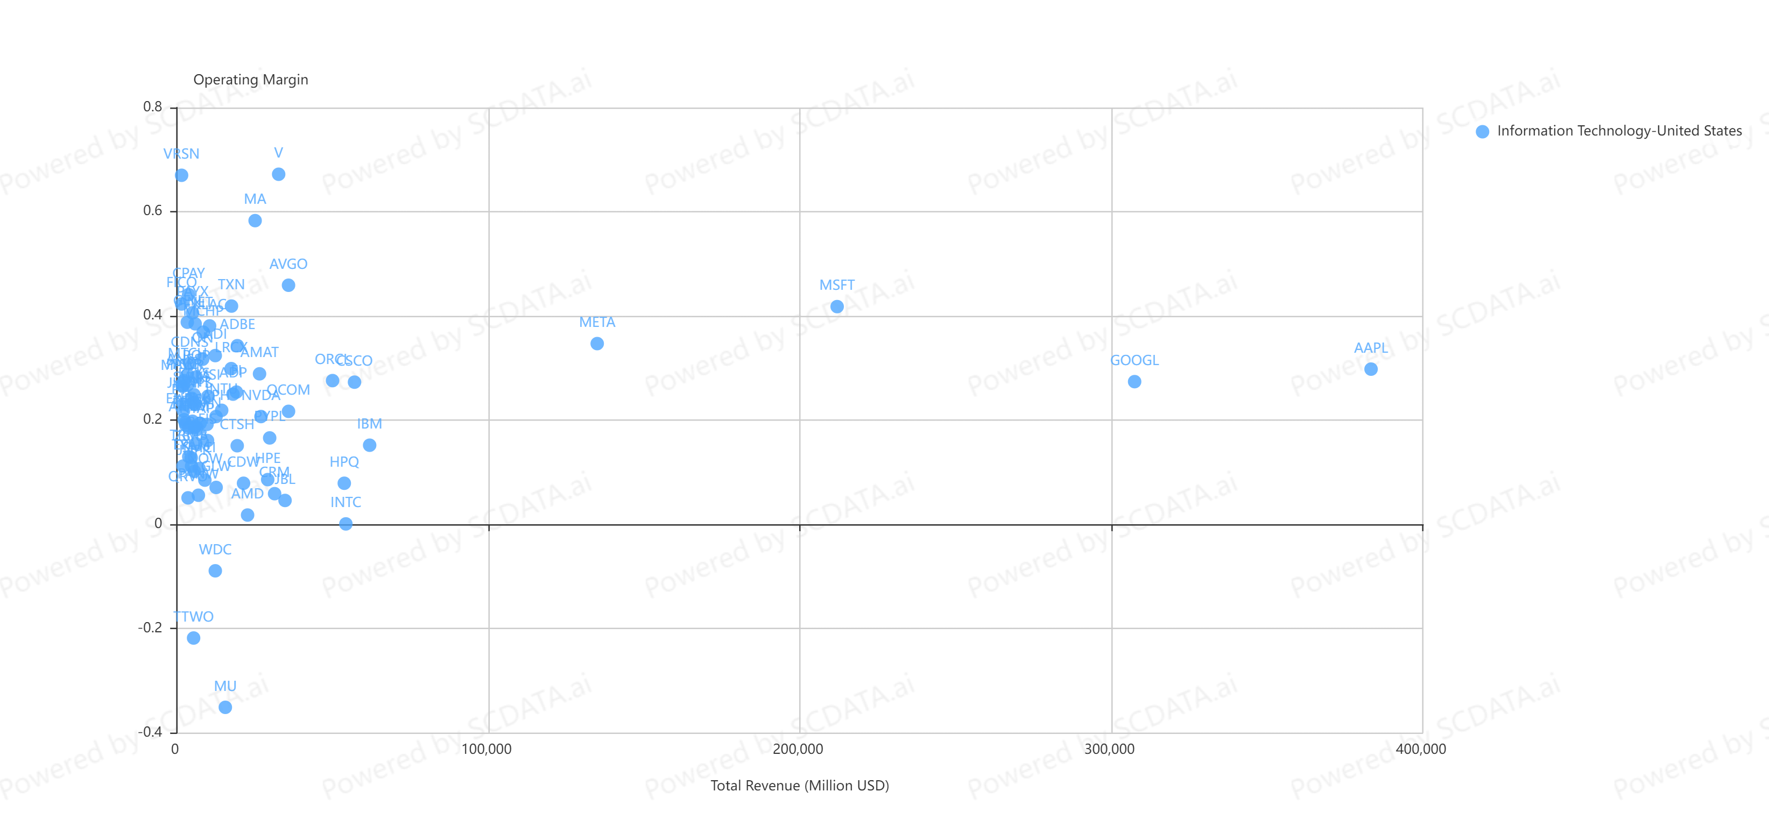
High revenue & high profit margin companies are more competitive: Apple, Microsoft, Google, Meta and Visa are the best in their class.
Profit frontier
Operating Margin vs. Total Revenue, US IT S&P500 companies, 2023
Data source: https://www.scdata.ai/project/30332
Notes:
Operating Margin vs. Revenue analysis of the US IT industry in 2023 shows the profit frontier, showing the most profitable companies in each revenue class. That is, given the same revenue, the firms with the highest operating margin form the profit frontier. Clearly, Apple, Microsoft, Google, Meta and Visa are on the profit frontier and thus the best among their peers.

Slide 38
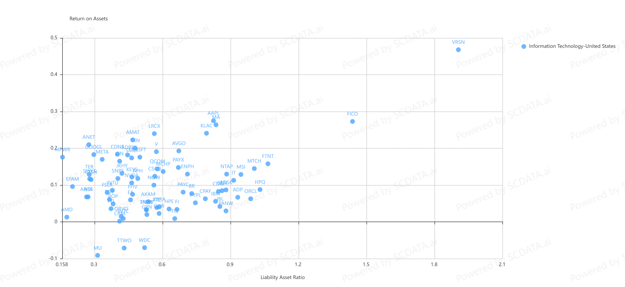
Texas instruments, Meta, Adobe, …
Low risk and high return
High risk and high return
Apple, Maser Card, Broadcom, …
HP, Oracle, IBM, …
Low risk and low return
High risk and low return
AMD, Salesforce, ...
Return on Assets vs. Liability Asset Ratio, US IT S&P500 companies, 2023
Data source: https://www.scdata.ai/project/30332
Notes:
To measure risk, we use the risk vs. return analysis. Higher risk does not always give you a higher return. Which also means that you can have high return and low risk (liability) in the same time! This picture shows the risk and return of the SP500 IT firms. The four regions: low risk and high return (for example, Texas Instrument, Meta, Adobe, etc.), high risk and high return (example, Apple, MasterCard, Broadcom), low risk and low return (AMD, Salesforce), high risk and low return (HP, Oracle, IBM); companies in the last category may find it hard to survive.

Slide 39
Recap
Job opportunity analysis is the job intelligence
  Locate strategically
  Enter the right industry
  Work for the right company
Plenty of opportunities, higher pay & lower effort, career growth, job security → Dream Job!
Notes:
Let’s recap: job opportunity analysis is job intelligence – we need to make decisions on the right region to locate, the right industries to enter, and pick the right companies to work for. Doing so we will get plenty of opportunities, a higher pay with a lower effort, a promising career path and job security, in another word, a dream job!

Slide 40
Homework – Find Your Dream Job
As a job seeker and career builder, please find regions, industries and companies that you like to work for:
  Search for the regions of prosperity and your favorite industries.
  Compare your favorite industry to “Industrials” on profitability, growth and risk (financial health), and comment on which industry you like to enter based on the findings.
  In your favorite industry, find the best performing companies on the profit frontier and compare their ROA and risk (liability / asset ratio).
Example: https://www.scdata.ai/project/30332
User guide: https://www.scdata.ai/project/965
Notes:
Here is the homework: as a job seeker and career builder, please find your region, industry and company using the web-tools. Specifically, …

