Slide 1
Supply Chain Analytics (SCA)
An Introduction
Yao Zhao
Professor @ Rutgers Business School
Co-director @ Rutgers Supply Chain Analytics Lab
https://yzhao12345.github.io/
Instructors are free to use and modify the content of these slides

Slide 2

Agenda
Impact of SCA
Job outlook
Topics covered
Dream job analysis …

Slide 3
Impact of supply chain analytics

Slide 4
Supply Chain Management
A supply chain is a network of firms that designs, produces and delivers products and services to meet customer needs
SCM: How to coordinate / optimize the network to reduce cost and increase revenue?
Notes:
A supply chain is a network of companies that creates, produces and distributes products and services to meet customer needs. It typically consists of companies from multiple industries such as raw material and components suppliers, manufacturers, distributor and wholesalers, logistics and transportation, and finally consumer facing industries such as retailing. SCM is about coordinating and optimizing the network to reduce cost and improve revenue.

Slide 5

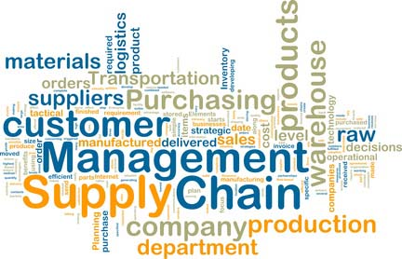
What Is Supply Chain Analytics?
Notes:
Supply chain analytics, in plain words, is the application of data analytics to supply chains, to generate insights, intelligence and solutions for improving supply chain performance; it is an emerging area that could generate a significant financial and economic impact.

Slide 6

K-Mart vs. Wal-Mart
Wal-Mart
No. of stores (1979): 229
Revenue per-store: $3.5 M.
No. of stores (2003): 4688
Revenue: $245 B.
Operating margin: 5.5%
Number 1 on Fortune 500 list
Number 1 on Fortune’s most admired companies list
K-Mart
No. of stores (1979): 1891
Revenue per-store: $7.2 M.
Operating income (2003): ‒ 6.6%. Bankrupt
Notes:
To see the impact of SCA, let’s first compare K-mart and Wal-Mart. Back in 1979, WM was a small discounted retail chain with 229 stores and a revenue per store around $3.5 million, it is in no comparison with K-Mart which has 1891 stores with a revenue per store $7.2 million. Discount store is a tough business with an average operating margin of about 1%, meaning for every dollar of sales, you only make a profit of 1 cent. * After 24 years, in 2003, their competitive positions completely switched; Wal-Mart grew into the No. 1 company on Fortune 500 list with 4688 stores and a total revenue of $245 billion. Its operating margin is much higher than the average, 5.5%. In the same year, K-Mart declared bankruptcy with an operating margin of negative 6.6%.

Slide 7
K-Mart vs. Wal-Mart
Starting in the 1990s, the two firms embarked on different strategies
  Kmart invested in flashy marketing and advertising…
  Wal-Mart invested in SCM technology …
How did Wal-Mart do it?
  Provide customers with access to goods where and when they want them
  Develop a competitive cost structure
Lesson: in the long-run cost efficiency and customer satisfaction beat pure marketing plays!
High service levels
Cost reduction
Notes:
What has happened? Starting in the 1990s, the two companies embarked on different strategies, K-Mart focused on flashy marketing and advertising, while Wal-mart, invested in SCM technology, which allowed Wal-mart to provide customers with access to goods when and where they want them – what is this? High service levels! So customers visiting Wal-Mart can always get what they want. In the same time, Wal-Mart developed a competitive cost structure – which is cost reduction. The lesson, cost efficiency and customer satisfaction beat pure marketing plays.

Slide 8
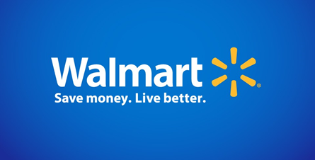
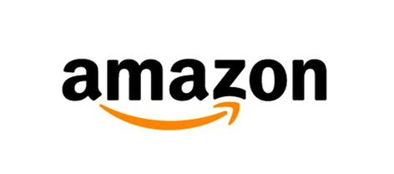
Wal-Mart vs. Amazon
World’s largest retailer (offline)
Sell anything
World’s main online seller
Sell anything including those of 3rd party sellers
The Future of Retailing?
Notes:
Fast forward for another 20 years, now we have Wal-Mart vs. Amazon Walmart is the world’s largest retailer – mainly offline, it sells anything. Amazon is the world’s leading online retailer, it also sells anything including those of 3rd party sellers. They are competing head-on all these years, and the outcome may determine the future of retailing in the US and around the world.

Slide 9
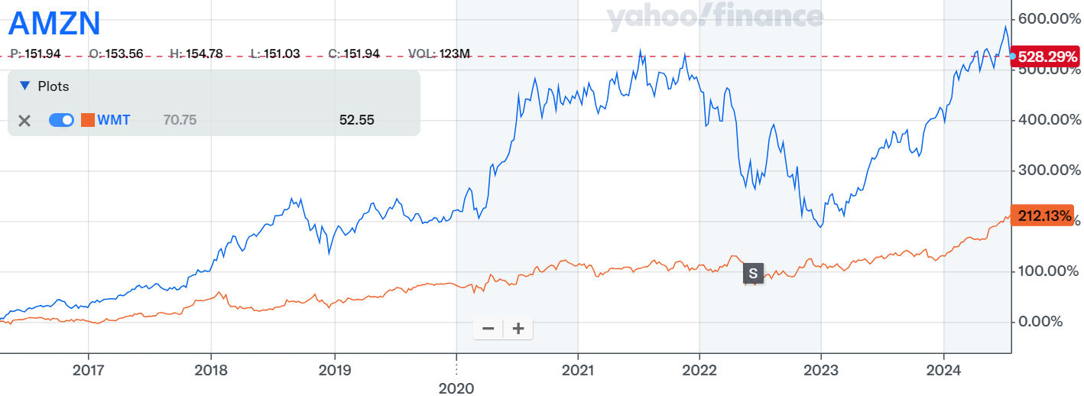
Stock price changes for Amazon and Walmart
Amazon
Walmart
Data source: Yahoo finance, retrieved on 1/14/2023.
Notes:
Let’s first peek into their stock market performance. The chart shows the 10-year stock price changes for Amazon, Walmart and SP500 index. Amazon clearly far outperformed SP500 which in turn outperformed Walmart, despite the recent decline of amazon. Specifically, in 10 years, Amazon’s stock price increase by 384%, SP500 121% and Walmart 79%. Clearly investors already gave an answer to the question.

Slide 10
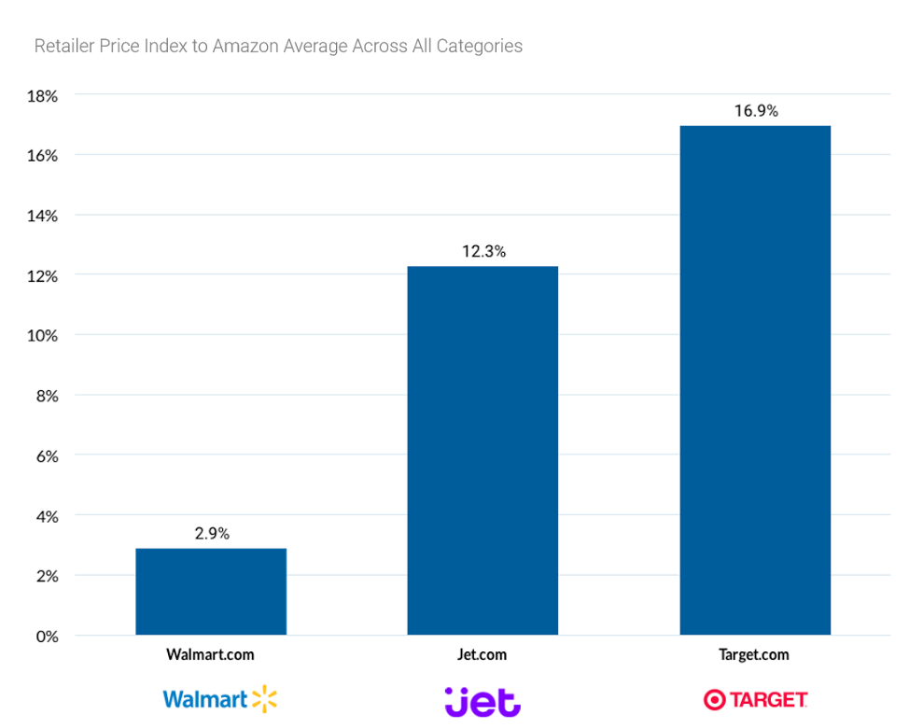
Pricing
Source: https://www.profitero.com/2017/10/new-profitero-study-reveals-amazon-is-winning-the-online-price-war-but-walmart-is-on-the-offensive/
Notes:
Let us look at the pricing of these companies. Using Amazon as a benchmark, we find that Walmart is on average 2.9% higher on prices than Amazon, and Target is 16.9% higher on prices according to the 2017 data.
Walmart appears to be making the largest strides to compete with Amazon in the beauty category, with products found to be 1% lower than Amazon on average; in the Profitero 2014 study, beauty products were priced 10% higher than Amazon;
Electronics is one of Walmart’s least competitive categories to Amazon, with products priced 7% higher on average than Amazon;
Target was found to be the most expensive of the major retailers, and 17% more expensive than Amazon; this marks a shift in price competitiveness from the 2014 Profitero study which found Target pricing to be 10% more expensive on average;
Specialist retailers such as Staples, Best Buy and Home Depot struggle to compete with Amazon on price: Staples was found to be the most expensive specialist retailer to Amazon (products were 49% higher than Amazon on average), while Chewy.com had the closest pricing (its average prices were just 7% higher than Amazon).

Slide 11
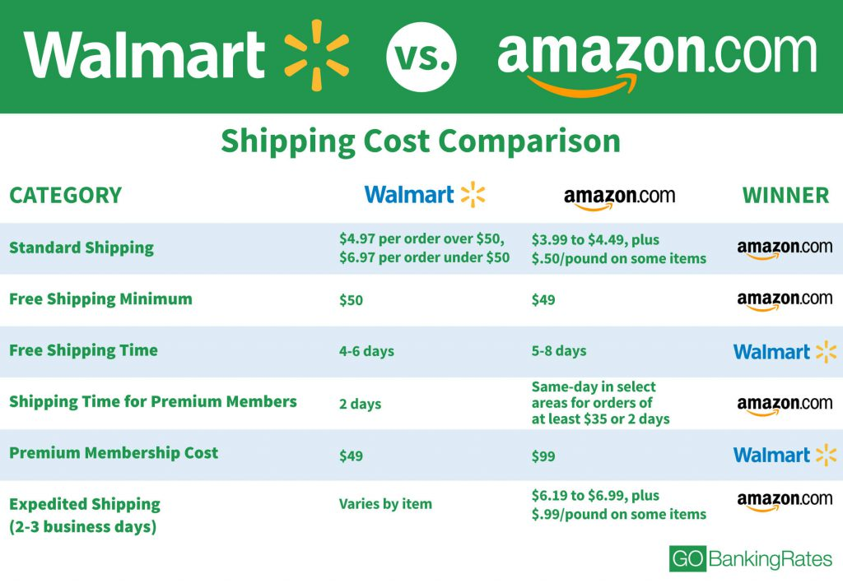
Delivery
Source: https://www.gobankingrates.com/saving-money/walmart-amazon-shipping-cost-comparison/
Notes:
Regarding shipping and delivery, we look at 5 dimensions of performance, from standard shipping, free shipping minimum to expedited shipping. Walmart and Amazon are comparable on delivery with Amazon being slightly better, by 2017 data.

Slide 12
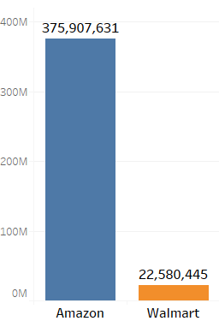
Product-Variety
March 2017
Walmart (22 million products) vs. Amazon (375 million products)
Walmart has 5.8% of what Amazon has to offer.
Source: https://www.scrapehero.com/amazon-vs-walmart-products-sold-in-march-2017/
Notes:
We also look at product variety. In March 2017, Walmart has 22 million products while Amazon has 375 million, Walmart has 5.8% of what Amazon has to offer. So Amazon has a much bigger product variety and thus can better match customer needs with its products. So far, the data shows that Amazon outperforms Walmart on price, delivery and product variety, and thus can provide a better service level (satisfaction) to customers.

Slide 13
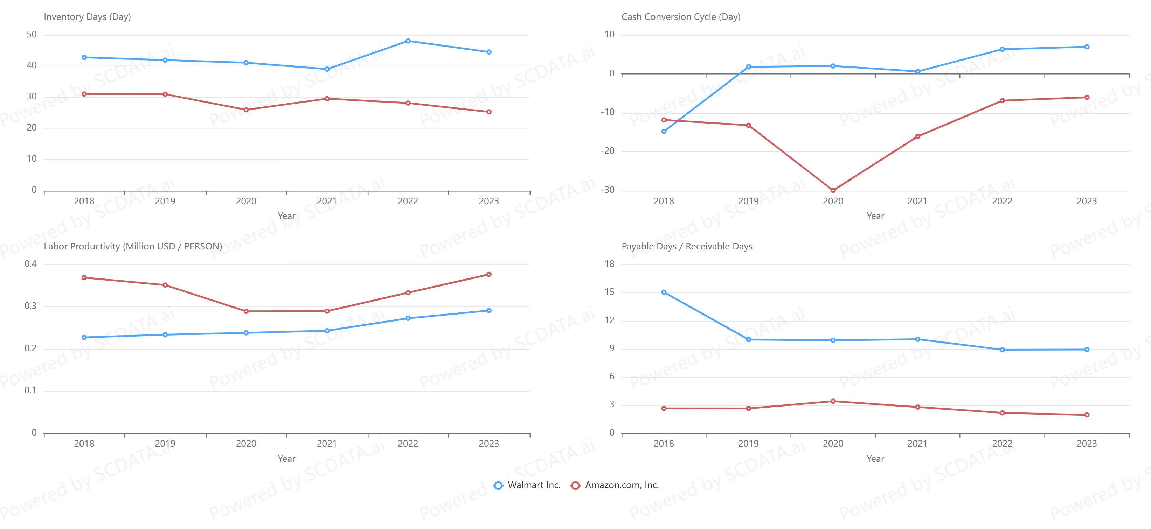
Operating Efficiency
Amazon: lower inventory days
Amazon: shorter cash cycle
Walmart: more market power
WMT: Poor labor productivity
Data source: https://www.scdata.ai/project/403
Notes:
What about AMZN’s operating efficiency? Usually if a company provides a much larger variety of products than others, we expect a higher inventory level and a higher spending on operations. However, what we find from data is the opposite: AMZN's inventory days is smaller than Walmart! Amazon also enjoys a shorter cash cycle than WMT, meaning its $ on purchases returns faster. We also observe that Amazon had higher labor productivity than Walmart but the advantage is narrowing down - did Amazon hire too many people during the pandemic? WMT has more market power than AMZN on its customers and suppliers: with a higher payable / receivable days, WMT can pay its suppliers later and ask its customers to pay sooner than AMZN.

Slide 14
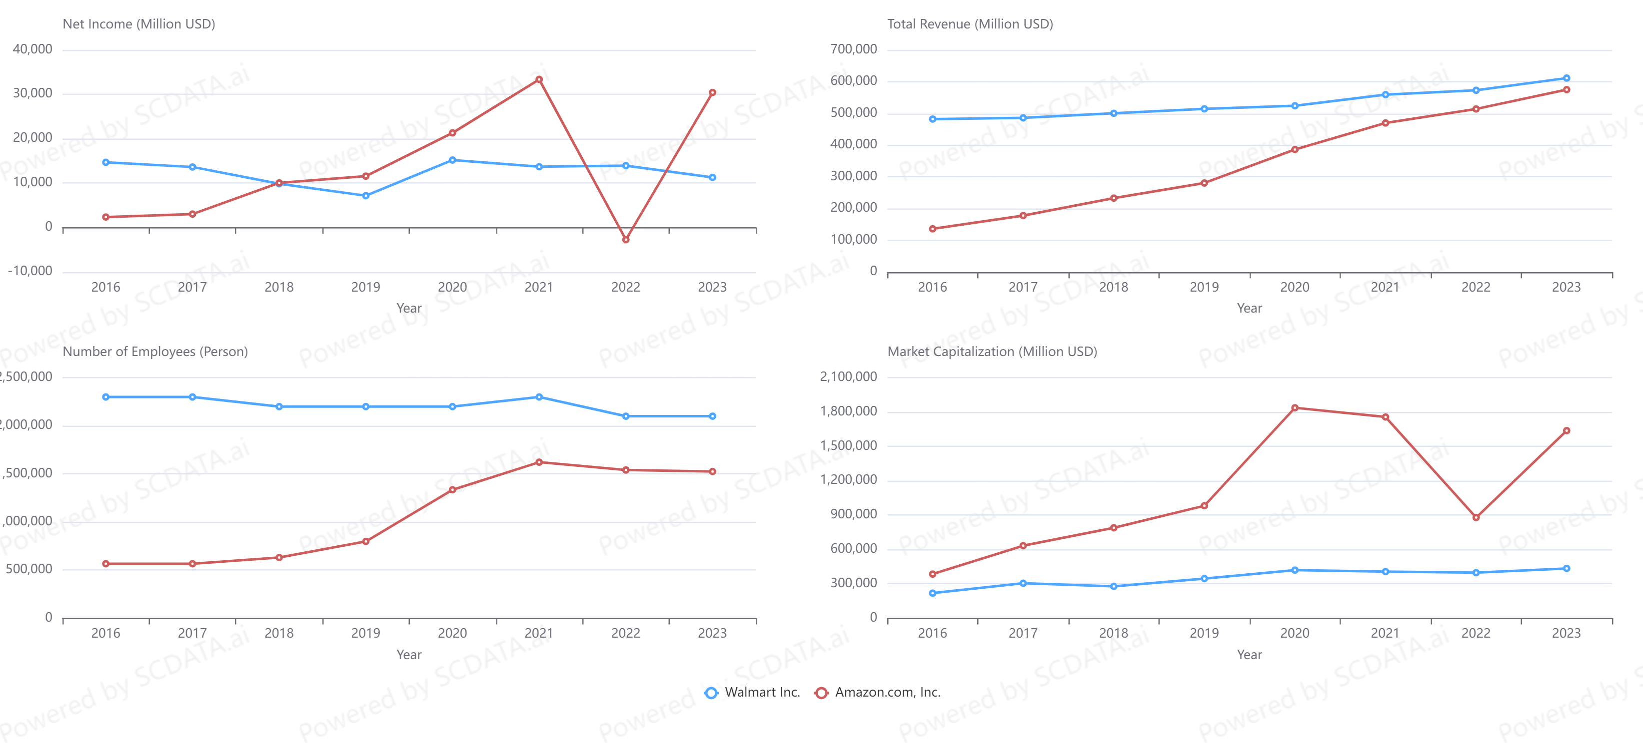
Financial Impact
AMZN: higher net income w/ lower revenue!
AMZN: faster revenue growth
AMZN slip
AMZN slip
Data source: https://www.scdata.ai/project/403
Notes:
Combining pricing, delivery, product variety and operating efficiency, the following financial outcomes are not surprising: Amazon’s faster growth, closing down the gap from WMT. Using less revenue, it made higher net income. Amazon expanded faster especially during the pandemic while WMT overall is downsizing. AMZN over-expanded → slip in 2022, in net income and market cap, so it fell back a bit on workforce. But as soon as its net income turnaround, its mkt cap rebounded. Overall AMZN market cap far outperformed WMT.

Slide 15
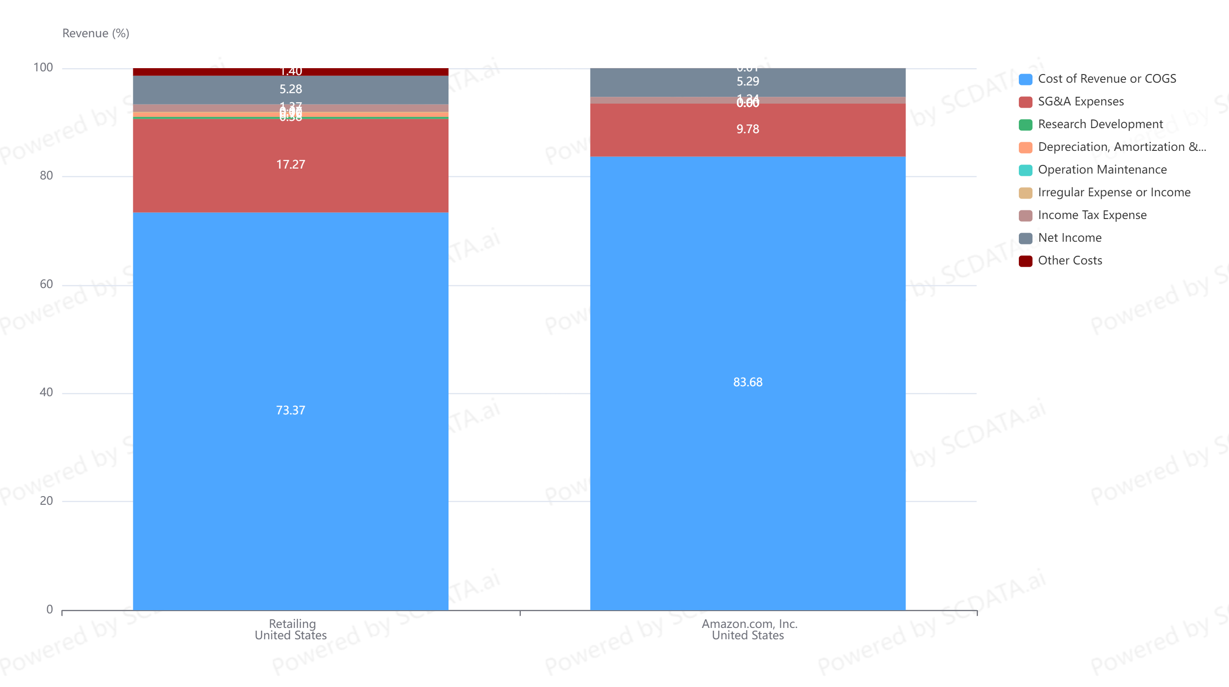
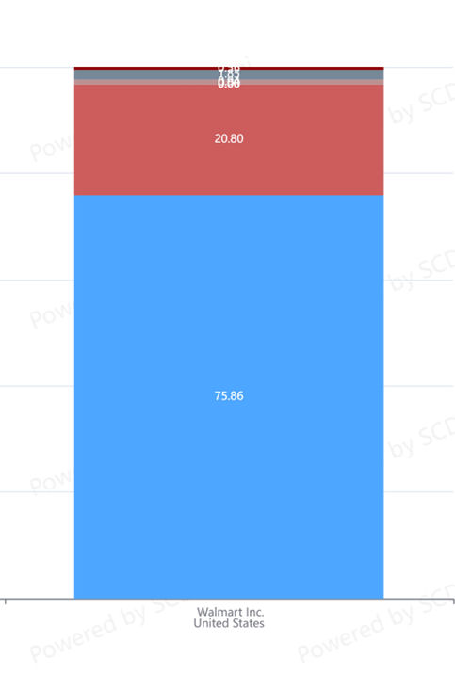
For Item Costing $100, You Pay $132 (WMT), $120 (AMZN)
How did AMZN make a higher profit by a lower pricing?
Operations / SCM … SG&A!
WMT
AMZN
Data source: https://www.scdata.ai/project/403
Notes:
(1) Walmart’s gross margin is 25% while Amazon is decreasing and now at 15%. For an item of cost $100, you pay $133 at Walmart, but $118 at Amazon, on average. (2) With a lower pricing, Amazon made higher operating and net margins than Walmart, especially after 2017. * We also note that Walmart’s net margin is 2-3%, a tough business * We know Amazon is not just retailing but web-services, but AWS is only 13% of its total revenue in 2021 (source: https://www.globaldata.com/data-insights/retail-amp-wholesale/amazons-sales-by-segment/). So you tell me what is the future of retailing.

Slide 16
PWC 2013 Global Survey – Economic Impact
“Companies that acknowledge supply chain as a strategic asset achieve 70% higher performance.”
“Nearly 50% higher sales growth and 20% more profitable.”
“Supply chain leaders achieve an average of earnings before interest and taxes (EBIT) margins of 15.6%, versus the laggards at 7.3%.”
Source：“Next-generation supply chains, Efficient, fast and tailored”，PWC Global Survey，2013 。
Notes:
These differences and advantages won’t be possible without sophisticated SCA. These examples do not stand alone. A PWC survey shows that …

Slide 17
Stock Market Impact
Crash by operations
Rebound by operations
Data source: https://www.scdata.ai/project/403
Notes:
Crash by operations (SCM), rebound by operations (SCM).

Slide 18
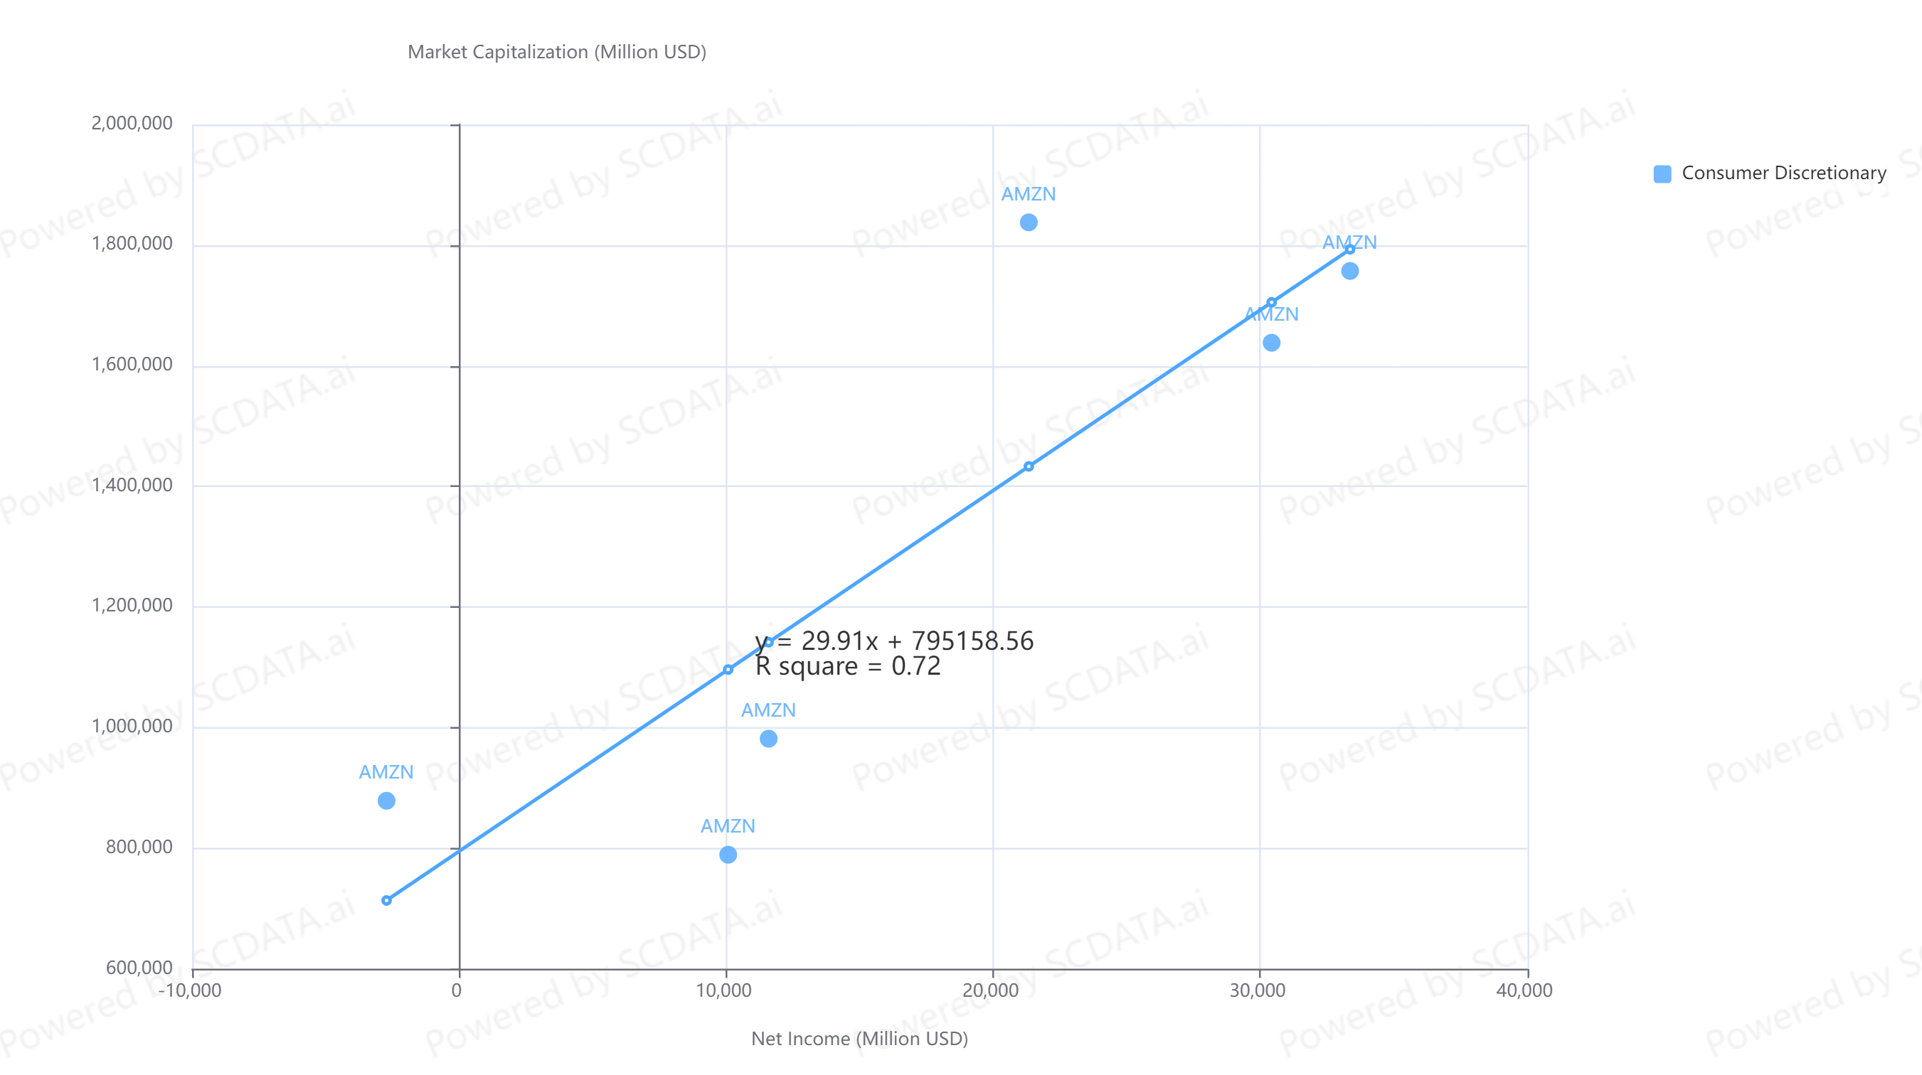
Amazon:
Market Cap vs. Net Income
Data source: https://www.scdata.ai/project/403

Slide 19
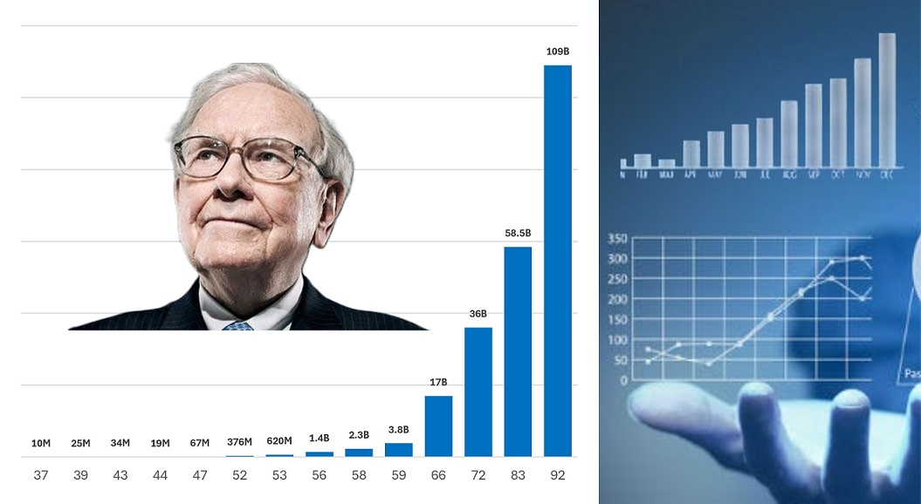
Details: “Data Science 4 Buffett Value Investing”
https://www.udemy.com/course/data-science-4-buffett-value-investing/
Notes:
For details on predict long-term stock movement (Buffett value investing) using data science, please see … for additional resources.

Slide 20
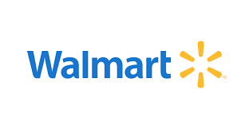

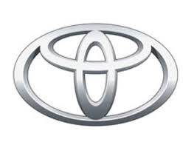

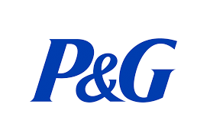

Top Companies in SCM
SCM is important that the success of Wal-Mart, Amazon, McDonald, Toyota, Apple, P&G, largely depends on it.
The CEOs of Apple, GM and P&G have a SCM background.
Notes:
SCM is important that the success of many companies, such as, Wal-Mart, Amazon, McDonald, Toyota, Apple, P&G, partially depends on it.
In fact, the CEOs of Apple, GM and P&G have a SCM background.

Slide 21
Job outlook
Supply chain Analytics
Notes:
Now let us take a look at the job outlook for supply chain analytics.

Slide 22

Talent Crisis
Demand-to-supply ratio of supply chain jobs:
6 to 1
Without analytics, it is a pile of numbers!
SOLVING THE TALENT CRISIS (Automotive Industry Brief 2015)
https://www.supplychaindive.com/news/talent-crisis-education-tech-supply-chain-nature/440392/
Notes:
A major hurdle for companies to materialize the potential of supply chain analytics is the talent crisis – a significant shortage of talents. One report shows that the demand to supply ratio of supply chain jobs is 6 to 1. Another article from supply chain dive explained the need for SCA talents: “without analytics, it is a pile of #s!”

Slide 23
“We don’t need more data weenies and we don’t need more strategic marketing planners. What we really need are more people with a foot in each camp who can make some sense of all of this new technology.”
–Don E. Schlutz
Source: Big Data: Prospects and Challenges.
Source: https://www.researchgate.net/publication/275035912_Big_Data_Prospects_and_Challenges
Notes:
There are lots of gold on the ground but no everyone can pick them up. You need to have certain skills - a SCA talent should have both the supply chain domain knowledge and data analytics skills. As Don Schlutz said in his paper on big data: prospects and challenges, “…”. he was talking about marketing, the same situation also applies to supply chains.

Slide 24
Hottest Jobs
“In five years of fielding quantitative studies on supply chain talent, we consistently find that the greatest shortages of professionals are at the intersection of process and analytical mastery. …”
Source: http://supplychaininsights.com/portfolio/supply-chain-talent-evolving-across-generations/
Notes:
What are the hottest jobs in SCA? People found the greatest shortages of professionals (in supply chain management) are at the intersection of process and analytical mastery. It shows that demand planner, data scientists, supply planner, and S&OP planning top the list of positions in greatest demand.

Slide 25
Most Important Skills
Source: http://supplychaininsights.com/portfolio/supply-chain-talent-evolving-across-generations/
Notes:
Top three skills required: Problem solving, Strong analytical skills, The ability to see the big picture (what is this? Problem discovery!)

Slide 26
A Sample Job
Business Analyst - Supply Chain Data and Analytics
Benefits: Highly competitive salaries, bonus programs, world-class benefits
Job Overview: Dell is driven by data. Our business is built on the understanding that data creates value and drives progress. So we take the stewardship of our data very seriously. That’s the vital role played by Business Intelligence teams within Business Support. Internal clients across Dell rely on us to analyze, test, validate and maintain the integrity of data. We make use of leading-edge software and tools to collect, mine and interpret data and the statistical analyses and reports we produce informed decisions with a global impact
Source: https://www.indeed.com/ searched “supply chain analytics” in June 2018
Notes:
Let’s look at an example job on www.indeed.com from Dell; The job title is business analyst – supply chain data and analytics, it offers highly competitive salaries and world-class benefits. Dell has a firm belief on the value of data and analytics. The position is with Dell’s business intelligence team to provide data analytics support across the organization, so Dell can make informed decisions with a high impact. I remember one of our graduates got this position.

Slide 27
Topics covered
Review by module

Slide 28
Supply Chain Domains – Manufacturing / Trade
Company Infrastructure
Human Resource Development
Support
Activities
Technology
Margin
Finance / Accounting
Source
Make
Move
Sell
Service
Primary Activities (Supply Chain Domains)
Notes:
In a typical manufacturing firm, the primary activities can be classified into five categories: source, make, move, sell and service. Source refers to purchasing and procurement; make can be production and packaging, move refers to transportation and logistics; sell is about pricing, promotion and retailing, and services refers to customer services, such as maintenance and support. Human resource, technology and finance / accounting are supporting activities.
Marketing – generates demand
Supply chain – create the product and service, and fulfill demand
Finance/accounting – tracks how well the organization is doing, pays bills, collects the money, …

Slide 29
Competitive Intelligence & Benchmarking
Discovering problems & opportunities via data analysis.
  Industry analysis (industry trend, competition intensity, value chain analysis) to assess industry potential and risk.
  Competition positioning (profit frontier, enterprise ranking, KPI examination) to position a company in the competitive landscape.
  Enterprise diagnosis (strengths & weaknesses, value driver analysis, breakdown analysis) to discover problems and diagnose causes.
Notes:
Competitive intelligence & benchmarking can provide the insights necessary to discover the problems and opportunities for companies, which includes three phases. First, Industry analysis (industry trend, competition intensity, value chain analysis) to assess industry potential and risk. * Second, competition positioning (profit frontier, enterprise ranking, KPI examination) to position a company in the competitive landscape. Finally, Enterprise diagnosis (strengths & weaknesses, value driver analysis, breakdown analysis) to discover problems and diagnose causes.

Slide 30

Forecasting & Decisions Under Uncertainty
Align commerce with public health
Teaching objectives
  Predict rare but disastrous events
  Decision making under uncertainty
  Companies want to make money, governments want to save lives; how to align the mismatched interests?
Case: Pandemic Influenza – Just-in-Time vs Just-in-Case Strategies.

Slide 31

Distribution Analytics
A major US wireless carrier changed its supply chain model from store to showroom and save $1 billion in inventory.
Teaching objectives
  Supply chain analytics
  Distribution strategies: store vs showroom models
  Integrating inventory and transportation decisions in distribution and logistics
Case: VASTA Wireless – Push vs. Pull Distribution Strategies (1st prize INFORM case writing competition 2014)

Slide 32

Sales & Operations Planning
Redesign Coach’s logistics network to reduce cost and improve customer satisfaction.
Teaching objectives
  Prescriptive analytics: Linear and integer programming, solvers.
  Applications: production planning, staff scheduling, transportation planning, resource allocation, logistics network design.
Case: Distribution Network Design – COACH Handbags Inc.

Slide 33
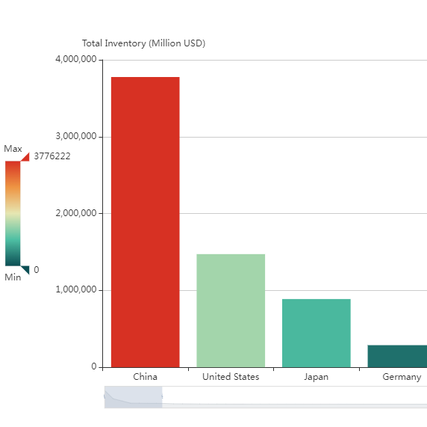
Inventory Analytics
Where to look for inventory problems?
What’s the strategic importance of inventory and how to diagnose & discover inventory problems?
How does inventory drive financials and subsequently the stock market performance?
Notes:
(1) For which industries is inventory relevant and important? (2) How does inventory drive firms’ performance in my industry? (3) How do I know if I have an inventory problem?

Slide 34
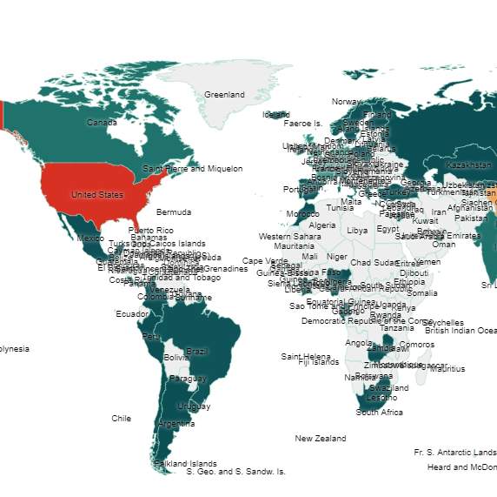
Sourcing Analytics
Supplier intelligence: Explore and select suppliers globally
Bargaining power analysis: Measure leverage.
Supplier benchmarking: Compare suppliers’ pricing, profitability, health and supplying capability.
Notes:
Leveraging data analytics, we introduce a new course module on sourcing analytics. The learning objectives are …

Slide 35

Shortage Gaming and Supply Rationing
Play the Hunger Chain simulation (hunger games) to learn:
  Shortage gaming (panic order, hoarding).
  Supply rationing for efficiency and fairness.
  Competition (the Prisoner’s Dilemma) and the value of information.
  The Newsvendor model.
Game: Hunger Chain simulation (Best DSJIE Teaching Brief Award 2021)

Slide 36

Supply Chain Collaboration & Contracts
Play the FloraPark simulation (flower games) to learn:
  Supply chain collaboration via contracts
  Supply chain marketing interfaces
  Supply chain competition
  Negotiation
Game: Flora-Park simulation.

Slide 37
Dream job Analysis
Find your dream job by data analytics

